Slide 1


Image Processing Pipeline Review
Tom Zimmerman
IBM Research-Almaden
Center for Cellular Construction
Sept 2, 2021
This material is based upon work supported by the NSF under Grant No. DBI-1548297.
Disclaimer: Any opinions, findings and conclusions or recommendations expressed in this material are those of the authors and do not necessarily reflect the views of the National Science Foundation.

Slide 2
Object Classification Pipeline
Detect
Feature
Unsupervised
Cluster
Curate Training & Testing Dataset
Supervised
Classification
Evaluate
Performance

Slide 3
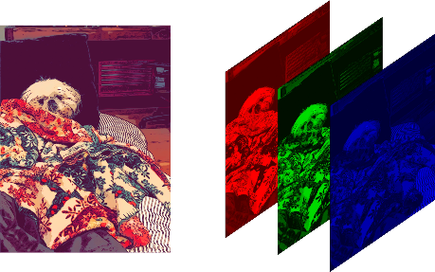
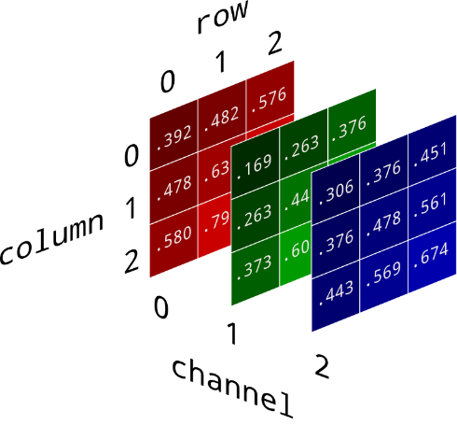
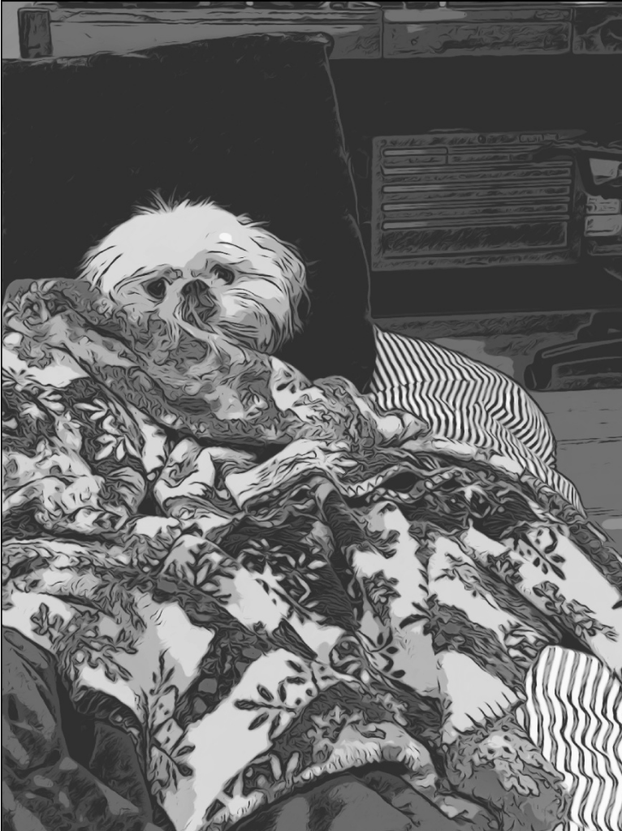
Color Image composed of three color channels; red, green and blue (RGB)
Monochromatic image composed of one gray channel (0=black, 255=white)
x
0-255 for OpenCV
y
R G B
2
1
Grayscale = (R + G + B / 3)
... or 0.3*R + 0.59*G +0.11*B
to maintain perceptual luminance
0
gray
www.kdnuggets.com/2019/12/convert-rgb-image-grayscale.html

Slide 4
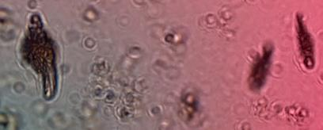
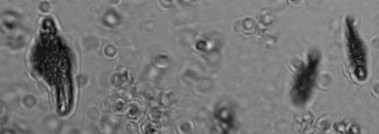
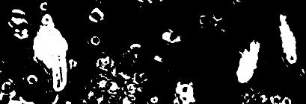
Image Quantization by Thresholding
Color
255
0
Red (0-255)
Green (0-255)
Blue (0-255)
255
0
Grayscale
255
0
Gray (0-255)
255
0
threshold
Binary Quantized*
Binary (0=black, 255=white)
255
0
*Inverted so object is white on black background

Slide 5




No Blur Blur

Slide 6

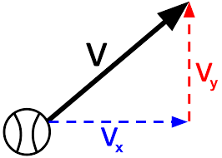
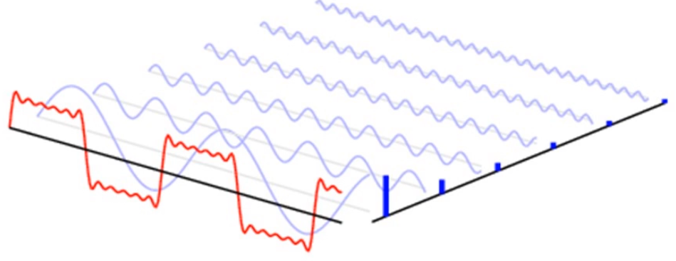
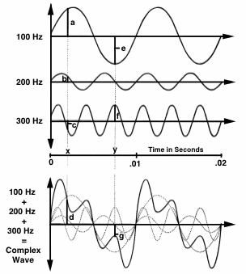
Fourier Analysis & Synthesis (1D)
Every continuous function in the function space can be represented as a linear combination of basis functions, just as every vector in a vector space can be represented as a linear combination of basis vectors.
Analysis: Any time-varying sound can be analyzed to find its frequency components.
Synthesis: Any complex wave can be constructed by adding together sine waves of appropriate frequency, amplitude, and phase.
Linear Combination of Basis Function
(sines and cosines of N frequencies)
11
9
7
5
Frequency
3
Basis Function
1
squareWave = sum of (1/N)*sin(N*x)
squareWave=sin(x) + 1/3*sin(3x) +...+ 1/11*sin(11x)
https://hearinghealthmatters.org

Slide 7
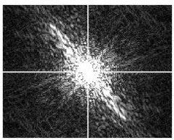
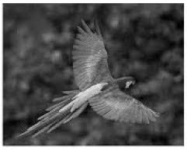
Fourier Analysis & Synthesis (2D)
Spatial Domain Frequency Domain
DC Component
(sum of all pixel intensities)
Fourier Transform
Increasing freq in across Y spatial axis
Y
V
Inverse
Fourier
Transform
Increasing freq in across Y spatial axis
Increasing freq in across X spatial axis
Increasing freq in across X spatial axis
U
X
www.youtube.com/watch?v=4gp-3pFFyPk

Slide 8
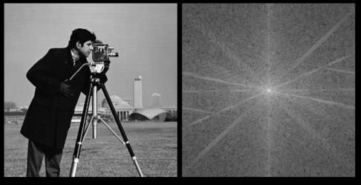

Image of “cameraman” Copyright MIT

Slide 9
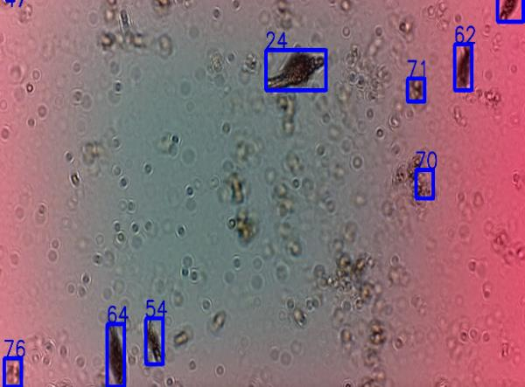
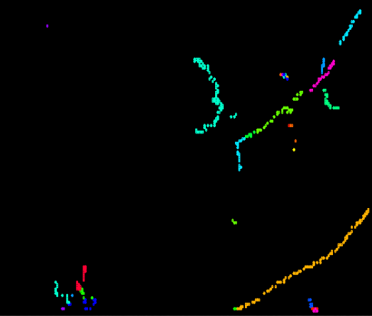
Tracking Multiple Objects
contours, hierarchy = cv.findContours(thresh, cv.RETR_TREE, cv.CHAIN_APPROX_SIMPLE)
Tracklets
6
1
5
4
3
2

Slide 10
Object Classification Pipeline
Detect
Feature
Unsupervised
Cluster
Curate Training & Testing Dataset
Supervised
Classification
Evaluate
Performance

Slide 11
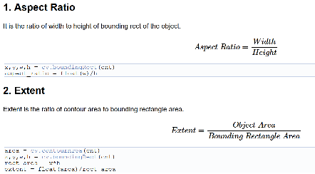
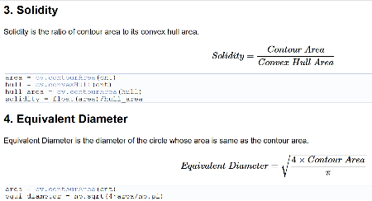
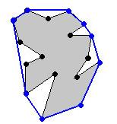

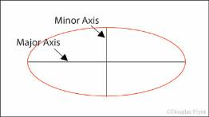


Contour Properties
contours, hierarchy = cv.findContours(thresh, cv.RETR_TREE, cv.CHAIN_APPROX_SIMPLE)
How much fills out the rectangle bounding box
Extent=Yellow Area/Rectangle Area
How much fills out the convex bounding hull
Solidity=Gray Area/Blue Bounded Area
area=pi*d²/4
d
Can also look at R/G, B/G
https://docs.opencv.org/master/d1/d32/tutorial_py_contour_properties.html

Slide 12

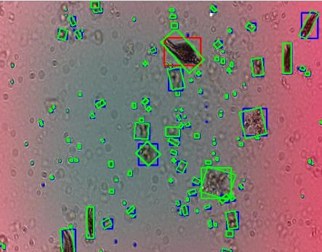
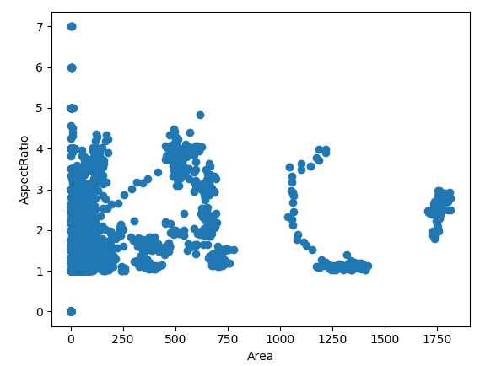
Scatter Plot of Area vs Aspect Ratio
boundingRect()
minAreaRect()
W
H
Aspect Ratio=W/H
where W>=H
w=4 pix
AREA CALCULATIONS
Area of Rectangle
Area Object (pixels on)
Area Object (Green’s method*)
area=16
area=13
= 1
h=4
pix
area=7.8
1
= 4
4
*https://mathinsight.org/greens_theorem_idea

Slide 13
All images are displayed at the same scale. (a) Didinum (b) Paramecium (c) Blepharisma (d) Euplotes
(e) Algae1 (f) Algae2 (g) Volvox (h) Dileptus (i) Stentor

Slide 14
Object Classification Pipeline
Detect
Feature
Unsupervised
Cluster
Curate Training & Testing Dataset
Supervised
Classification
Evaluate
Performance

Slide 15
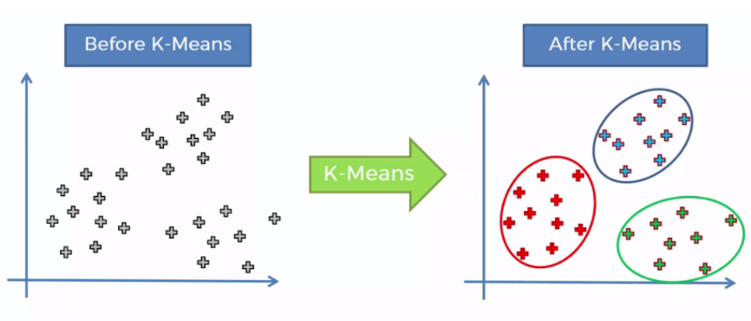
k-Means Unsupervised Clustering
Feature Y
Feature Y
Feature X
Feature X
Unsupervised machine learning dividing data into distinct groups with similar feature values.
K refers to how many groups (clusters) to create.
https://towardsdatascience.com/k-means-clustering-identifying-f-r-i-e-n-d-s-in-the-world-of-strangers-695537505d

Slide 16
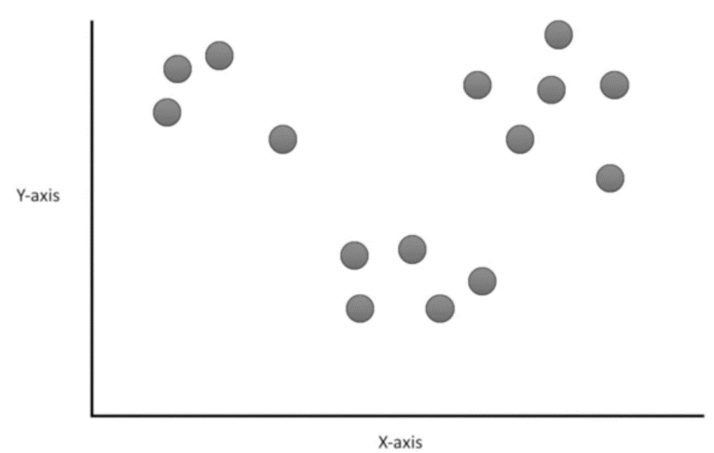
Assign each object to nearest cluster point using Euclidian distance
See Video StatQuest: K-means Clustering https://youtu.be/4b5d3muPQmA

Slide 17
Calculate the center of each cluster ...
See Video StatQuest: K-means Clustering https://youtu.be/4b5d3muPQmA

Slide 18
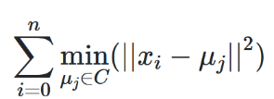
K-means Algorithm: Find a Centroid with Minimum Inertia (within-cluster sum of squares)
See Video StatQuest: K-means Clustering https://youtu.be/4b5d3muPQmA

Slide 19
Use Inertia To Determine Number of Clusters
Elbow in curve.
Huge reduction in inertia with K=3.
After that, small reductions.
Inertia
1 2 3 4 5 6
K clusters

Slide 20
Object Classification Pipeline
Detect
Feature
Unsupervised
Cluster
Curate Training & Testing Dataset
Supervised
Classification
Evaluate
Performance

Slide 21
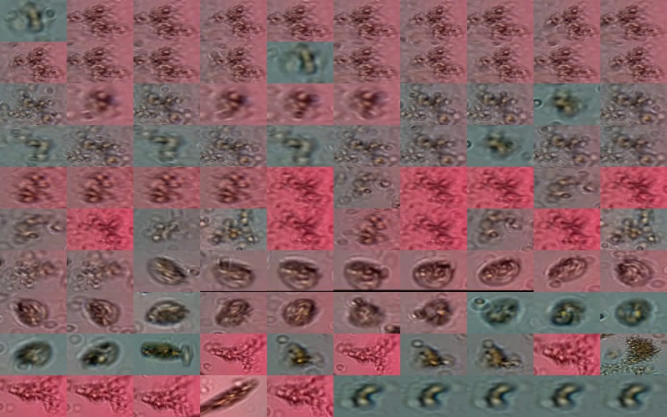
10x10 Grid Array of Cluster #1

Slide 22
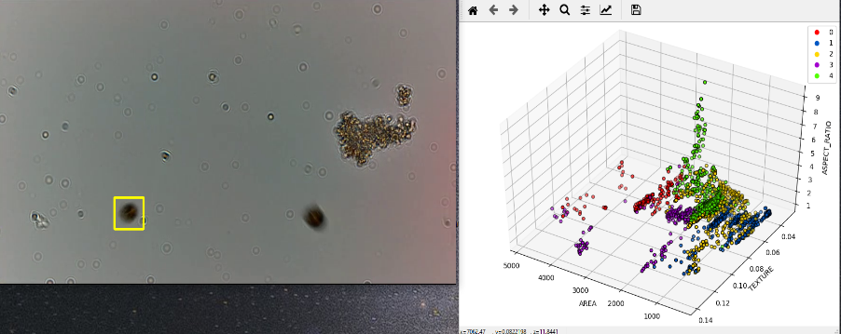
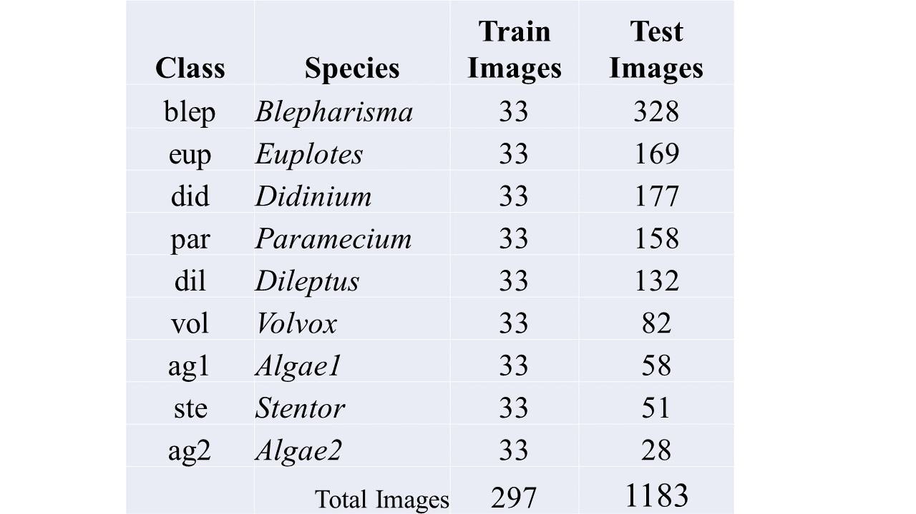
Multiple Planktons in Feature Space
planktonWhite_960_544.mp4
0:0 blep
0:15 did
0:25 dil
0:34 eup
0:47 par
0:56 ste
1:04 vol

Slide 23
Object Classification Pipeline
Detect
Feature
Unsupervised
Cluster
Curate Training & Testing Dataset
Supervised
Classification
Evaluate
Performance

Slide 24
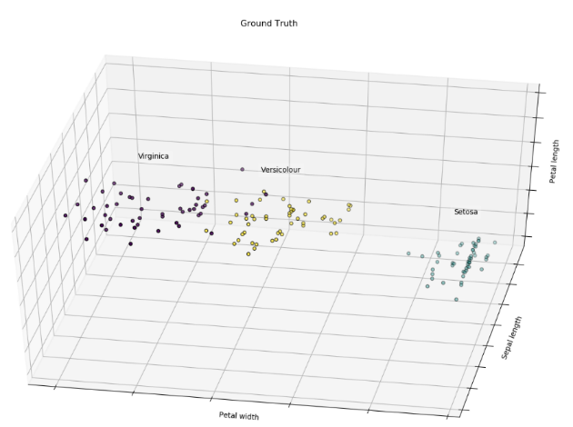
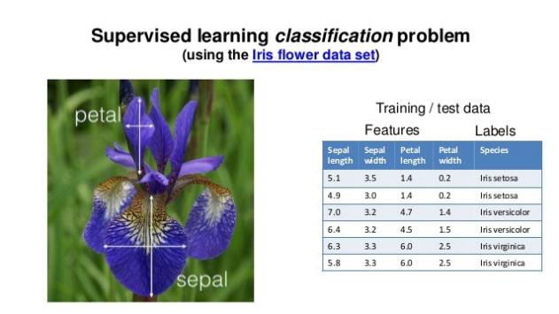
Linear Support Vector Machine (SVM)
a
c
b
d

Slide 25
Object Classification Pipeline
Detect
Feature
Unsupervised
Cluster
Curate Training & Testing Dataset
Supervised
Classification
Evaluate
Performance

Slide 26
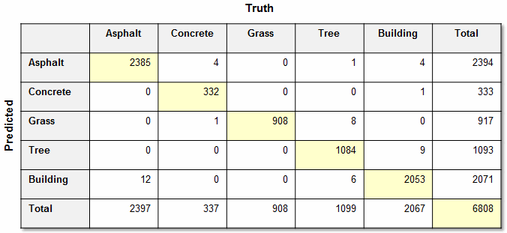
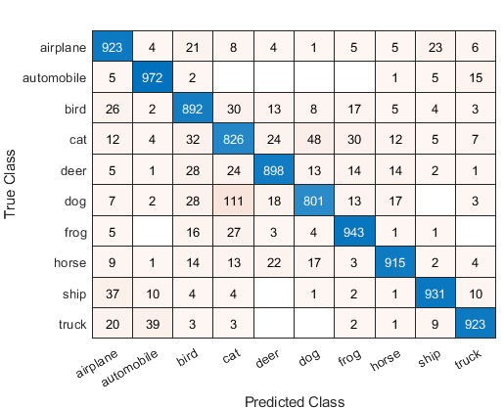
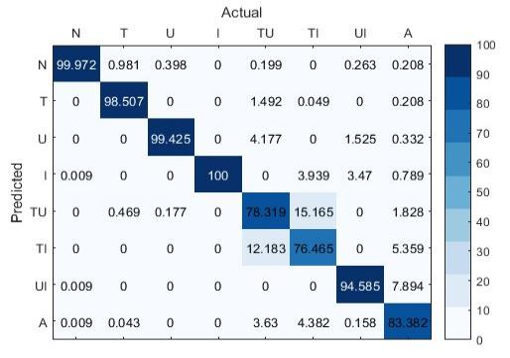
Confusion Matrix Examples

