Slide 1


Holographic Microscope Performance
Ziah Dean
SFSU, Center for Cellular Construction
4.12.22
This material is based upon work supported by the NSF under Grant No. DBI-1548297.
Disclaimer: Any opinions, findings and conclusions or recommendations expressed in this material are those of the authors and do not necessarily reflect the views of the National Science Foundation.

Slide 2
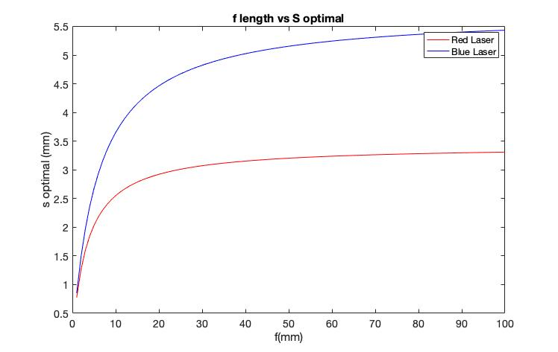
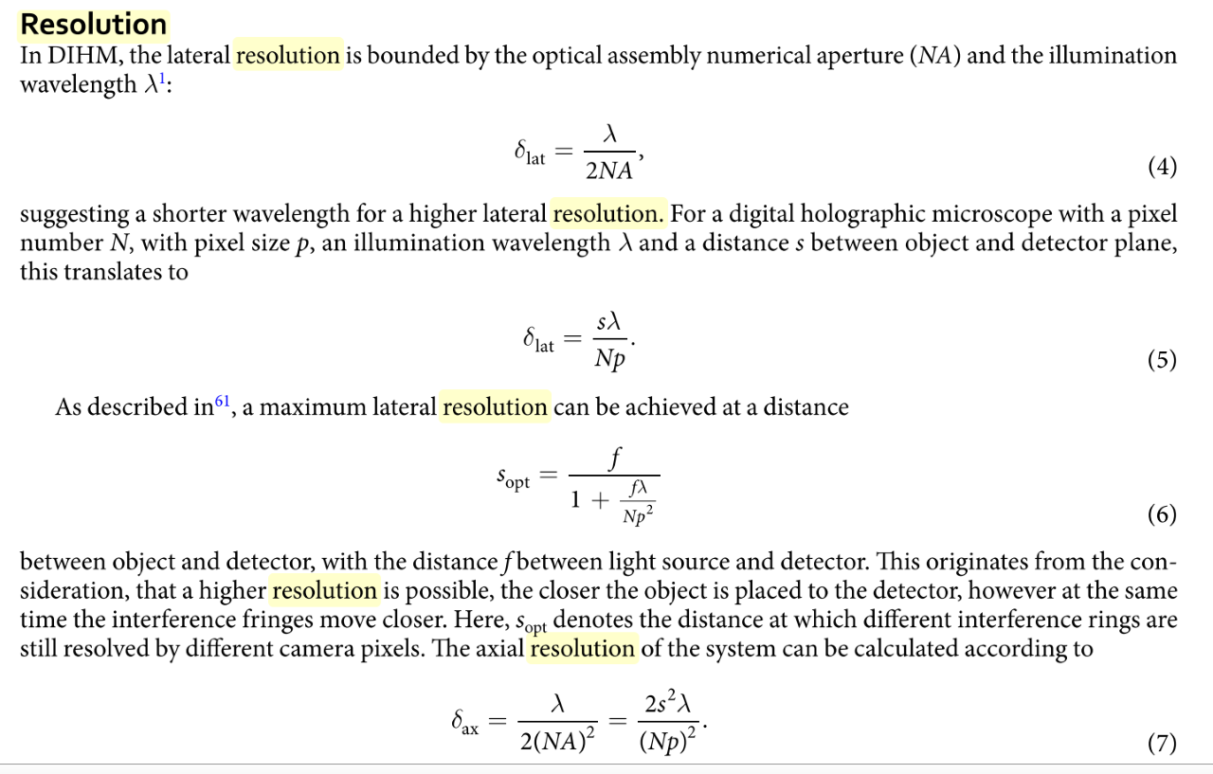
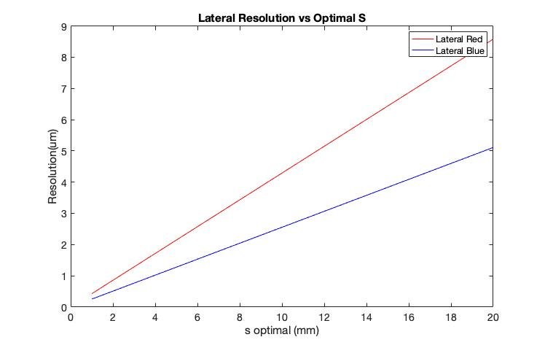
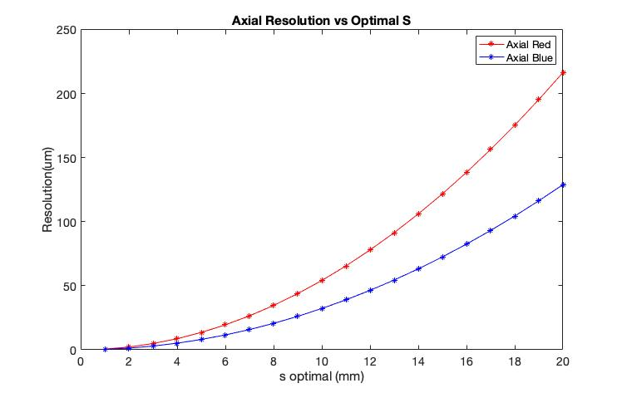
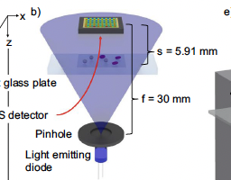
Our setup
f=25mm
S_{o} =3.95mm (Z)
X-Y-Z stage
X-Y-Z stage
Detector
Laser
Specimen
(USAF)
Raspberry Pi
Stephan Amann setup

Slide 3
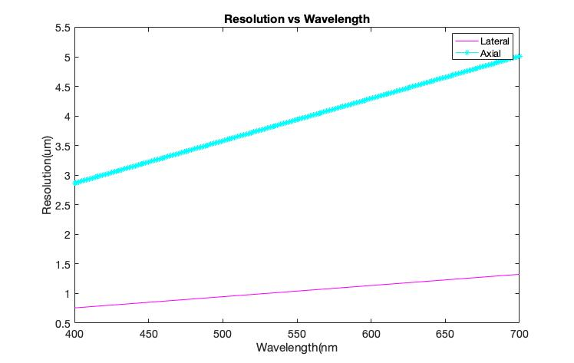
Our setup
f
S_{o}
X-Y-Z stage
X-Y-Z stage
Detector
Laser
Specimen
(USAF)
Raspberry Pi
Stephan Amann setup

Slide 4
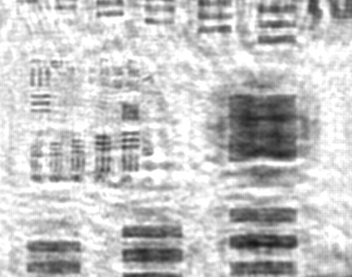
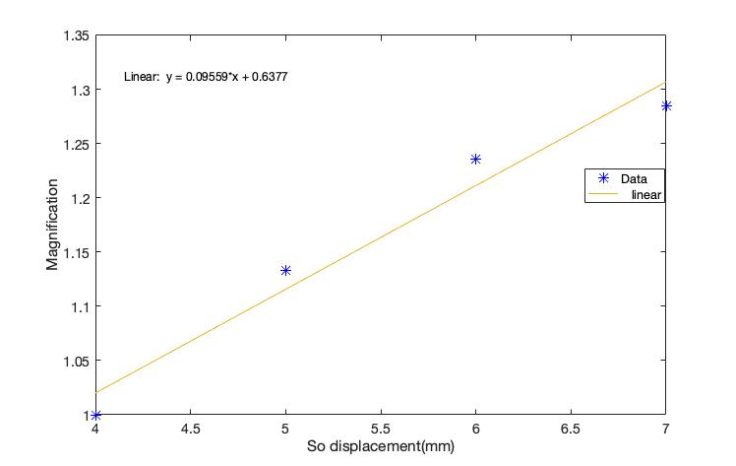
f=25mm
S_{o} =3.95mm (Z)
X-Y-Z stage
X-Y-Z stage
Detector
Laser
Specimen
(USAF)
Raspberry Pi

Slide 5
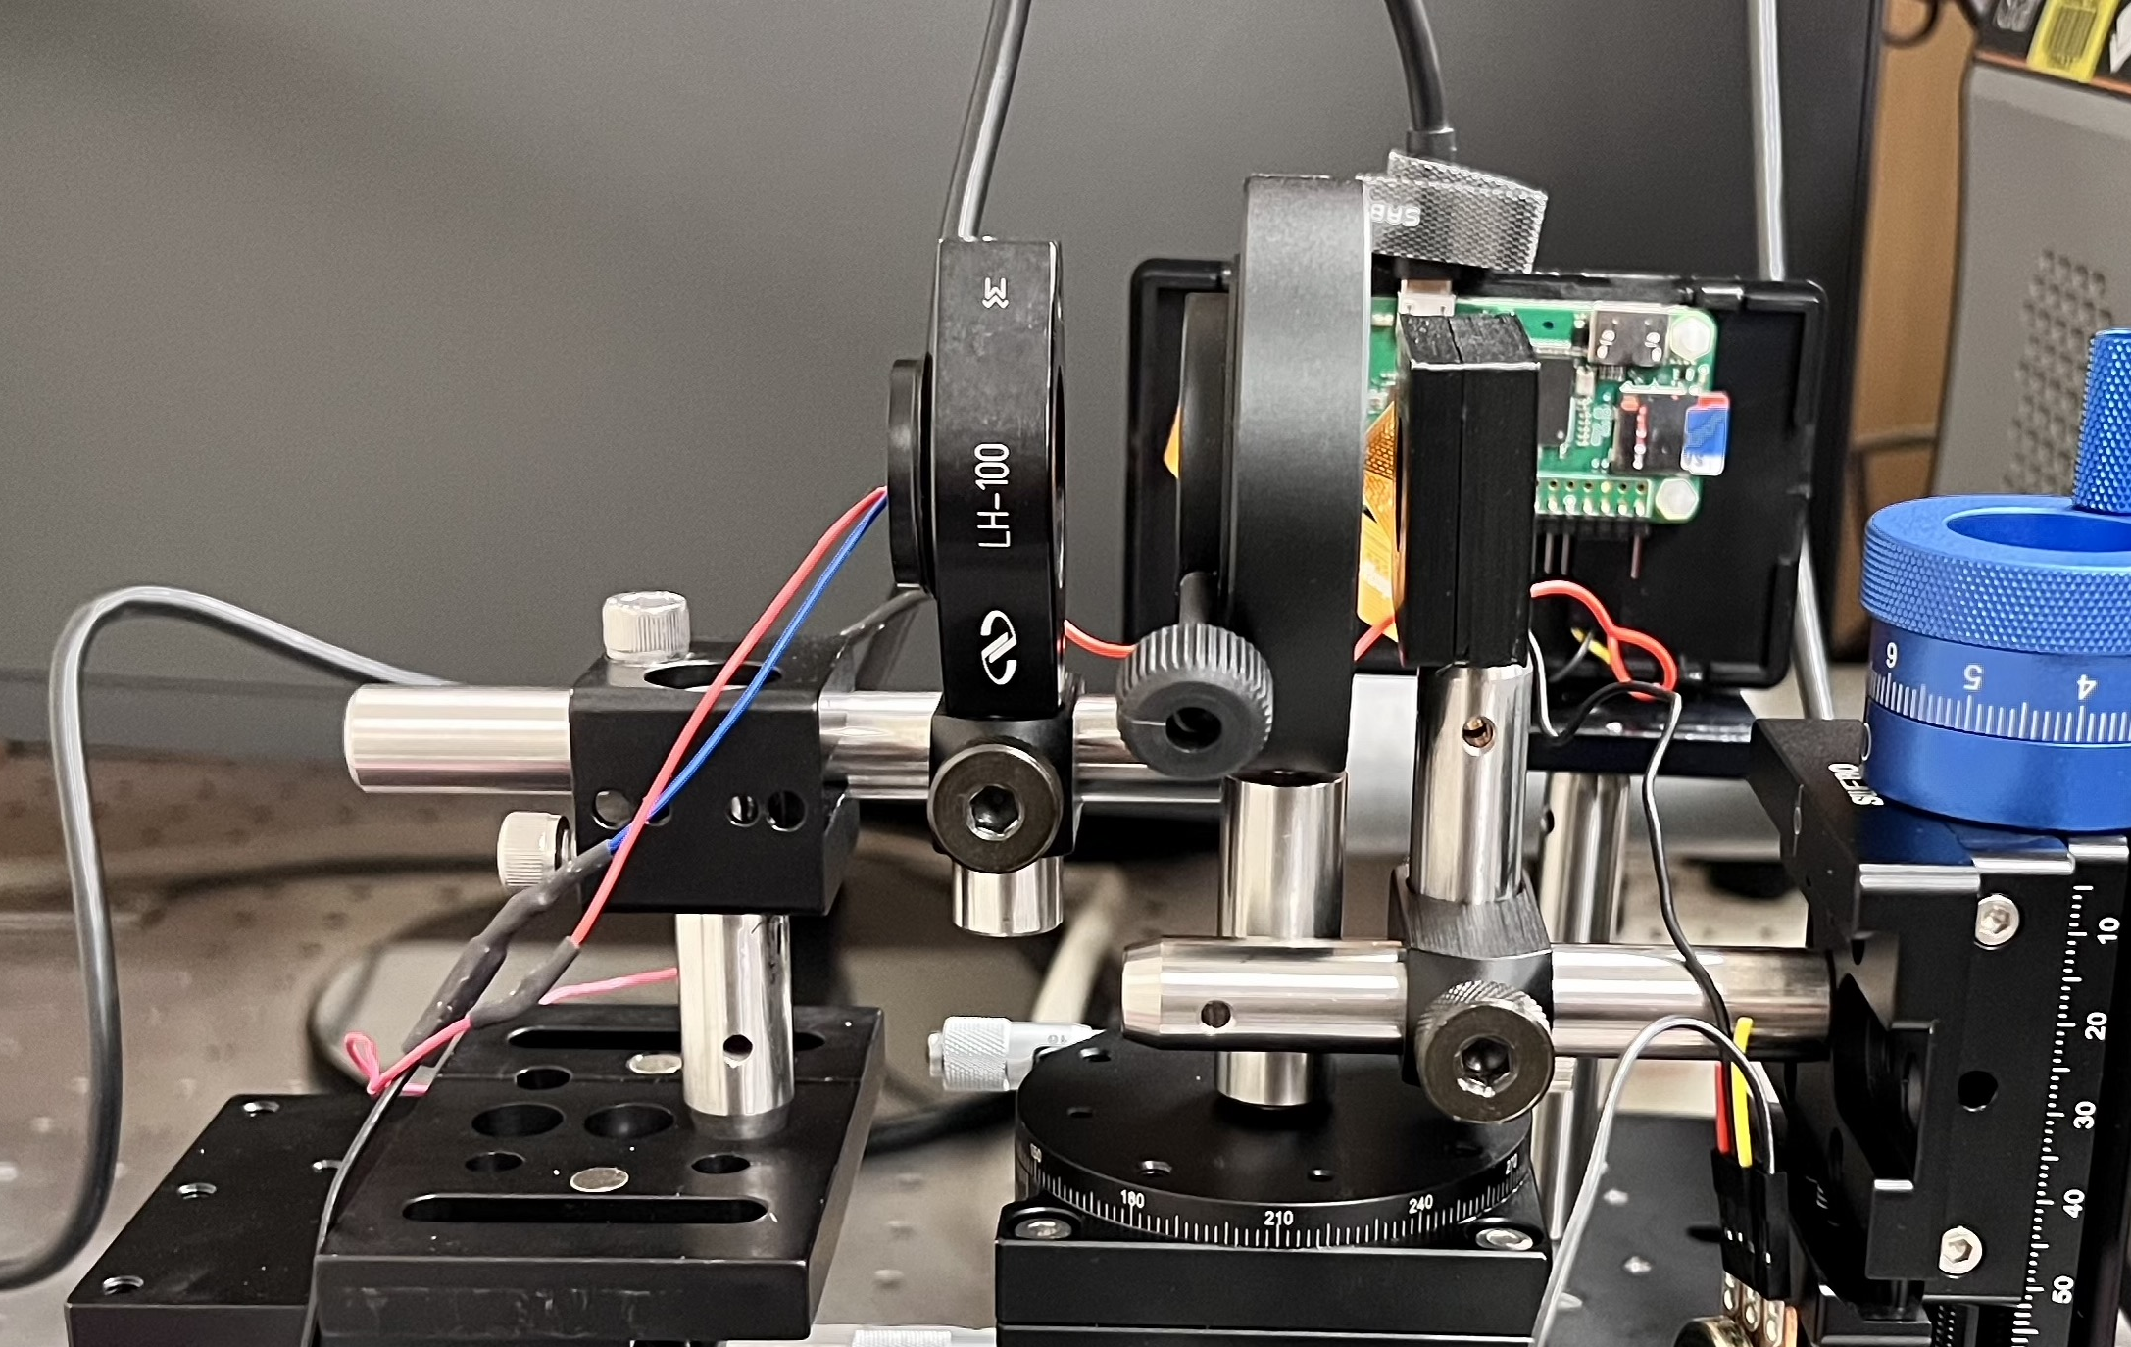
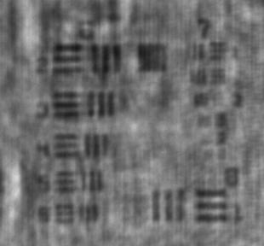
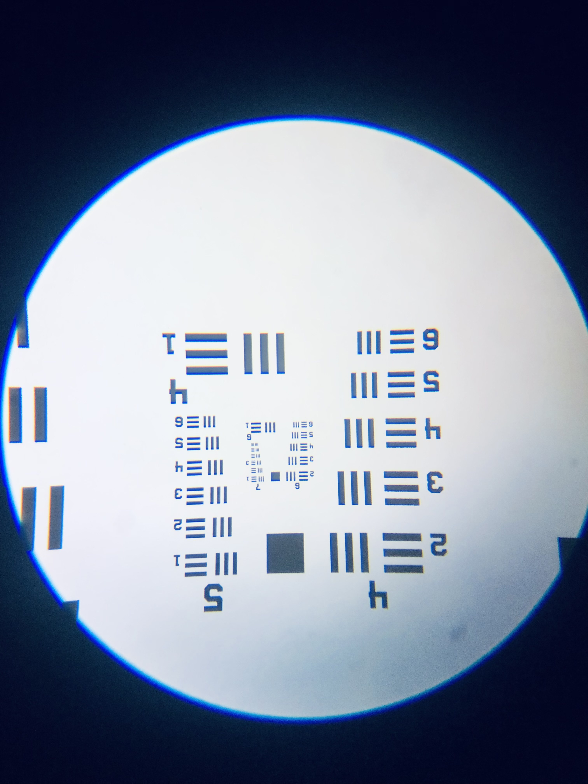
Holographic Microscopy for Research Purposes
X-Y-Z stage
X-Y-Z stage
Detector
Robust and high throughput imaging
Compact and inexpensive system
Tracking in 3D
Large depth of field
Laser
Specimen
(USAF)
Raspberry Pi
System Resolution
Holographic Microscope
Group 7 Element 1
3.9 µm
Optical Microscope
USAF Image
310x288 Cropped 8-bit .jpg

Slide 6
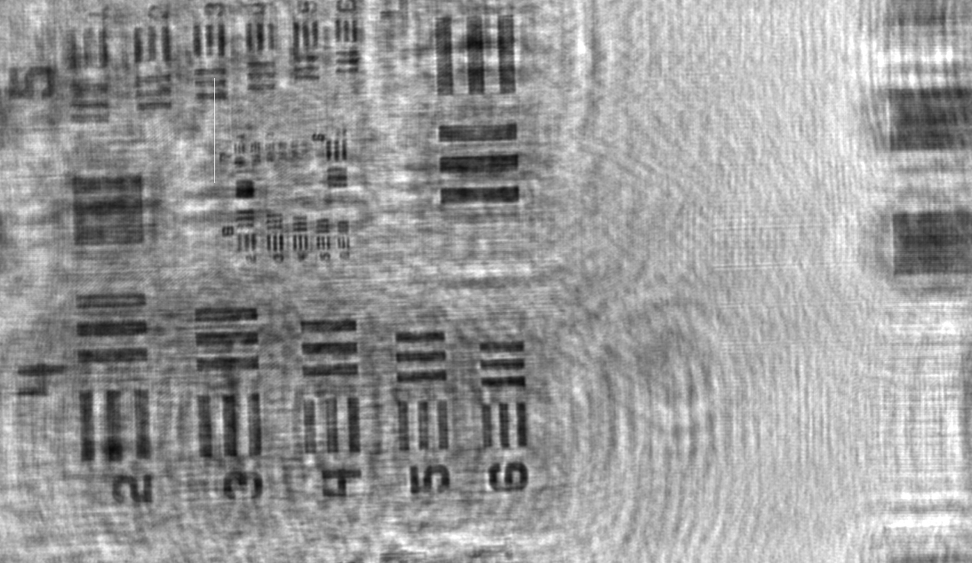
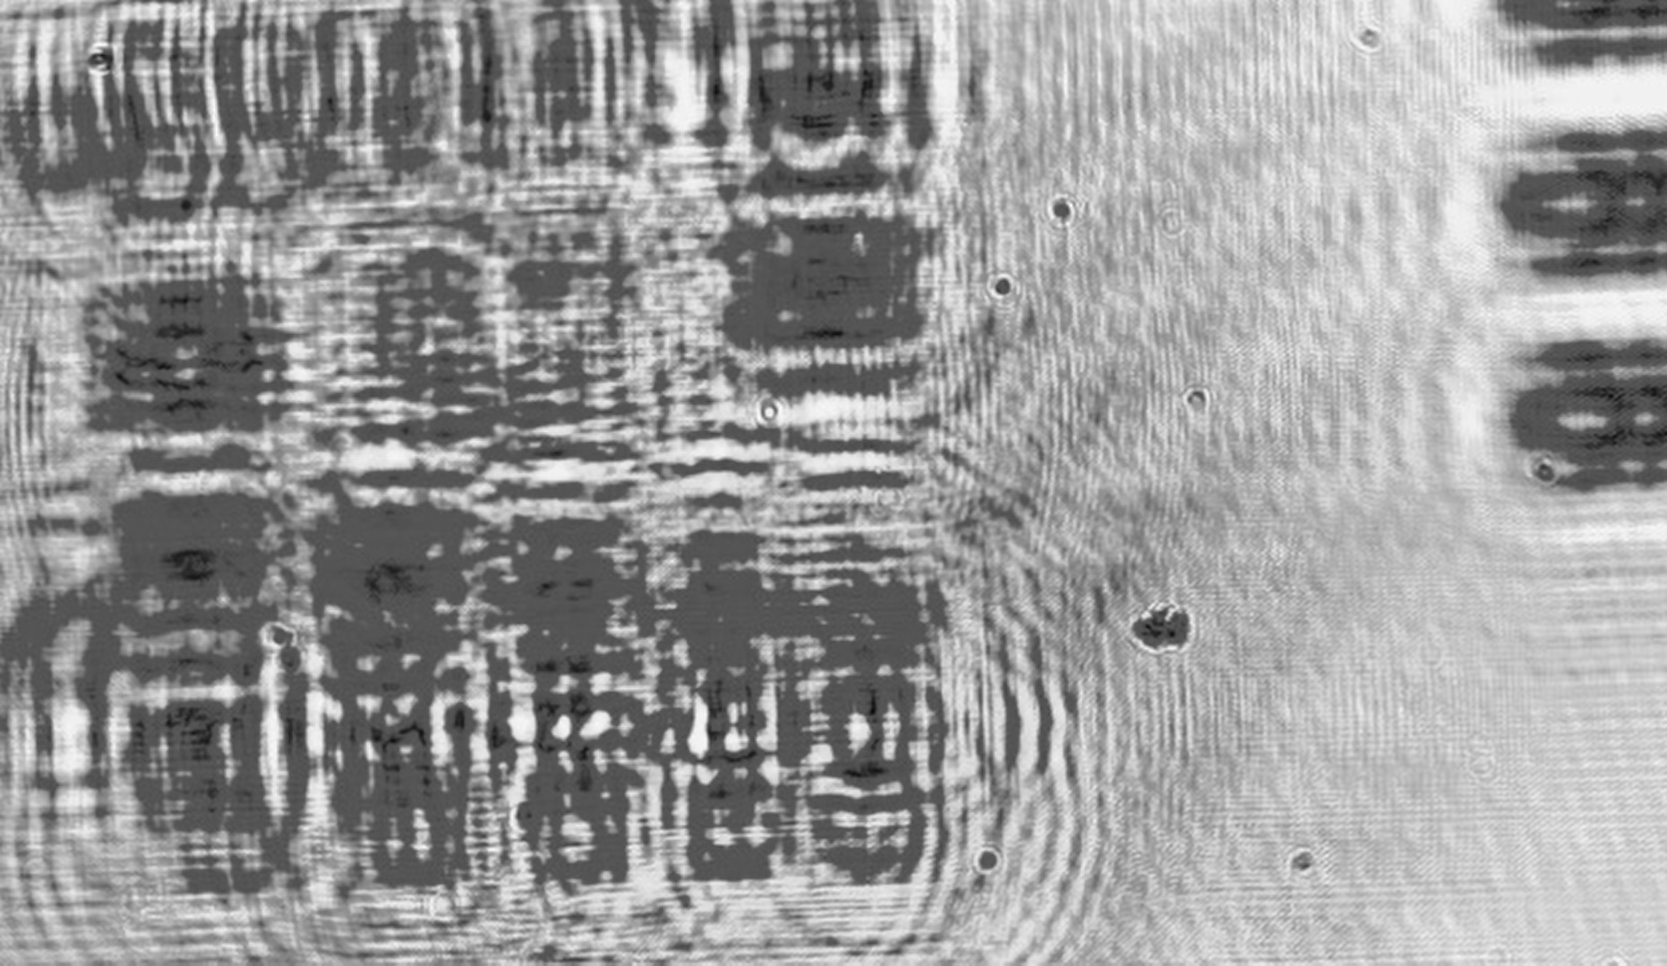
Group 7 Element 1
3.9 µm
Student Holoscope testbed Updates
Reco
Raw
Red Laser Power= 0.86mA
Pi Zero on PC
5MP Cam
Z= 19120
Actual Z=22000

