Slide 1


高性能计算程序设计
任课教师：
黄聃（Huang，Dan）

Slide 2
CUDA C++ BASICS
NVIDIA Corporation

Slide 3
WHAT IS CUDA?
CUDA Architecture
  Expose GPU parallelism for general-purpose computing
  Expose/Enable performance
CUDA C++
  Based on industry-standard C++
  Set of extensions to enable heterogeneous programming
  Straightforward APIs to manage devices, memory etc.
This session introduces CUDA C++
  Other languages/bindings available: Fortran, Python, Matlab, etc.

Slide 4
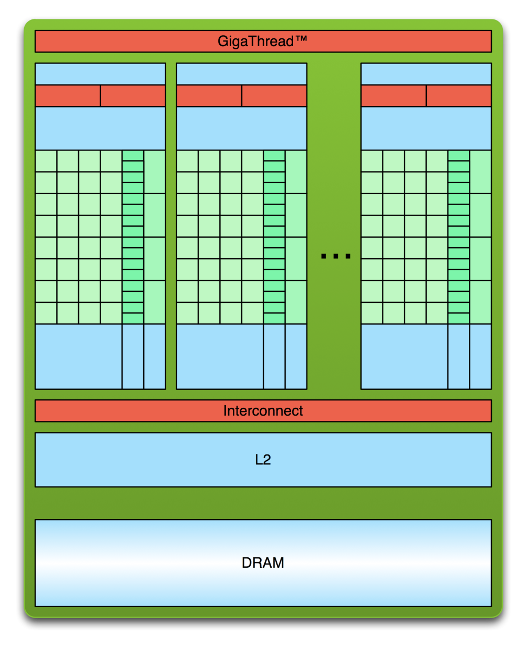
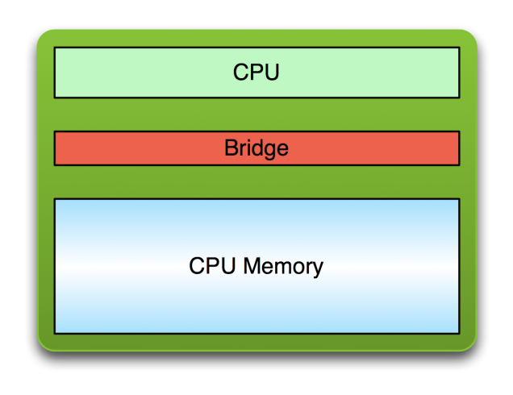
SIMPLE PROCESSING FLOW
PCIe or NVLink Bus
Copy input data from CPU memory to GPU memory
Load GPU program and execute, caching data on chip for performance
Copy results from GPU memory to CPU memory

Slide 5
GPU KERNELS: DEVICE CODE
global
void mykernel(void) {
}
CUDA C++ keyword indicates a defined function that:
  Runs on the device
  Is called from host code (can also be called from other device code)
nvcc separates source code into host and device components
  Device functions (e.g. mykernel()) processed by NVIDIA compiler
  Host functions (e.g. main()) processed by standard host compiler:
  gcc, cl.exe
global

Slide 6
GPU KERNELS: DEVICE CODE
mykernel<<<1,1>>>(); // run a kernel on GPU
Triple angle brackets mark a call to device code
    Also called a “kernel launch”
    the number of CUDA threads that execute that kernel for a given kernel call is specified using a new <<<...>>> execution configuration syntax
    Each thread that executes the kernel is given a unique thread ID (threadIdx) that is accessible within the kernel through built-in variables.
    The parameters inside the triple angle brackets are the CUDA kernel execution configuration
That’s all that is required to execute a function on the GPU!

Slide 7
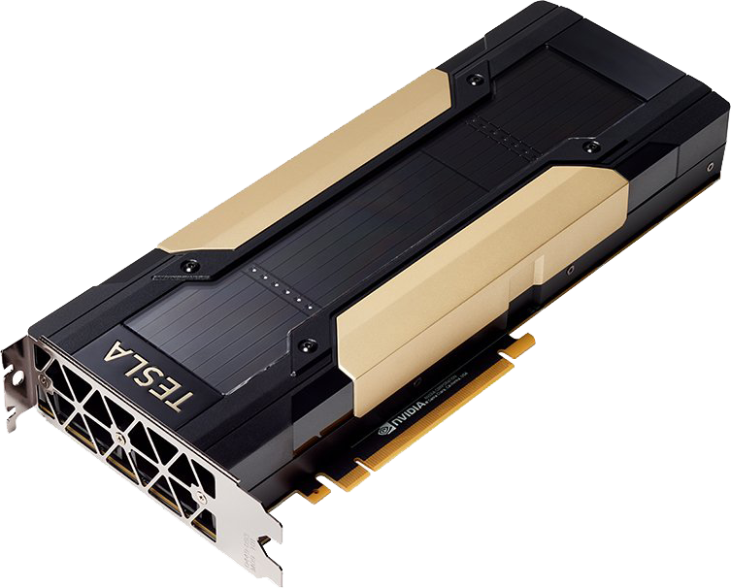
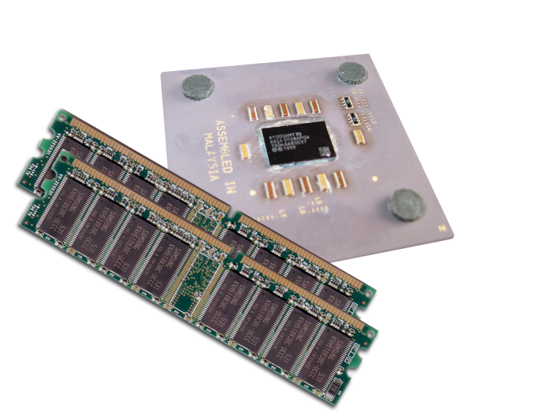
MEMORY MANAGEMENT
Host and device memory are separate entities
  Device pointers point to GPU memory
    Typically passed to device code
    Typically not dereferenced in host code
Host pointers point to CPU memory
  Typically not passed to device code
  Typically not dereferenced in device code
Simple CUDA API for handling device memory
  cudaMalloc(), cudaFree(), cudaMemcpy()
  Similar to the C equivalents malloc(), free(), memcpy()

Slide 8
RUNNING CODE IN PARALLEL
GPU computing is about massive parallelism
  So how do we run code in parallel on the device?
  add<<< 1, 1 >>>();
  add<<< N, 1 >>>();
  Instead of executing add() once, execute N times in parallel

Slide 9
VECTOR ADDITION ON THE DEVICE
    With add() running in parallel we can do vector addition
    Terminology: each parallel invocation of add() is referred to as a block
      The set of all blocks is referred to as a grid
      Each invocation can refer to its block index using blockIdx.x
  __global__ void add(int *a, int *b, int *c) {
  c[blockIdx.x] = a[blockIdx.x] + b[blockIdx.x];
  }
    By using blockIdx.x to index into the array, each block handles a different index
    Built-in variables like blockIdx.x are zero-indexed (C/C++ style), 0..N-1, where N is from the kernel execution configuration indicated at the kernel launch

Slide 10
VECTOR ADDITION ON THE DEVICE
#define N 512 int main(void) {
int *a, *b, *c;
int *d_a, *d_b, *d_c;
// host copies of a, b, c
// device copies of a, b, c
int size = N * sizeof(int);
// Alloc space for device copies of a, b, c
cudaMalloc((void |  | **)&d_a, | size);
cudaMalloc((void |  | **)&d_b, | size);
cudaMalloc((void |  | **)&d_c, | size);
// Alloc | space for host copies of a, b, |  |  | c and setup input values
a = (int | *)malloc(size); random_ints(a, |  |  | N);
b = (int c = (int | *)malloc(size); random_ints(b, *)malloc(size); |  |  | N);

Slide 11
VECTOR ADDITION ON THE DEVICE
// Copy inputs to device
cudaMemcpy(d_a, a, size, cudaMemcpyHostToDevice); cudaMemcpy(d_b, b, size, cudaMemcpyHostToDevice);
// Launch add() kernel on GPU with N blocks
add<<<N,1>>>(d_a, d_b, d_c);
// Copy result back to host
cudaMemcpy(c, d_c, size, cudaMemcpyDeviceToHost);
// Cleanup
free(a); free(b); free(c);
cudaFree(d_a); cudaFree(d_b); cudaFree(d_c); return 0;
}

Slide 12
CUDA THREADS
Terminology: a block can be split into parallel threads
Let’s change add() to use parallel threads instead of parallel blocks
    __global__ void add(int *a, int *b, int *c) {
    c[threadIdx.x] = a[threadIdx.x] + b[threadIdx.x];
    }
We use threadIdx.x instead of blockIdx.x
Need to make one change in main():
    add<<< 1, N >>>();// N <= 1024, a thread block may contain up to 1024 threads

Slide 13
COMBINING BLOCKS AND THREADS
We’ve seen parallel vector addition using:
  Many blocks with one thread each
  One block with many threads
Let’s adapt vector addition to use both blocks and threads
Why? We’ll come to that…
First let’s discuss data indexing…

Slide 14

















































INDEXING ARRAYS WITH BLOCKS AND THREADS
No longer as simple as using blockIdx.x and threadIdx.x
  Consider indexing an array with one element per thread (8 threads/block):
threadIdx.x threadIdx.x
threadIdx.x
threadIdx.x
0
1 | 2 | 3 | 4 | 5 | 6 | 7 | 0 | 1 | 2 | 3 | 4 | 5 | 6 | 7 | 0 | 1 | 2 | 3 | 4 | 5 | 6 | 7 | 0 | 1 | 2 | 3 | 4 | 5 | 6
7
blockIdx.x = 0
blockIdx.x = 1
blockIdx.x = 2
blockIdx.x = 3
With M threads/block a unique index for each thread is given by:
  int index = threadIdx.x + blockIdx.x * M;

Slide 15





















































































































INDEXING ARRAYS: EXAMPLE
Which thread will operate on the red element?
0
1 | 2 | 3 | 4 | 5 | 6 | 7 | 8 | 9 | 10 | 11 | 12 | 13 | 14 | 15 | 16 | 17 | 18 | 19 | 20 | 21 | 22 | 23 | 24 | 25 | 26 | 27 | 28 | 29 | 30
31
M = 8
threadIdx.x = 5
0
1
2
3
4
5
6
7
0
1
2
3
4
5
6
7
0
1
2
3
4
5
6
7
0
1
2
3
4
5
6
7
int index = | threadIdx.x | blockIdx.x + blockIdx.x | = 2 * M;
= | 5 | + 2 | * 8;
= | 21;

Slide 16
VECTOR ADDITION WITH BLOCKS AND THREADS
Use the built-in variable blockDim.x for threads per block
    int index = threadIdx.x + blockIdx.x * blockDim.x
Combined version of add() to use parallel threads and parallel blocks:
      __global__ void add(int *a, int *b, int *c) {
      int index = threadIdx.x + blockIdx.x * blockDim.x;
      c[index] = a[index] + b[index];
      }
What changes need to be made in main()?

Slide 17
ADDITION WITH BLOCKS AND THREADS
#define N (2048*2048) #define THREADS_PER_BLOCK 512
int main(void) {
int *a, *b, *c;
int *d_a, *d_b, *d_c;
int size = N * sizeof(int);
// host copies of a, b, c
// device copies of a, b, c
// Alloc space for device copies of a, b, c
cudaMalloc((void | **)&d_a, | size);
cudaMalloc((void | **)&d_b, | size);
cudaMalloc((void | **)&d_c, | size);
// Alloc space for host copies of a, b, c and setup input values
a = | (int | *)malloc(size); random_ints(a, | N);
b = c = | (int (int | *)malloc(size); random_ints(b, *)malloc(size); | N);

Slide 18
ADDITION WITH BLOCKS AND THREADS
// Copy inputs to device
cudaMemcpy(d_a, a, size, cudaMemcpyHostToDevice); cudaMemcpy(d_b, b, size, cudaMemcpyHostToDevice);
// Launch add() kernel on GPU
add<<<(N+THREADS_PER_BLOCK-1)/THREADS_PER_BLOCK,THREADS_PER_BLOCK>>> (d_a, d_b, d_c);
// Copy result back to host
cudaMemcpy(c, d_c, size, cudaMemcpyDeviceToHost);
// Cleanup
free(a); free(b); free(c); cudaFree(d_a); cudaFree(d_b); cudaFree(d_c); return 0;
 |  | 25
}

Slide 19
HANDLING ARBITRARY VECTOR SIZES
Typical problems are not friendly multiples of blockDim.x
Avoid accessing beyond the end of the arrays:
__global__ void add(int *a, int *b, int *c, int n) {
int index = threadIdx.x | + | blockIdx.x | * blockDim.x;
if (index < n)
c[index] = a[index] | + | b[index];
}
Update the kernel launch:
add<<<(N + M-1) / M, M>>>(d_a, d_b, d_c, N);

Slide 20
Multi-Dimensional CUDA Grids
In previous 1D example
    thr_per_blk = 128
    blk_in_grid = ceil( float(N) / thr_per_blk );
    vec_add<<< blk_in_grid, thr_per_blk >>>
In general
    dim3 is c struct with member variables x, y, z.
dim3 | threads_per_block( | threads | per | block | in | x-dim,
 |  | threads | per | block | in | y-dim,
 |  | threads | per | block | in | z-dim);
dim3 | blocks_in_grid( grid | blocks | in | x-dim,
 | grid | blocks | in | y-dim,
 | grid | blocks | in | z-dim );

Slide 21
Multi-D CUDA Grids
In previous 1D example
    thr_per_blk = 128
    blk_in_grid = ceil( float(N) / thr_per_blk );
    vec_add<<< blk_in_grid, thr_per_blk >>>
So we could have used
    dim3 threads_per_block( 128, 1, 1 );
    dim3 is c struct with member variables x, y, z.
  dim3 blocks_in_grid( ceil( float(N) / threads_per_block.x), 1, 1 );
  vec_add<<< blocks_in_grid, threads_per_block >>>(d_a, d_b, d_c);
多态
Polymorphism

Slide 22
Map CUDA threads to 2D array
^{A}0,0
^{A}0,1
^{A}0,2
^{A}0,3
^{A}0,4
^{A}0,5
^{A}0,6
^{A}0,7
^{A}0,8
^{A}0,9
    M = 7 rows
    N = 10 columns
    Assume a 4x4 threads per block…
    Then to cover all elements in the array, we need 3 blocks in x-dim and 2 blocks in y-dim.
^{A}1,0
^{A}1,1
^{A}1,2
^{A}1,3
^{A}1,4
^{A}1,5
^{A}1,6
^{A}1,7
^{A}1,8
^{A}1,9
^{A}2,0
^{A}2,1
^{A}2,2
^{A}2,3
^{A}2,4
^{A}2,5
^{A}2,6
^{A}2,7
^{A}2,8
^{A}2,9
^{A}3,0
^{A}3,1
^{A}3,2
^{A}3,3
^{A}3,4
^{A}3,5
^{A}3,6
^{A}3,7
^{A}3,8
^{A}3,9
^{A}4,0
^{A}4,1
^{A}4,2
^{A}4,3
^{A}4,4
^{A}4,5
^{A}4,6
^{A}4,7
^{A}4,8
^{A}4,9
^{A}5,0
^{A}5,1
^{A}5,2
^{A}5,3
^{A}5,4
^{A}5,5
^{A}5,6
^{A}5,7
^{A}5,8
^{A}5,9
^{A}6,0
^{A}6,1
^{A}6,2
^{A}6,3
^{A}6,4
^{A}6,5
^{A}6,6
^{A}6,7
^{A}6,8
^{A}6,9
    dim3 threads_per_block( 4, 4, 1 );
    dim3 blocks_in_grid( ceil(float(N) / threads_per_block.x ), ceil(float(M) / threads_per_block.y ) , 1 );
    mat_add<<< blocks_in_grid, threads_per_block >>>(d_a, d_b, d_c);

Slide 23
Row-Major Order
^{A}0,0 | ^{A}0,1 | ^{A}0,2 | ^{A}0,3 | ^{A}0,4
^{A}1,0 | ^{A}1,1 | ^{A}1,2 | ^{A}1,3 | ^{A}1,4
^{A}2,0 | ^{A}2,1 | ^{A}2,2 | ^{A}2,3 | ^{A}2,4
^{A}3,0 | ^{A}3,1 | ^{A}3,2 | ^{A}3,3 | ^{A}3,4
…
0 | 1 | 2 | 3 | 4 | 5 | 6 | 7 | 8 | 9 | 10 | 11 | 12 | 13 | 14 | 15 | 16 | 17 | 18 | 19
…

Slide 24
Row-Major Order
^{A}0,0 | ^{A}0,1 | ^{A}0,2 | ^{A}0,3 | ^{A}0,4
^{A}1,0 | ^{A}1,1 | ^{A}1,2 | ^{A}1,3 | ^{A}1,4
^{A}2,0 | ^{A}2,1 | ^{A}2,2 | ^{A}2,3 | ^{A}2,4
^{A}3,0 | ^{A}3,1 | ^{A}3,2 | ^{A}3,3 | ^{A}3,4
…
^{A}0,0 | ^{A}0,1 | ^{A}0,2 | ^{A}0,3 | ^{A}0,4
0 | 1 | 2 | 3 | 4 | 5 | 6 | 7 | 8 | 9 | 10 | 11 | 12 | 13 | 14 | 15 | 16 | 17 | 18 | 19
…

Slide 25
Row-Major Order
^{A}0,0 | ^{A}0,1 | ^{A}0,2 | ^{A}0,3 | ^{A}0,4
^{A}1,0 | ^{A}1,1 | ^{A}1,2 | ^{A}1,3 | ^{A}1,4
^{A}2,0 | ^{A}2,1 | ^{A}2,2 | ^{A}2,3 | ^{A}2,4
^{A}3,0 | ^{A}3,1 | ^{A}3,2 | ^{A}3,3 | ^{A}3,4
…
^{A}0,0 | ^{A}0,1 | ^{A}0,2 | ^{A}0,3 | ^{A}0,4 | ^{A}1,0 | ^{A}1,1 | ^{A}1,2 | ^{A}1,3 | ^{A}1,4
0 | 1 | 2 | 3 | 4 | 5 | 6 | 7 | 8 | 9 | 10 | 11 | 12 | 13 | 14 | 15 | 16 | 17 | 18 | 19
…

Slide 26
Row-Major Order
^{A}0,0 | ^{A}0,1 | ^{A}0,2 | ^{A}0,3 | ^{A}0,4
^{A}1,0 | ^{A}1,1 | ^{A}1,2 | ^{A}1,3 | ^{A}1,4
^{A}2,0 | ^{A}2,1 | ^{A}2,2 | ^{A}2,3 | ^{A}2,4
^{A}3,0 | ^{A}3,1 | ^{A}3,2 | ^{A}3,3 | ^{A}3,4
…
^{A}0,0 | ^{A}0,1 | ^{A}0,2 | ^{A}0,3 | ^{A}0,4 | ^{A}1,0 | ^{A}1,1 | ^{A}1,2 | ^{A}1,3 | ^{A}1,4 | ^{A}2,0 | ^{A}2,1 | ^{A}2,2 | ^{A}2,3 | ^{A}2,4
0 | 1 | 2 | 3 | 4 | 5 | 6 | 7 | 8 | 9 | 10 | 11 | 12 | 13 | 14 | 15 | 16 | 17 | 18 | 19
…

Slide 27
Row-Major Order
^{A}0,0 | ^{A}0,1 | ^{A}0,2 | ^{A}0,3 | ^{A}0,4
^{A}1,0 | ^{A}1,1 | ^{A}1,2 | ^{A}1,3 | ^{A}1,4
^{A}2,0 | ^{A}2,1 | ^{A}2,2 | ^{A}2,3 | ^{A}2,4
^{A}3,0 | ^{A}3,1 | ^{A}3,2 | ^{A}3,3 | ^{A}3,4
…
^{A}0,0 | ^{A}0,1 | ^{A}0,2 | ^{A}0,3 | ^{A}0,4 | ^{A}1,0 | ^{A}1,1 | ^{A}1,2 | ^{A}1,3 | ^{A}1,4 | ^{A}2,0 | ^{A}2,1 | ^{A}2,2 | ^{A}2,3 | ^{A}2,4 | ^{A}3,0 | ^{A}3,1 | ^{A}3,2 | ^{A}3,3 | ^{A}3,4
0 | 1 | 2 | 3 | 4 | 5 | 6 | 7 | 8 | 9 | 10 | 11 | 12 | 13 | 14 | 15 | 16 | 17 | 18 | 19
…

Slide 28
Map CUDA threads to 2D array
^{A}0,0
^{A}0,1
^{A}0,2
^{A}0,3
^{A}0,4
^{A}0,5
^{A}0,6
^{A}0,7
^{A}0,8
^{A}0,9
    M = 7 rows
    N = 10 columns
    Assume 4x4 blocks of threads…
    Then to cover all elements in the array, we need 3 blocks in x-dim and 2 blocks in y-dim.
^{A}1,0
^{A}1,1
^{A}1,2
^{A}1,3
^{A}1,4
^{A}1,5
^{A}1,6
^{A}1,7
^{A}1,8
^{A}1,9
^{A}2,0
^{A}2,1
^{A}2,2
^{A}2,3
^{A}2,4
^{A}2,5
^{A}2,6
^{A}2,7
^{A}2,8
^{A}2,9
^{A}3,0
^{A}3,1
^{A}3,2
^{A}3,3
^{A}3,4
^{A}3,5
^{A}3,6
^{A}3,7
^{A}3,8
^{A}3,9
^{A}4,0
^{A}4,1
^{A}4,2
^{A}4,3
^{A}4,4
^{A}4,5
^{A}4,6
^{A}4,7
^{A}4,8
^{A}4,9
^{A}5,0
^{A}5,1
^{A}5,2
^{A}5,3
^{A}5,4
^{A}5,5
^{A}5,6
^{A}5,7
^{A}5,8
^{A}5,9
^{A}6,0
^{A}6,1
^{A}6,2
^{A}6,3
^{A}6,4
^{A}6,5
^{A}6,6
^{A}6,7
^{A}6,8
^{A}6,9
global void add_matrices(int *a, int *b, int *c){
int column = blockDim.x * blockIdx.x + threadIdx.x;
int row = blockDim.y * blockIdx.y + threadIdx.y;
if (row < M && column < N){
int thread_id = row * N + column;
c[thread_id] = a[thread_id] + b[thread_id];
}
}

Slide 29
Map CUDA threads to 2D array
0
1
2
3
4
5
6
7
8
9 10
11
    M = 7 rows
    N = 10 columns
    Assume 4x4 blocks of threads…
    Then to cover all elements in the array, we need 3 blocks in x-dim and 2 blocks in y-dim.
    Ex: What element of the array does the highlighted thread correspond to?
    thread_id = row * N + column
0
^{A}0,0
^{A}0,1
^{A}0,2
^{A}0,3
^{A}0,4
^{A}0,5
^{A}0,6
^{A}0,7
^{A}0,8
^{A}0,9
1
^{A}1,0
^{A}1,1
^{A}1,2
^{A}1,3
^{A}1,4
^{A}1,5
^{A}1,6
^{A}1,7
^{A}1,8
^{A}1,9
2
^{A}2,0
^{A}2,1
^{A}2,2
^{A}2,3
^{A}2,4
^{A}2,5
^{A}2,6
^{A}2,7
^{A}2,8
^{A}2,9
3
^{A}3,0
^{A}3,1
^{A}3,2
^{A}3,3
^{A}3,4
^{A}3,5
^{A}3,6
^{A}3,7
^{A}3,8
^{A}3,9
4
^{A}4,0
^{A}4,1
^{A}4,2
^{A}4,3
^{A}4,4
^{A}4,5
^{A}4,6
^{A}4,7
^{A}4,8
^{A}4,9
5
^{A}5,0
^{A}5,1
^{A}5,2
^{A}5,3
^{A}5,4
^{A}5,5
^{A}5,6
^{A}5,7
^{A}5,8
^{A}5,9
6
^{A}6,0
^{A}6,1
^{A}6,2
^{A}6,3
^{A}6,4
^{A}6,5
^{A}6,6
^{A}6,7
^{A}6,8
^{A}6,9
7
global void add_matrices(int *a, int *b, int *c){
int column = blockDim.x * blockIdx.x + threadIdx.x;
int row = blockDim.y * blockIdx.y + threadIdx.y;
if (row < M && column < N){
int thread_id = row * N + column;
  c[thread_id] = a[thread_id] + b[thread_id];
  }
  }
(0 – 11)
(0 – 7)
(0 – 69)

Slide 30
Now let’s run the matrix_addition program.
Run the matrix_addition program
  Change execution configuration parameters
    threads_per_block( 16, 16, 1 );
  NOTE: you cannot exceed 1024 or 512 threads per block (in total), depending on the GPU architecture
    threads_per_block(16, 16, 1 ); 256 ✔
    threads_per_block(32, 32, 1 ); 1024 ✔
    threads_per_block(64, 64, 1 ); 4096 x

