Slide 1

CUDA UNIFIED MEMORY

Slide 2
AGENDA
Managed Memory - basic idea, objectives, benefits
Demand-Paging, Oversubscription, Concurrency, Atomics
Use Cases: Deep Copies, Linked Lists, C++ Objects, Graph Traversal
Performance: Prefetching, Hints
Multi-GPU Considerations
Further Study
Homework

Slide 3
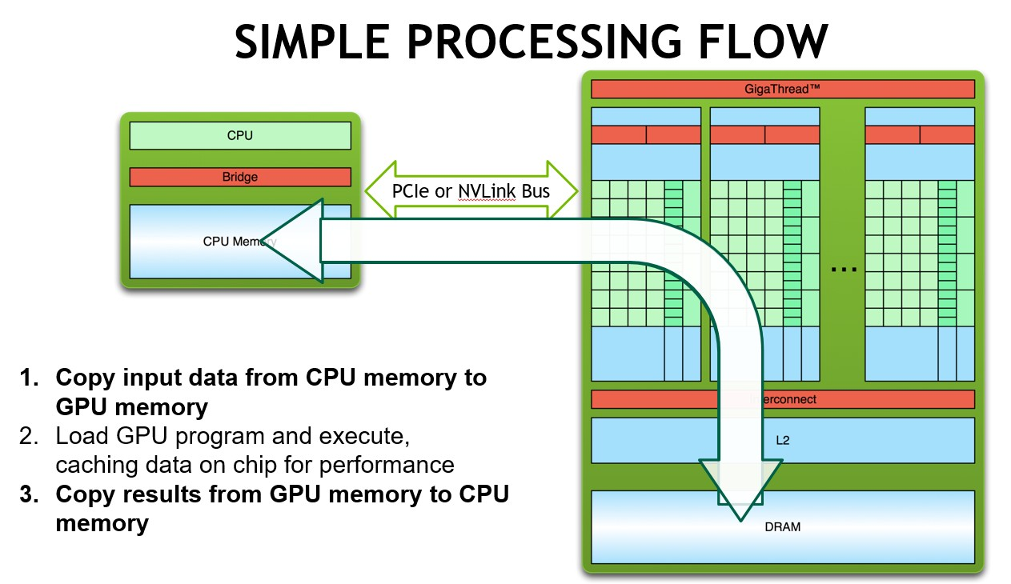
THE CUDA 3-STEP PROCESSING SEQUENCE
Recall from Module 1…
->Wouldn’t it be nice if we didn’t have to do (i.e. write the code for) steps 1 and 3?
3

Slide 4
INTRODUCING UNIFIED MEMORY
WITH DEMAND PAGING

Slide 5




UNIFIED MEMORY
Reduce Developer Effort
统一内存
CUDA 6+
Kepler+ GPU
CPU
Single allocation, single pointer, accessible anywhere
Eliminate need for explicit copy Simplifies code porting
Simpler Programming & Memory Model
Unified Memory
Maintain Performance through
Data Locality
Migrate data to accessing processor Guarantee global coherence
Still allows explicit hand tuning
Allocate Up To
GPU Memory Size

Slide 6







CUDA 8+: UNIFIED MEMORY
Demand Paging For Pascal and Beyond
CUDA 8+
Oversubscribe GPU memory Allocate up to system memory size
Enable Large Data Models
Pascal+ GPU
CPU
Simpler Data Accesss
CPU/GPU Data coherence
Unified memory atomic operations
Unified Memory
Tune
Unified Memory Performance
Usage hints via cudaMemAdvise API Explicit prefetching API
Allocate Beyond
GPU Memory Size

Slide 7


SIMPLIFIED MEMORY MANAGEMENT CODE
CPU Code
void sortfile(FILE *fp, int N) {
char *data;
data = (char *)malloc(N);
fread(data, 1, N, fp);
qsort(data, N, 1, compare);
use_data(data);
free(data);
}
Ordinary CUDA Code
void sortfile(FILE *fp, int N) { char *data, *d_data;
data = (char *)malloc(N); cudaMalloc(&d_data, N); fread(data, 1, N, fp);
cudaMemcpy(d_data, data, N, …); // 1 qsort<<<...>>>(data,N,1,compare); // 2 cudaMemcpy(data, d_data, N, …); // 3
use_data(data); cudaFree(d_data); free(data);
}

Slide 8
SIMPLIFIED MEMORY MANAGEMENT CODE
CUDA Code with Unified Memory
void sortfile(FILE *fp, int N) {
char *data;
cudaMallocManaged(&data, N);
fread(data, 1, N, fp);
qsort<<<...>>>(data,N,1,compare); cudaDeviceSynchronize();
use_data(data); cudaFree(data);
CPU Code
void sortfile(FILE *fp, int N) { char *data;
data = (char *)malloc(N);
fread(data, 1, N, fp); qsort(data, N, 1, compare);
use_data(data); free(data);
}
}

Slide 9
UNIFIED MEMORY EXAMPLE
With On-Demand Paging
global
void setValue(int *ptr, int index,
{
ptr[index] = val;
}
int val)
void foo(int size) {
char *data;
cudaMallocManaged(&data,
size);
Unified Memory allocation
memset(data, 0, size);
Access all values on CPU Access one value on GPU
setValue<<<...>>>(data, size/2, 5); cudaDeviceSynchronize();
useData(data);
cudaFree(data);
}

