Slide 1

介词的用法
一.表示时间介词
二.表示地点介词
三.表示方位介词
四.表示方法、手段
五.常见介词的搭配

Slide 2
介词的含义
介词 1.是一种用来表示:词与词,
:词与句之间的关系的词。
2.在句中不能单独作句子成分
介词 后面一般有:名词、代词或相当于名词的其他词类，短语或从句作它的宾语。

Slide 3
什么是介词？它的作用是什么？
1.Look at me.( )
2.He goes to school by bike.( )
3.He is interested in drawing.( )
4.The book is on the desk.( )
代词
名词
动名词
名词
介词:通常用在_________、_______、_______
之前，表示某个人、事物/东西、事件与
另一个之间的_________。
代词
名词
动名词
关系

Slide 4
介词的主要分类：
1. at the cinema, in the hospital __________
2. Write with a pen, go by bus ___________
3. in summer, on Septemper 1st ___________
4. by the way, at last, in the end ___________
地点介词
方式介词
时间介词
固定搭配

Slide 5
一.时间介词
1.
in | 年、月、季节及时间段（早、午、晚）
on | 具体某一天，星期、节日
at | 钟点、节日、（一段时间）的起点
注意：at noon 在中午
at night 在夜间
in the morning 在早上
on the morning of July 1st
在七月一日的早上
on a rainy day 在雨天

Slide 6
时间介词
1.at six o’clock, at noon, at that time, at half past three, at mid-night… ________________
2.on Sunday, on New Year’s Day, on March 21^{st,} on my birthday … _________________
3. in three days, in a week, in a month, in May,
in 1998 … _____________________
4. in the morning, in the afternoon , in the evening _____________________
但： on the morning of May 1st
5. at night = ____ _____ night
6. in the day = in the ________
表示点钟或具体一点时间用at
表示在某一天用 on
表示大于一天的时间用 in
在早上/下午/傍晚 用 in
in
the
day-time

Slide 7
1. Mary is flying to France soon. She will arrive in Paris ___ the morning of July 9.
A. on B. in C. at
2. The twins were born __ a Friday evening.
A. in B. on C. at
3. We travelled overnight to Paris and arrived __5 o’clock __ the morning.
A. on, in B. at, in C. at, in
4. We finish our lessons ___ 11:30 and then
have a rest __ noon.
A. in , in B. at ,at C. in, at

Slide 8
in + 时间段 在……之后（内），多用于将来时
after +时间段 在……之后， 多用于过去时
1. Mr Brown has gone to Canada.He will
be back ___ two weeks.
A. for B. after C. in
2. Our manager came back ___ an hour.
A. in B. after C. at

Slide 9
before 在……之前
by 到……时为止,不迟于……
1.He won’t come back ___ five .
A.before B. after C.by
2.The work must be finished __ Friday.
A.at B.by C.after
3.We had three meetings ___ last
Friday.
A.in B.before C. by

Slide 10
二、地点介词
At: 表示小地方用
In:表示大地方用

Slide 11
地点介词
1.at the village , at home, at the corner of the street..
______________________
2.in Shanghai , in the country, in Asia, in the world,
in space…
_______________________
3. in the box, on the chair, under the desk, next to Kate, on the right of Lucy, in front of the house, behind the door…
_________________________
表示小地方用at
表示大地方用in
表示不同地方用具体不同的介词

Slide 12
填上正确的地点介词：
1.在广州 _______ Guangzhou
2.在电影院 _______ the cinema
3.在湖边 _______ the lake
4.在海里 _______ the sea
5.树上的苹果 apples ______ the tree
6.树上的小鸟 birds ______ the tree
7.在天空上 ______ the sky
8.在农场上 ________ the farm
19.在街道上 ________ the street
in
at
at
in
on
in
in
on
in

Slide 13
地点介词
1.on 在……的上面,与表面接触
over 在……的正上方,不接触表面
under 在……下面(是on,over的反义词)
1.Look!There is a bridge__the river.
A.on B. over C.above
2.Can you see the egg ___ the plate?
A.on B.in C.over
3.The light__us is very bright.
A.over B.under C.on

Slide 14
2. above 在……上方
below 在……下方,是above的反义词
1. The temperature will fall__zero at
night.
A.below B.above C.over
2.Suddenly there is a loud voice ___
the tree.
A.below B.above C.on
3.There is a clock on the wall. It’s
___ the blackboard.
A.on B.in C.above

Slide 15
3. in + 大地方
at + 小地方
on +门牌，某层楼
1.My uncle live ___ F12 __the fifth floor.
A.at, on B. in,on C.on, at
2.They arrived ___Beijing at 12:00 and waited for a bus ___ the station to the hotel.
A.at, in B. in, on C. in, at

Slide 16
4.The sun rose ___the horizon(地平线).
A. on B. above C.over
注意: on 接触平面
over 在平面的正上方
above 在上方

Slide 17
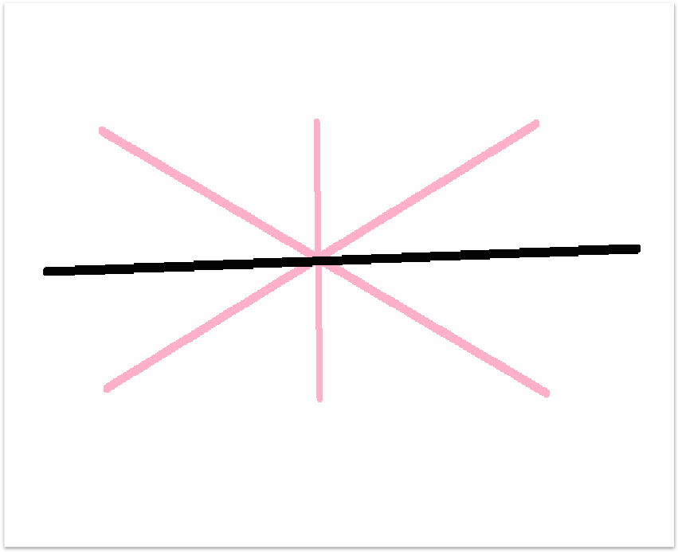









Slide 18
in, on
表示"在……上"时，不是都用"on"，有时须用in。
在树上
in the tree 用于指树上的鸟、人等。
on the tree用于指生长在树上的叶子、果实。
在墙上
in the wall镶嵌在墙内，指窗户、门、钉子等。
on the wall在墙的表面之上，指地图、画像等。
在报纸上
in the newspaper用于指报上的内容。
on the newspaper用于指放在报纸上的东西，如眼镜等。

Slide 19
in | 里面，排、行、组
on | 左、右边
at | 前、后部
2.
1.We are ___Team One.I sit __the front of
the classroom.Li Ping is ___my left.
A.on, in , at B.in ,in ,at C.in, at, on
2.I have a good seat. I sit __the bus.
A.in the front of B.in front of
3.The teacher is standing ___ our class
and give a talk.
A.in the front of B.in front of

Slide 20
3. to 表目的地或去的目的
for 动身去某地
1.He got on a train ___ Shanghai .
A.to B. for C. towards
2.Wil you take a train___ Tianjian.
A. to B. for C.at
3. I’m leaving ____ Beijing next week.
A. to B. for C. towards

Slide 21
方式介词
使用工具用介词 with
使用器官用介词 with
使用语言用介词 in
使用声音用介词 in
使用方法用介词 in 或 by

Slide 22
三、方式介词
1.write with a pen, cut with a knife, lock with a lock… ____________________
2. see with our eyes, do with our hands, smell with our noses, eat with our mouths…
____________________
3. in English , in French , in your own words,
in three language… _____________________
4. in a loud voice, in a low voice…
___________________
5. in this way, by this means…
___________________
使用工具用介词 with
使用器官用介词 with
使用语言用介词 in
使用声音用介词 in
使用方法用介词 in 或 by

Slide 23
6.by bike, by bus, by train, by plane, by ship, by car… (on foot) by land 陆路， by sea 水路，by air 空运
_________________
但：on the bike, on the bus, on the train, on the plane, on the ship, in the car…
7.in a red coat, the girl in yellow, the boy in white…
__________________
8.lie in bed, after a while, in the sun（在阳光下）
under the sun（天下，世界上；到底，究竟）
使用交通工具用 by
表示穿衣服用 in
( )
固定搭配

Slide 24
四.方位介词
1.in 在某范围之内
to 在某范围之内
on 与某地相邻、接壤
1.China lies ___the east of Asia and ___the north of Australia.
A. in, on B. in ,to C. to, in
2.Mongolia is ___the north of China.
A. in B. on C. to

Slide 25
①Shanghai lies ___the east of China.( )
②Japan lies _____the east of China.( )
③Hubei lies _____the north of Hunan.( )
in
在中国内部
to
在中国外部
on
两地接壤

Slide 26
across 表面穿过
through 中间穿过
1.The sunshine come into the room ___ the window.
A. across B. through C. past
2.You can go ___ the road here.
A. across B. through C. past
3.Can you swim ____ the river.
A. across B. through C. past

Slide 27
常用易混淆介词辨析
after/ in
皆可表示时间在……之后，其区别为：
after
①.表示“在某点时间之后”，用于将来时。如：
We’ll go out for a walk after supper.
②.表示“一段时间之后”，用于过去时。如：
My mother came home after half an hour.
in
表示“一段时间之后”，用于将来时。如：
We’ll go to school in two weeks.

Slide 28
between /among
1) between 多指两者之间。如：What's the difference between the two words?
2) among 指三者或三者以上的同类事物之间，在或笼统的一群人或一些物之中，表示“在……中间，在……之中”。如：The young people lived and worked among the workers.
注意：我们可以说between you and me，但不能说 between you and I，因为between是介词。
3) between还可以用来指三个或三个以上的人或物的每两个之间。三个或三个以上的名词用and连接，前面用between，而不用among。如：There is not much difference between the three of them.
Switzerland lies _______ France, Ger-many, Austria and Italy.
between

Slide 29
cross，across, through
1. cross 作动词用，“穿过，越过”的意思。主要表示在物体表面上横
穿。如横过马路、过桥、过河等，与go across同义。
cross作名词用是“十字架，十字形饰物”的意思。
2. across是介词，有“横跨，横穿，穿越”之意。
across与go/walk等动词连用表示“穿过，越过，横穿”的意思。与
cross基本同义，也是表示从物体表面经过。
3.through是介词，“在...之中，透过”的意思，常与go,walk等动词连用，主要表示从物体内部穿过。如穿过森林、隧洞等

Slide 30
cross
1. We must ________ the road very carefully.
2. Before going _________ the road, you should look left first and then right.
3. I try to get into the room ________ the window because I can’t open the door.
4. They drove _______ the street quickly, but the police caught them at last.
5. It’s dangerous to swim ________ the river.
6. Go _________ the bridge and you will see the station.
across
through
across
across
across

Slide 31
in front of, in the front of
in front of 表示“在某人或某物的前面”，在某个范围
以外；
in the front of 表示“在……的前部”，在某个范围以内
例如：
There are some tall trees in front of the building.
在楼前有一些高树。
The teacher is sitting in the front of the classroom.
老师坐在教室前面

Slide 32
over
above
on
above\over\on\below\under
under
below
over
Be careful, there is a heavy box______ your head.
The sun is _____ the mountain in the east.
There are some stamps _______ the desk.
The little mouse is _____ the table, so it is not easy to find it.
above
on
under

Slide 33
表示“延续的一段时间”时，可用“for＋时间段”或“since＋过去的时间点”，常与含延续动词的完成时连用。
—How long have you been in this city?
你在这座城市待了多久了？
—For ten years. 十年。
Mr Smith has lived here since 1998.
史密斯先生自从1998年就住在这。
since, for

Slide 34
用适当的介词填空
1.We usually have lunch______ noon.
2.Lin Tao was born______ February 18th.
3.Ann sits_____ my right,______ Kate's left.
She sits___________us.
4.My father is leaving______ Suzhou tomorrow.
5.We must learn_______ each other.
at
on
on
on
between
for
from

Slide 35
through
6.They went_________ the gate and entered the garden.
7.We can do all things _______our hands.
______the end of the last cap，he caught up _____the others.
9.Be kind_____people.Don't shout _____people.
10.Last month he worked_____ a teacher _____
three weeks.
with
At
with
to
at
as
for

Slide 36
B
1.His father is very angry_________him his study.
A. at，with B.with，at C.to，about D.about，to
2.Paper is made_________wood.
A.from B.of C.by D.in
3.The basket is full_________apples.
A.with B.of C.in D.by
4.Kate can't come. Let's ask wei Hua instead______her.
A.of B.for C.to D.with
5.The heavy rain stopped me___getting to school on time.
A. to B.from C.on D.for
A
B
A
B

Slide 37
6.Li Lida's parents are very proud _________ their son.
A.to B.in C.for D.of
7.The fox looked up_________ a cock sitting the tree.
A. to，in B.at,in C. for，on D.at，on
8.Please wait _________ the bus stop near my home.
A.for B.at C.next D. in front
9.Where is your bike made_________?
A.in B.from C. of D./
10.When the red light is on，it's dangerous to go_____the street. A.across B.through C. cross D. to
D
B
B
D
A

Slide 38
11.He is rich _____ unhappy.
A.or B.and C.so D.but
12.Take a rest ______ you finish the work.
A.before B.after C.until D.while
13.You can't pass the exam, ______ you study hard.
A.if B.of C.unless D.and
14.______our team tried best, ____ we failed.
A.Though,but B.Because,so C.If,and D. Though,/
15.Don't get off _______the bus stops.
A.when B.after C.until D.so
D
B
C
D
C

Slide 39
A
16.There is a good play______TV this evening.
A. on B. by C. in
17. How far is it ____ Guangzhou____Beijing?
A. from…to B. from…for C. away…to
18. Japan lies _____the east of China.
A. to B. in C. on
19. Mr. Brown has gone to Canada. He will be back
___ tow weeks. A. for B. after C. in
20. A: What time did you get there this morning?
B: ____ eight. A. In B. At C. On
21. We all agree _____you. Let’s start at once.
A. to B. for C. with
A
A
C
B
C

Slide 40
22. My aunt arrived here ____a warm spring morning.
A. in B. at C. on
C
23. A:When did your uncle arrive ______ China?
B: He got to Guangzhou_____the morning of the
16th of April.
A. in, on B. in, in C. at, on
24. Hawaii is famous _____its beautiful beaches.
A. in B. for C. with
25. We must stop children from______with fire.
A. play B. played C. playing
A
B
C

Slide 41
形容词+介词
be good/poor at, be used to, be pleased with,
be used to, be surprised at, be different from,
be bad for, be interested in, be keen on,
be busy with, be able to ,be careful with,
be fond of , be ready for, be full of, be thankful to
be responsible for, be proud of, be angry with,
be famous for, be afraid of, be late for,
be satisfied with, be strict with, be familiar to/with

Slide 42
动词+介词
talk about, die of/from, spend…on, worry about,
enter for, look after, stop…from, arrive in/at ,
look for, protect…from, listen to, look at,
send for, take part in, prefer…to, laugh at,
wait for ,call on sb., work at, learn from,
depend on, ask for, hear from, pay for,
operate on, belong to, agree with

Slide 43
介词+名词
at the moment, at the same time, at work
by bike, by phone, by the way, for example
for the first time, in fact, in danger, in a minute
on holiday, on the phone, to one’s surprise
on average, for the time being, with surprise
with the help of

