Slide 1
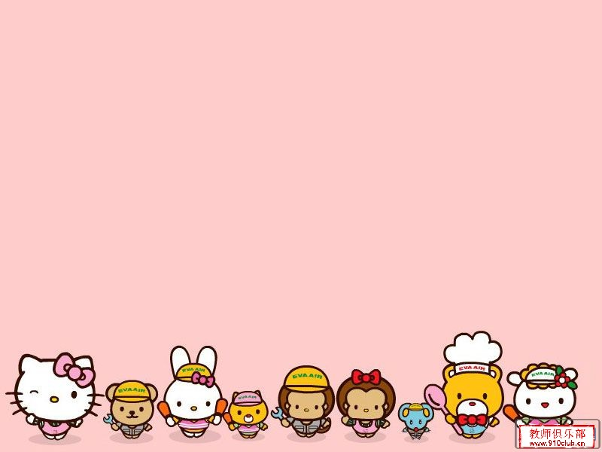
代词的用法

Slide 2
一、代词的定义和种类
定义：代词是代替名词，形容词和数词的词。它具有名词，形容词的功能。在句中作主语，宾语，表语和定语。

Slide 3



一.人称代词
二.物主代词
代词的种类
三.反身代词
四.指示代词
五.不定代词
六.疑问代词
七.连接代词
八.关系代词

Slide 4

人称、物主、反身、指示、疑问

Slide 5

一.人称代词
数
单数
复数
格
人称
主格
宾格
主格
宾格
第一人称
I
me
we
us
第二人称
you
you
you
you
he
him
第三人称
they
them
she
her
it
it
用法口诀： 人称代词分两格，主格宾格来分说；
主格定把主语作，宾格作宾不会错。

Slide 6
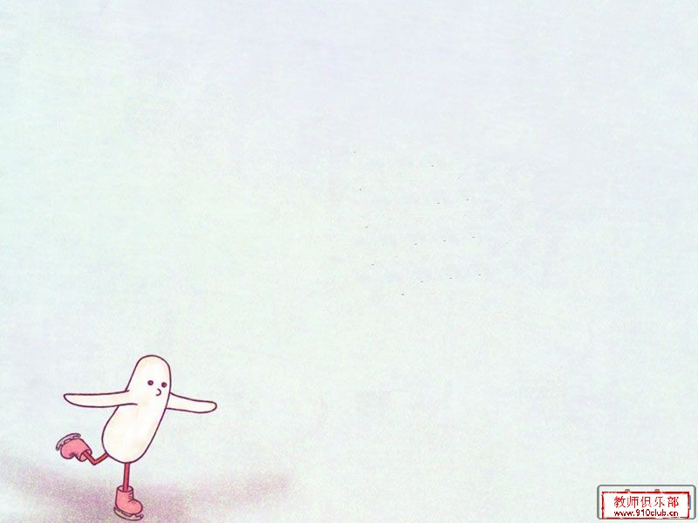
一.人称代词
1、单数你他我，复数一二三，道歉我为先.
1.我、你、他、都18岁。__________________
2.你们、我们、他们都来自中国。
______________________________.
You, he and I are 18.
We, you and they are from China
2、在简短对话中，当人称代词单独使用或在not 后多用宾格.作表语，也用宾格。
— I like English. — _____ too.
A. I B. He C. Me

Slide 7

1. — Who broke the window?
— Not _____.
A. I B. he C. her
2. Miss Li invited __ have dinner with her .
A. me and you
B. you and I
C. you and me
3. Who taught _____ English last term?
A. them B. their C. they

Slide 8

二.物主代词
人称 分类 | 第一人称 |  | 第二人称 |  | 第三人称
 | 单数 | 复数 | 单数 | 复数 | 单数 |  |  | 复数
形容词性
名词性
my
our
your
your
his
her
its
their
mine
ours
yours
yours
his
hers
its
theirs
用法口诀：物主代词两类型，形容词性、名词性。
形容词性作定语，后面定把名词用。
名词性、独立用，主宾表语它都充。

Slide 9
二.物主代词
形容词性物主代词相当于形容词。在句中作定语修饰名词。
I like my job.
形容词性物主代词与own连用表示强调。
This is my own house.
名词性物主代词相当于名词，不能用于名词之前。
This is your book. Where is mine？
“of+名词性物主代词”构成双重属格。
A friend of mine will come here next week.

Slide 10
1. She is a friend of ________.
A. my B. mine C. I
2. This isn’t my pen ,it is _____.
A. her B. his C. him
3. Frank can’t find ____ dictionary . Can you lend ____ to _____?
A. her , mine , her
B. / , yours , he
C. his , yours , him

Slide 11
4. ____ school is much bigger than ____.
A. Our , their
B. Ours , theirs
C. Our , theirs
5. The dog is so poor because ____ leg is badly hurt .
A. it B. its C. it’s

Slide 12

三.反身代词
人称 分类 | 第一人称 | 第二人称 | 第三人称
单 数
复 数
myself
yourself
himself
herself
itself
ourselves
yourselves
themselves
用法口诀：反身代词表自身，句中可作两成分。
表示强调同位语，宾语动作回自身。

Slide 13
三.反身代词
2. 反身代词常见固定搭配
过得愉快
自学
请随便吃…
自言自语
独自
为自己
不要客气
陶醉／沉浸于
自己穿衣服
照顾自己
enjoy oneself
learn by / teach oneself
help oneself to sth.
say to oneself
by oneself
for oneself
make oneself at home
lose oneself in…
dress oneself
look after oneself

Slide 14

The man is rich , he can buy ___ a lot of things .
A. he B. his C. himself
2. --- What a lovely card ! Where did you buy it?
--- I made it by _____.
A. me B. myself C. itself
3. “Help ____ to some chicken ,”my mother said to the guests.
A. yourself B. yourselves C. your

Slide 15
四.指示代词
this,that,these,those
时空的差别 this/these指在时间或空间上较近的事物或人,that/those指在时间或空间上较近的事物或人.
This is a pen and that is a pencil．
We are busy these days．
In those days the workers had a hard time．
行文叙述上的差别。
this/these指代下文要讲到的人或事
that/those指代前面讲到的人或事
I shall say this to you: he is a poor man.
He was ill. That’s why he didn’t come.
打电话时this 表示我,that表示你.
Hello! This is Mary. Is that Jack speaking?

Slide 16

四.疑问代词
疑问代词有who(指人,谁)，whom，whose（指人，谁的），what(指事，什么)和which(指人、事均可，哪一个)等。疑问代词用于特殊疑问句中，一般都放在句首，并在句子中作为某一句子成分。
Who is going to come here tomorrow? （作主语）
What is that? (作表语)
Whose umbrella is this? (作定语)
Whom are you waiting for? (作宾语)

Slide 17
不定代词的用法

Slide 18
五、不定代词及其用法
1.定义：不指明所代替的名词或形容词的代词叫做不定代词，不定代词可分为：
every-,some-,any-,no-和-one,-body,-thing构成的复合代词。
some, any， many, much, each, neither, other, another, all, both, one, none, either,a few,few,a little,little…等
2.不定代词在使用中的注意点：
由every-,some-,any-,no-和-one,-body,-thing构成的复合代词通常只看做单数形式，其谓语要用单数。
Somebody is waiting for you at the school gate.
Something,anything,nothing和形容词连用时，形容词要放在他们的后面。
Something important/anything interesting/nothing funny

Slide 19
一些重要的不定代词的用法
some, any
some — 肯定句
any — 否定句/ 疑问句/ 条件句
some 也可以用于疑问句中表示请求、建议，希望得到肯定答复。
Would you like ______ coffee?
some
不定代词（something ,anyone…）+ 形容词

Slide 20

some, any
当some修饰的可数名词是单数时，some 表示 “某个” 的意思。
I have read that in some magazine.
any 用于肯定句中有 “任何一个” 解。
Tom runs faster than any other boy in his class.

Slide 21
1. Do you have _____ to do this evening?
A. important something
B. anything important
C. something important
2. _____ is watching TV . Let’s turn it off .
A . Somebody B. Anybody C. Nobody
3. Would you like ___? I can get it for you .
A. something else
B. anything else
C. everything else

Slide 22
other, the other, another, others, the others
代名词 |  | 形容词
单数 | 复数 | 单数 | 复数
another 另一个 | others 别人，其他人 | another (boy) 另一个（男孩） | other (boys) 其他男孩
the other 另一个 | the others 其余那些人、物 | the other (boy) 另一个男孩 | the other (boys) 其余那些男孩
1.antoher 表示“又一个，另一个，再一个”，泛指众多中的一个，可单独使用或接单数可数名词，其前面不加定冠词。
I'm still hungry after I've had this cake. Please give me another.
You can see another ship in the sea, can't you?
2.antoher用在复数名词前，表示“再，又”，相当于more。
If you give me another five minutes,I’ll finish the work.
3.the other 表示“两者中的另一个”，常与one搭配构成“one ..., the other ...”句型。
He has two brothers. One is 10 years old , the other is 5 years old.

Slide 23
other, the other, another, others, the others
4. “the others”表示特指某范围内的“其他的人或物”。是复数的特指。the others=the other+名词复数
In our class only Tom is English, the others are Chinese.
5.others表示“别人，其他人”，是复数的泛指，others=other+名词复数
In the park some are playing games. Others are walking near the river.

Slide 24
the other others
the others another
① Tom and Mary have arrived, but __ in your class aren't here yet.
A. the others B. others C. the other
② One of the sides of the road should be painted yellow, and___ white.
A. the other B．another C. others
③ This pair of trousers is too short. Would you please show me ___ one.
A. other B. others C. another

Slide 25
④ I have two brothers. __ is a doctor, __ is a soldier.
A. One, the other B. One, other
C. The one, the other
⑤ Some of the students are playing on the playground. But where’re ______?
A. the other B.others C.the others
⑥ --- Is this your sock ?
--- Yes, it is . Where is _?
A. another B. the other one C. others
⑦ We got home by 4 o’clock ,but ___ didn’t get back until 8 o’clock.
A. the other B. others
C. the others

Slide 26
each, every
不定代词 | 含义 | 数量关系 | 作定语时名词的数 | 作主语时动词的数
each | 每一个 | ≥2 | 单数 | 单数
every | 每一个 | ≥3 | 单数 | 单数
each：1)可单独使用，2)可做代名词、形容词，
3)着重“个别”， 4)用于两者或两者以上中的每一个人或物。
every：1)不可单独使用，2)仅作形容词，
3)着重“全体”，毫无例外，4)用于三者或三者以上每一个人或物。
当我们说each child, each student或each teacher时，我们想到的是一个人的情况。而当我们说every child和every student时，我们想到的是全体的情况，every的意思与all接近，表示他们都如此。
Each ball has a different colour.
Every child likes playing. = All children like playing.
注意：我们可以用each of …, 而不能用 every of …如：Each of you can have a rest.
every other … 每隔… every other day 每隔一天 = every two days

Slide 27
① I gave them __ an apple.
A. every B. each C. each of
② There is a line of trees on ___ side of the street.
A．every B．each C．both
③ She goes shopping __ five days.
A. every B. each C. each of
④ 他隔天来这里。 He came here __________ day.
every other

Slide 28
neither, either, both
不定代词 | 含义 | 数量关系 | 作定语时名词的数 | 作主语时动词的数
either | 两者中的任何一个 | =2 | 单数 | 单数
neither | 两者都不 | =2 | 单数 | 单数
both | 两者都 | =2 | 复数 | 复数
either of 两者之一 | + 复数名词 / them / us | 谓单
neither of 两者都不 |  | 谓单
both of 两者都 |  | 谓复

Slide 29
either neither both
① ___ of the girls ___ him. They asked him for name card.
A. Neither; know
B. Either; know
C. Neither; knows
② Both of his parents ___ teachers.
A. is B. are C. was
③ Both of his brothers ___ in this hospital, but neither of them ___ a doctor.
A. works; is B. work; is C. work; are

Slide 30
either neither both
either …or … 或者…或者… | 就近原则
neither …nor … 两者都不
both …and … 两者都 | 复数谓语
① Either Tom or the twins __ the way to the shop.
A. know B. knows C. finds
② Neither you nor I ___ a scientist.
A. is B. are C. am
③ Both Tom and Mary ___ hard.
A. studies B. study C. studying

Slide 31
The students are all from Foshan . They ___ like their city .
A. both B. all C. either
Lucy and Lily ___ agree with us.
A. all B. both C. neither
How are your parents ? They are ____ fine.
A. both B. all C. no

Slide 32
either | 否定句末 “也”
neither | 倒装句表否定 neither + 助动词 / be / 情态动词 + 主语
both | 助动词 / be / 情态动词 + both both + 行为动词
① I didn’t see it, ___.
A. too B. as well C. either
② He couldn’t open the door. _______.
A. Neither could I B. So could I
C. Neither couldn’t I
They__ in good health, and they___ there.
A. are both; will both go
B. both are; will go both
C. are both; both goes

Slide 33
none, no one, nothing
none | no one | nothing
没有什么人 / 物 | “没有人” 只能指人 | 没有东西，只能指物
回答 how many/much 问句 | 回答who问句 | 回答what的问句
none of + 复数名词 / them 谓语用单数
How many people are there in the room? — ___.
A. None B. No one C. Lucy
② Who is in the room? — ___.
A. None B. No one C. one
③ None of them ___ China.
A. come from B. is from C. is come from

Slide 34
little, a little, few, a few
 | 肯定 | 否定
可数 | a few | few
不可数 | a little | little
当前面由only 修饰，常用 a few 或a little .
a little 可表示“有点，稍微”

Slide 35
Although all the girls have tried their best , only ___ pass the exam.
A. few B. a few C. a little
2. Don’t worry .There is ____ time left .
A. little B. a little C. few
3. You are so great! ____ people in the school can do it .
A. A little B. Little C. Few

Slide 36
人称代词It的用法

Slide 37
it在英语语法中属人称代词，意思是“它”。
用于指人以外的一切生物、无生命的东西和事情。它的作用即可作指示代词，又可作形式主语和形式宾语等。

Slide 38
一、用来指代前文中已经提到过的事物。如：
1.He bought a new book and lent it to me. 他买了一本新书并把它借给了我。
2.—Where is your bag?
—It’s on the chair.
你的书包在哪里？
它在椅子上。

Slide 39
The doctor advised strongly that she should take a holiday, but ____ didn't help.
A. it B. she C. which D. he
It 指代前文中的事情。
解析

Slide 40
二、用来表示时间、距离、天气等。
1．表示时间。如：
—What time is it？几点钟？
—It's ten．十点钟。
2．表示距离。如：
It's half an hour's walk from my
home to the school．从我家到学校步行得花半小时时间。
3. 表示天气。如：
It is very cold today.今天很冷。

Slide 41
（ ）4.______ five years since I left that town.
That’s B. They’re C. The time’s D. It’s
（ ）5.___about ten minutes’ walk from my home to the factory.
A. The way is B. It’s C. The road D. That’s

Slide 42
三、指代性别不详的婴幼儿或在不清楚对象性别时，也可用it来指人。如：
The child smiled when it saw its mother．这小孩一见到母亲就笑了。
I don‘t know who it is．
我不知道他是谁。

Slide 43
（ ）3.—Who’s that baby in the photo?
— _____ me. I was only two years old that year.
A. That’s B. It’s C. I’m D. The baby’s

Slide 44
指代说话者心目中不太清楚的那个人，常在打电话或敲门时用。如：
—Who was it？是谁（打来的电话）？
—Was it Susan？（打电话的）是苏珊吗？
—Yes，it was．是的，我是。

Slide 45
（ ）1.—Who’s knocking at the door?
— I don’t know. Maybe ___ is my uncle.
A.he B. that man C. it D. She

Slide 46
四、作形式主语，用来代替后面真正的主语。经常用在如下句型中：
It is+形容词+that……
It is +形容词（描述事件的形容词）+for sb to do sth.
It is +形容词（描述人的形容词） +of sb to do sth.

Slide 47
It is+形容词+that……
It is certain that he will get on well with them.
他将会与他们相处愉快这一点是确定的。

Slide 48
It is +形容词（描述事件的形容词）+for sb to do sth.
It is important for us to learn English well. 把英语学好对我们很重要。

Slide 49
It is +形容词（描述人的形容词） +of sb to do sth.
It is kind of you to help me with my English. 感谢你帮我学英语。

Slide 50
该句型中的形容词通常是表示事物的特点或特征的如difficult，hard，easy，impossible，necessary，important等，此时用for；
表示人的性格特征或特点的如nice，good，bad，kind，silly，foolish，wise，clever， careless，rude，brave，cruel，careful， grateful等，这时要用 of。

Slide 51
（ ）2.—I have only two dollars with me.
— Oh, ____ enough to buy this book.
A. it’s B. that’s C. you’re D. they’re

Slide 52
五、作形式宾语，用来代替后面真正的宾语。经常用在如下句型中：
I think it easy to learn English well.
我觉得学好英语很简单。
I find it a waste spending so much time on TV. 我发现在电视上花太多时间是很浪费的。
I made it clear that he had nothing to do with the matter. 我弄清楚了他和这件事没关系。

Slide 53
1. The fact that she was foreign made_____difficult for her to get a job in that country.
A.so B.much C.that D.it

Slide 54
2. ____ is known to us that the earth is round.
A.As B.It C.Which D.That

Slide 55
3.I’d appreciate _____ if you would like to teach me how to use the computer.
A.that B.it C.this D.you

Slide 56
4. I don’t think _____ possible to master a foreign language without much memory work.
A.this B.that C.its D.it

Slide 57
5. _____ is a fact that English is being accepted as an international language.
A.There B.This C.That D.It

Slide 58
I don't think ___ possible to master a foreign language without much memory work.
A. this B. that C. its D. it

Slide 59
The chairman thought ___________necessary to invite Professor Smith to speak at the meeting.
A. that B. it C . this D. him

Slide 60
6. I don‘t like working late into the night， but I can’t help _____.
A. so B. that C. it D. them.
解析
I can’t help it. 为习惯用法，意思是“我实在控制不住”，“这不能怪我”。全句意思是“我不想熬夜，但我控制不住自己。

Slide 61
小结：固定句型
1. 做某事情对某人来说是…
It is + adj. (+for sb.) +to do sth.
2. 轮到某人做…
It’s one’s turn to do sth.
3. 是（某人）做某事的时候了
It’s time (for sb.) to do sth.
4. 据说… It’s said that …

Slide 62

5. 某人花费…做某事
It takes sb. some time to do sth.
6. 自从…以来，已经有…（时间）了。
It is / has been + 时段 + since + 从句(过去时)
7. 某人发现/认为/感觉到做某事是…的
find
sb. think
feel
+ it + adj. + to do

Slide 63
I found ___ very difficult to make progress in my study .
A. it’s B. it C. that
2. It __ my father a whole month to go on business .
A. spent B. cost C. took
3. It is great fun __ surfing on the Internet .
A. go B. to go C. going

Slide 64


THE END

