Slide 1
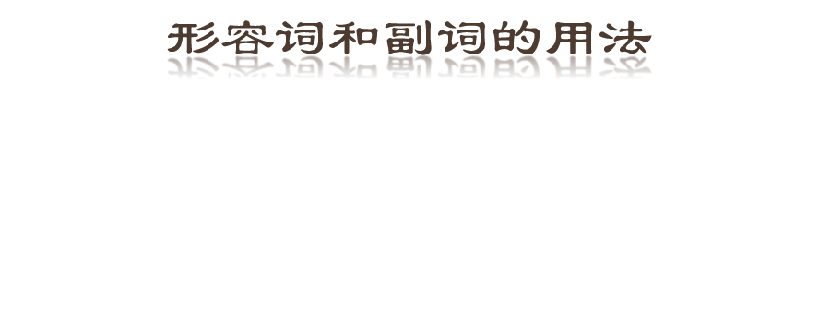

Slide 2
形容词(adj.)用来修饰名词或代词， 表示人或事物的性质、状态和特征。

Slide 3
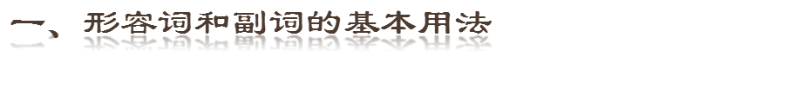
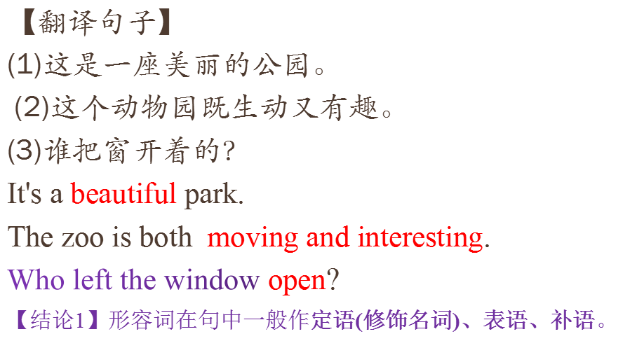

Slide 4

常用系动词(后面直接加形容词)
1. 状态系动词：be
2.持续系动词: keep, remain, stay, lie, stand
3.表像系动词:seem, appear, look
4.感官系动词:feel, smell, sound, taste
5.变化系动词:become, grow, turn, fall, get, go, come, run.
6.终止系动词:prove, turn out

Slide 5
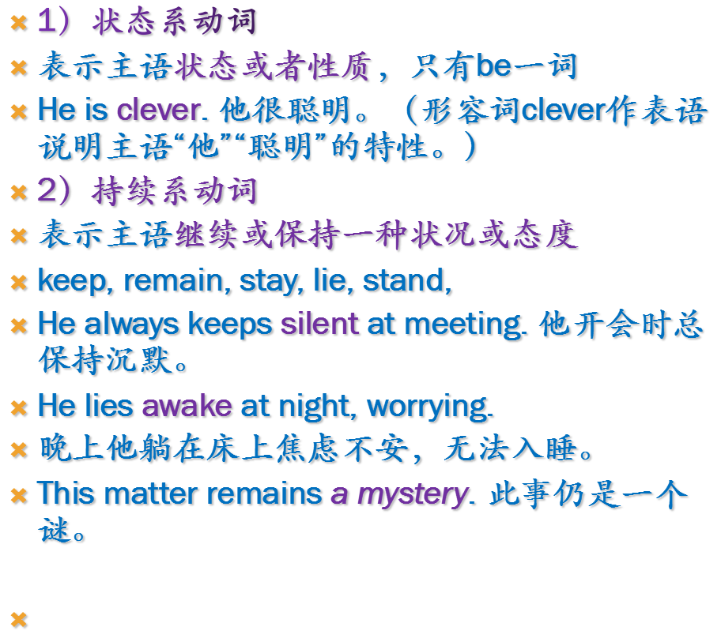


Slide 6
3）表像系动词
表示"看起来像"这一概念，seem, appear, look, 例如：
He looks tired. 他看起来很累。
He seems (to be) very sad. 他看起来很伤心。
4）感官系动词
feel, smell, sound, taste
This kind of cloth feels very soft.
这种布摸起来很软。
This flower smells very sweet.
这朵花闻起来很香。

Slide 7
5）变化系动词
表示主语变成什么样：become, grow, turn, fall, get, go, come, run.
He became mad after that. 自那之后，他疯了。
She grew rich within a short time. 她没多长时间就富了。
6）终止系动词
表示主语已终止动作：prove, turn out, 表达"证实"，"变成"之意
The rumor proved false. 这谣言证实有假。
His plan turned out a success. 他的计划终于成功了。（turn out表终止性结果）

Slide 8

make / keep/ leave/ drive/find/feel/consider/think ( it) +adj
make me happy / make the room dirty
keep the desk tidy
leave the door open
I consider him honest.
He thinks it unnecessary to learn English.

Slide 9

定语形容词
表语形容词
以-ly 结尾的形容词
复合形容词

Slide 10
latter, little, many, live, lonely, main, only, real, inner, outer, wooden, elder
the latter one, a little boy, many students, the only one, a wooden box ...

Slide 11

ill, well, sure, unable, worth, drunk, glad, content, sorry
afraid, alike, awake, alone, alive, asleep, ashamed,
修饰这类形容词一般不用very，而用much或其他副词，（ill, well除外）
much afraid, fast / sound asleep
wide awake, well worth (doing)

Slide 12
以-ly 结尾的形容词
elderly, lively, lovely, orderly, silly, ugly, smelly, deadly
friendly, motherly, manly, comradely
monthly, timely, daily, newly, weekly

Slide 13
难得的，来之不易的
ten-year, two-man
life-long, world-famous,
red-hot(炽热的), dark-blue
tired-looking, ordinary-looking
hard-working, fast-moving
peace-loving, kite-flying,
mouth-watering(令人垂涎的； 非常好吃的)
kind-hearted
hard-won(难得的，来之不易的 ), newly-made
snow-covered, hand-made; four-storeyed,
three-legged(有三条腿的，三脚的 )

Slide 14

表示情感类的过去分词表示心理状态，而现在分词则表示性质，令人……

Slide 15
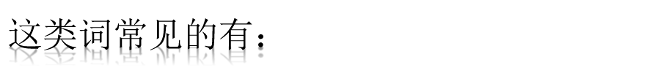
exciting令人激动的
excited感到激动的
delighting令人高兴的
delighted感到高兴的
disappointing令人失望的
disappointed感到失望的
encouraging令人鼓舞的
encouraged感到鼓舞的

Slide 16
pleasing令人愉快的
pleased感到愉快的
puzzling令人费解的
puzzled感到费解的
satisfying令人满意的
satisfied感到满意的
surprising令人惊异的
surprised感到惊异的
worrying令人担心的
worried感到担心的

Slide 17
如果两个以上的形容词修饰一个名词时，与被修饰的名词关系较密切的形容词靠近名词；如果几个形容词的密切程度差不多，则音节少的形容词在前，音节多的在后。
a small beautiful room。

Slide 18
常用的顺序为：
限定词(those) + 数量形容词(three) + 描绘性形容词(beautiful) + 大小、长短、高低等形体性形容词(large) + 新旧(old) + 颜色(brown) + 国籍 + 材料(wood) + 被修饰名词(table)

Slide 19
方法:美小圆旧黄，中国木书房
a nice small round old yellow Chinese wooden reading room.
美代表描述或性质类；小代表大小、长短、高低、胖瘦类；圆代表形状类；旧代表新旧、年龄类形容词；黄代表颜色类；中国代表来源、国籍、地区、出处类；木代表“物质、材料、质地类形容词；书代表用途、类别、功能、作用类；房代表中心名词。

Slide 20

【完成例句】
(7)今天的报纸没有什么新的东西。
There is nothing new in today's newspaper.
(8)人民，只有人民，才是创造历史的动力。
The people, and the people alone, are the motive force in the making of world history.
(9)你还知道别的什么？
What else do you know?

Slide 21
(10)你认识那个肩上扛一袋米的人吗？
Do you know the man carrying a bag full of rice on his back?
【结论】形容词一般都作前置定语，但在下列情况作后置定语：

Slide 22
1.由 some, any, no, every 构成的复合不定代词的修饰语要后置．如：
something new; nothing serious; anything interesting
2.else 修饰不定代词和疑问代词时，要后置。如：
Nobody else is so silly as you are.
3.不定式短语，动名词短语，分词短语，介词短语做定 语要后置。
如：eg: Do you still remember the afternoon in the first year at college when the professor gave us a chemistry lesson?

Slide 23
4.以 a- 开头的形容词做定语要后置．如：alike, alive, alone, asleep, afraid, awake… 如：
Eg. He is the only man awake at that time.
5.以下词只做后置定语： present (在场的，出席的), involved (有关的), concerned (相关的), left (剩下的), objecting (反对的), mentioned (提及的), selected (当选的)等。
Eg. the students present (出席的学生)
Eg. the cost involved (所需费用)

Slide 24
副词(adv.)是一种用来修饰动词、 形容词、全句的词，说明时间、地点、程度、方式等概念的词。

Slide 25
【完成例句】
(4)你是完全对的。
(5)他昨晚很晚才睡觉。
(6)幸运的是，我没有被撞倒。
You are completely right.
He went to bed late last night.
Luckily, I was not knocked down.
【结论2】副词在句中主要作状语，用来修饰形容词、副词、动词和句子。

Slide 26
一．副词的种类
时间副词 | now, today, recently, late, soon, yet等。
频率副词 | often, always, usually, seldom, frequently等。
地点、方向副词 | away, abroad, anywhere, downstairs, home, here, there等。
方式副词 | clearly, carefully, alone, high, quickly等。
程度副词 | almost, a little, much, very, rather, quite, fairly, deeply等。
疑问连接副词 | when, where, why, how等。
否定副词 | not, hardly, scarcely, rarely, never等。
其他副词 | even, also, only, too, perhaps等。

Slide 27
二、副词的位置
【完成例句】
(14)这本书是很有趣的。
This book is quite interesting.
(15)这男孩已够大，可以上学了。
【结论1】 The boy is old enough to go to school. 副词修饰形容词和副词时，应放在被修饰的词之前，但enough, nearby必须置于其后。

Slide 28
【完成例句】
(16)他总是乐于助人。
He is always ready to help others.
(17)我永远也忘不了那天。
I will never forget that day.
【结论2】频率副词(always, often, usually, never, seldom, hardly, sometimes等)要放在实义动词之前，be动词、助动词、情态动词之后。

Slide 29
【完成例句】
(18)幸运的是，他没有被淹死而是被解放军救了起来。
Fortunately, he was not drowned and was saved by the PLA men.
(19)对她来说，她的继母对她很慈善。
Happily for her, her stepmother was kind to her.
【结论3】修饰全句的副词多置于句首，作评注性状语(即发表评论或表明看法的状语)。

Slide 30
1．多个副词同时出现时的顺序
(1)、方式副词→地点副词→时间副词
Eg: She sat quietly in the room for an hour
(2)、在表示动作的动词后面，地点副词或状语通常置于副词前面。
They went to school hurriedly after launch
(3)小的时间/地点→大的时间/地点
  Come to see me at 3 o‘clock in the afternoon.

