Slide 1
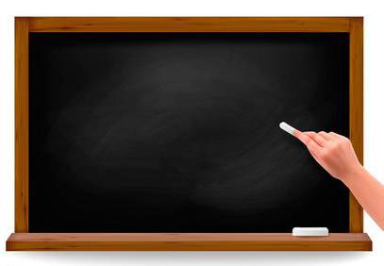
形容词和副词的比较级和最高级

Slide 2

形容词和副词的比较等级
一、形容词和副词比较等级的构成
1. 形容词的比较级和最高级
单音节词和少数双音节词, 一般在词尾加­er, ­est来构成比较级和最高级。
构成法 | 原级 | 比较级 | 最高级
单音节词和少数双音节词一般在词尾加­er, ­est | tall cheap | taller cheaper | tallest cheapest
以不发音的e结尾的单音节词只加­r, ­st | nice large | nicer larger | nicest largest

Slide 3
以一个辅音字母结尾的重读闭音节词, 双写结尾的辅音字母, 再加­er, ­est | big thin | bigger thinner | biggest thinnest
以辅音字母加y结尾的双音节词, 变y为i, 再加­er, ­est | busy angry | busier angrier | busiest angriest
少数以­er, ­ow结尾的双音节词末尾加­er, ­est | clever narrow | cleverer narrower | cleverest narrowest
部分双音节词和多音节词, 在其前加more, most来构成比较级和最高级 | important | more important | most important

Slide 4
注意:
有些形容词的比较级和最高级可采用在词尾加­er和­est的形式, 也可采用在单词前加more和most的形式, 这类形容词有clear, common, cruel, free, handsome, lively, often, pleasant, polite, pretty, quiet, secure, solid, stupid等。

Slide 5
2. 副词的比较级和最高级
1) 大多数以­ly结尾的副词在其前加more和most来构成比较级和最高级。如：
quickly—more quickly—most quickly
carefully—more carefully—most carefully
2) 单音节词及少数双音节词在词尾加­er构成比较级, 加­est构成最高级。如：
hard—harder—hardest
fast—faster—fastest
early—earlier—earliest

Slide 6
3. 几个特殊的形容词和副词的比较级和最高级
原级 | 比较级 | 最高级
good, well | better | best
bad, ill, badly | worse | worst
many, much | more | most
little | less | least
far | farther, further | farthest, furthest
old | older, elder | oldest, eldest

Slide 7
二、形容词原级的常用句型
1. as＋形容词/副词＋as （与….一样）如:
Tom is as tall as Mike.
Tom is three times as old as Mike.
There are as many students in your school as yours.

Slide 8
否定 ：not as+形容词原形+as,表示“和…不一样”
或 not so +形容词原形+as,表示“不及，不如…..”
Tom is not as tall as Mike.
Tom is not so tall as Mike

Slide 9
“as＋形容词＋a(n)＋单数名词＋as”或“as＋many/much＋名词＋as”。如:
This is as good an example as the other is.
I can carry as much paper as you can.
There are as many students in your class as in ours.

Slide 10

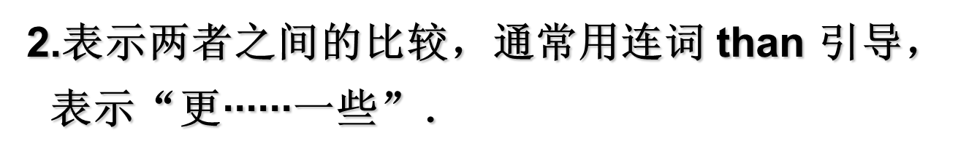
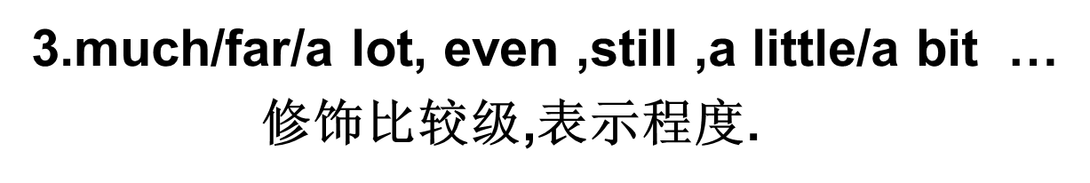
三、比较级的用法：
He runs faster than she.
He runs much faster than she.

Slide 11

4、the + 形容词的比较级 + …… + the +形容词的比较级
表示“ 越……，就越……”
The more you eat, the fatter you will be.
The harder you study, the more you will get.
The smaller the house is, the less it will cost.
The sooner, the better.
5、the + 形容词比较级 + of the two….短语 表示：两者中比较/更……的那一个。
She is the more careful of the two girls.
The bike is the older of the two.
His is the taller of the two.
This one is the more beautiful of the the two pictures.

Slide 12
倍数表达法的句式
6. 表示“……是……的几倍”倍数表达法主要有以下3种：
(1)A+动词+倍数＋as＋原级＋as+ B
(2) A+动词+倍数＋比较级＋than + B
(3) A+动词+倍数＋the size / length / weight / height of +B
【特别提醒】表示倍数的词始终在前面。

Slide 13
倍数表达法的句式
我们的新房子是旧房子的3倍大。
Our new house was three times as large as the old one.
＝Our new house was twice larger than the old one.
＝Our new house was three times the size of the old one.

Slide 14
7. more＋原级/名词＋than＋原级/名词, 意为“与其说是……不如说是……”。如:
He is more diligent than clever.
not so much as 与其说…不如说…
He is not so much a journalist as a writer.与其说他是个新闻工作者，不如说他是个作家。
2. He is not so much a writer as a reporter.他与其说是个作家，毋宁说是个记者。

Slide 15
8. “比较级＋and＋比较级”和“more and more＋多音节词原级”, 表示程度递增。这种结构后不可接than引导的从句。如:
Things are getting better and better.
She plays the piano more and more beautifully.

Slide 16
注意:
from bad to worse/worse and worse 越来越糟
make matters worse/what was worse/worse
than all/worse than ever 更糟的是
如:
Things are getting from bad to worse/worse
and worse.
The car broke down when I was driving home
from work, and to make matters worse it was
pouring with rain.

Slide 17
9. 如果比较对象不能相互包容时, 句型有:
any other+单数名词
all (the) other+复数名词
anyone else
any of the other+复数名词
the rest of+复数名词或不可数名词
比较级＋than＋
比其他任何…都….
(暗指: 最高级)

Slide 18
10. “no＋比较级＋than...”意为“都不”, 是对两者的共同否定, 侧重前者; “not＋比较级＋than...”意为“不及”, 表示前者不如后者, 隐含对两者的肯定, 侧重后者。如:
He is no taller than I.
My handwriting is not better than yours.

Slide 19
11. not/never＋比较级 “最……不过”。
在比较级前加上否定意义的词, 表达最高级的含义。如:
His work couldn’t be worse.
He has never spent a more worrying day.

Slide 20
12. “nothing/nobody...＋比较级＋than”意为“没有……更/最”。如:
Nothing is better than a hot drink on a cold winter day.

Slide 21
13. 以“or”结尾的形容词，构成比较级时，后面直接用“to”,常见的这类形容词有：superior, junior, senior, prior, inferior等。

Slide 22
四、最高级的用法：
1. the＋最高级＋of/in＋比较范围
最高级表示在一定范围内某事物或某人在性质、高低或大小等方面程度最高或最低。“……之中最……”, 用于三者或三者以上的比较。同类范畴用of, 不同类用in。
He talks (the) least and does (the) most in his class.
He is the fastest runner of the three boys.

Slide 23
2、one of the + 最高级 + 名词复数 + in/of “最……中之一”
Yaoming is one of the tallest basketball players in the world.

Slide 24
3、the + 序数词 + 最高级 + 名词 + in/of
The Yellow River is the second longest river in China
4、Which/Who is the + 最高级,A ,B or C ?
Which is the biggest , the moon, the earth or the sun ?
5、This is the + 最高级 + 名词 (that) I have ever seen/listened.
This is the most beautiful city that I have ever visited.

Slide 25
五、形容词和副词的比较等级的修饰语
1. almost, exactly, half, just, nearly, quite, twice, three times, a third time等用于原级之前, 表示程度。如:
He is almost as tall as his brother.
This line is twice as long as that one.

Slide 26
2. a bit, a little, rather, any, much/many, far, a great/good deal, a lot, still, even等用于比较级之前, 表示确定的程度。分数或有关长度、时间、重量等名词短语通常放在比较级前, 也可由by引出而置于比较级之后。如:
It’s a little colder today than it was yesterday.
This shirt is much more expensive than that one.
He is two years older than me.
＝He is older than me by two years.

Slide 27
注意:
① 修饰可数名词的比较级不用much, 而用many, 如many more books; 修饰不可数名词的比较级用much, 如much more work, “更多的工作”; much more necessary, “更有必要”。
② 除quite better外, quite不可修饰比较级。

Slide 28
3. by far, much, the first/second， almost, nearly, by no means用于形容词的最高级前。如:
The Yellow River is the second longest river in China.
This is by far the best.
This is much the most important.

Slide 29
注意：most用作副词时，有下面几种用法：
1. 常置于两个音节以上的形容词或副词之前，并与其一起构成该词的最高级形式。例如：
Which lesson is the most difficult in this book? 这本书里哪一课最难？
2. 表示“极”、“得”、“十分”、“非常”等意思，用来强调或加强语气，相当于very。在这种情况下，most前面不用定冠词the。例如：
That’s most kind of you. 你心肠真好。
We shall most certainly come. 我们一定来。
3. 表示“几乎”、“差不多”等意思，相当于almost / nearly。例如：
Most everybody talks about it.

Slide 30
六、比较级相关习语
more than
1. more than＋数词 多于, 超过
I have known him for more than twenty years.
我认识他已超过二十年了。
2. more than＋名词 不仅仅是
Hibernation is more than sleep.
冬眠不只是睡觉。
3. more than＋形容词 非常, 很
They were more than happy to see us come back from the expedition.
看到我们远征而归，他们异常高兴。

Slide 31
4. more than+动词，对动词起着加强语气的作用。
His progress in English learning more than encouraged him to learn the subject well.
在英语学习方面的进步激励他学好这门课程。
5. more than＋含有情态动词的从句有否定意义，表示“是……难以……”或“超过了……所能”之义。
The beauty of the mountainous country is more than I can describe.
我难以描述那个山村的美丽。

Slide 32
more A than B 与其说……倒不如说……
no more than(＝only) 仅仅, 只有
not more than(＝at most) 不超过, 至多

Slide 33
less than 不到……, 少于……
no less than(＝as much as) 多达, 不少于
not less than(＝at least) 至少
more or less(＝almost, nearly, about)
基本上, 差不多; 或多或少
sooner or later 迟早, 早晚, 总有一天
what‘s more 而且, 此外
no sooner...than... 一……就……

Slide 34


1. The environment in our hometown is _____ than it was before.
good B. worse
C. better D. bad
2. I can type _____ than I can write by hand.
A. fast B. much faster
C. more faster D. fastest

Slide 35
3. ---Have you decided which you’d like to buy, the black shirt or the yellow one?
---The black one. Because it is _______ of the two.
A. the nicer
B. the nicest
C. nicer

Slide 36
4. Lilei is _____ than any other _______ in his class.
A. tall, students
B. taller, students
C. taller, student.
比较级+any other + 单数名词.
“比其他任何……都……”.
(暗指: 最高级)

Slide 37

The Yellow River is _______ river in China.
A. the second longest
B. the second longer
C. second longest
the +序数词＋最高级
表示第几……

Slide 38
Remember
一者比较用原级，比较级限二者比，
三者三者往上比，最高级的用法起；
若甲乙程度相同，as…as 结构体；
若甲某方面不及乙， not so/as…as来担起；
中间形、副连接要切记！

Slide 39
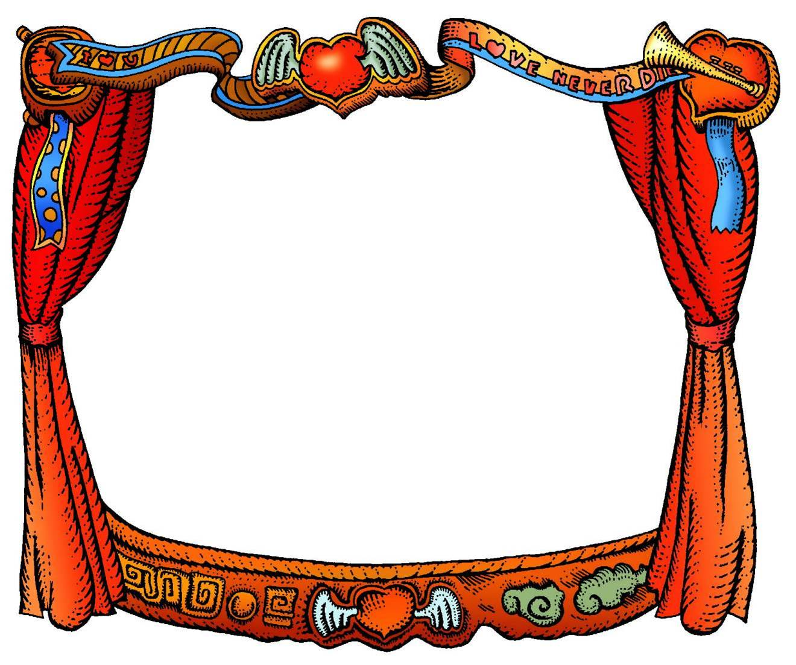
Good--bye

