Slide 1
Methodology

Slide 2
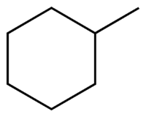
Representing Hotspot Environments
“Hydrogen bonds plus hydrophobic enclosure”
“Hydrophobic enclosure”
Use molecular probes that reflect hotspot environments

Slide 3
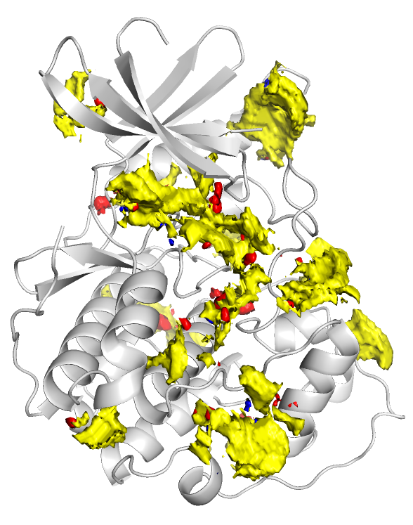
Atomic Propensities from SuperStar
SuperStar¹ is a grid-based method
Uses interaction data in the CSD
Generates atomic propensities
Red: Acceptor
Blue: Donor
Yellow: Hydrophobe
Reflects how likely a given atom will be found at that point
1. M. L. Verdonk, J. C. Cole and R. Taylor, J. Mol. Biol., 289, 1093-1108, 1999

Slide 4
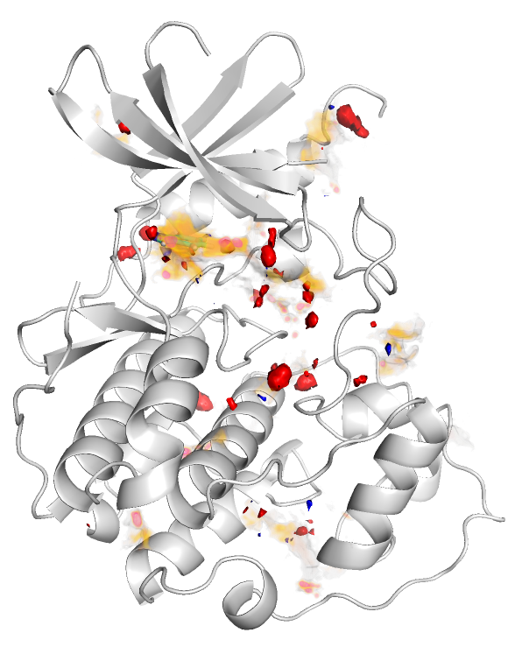
Introducing Enclosure
Multiply each propensity by the buriedness to represent enclosure
Buriedness calculated using LIGSITE¹
Weighted propensity
1. Hendlich, M.; Rippmann, F.; Barnickel, G. J. Mol. Graph. Model. 1997, 15 (6), 359–363, 389

Slide 5
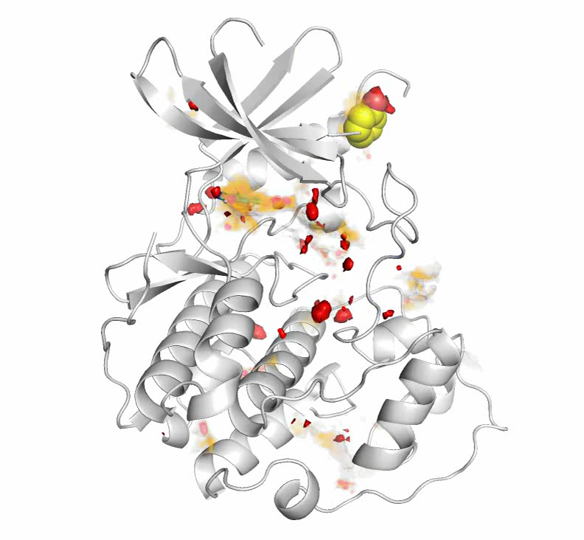
Sampling Example: Acceptor probe
Translate probe to high scoring acceptor grid points
3000 rotations
Probe score = Geometric mean of atom scores
55
15
19.7 = G.M
17
17
17
18
16

Slide 6
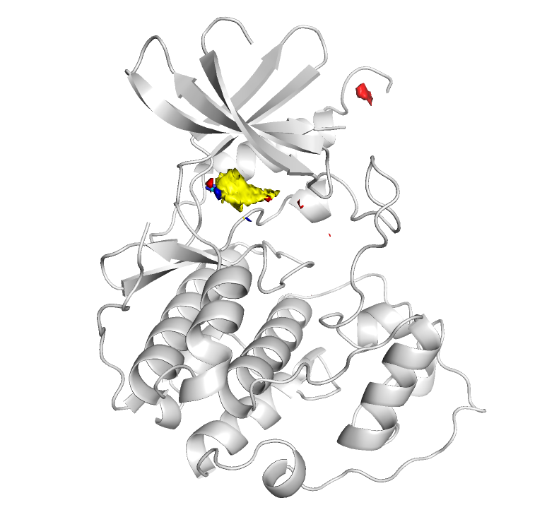
Creating Fragment Hotspot Maps
Probe scores assigned to a grid
High scoring regions:
High propensity for the polar atom (if applicable)
Environment is hydrophobic
Environment is enclosed
Probe size eliminates pockets too small for binding
5-10 minutes on a desktop

Slide 7
SuperStar Vs. Fragment Hotspot Maps

