Slide 1



Authoring a FieldPro Map
Josh Coleman & Travis Durrance

Slide 2

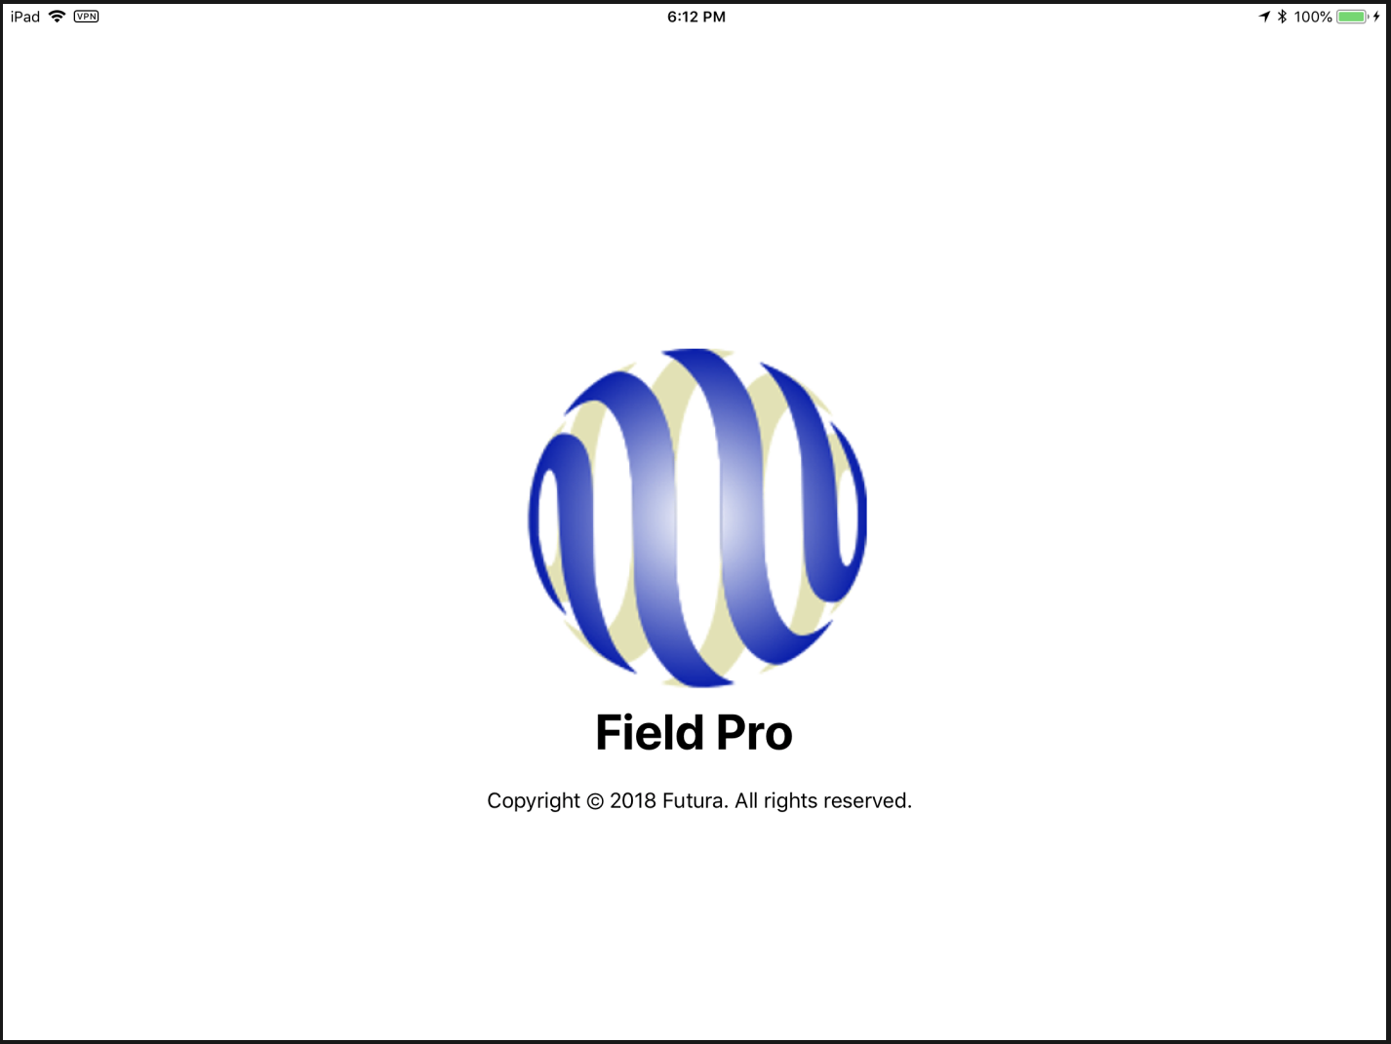
FieldPro Server Processes:
GIS
Staking
UPN
SDE (GIS & Inspection Data)
FieldPro Folder
Field Inspections .mxd
Field Inspection Feature Service
Server Utility
FieldPro Source FileGDB
Futura Copy
(iPad)
(iPhone)
FieldPro Export Task
FieldPro .mxd
IIS
Map Services
(AVL, etc.)
FieldPro Map Export (.geodatabase)
Geodatabase
Service

Slide 3
The .mxd: The driving force behind FieldPro
Electric Network / Components
(GIS Data)
Settings & Config Tables
FieldPro .mxd
GIS Data
Inspection Data
Settings & symbology
Tables
Asset & UPN Tables
LandBase
(GIS Data)

Slide 4
How to modify the existing FieldPro .mxd
Back up the current FieldPro .mxd & export file (.geodatabase) by creating a folder called FP_Backup & copying the files into it.
Make the desired changes to the FieldPro .mxd (applying the Do’s & Don’ts)
Export a new FieldPro .geodatabase file. Don’t forget to zoom to full extents & save before running the export.
Load the .geodatabase file onto your iPad & test it.
The new map will now be ready to download from the server.

Slide 5
FieldPro .mxd Creation – Do
Include all layers & tables you want to see in the map.
Fill out the map document properties. (At minimum: title, summary, description, & tags.)
Set data frame extent to automatic & specify a Custom Extent of with your full service area in it & with no clipping.
Set the coordinate system to WGS 1984 Web Mercator (auxiliary sphere), with a transformation of NAD_1983_To_WGS_1984_5.
Zoom to full extents & save before publishing.
Leave, at minimum, the following fields turned on when exporting: FuturaGUID (as well as any other GUIDs), MapNumber, ObjectID, PhaseCode, Enabled & Shape.

Slide 6
FieldPro .mxd Creation – Don’t
Don’t include layers from sources other than the FieldPro FileGDB.
Don’t include duplicate layers.
Don’t include relationship classes in the FieldPro FileGDB.
Don’t include feature extensions in the FieldPro FileGDB.
Don’t include joins or relates.
Don’t include layer name or field name aliases. (Must match source layer exactly)
No complex labelling. (No label expressions, only label on one field, & can’t label classes within one field differently)
No complex symbology. (Only symbolize on one field & only use Simple Marker & Character Marker symbols)
No event layers, Z values or M Values.
No null geometries. (No empty layers & no 0 length polylines or polygons)

Slide 7
How to update tables for FieldPro
Any time you make table changes, you will want to make them in the SDE.
Make a copy of the table in the SDE with a suffix of _Backup to have something to restore from if there are issues.
Any changes made will trickle down to FieldPro through the nightly export process, & will be available for download automatically after they have run.
If you need to see the changes more quickly, you will need to copy the table changes from the SDE to the FieldPro FileGDB & then run a manual export.

Slide 8
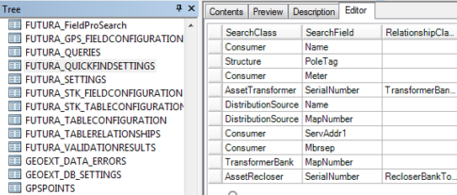
Quick find settings & ordering results
Use this table to set up FieldPro quick find searches
Example of proper quick find settings for FieldPro

Slide 9
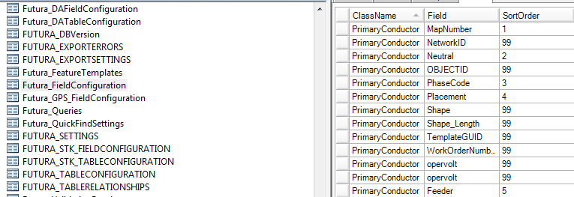
Ordering fields in the results tab
This is the SortOrder field used to order fields in the results tab. Type in values between 1 & 99 to set up the proper sort.
FieldPro uses this table to order fields in the results tab

Slide 10
How to create a new FieldPro .mxd
Download the existing FieldPro .mxd & FileGDB from the server to your local machine.
Rename the .mxd to whatever you want the export to be named (such as Contractor map, ROW map, etc…) with a _FP suffix.
Open the .mxd in ArcMap & source the renamed map to the FieldPro FileGDB by clicking the little red ! in the source tab & choosing the appropriate feature.
Make the desired changes to the FieldPro .mxd (applying the Do’s & Don’ts) & save.
Export a new FieldPro .geodatabase file.
Be sure to fill out the Rename As (Optional) VALUE on the first screen of the Create FieldPro Geodatabase dialog, or this map will replace your existing FieldPro map once you put it on the server.

Slide 11
How to create a new FieldPro .mxd (cont.)
Load the .geodatabase file onto your iPad & test it.
If it works & you are satisfied with the changes, upload the renamed .mxd & .geodatabase zip file onto the server in the FieldPro folder they came from.
The file should now be available to download on your iPad.
If you want to have the new map update automatically, you will need to get in contact with support at support@futuragis.com & set up a nightly or weekly Server Utility task. Otherwise, you will need to manually run the export periodically to update the GIS data.

Slide 12
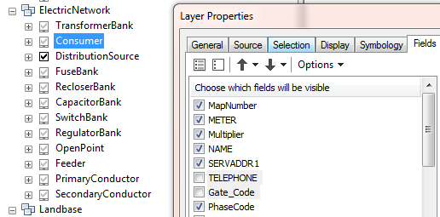
Turning off fields in the .mxd
Here we have unchecked sensitive data to exclude it from the new contractor FieldPro map, but left necessary data on.
Leave, at minimum, the following fields turned on when exporting: FuturaGUID (as well as any other GUIDs), MapNumber, ObjectID, PhaseCode, Enabled & Shape.

Slide 13

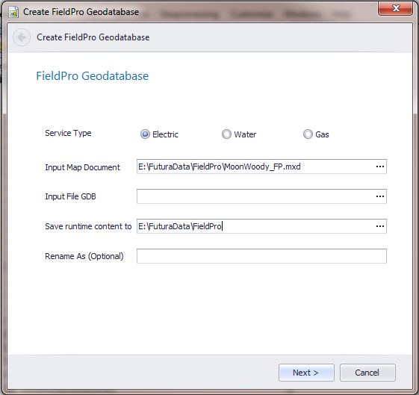
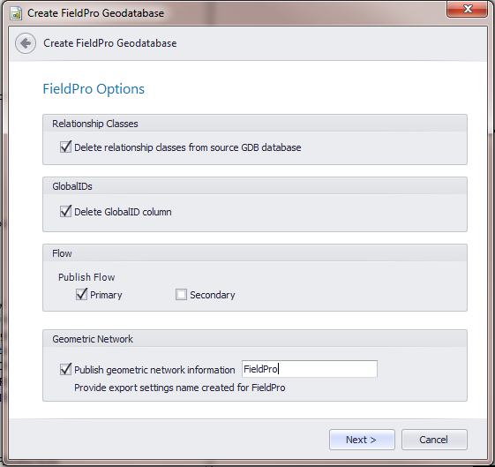
How to export the FieldPro map
1
2
3
Only if creating a new map

Slide 14
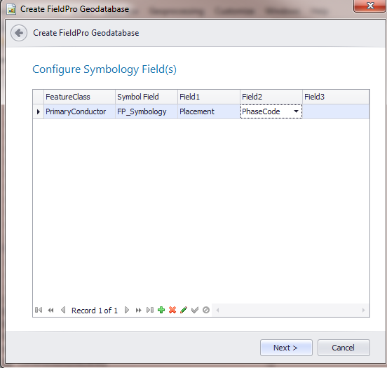
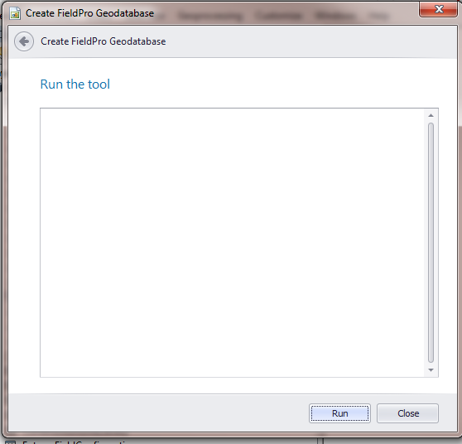
How to export the FieldPro map (cont.)
4
5

Slide 15


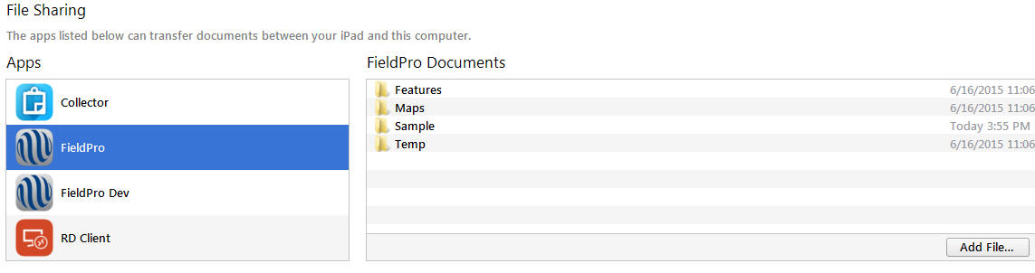
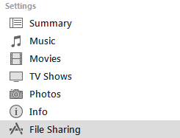
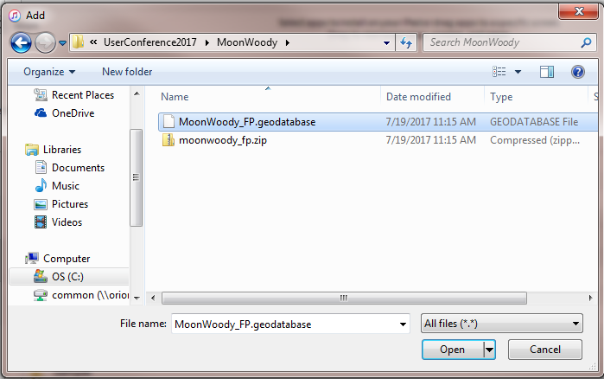
Loading the FieldPro .geodatabase via iTunes

Slide 16
What is a map service?
A map service makes maps, features, & attribute data available inside many types of client applications. Users can then use the map service in web applications such as Catalyst or FieldPro via the internet or intranet.

Slide 17
What can it be used for?
Inspections such as ROW, Poles, & Vegetation Management
Landbase data
Other utility data, such as water & gas information
IVR

Slide 18
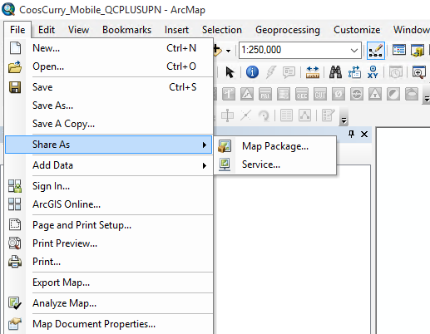
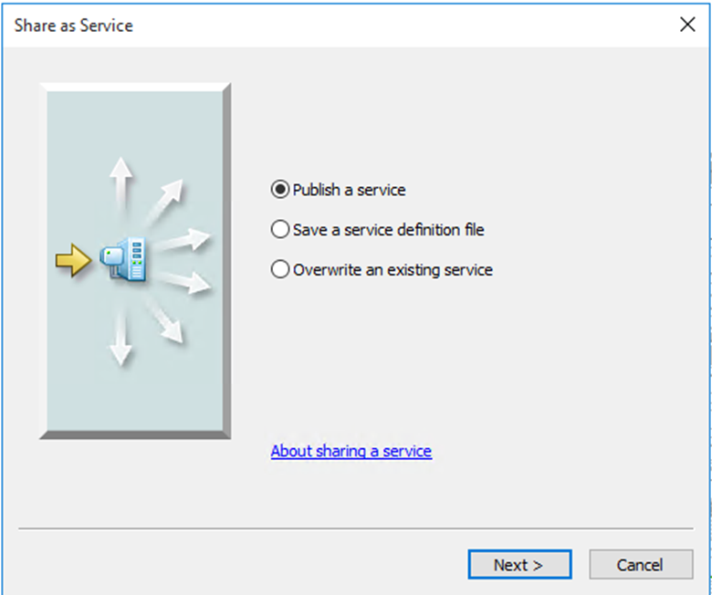
How to publish a mapping service for Futura Catalyst

Slide 19
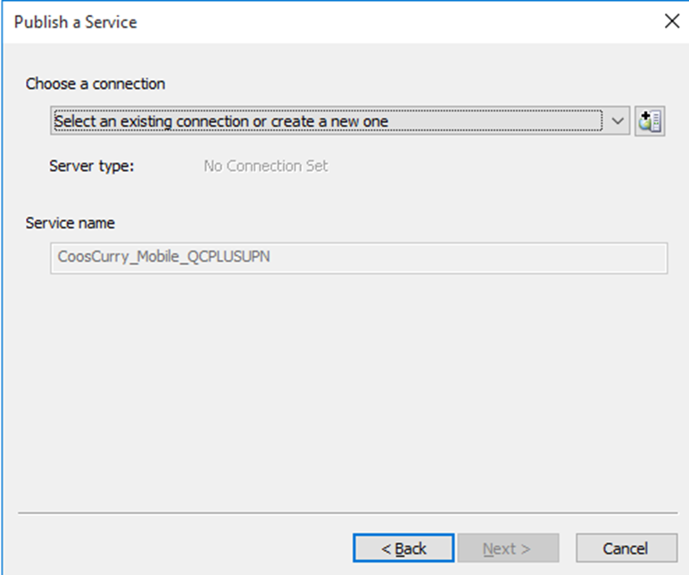
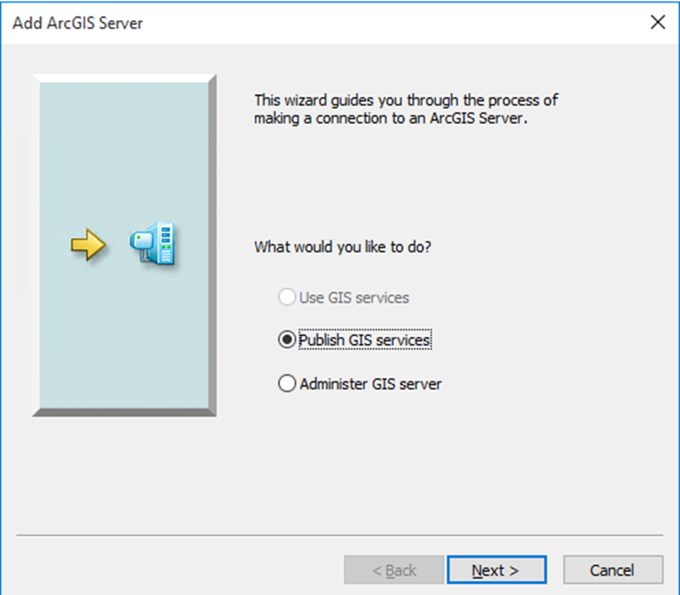
Creating a Map Service

Slide 20
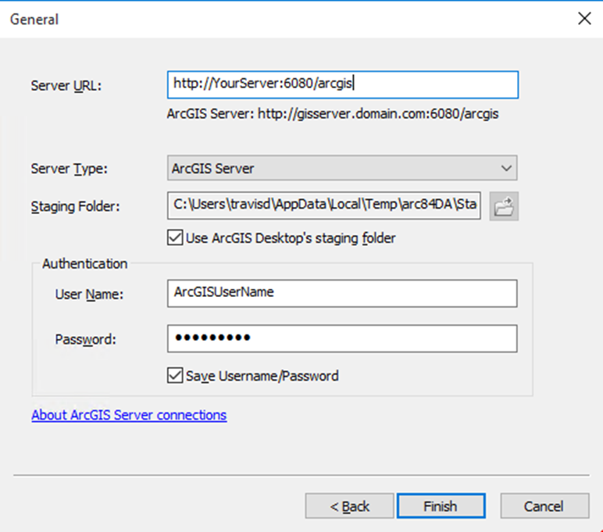
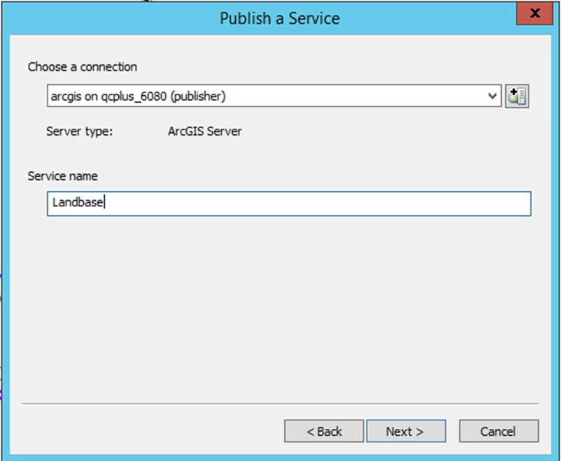
Creating a Map Service

Slide 21
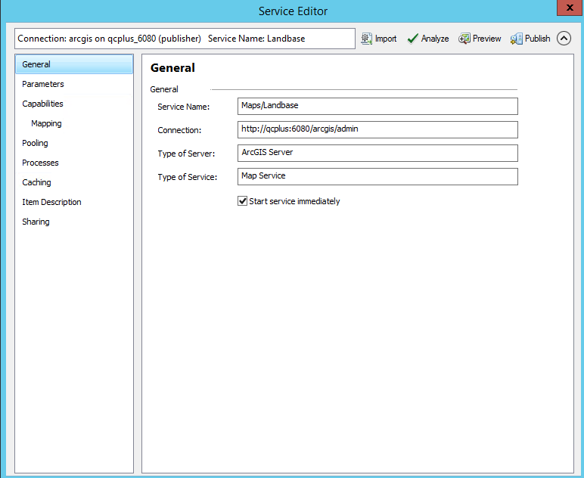
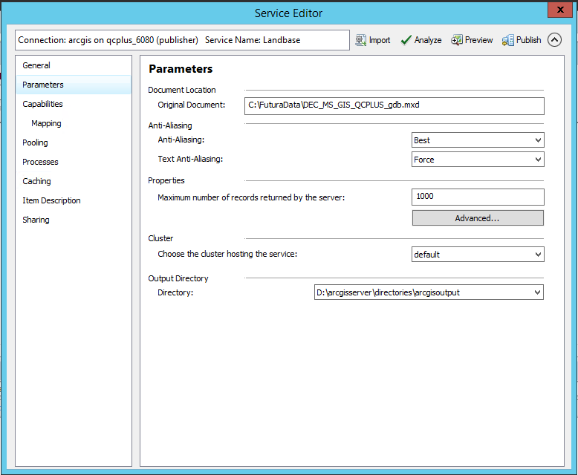
Creating a Map Service

Slide 22
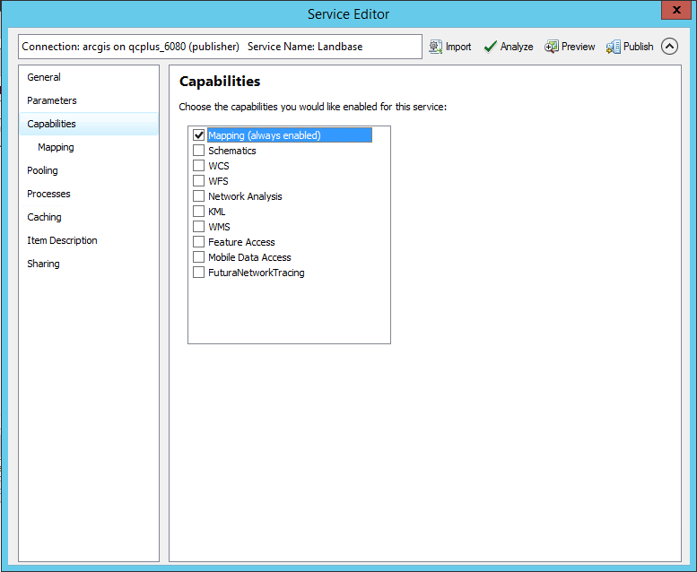
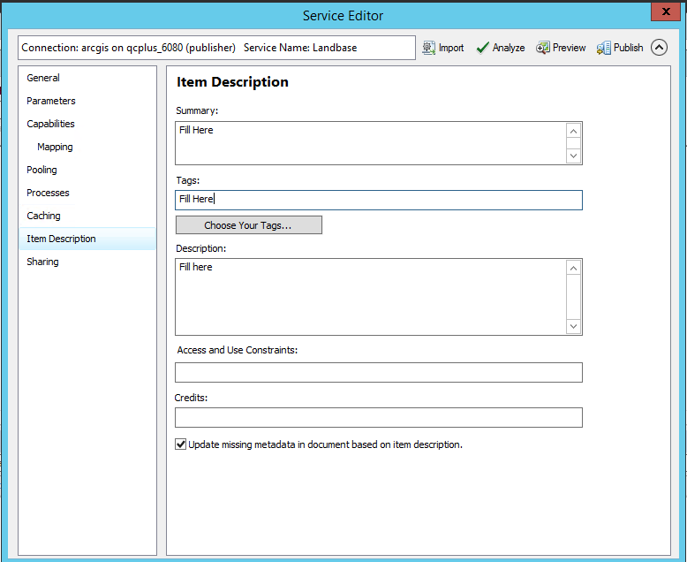
Creating a Map Service

Slide 23
Managing How Catalyst Displays Fields
Configure the order of how fields are displayed in Catalyst in the MXD.
Go to the properties of each feature & configure the field order.

Slide 24
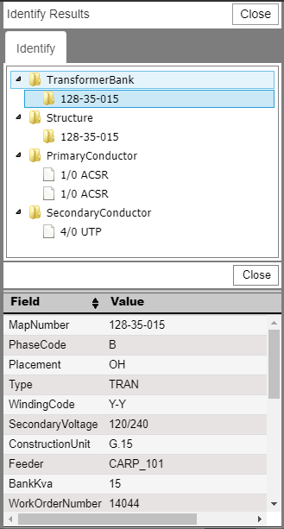
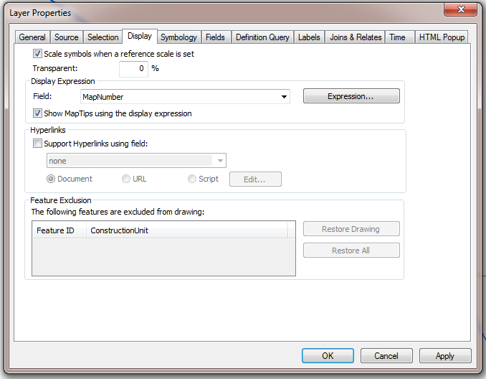
Selecting a Display Field

Slide 25
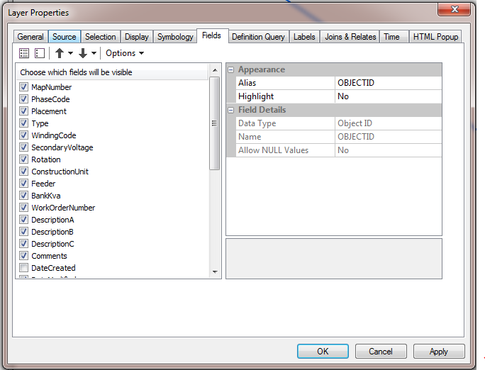
Field orientation in Catalyst

Slide 26
Turning off fields in Catalyst

Slide 27
Questions?
For more information or to schedule a demo contact Futura Sales:
Sales@futuragis.com
678.906.2577
For Technical Support contact use our client portal:
http://futura.crmvertex.com
Futura Support:
Support@futuragis.com

