Slide 1



Futura Export
Exporting your Engineering Analysis Data

Slide 2
Overview
Review the Futura Export tool and common configuration settings
How to make configuration changes
Best practices for running the engineering analysis export
New functionality

Slide 3
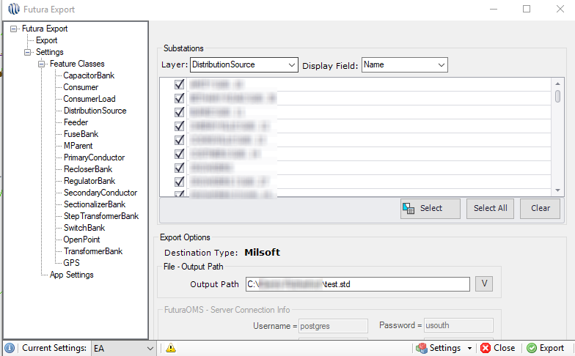
What is the Futura Export Tool
Export to Futura OMS
Export to Field Pro
Export to your engineering analysis
(Milsoft, Synergee, Cyme)

Slide 4
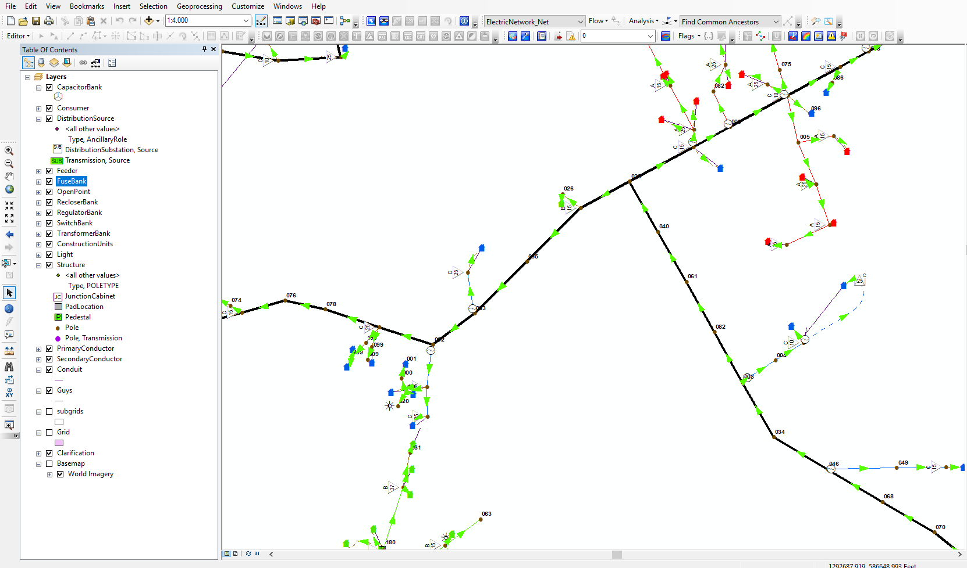
Running the Futura Export
Must stop editing in
order for Futura Export
tool to be active
No longer need to set
flow before running
the export!

Slide 5
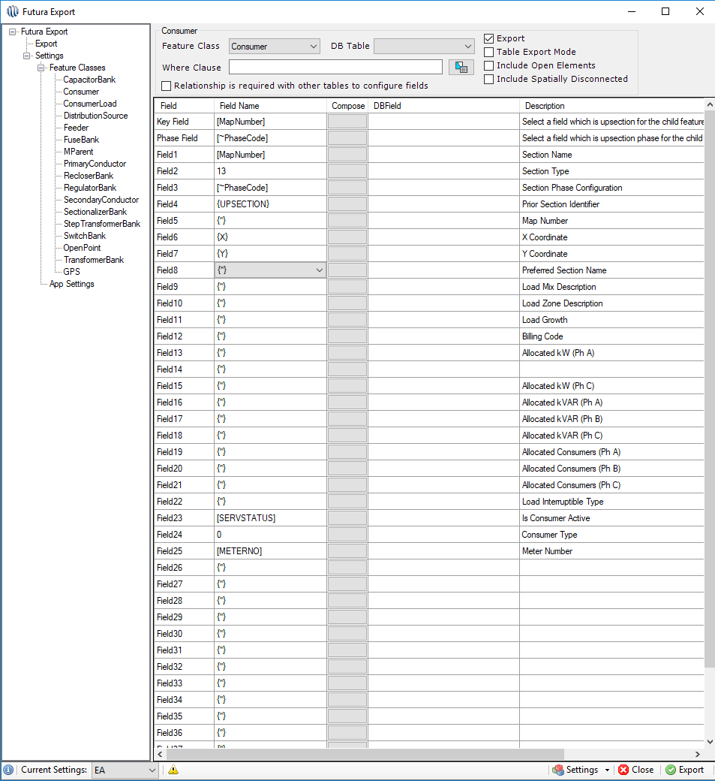
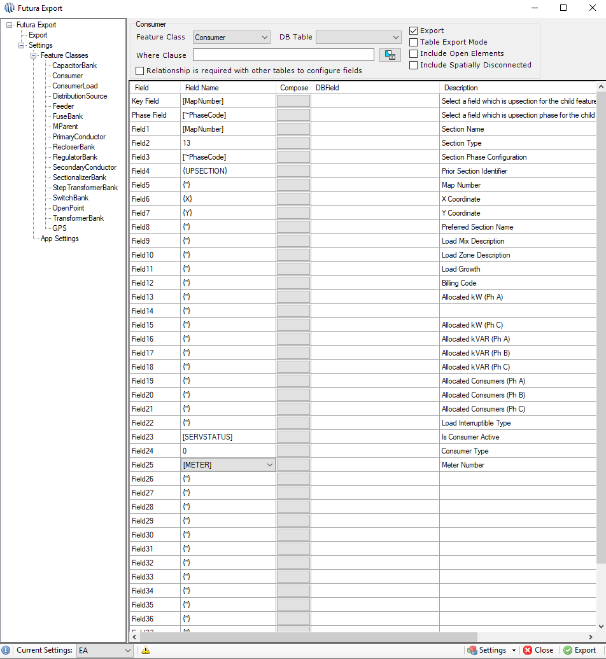
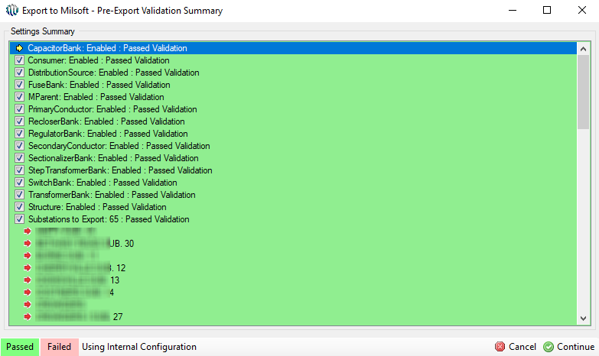
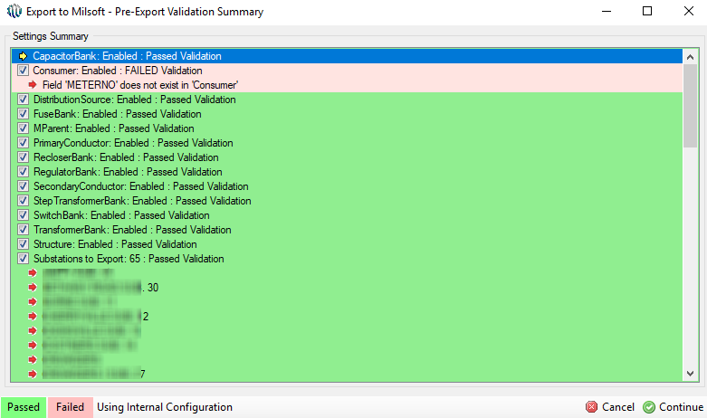
Running the Futura Export
Upon clicking the Export button the Pre-Export Validation Summary will appear.
All fields configured in the export settings must be valid
Once the Pre-Export Validation Summary passes click the Continue button to begin running the export.

Slide 6
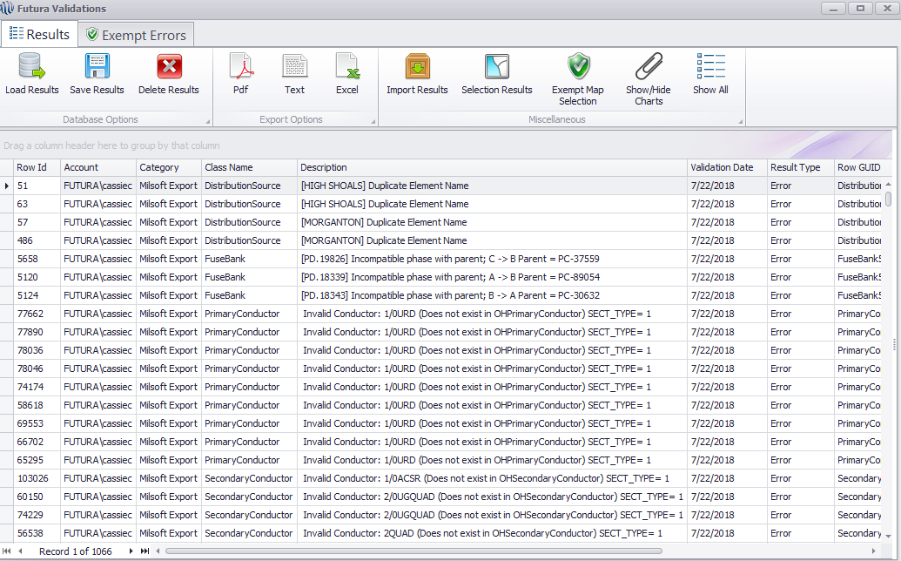
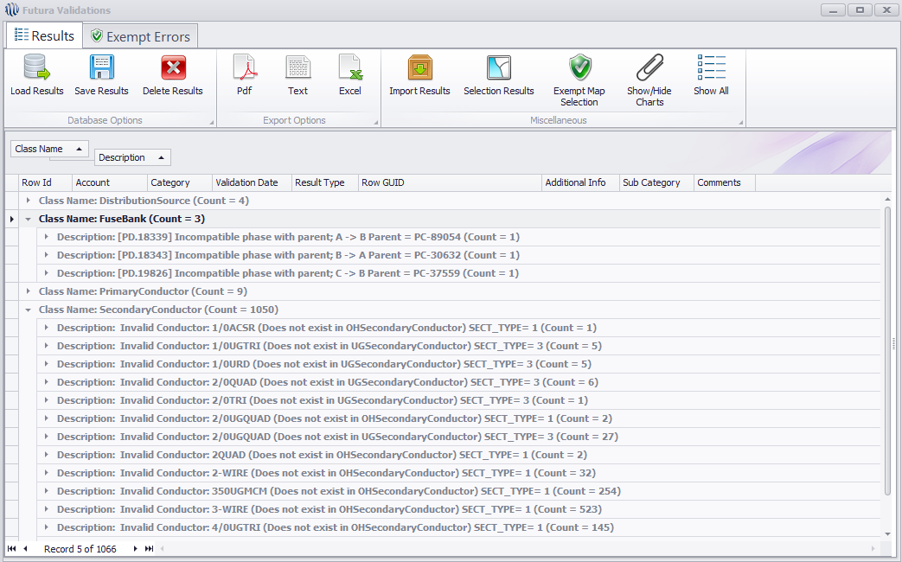
Running the Futura Export
Once the export is complete validation will run on the newly created export file. The validation results will appear automatically.
If the validation window is closed or the option to run validation was disabled in the export settings run the Export File Validation tool on the export file.

Slide 7
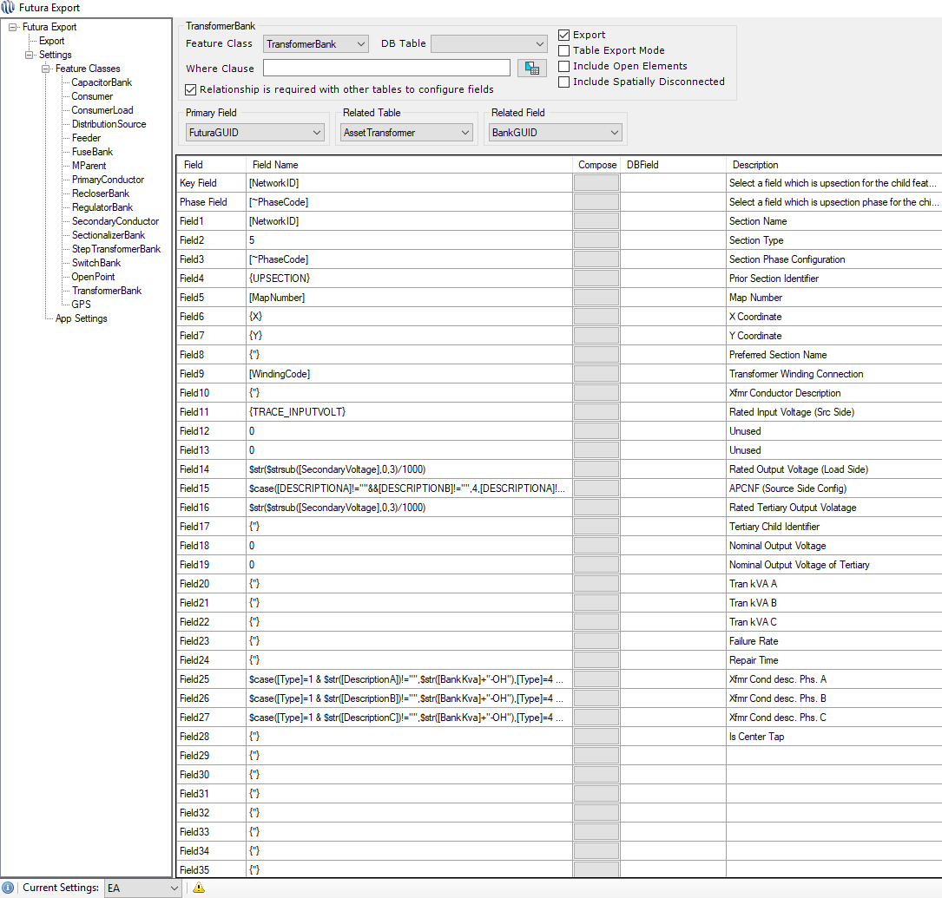
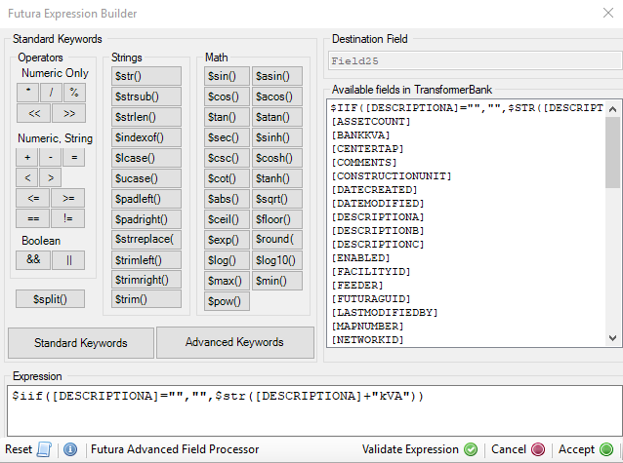
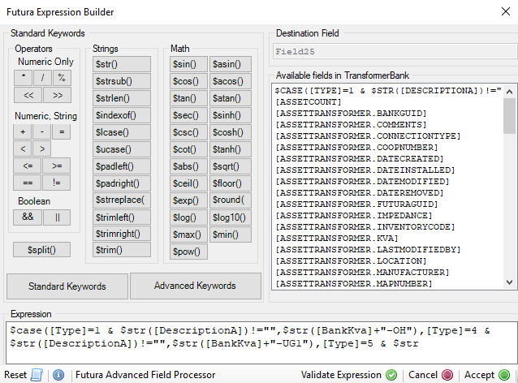
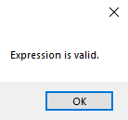
Making Configuration Changes
To edit the configuration click the gray ‘compose’ bar next to that field. This will open the expression builder.
Ex. 1: 15-OH, 25-UG1, etc.
Ex. 2: 15kVA, 25kVA, etc.
*NOTE: Please contact Futura for assistance with building expressions!

Slide 8
Best Practices
Try running the export from the nightly file geodatabase (.gdb).
Prevents network issues if other users are currently editing.
Improves speed!
Schedule the export to run after hours through Server Utility.
Create a backup of the export settings
Create a model, export results (.rsl), and import into primary conductor in order to use the Futura Fault Finder tool.

Slide 9
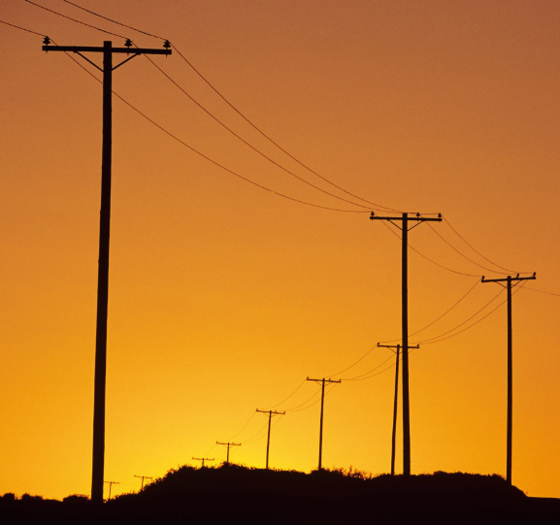
New Functionality
Exporting consumer load (not really that new)
Exporting open points
Exporting poles!

Slide 10
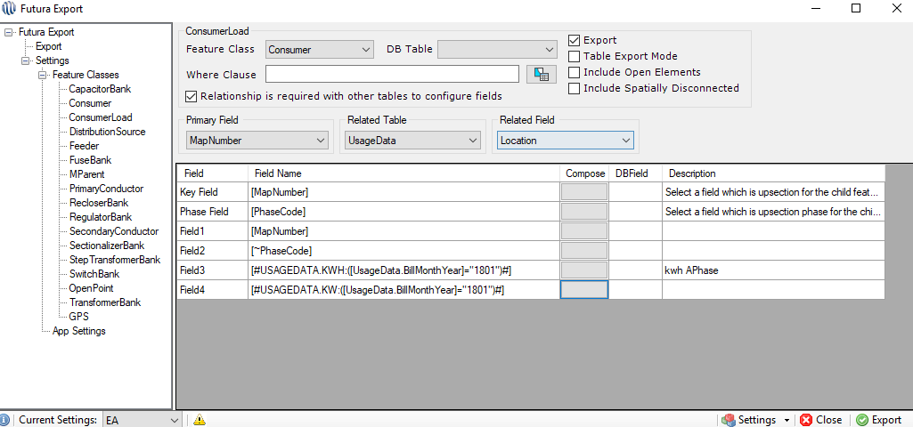
New Functionality
Exporting consumer load
Usage data must be in GIS
Usage data can be exported from KW & KWH fields of Consumer or from a specific month in the related Usage Data table.
Make sure the setting is enabled before running the export.

Slide 11
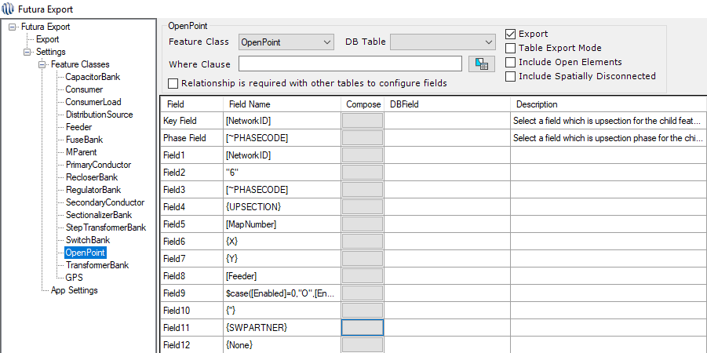
New Functionality
Exporting open points
Uses same configuration as switch banks.
Is not required to create a model.

Slide 12
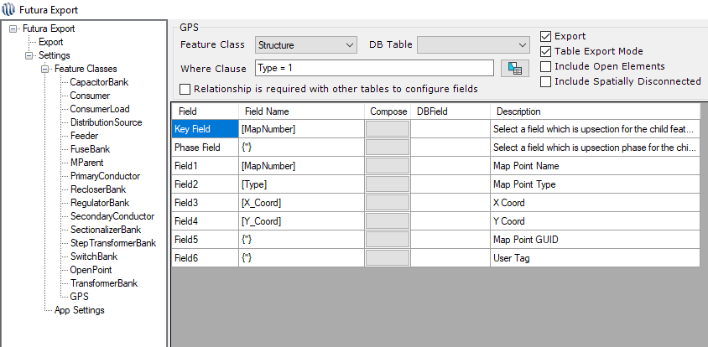
New Functionality
Exporting poles
Creates .gps file.
Must export all substations in order to create .gps file.

Slide 13



Questions
Cassie Corbett
GIS Operations Manager
cassiec@futuragis.com

