Slide 1



Mapping Tips & Tricks
Did You Know About That?

Slide 2
Overview
Review of key Mapping tools
ESRI tips & tricks
New Mapping functionality

Slide 3
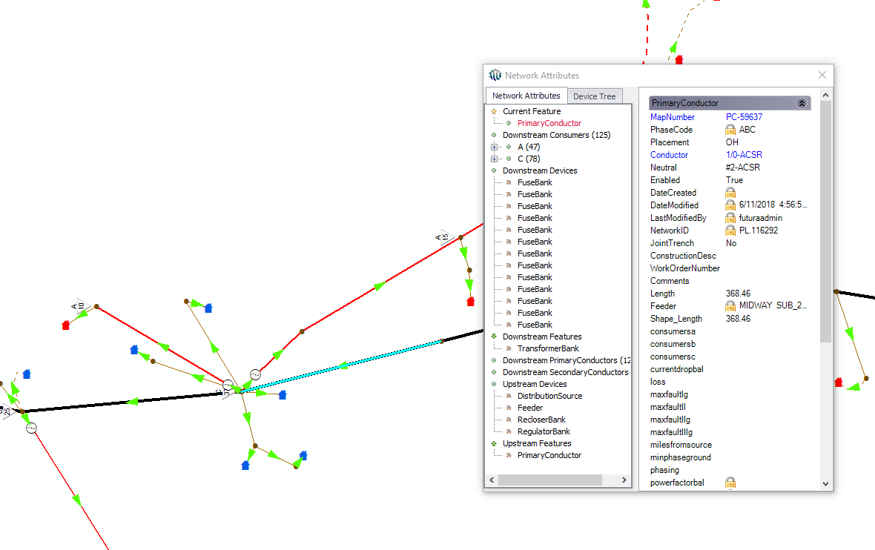

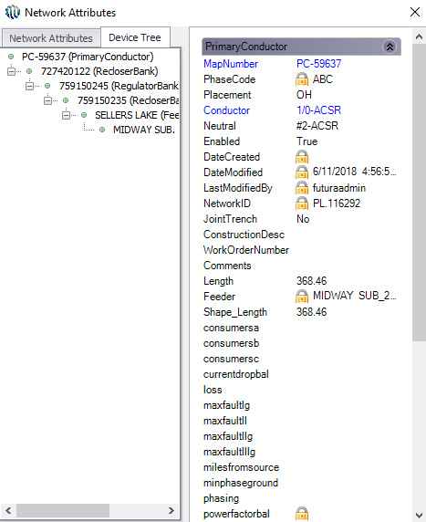
Mapping Tools
Network Attributes
Used to trace up an downstream without setting a flag.
View and select the number of consumers downstream per phase.
View and trace all upline devices.

Slide 4
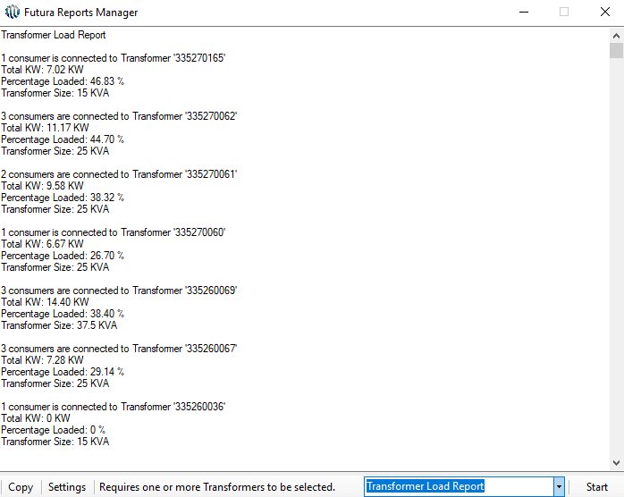
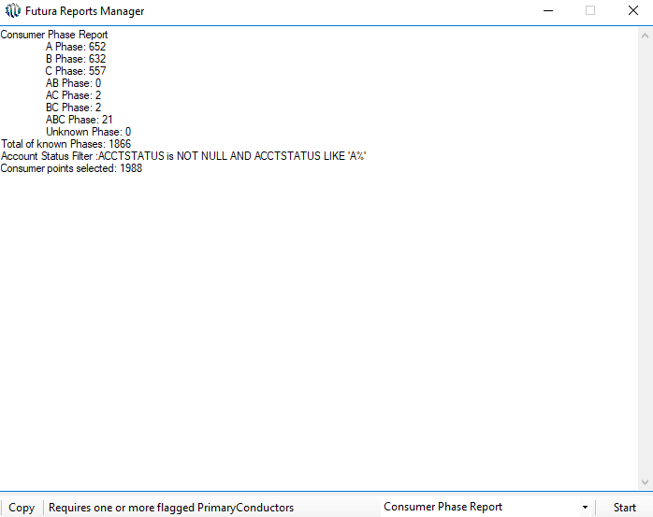
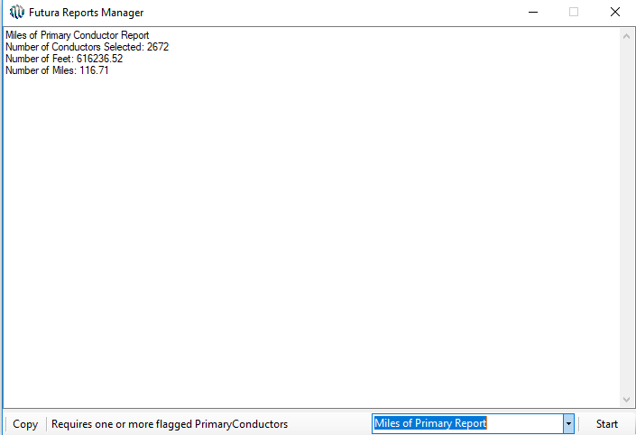
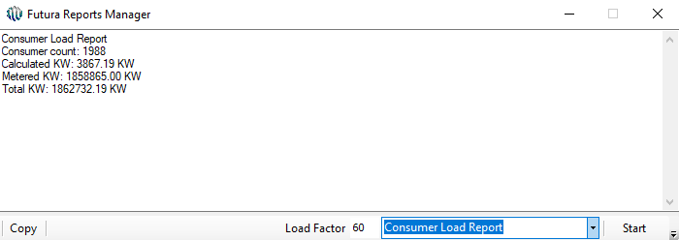

Mapping Tools
Futura Reports
Consumer and Transformer Load Reports
Must have KW & KWH of Consumer populated
Consumer by Phase Report
Miles of Primary Report

Slide 5

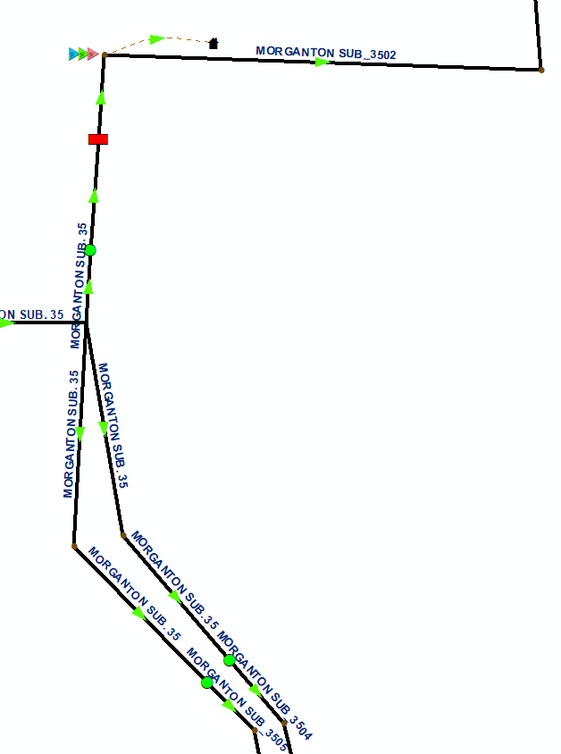
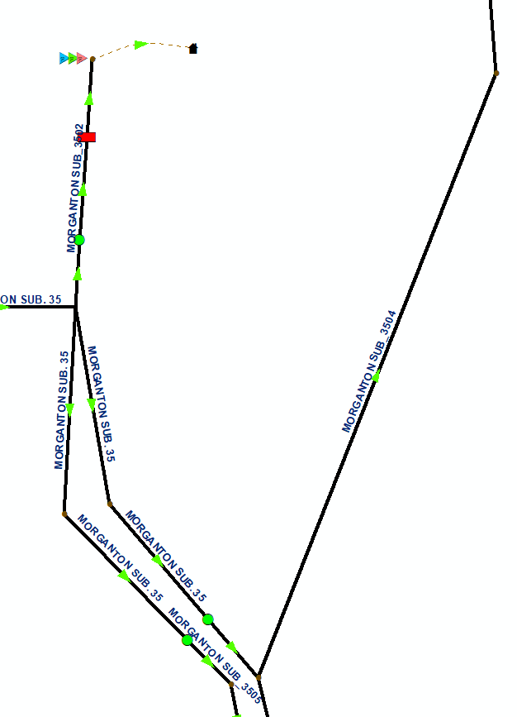
Mapping Tools
Refeed vs Autonumber
Refeed will run an autonumber setting on any downstream field that is configured with refeed catalyst (ex. Feeder). Note: this only works on electric features.
Autonumber must trace from the feature class upstream to retrieve the information for every record that is selected.

Slide 6
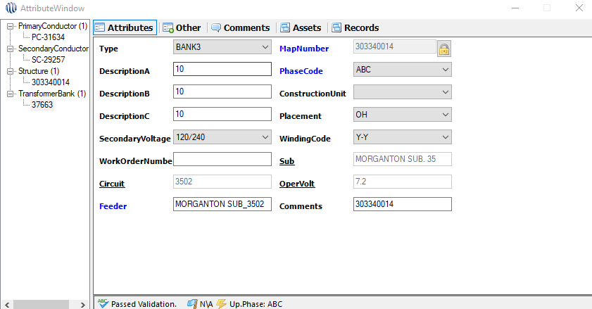
Mapping Tools
Futura Attribute Window
Form tracing and validation
Calculates bank fields (DescriptionA, B, & C), AssetCount, and BankKVA by clicking from the asset tab to the attribute tab

Slide 7

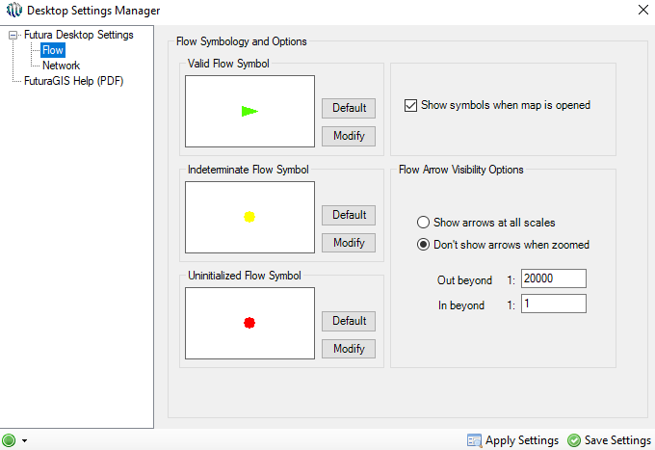
Mapping Tools
Desktop Settings
Change default flow settings
Change tracing selection
Futura Help file

Slide 8
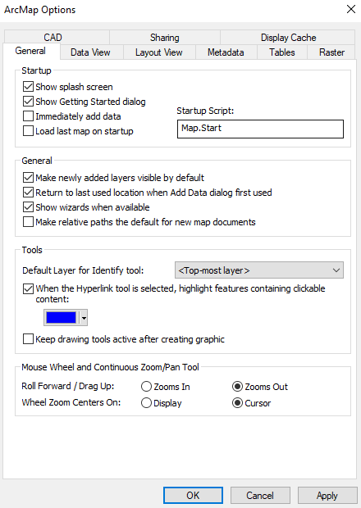
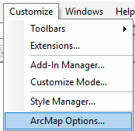
ESRI Tips & Tricks
ArcMap Options
Go to Customize - ArcMap Options
“Make newly added layers visible by default”
Disabling this option will leave the layers
turned off when added to the table of contents making the map refresh quicker.
Change mouse wheel direction!

Slide 9
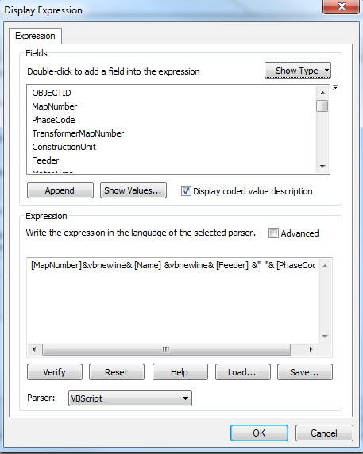
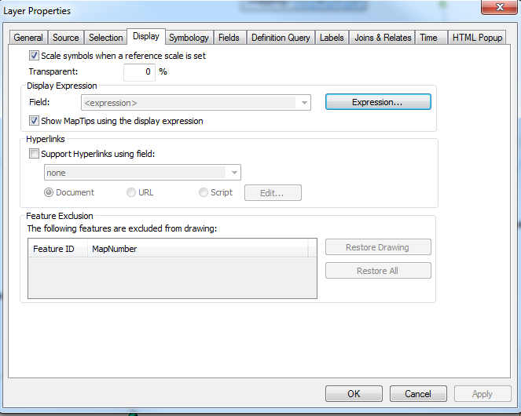
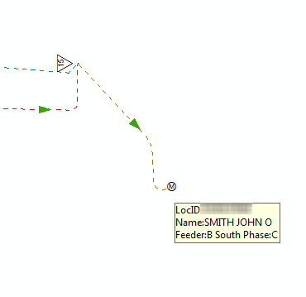
ESRI Tips & Tricks
Use Map Tips instead of labels
Can be configured to display one or more fields
Only appears when hovering over the feature

Slide 10
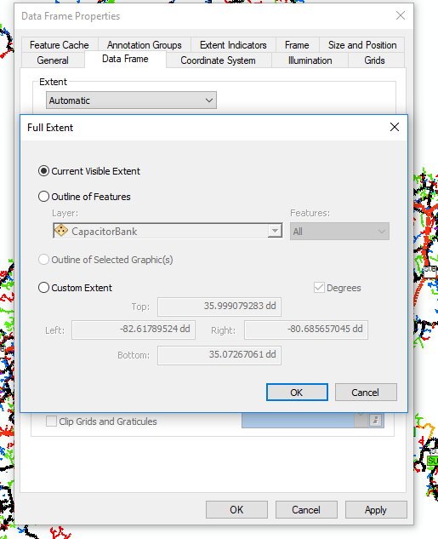
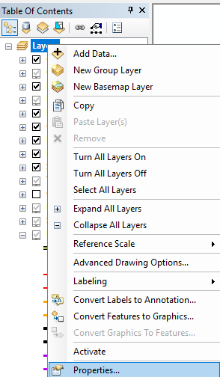
ESRI Tips & Tricks
Setting MXD extent
Go to Layers - Properties
Set Full Extent to Current Visible Extent then
save MXD.

Slide 11
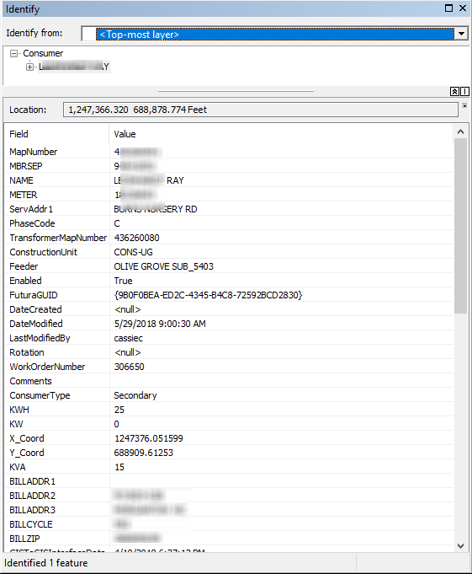
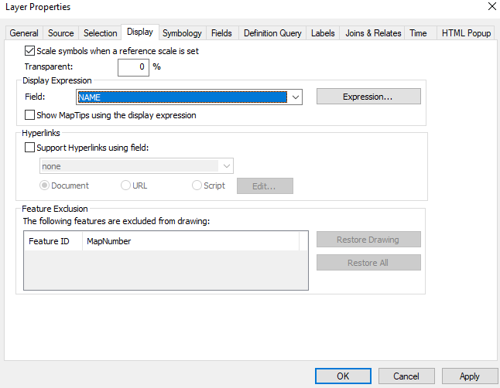
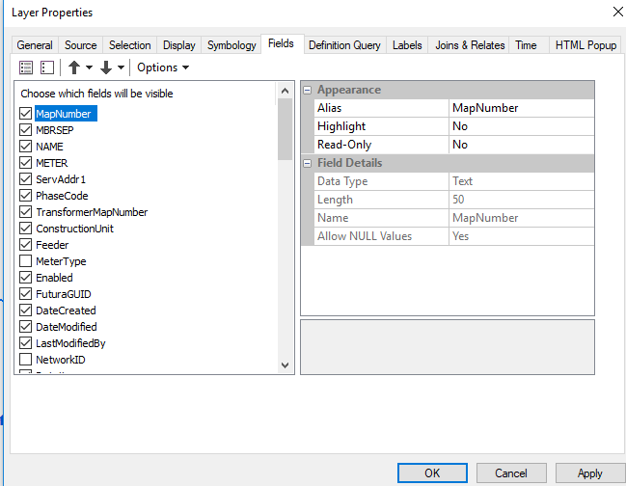
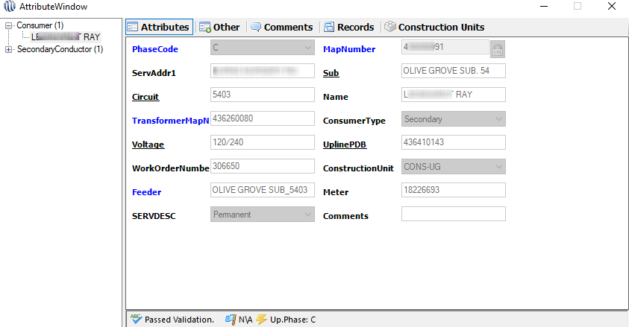
ESRI Tips & Tricks
Primary display fields and sort order
The primary display controls the default field that is visible. If this field is empty the ObjectID is displayed
Sort order controls the order that fields are
displayed when identifying. This is helpful with
controlling what is visible in Mapping and Catalyst.
Note: ObjectID, Shape, and ShapeLength can be
sorted to the bottom but cannot be disabled.

Slide 12
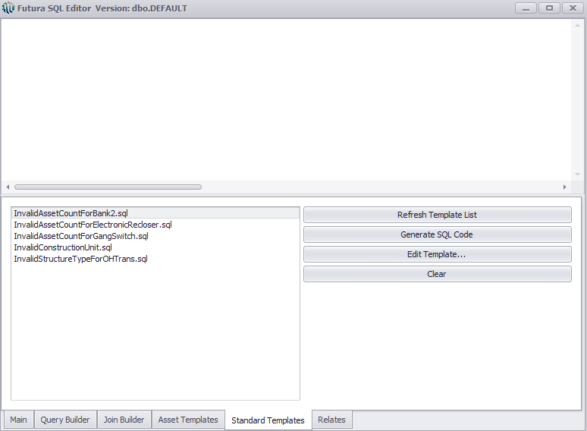
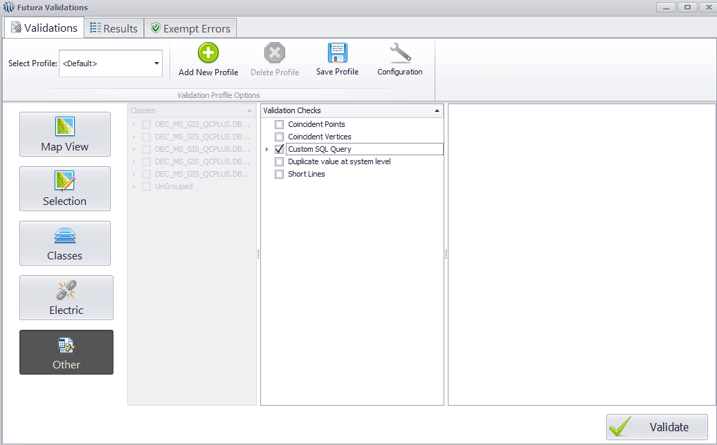
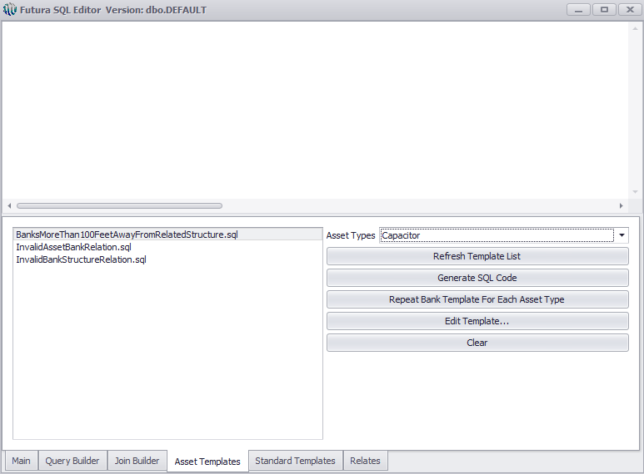
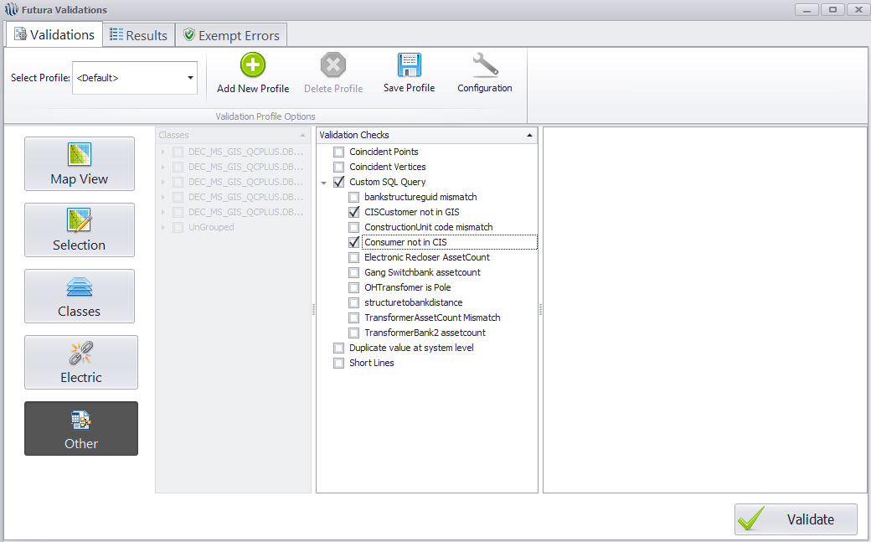
New Mapping SQL Validation
SQL Validation gives users the ability to create their own validation checks!
New tool will come with several predefined templates.
Example: Created queries to compare Consumers to CIS tables and CIS tables to Consumers.
Profile can be saved with these validation checks enabled. The profile can be ran manually or scheduled through Server Utility.

Slide 13



Questions
Cassie Corbett
GIS Operations Manager
cassiec@futuragis.com

