Slide 1



Tips & Tricks
Jody Picou & Brant Hood

Slide 2
Presentation Summary
Pole In Line
Labeling Features - Existing & New
Setting Map Tips
Defining Phase Symbology For New & Retired Conductor
Copy & Paste Units – Cut & Paste Units
Copy & Paste Staking Sheet
Select Multiple Units for Status Change
Select Multiple Units Drag and Drop
Expandable Edit Job Properties Windows

Slide 3
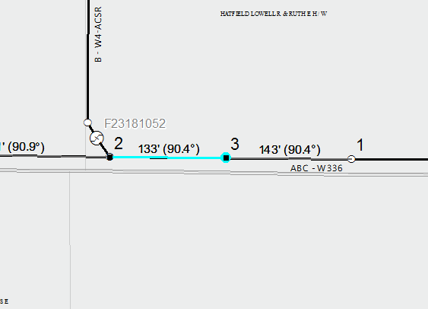
Pole In Line
When we stake a pole in line our normal process would be to create a location at the upstream and downstream locations.
This allows us to measure our distance from either pole.
If we are using GPS points and our GPS point lands mid-span, we can simply double left-click on our existing span and it will create the upstream and downstream locations for us.

Slide 4
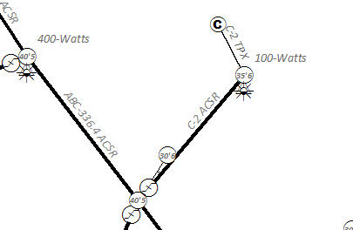
Labeling Existing Features
Existing features can only be labeled by data stored inside the feature class.
In this example I’ve labeled conductor to show phasing and wire type, structures to show height and class and lights to show wattage.
By right clicking any feature class you can access the attribute table. The attribute table will have all the fields and data stored inside the feature class. After finding the field with the data you want to see you should remember the field name and close the attribute window.
If you right click the feature class and choose Properties it will bring up the Properties window. Choose the Labels Tab. This is where you will enter an expression or choose the field you’d like to label this feature class with.
In the top left corner you will see a checkbox (Label Features in this Layer)
Place a checkmark and you will see the field labeled with the field data you’ve chosen.

Slide 5
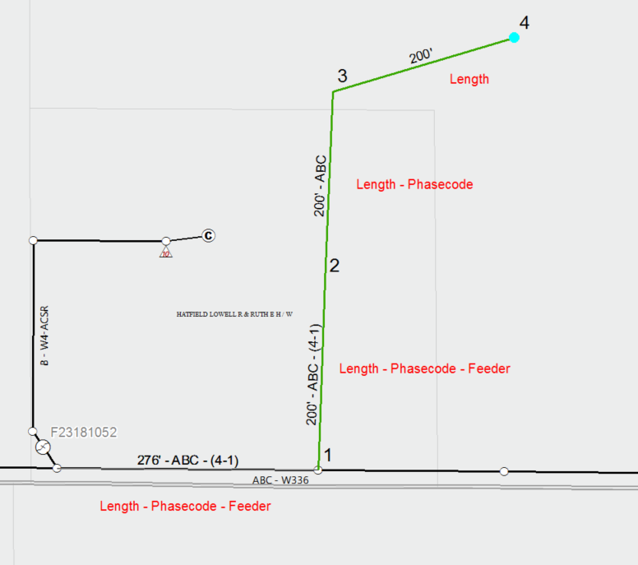
Labeling New Features
Labeling new features is a configuration that is done in the Staking configuration settings.
Labeling can be based on fields that automatically get populated when conductor is added.
This would be best accomplished by contacting our support staff.

Slide 6
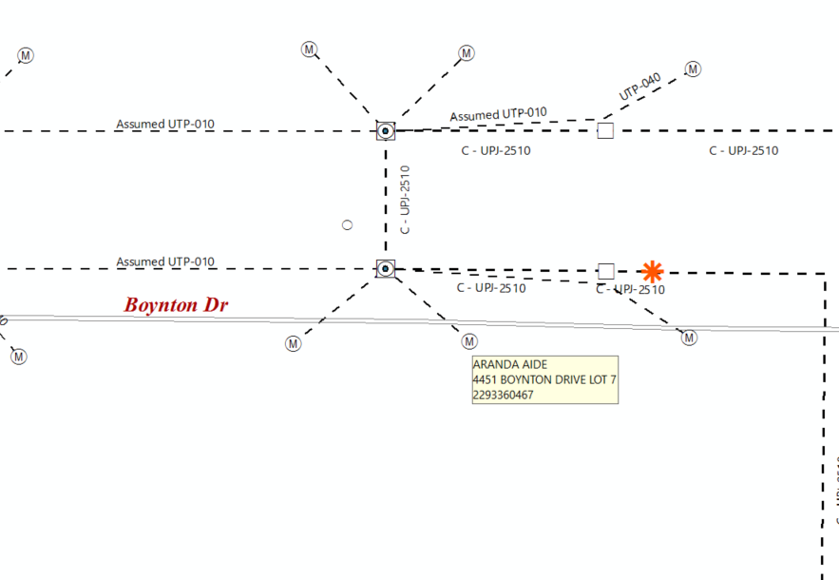
Setting Map Tips
Map Tips can be set on any feature class. Map Tips give you the ability to hover over a feature and view information.
This becomes helpful when you’d like to view information without turning labels on.
Often times labels can clutter your map and cause more confusion than helpful information.

Slide 7
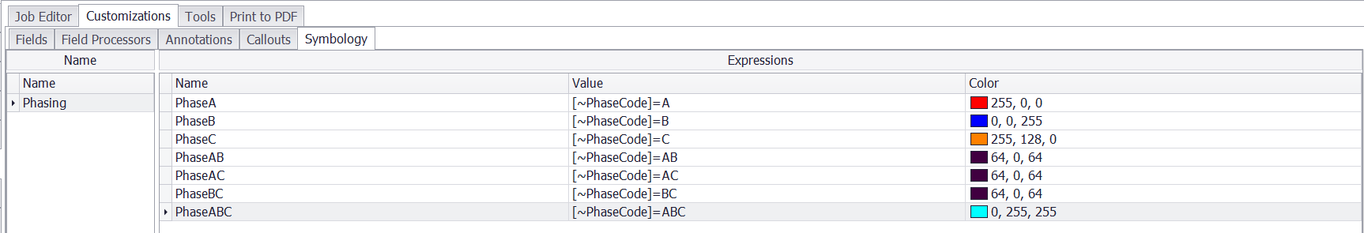
Defining Phase Symbology For New & Retired Conductor
In our Staking Configuration Settings we can set a custom symbology for both New and Retired conductor.
This becomes beneficial if the you need to visually indicate phasing by color.
We find it most often used in subdivision work orders when 3 phases will be pulled separately and identified by phase color.

Slide 8
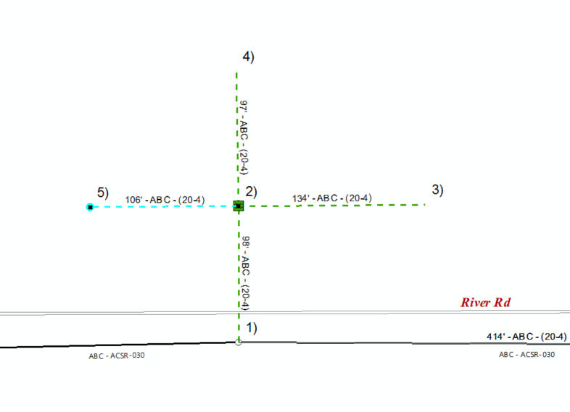
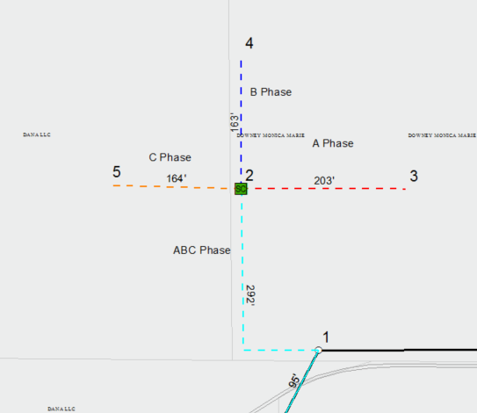
Defining Phase Symbology For New & Retired Conductor Per Phase

Slide 9
Copy & Paste
Copy & Paste
Staking Sheet
Copy & Paste Units – Cut & Paste Units
Often times when we draw multiple staking sheets we’d like to have each of those report sheets drawn to the same dimensions.
Once we draw our first staking sheet we can use the keyboard shortcut of
Ctrl + C ( Copy )
Ctrl + V ( Paste )
Our Favorites use to be our “Go-To” when we wanted to use the same assemblies at multiple locations.
We now have the option for you to copy units from one location and paste them to another.
We have also built in the ability to cut units from a location and paste them to another.

Slide 10
Selecting Multiple
Select Multiple Units for Status Change
Select Multiple Units Drag and Drop
We’re always looking for ways to cut down on the time it takes to Stake a job. With our multiple selection option you can do just that.
One of the most common ways to use this function is when you’re adding units that are Missing from the map. You can add all the units at one time, select the units, right click on the units and choose Missing. This will give all the selected units a status of Missing.
Often times during pole change-outs, consumer re-feeds or conductor re-feeds we need to select existing units and move them to the new location.
We have upgraded our drag and drop functionality. In the past we had to select 1 unit at a time for drag and drop. We can now select multiple units and drag them to another location.

Slide 11
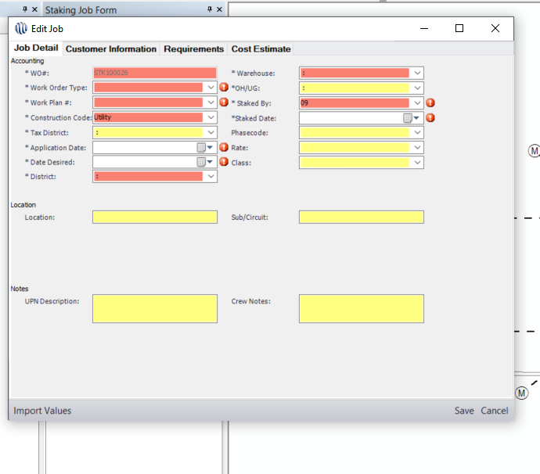
Edit Job Properties The Edit Job Properties window is now expandable

Slide 12
Thank You Have a Great Day!

