Slide 1
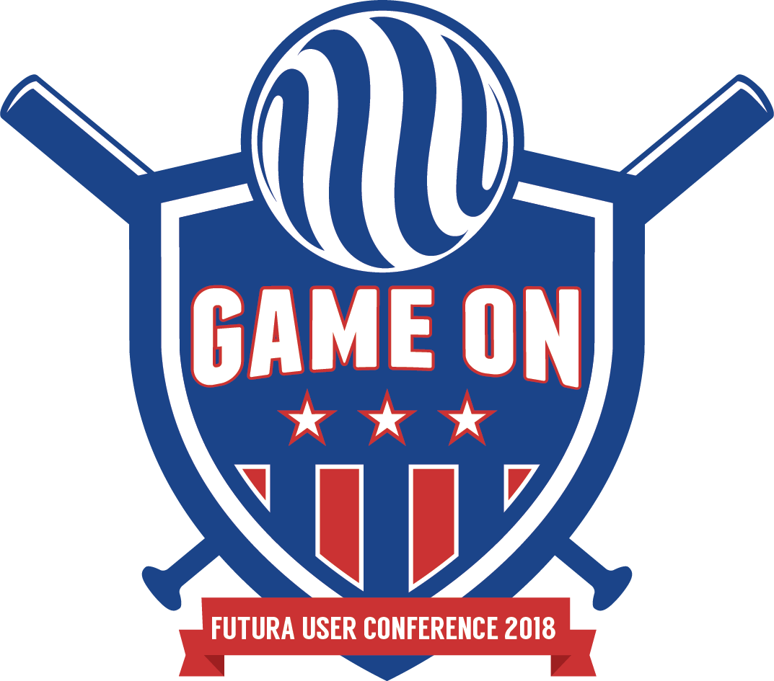


Futura IVR / AutoCue
From the Ground Up

Slide 2
Futura IVR / AutoCue - Topics
Overview
AutoCue
Futura IVR
Notes:
The purpose of this session is to give an overview of the full Futura IVR / AutoCue integrated solution.
<click>
AutoCue is SEDC’s automated phone system. We take a look at key components of that system, and follow the process of outage calls going over to OMS.
<click>
We’ll also take a detailed look at the full Futura IVR integration and follow the process of outage calls and handling callbacks with FuturaIVR.

Slide 3
Definitions
IVR: Interactive Voice Response
Calls: Reports of an outage coming into OMS from a variety of sources. One of these sources can be an IVR system.
Callbacks: Calls coming into OMS can be flagged to receive a call back once the outage is restored. FuturaIVR can handle these callbacks for you automatically.
SMS: Short Message Service / Text Message
The Cloud: The Cloud refers to internet based computing where computer processing and data is shared among different computers and devices on demand.
Logs: Text files that contain records of all transactions and errors for a webservice.
Notes:
First, let’s cover just a few key definitions so we are all familiar with the terminology we will be using.

Slide 4


Solution Overview
Joint effort between SEDC and Futura
Report outage using SEDC’s AutoCue IVR
Request to be notified when power is restored
Call back or “text” back
The Futura IVR system handles entire call back process
Automatic outage status reporting
Notes:
This Solution is <click> a joint effort between SEDC and Futura
It provides the capability of reporting an outage using SEDC’s AutoCue IVR
<click>
Customers can request to be notified when power is restored.
<click>
They can request a voice callback or a “text” callback.
<click>
The Futura IVR system handles the entire call back process for you automatically.
<click>
Customers will also be notified they are involved in a known outage with automatic outage status reporting built in.

Slide 5

Cloud-Based Technology
Infrastructure is in the cloud
No additional telephony hardware
Extremely reliable
Low up-front cost
Pay-as-you-go
Notes:
The system leverages ‘cloud-based’ technology.
<click>
Because the infrastructure is in the cloud
<click>
There’s no additional telephony hardware required.
<click>
The solution is extremely reliable.
<click>
There is a low up-front cost to you thanks to the cloud.
<click>
You are also able to Pay-as-you-go based on volume in the system.

Slide 6
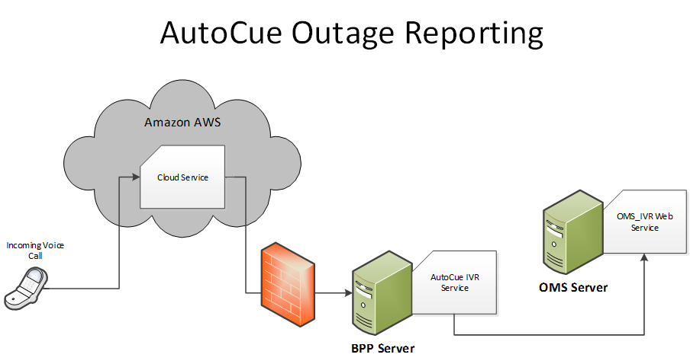

AutoCue Architecture
Notes:
This schematic illustrates the path of an outage report coming into OMS through the AutoCue system.
It outlines the network architecture that is in place on the AutoCue side.
<click>
The initial call is placed from a customer’s phone call into a Cloud Based phone Service.
<click>
That service relays the call through the external firewall into the AutoCue IVR Service running on SEDC’s BPP server. That server is typically on the same internal network as the OMS Server, so it is able to relay the call from the AutoCue IVR Service to the OMS_IVR Web Service.
<click>
Once the call hits the OMS_IVR webservice it is placed into OMS as an active call.

Slide 7
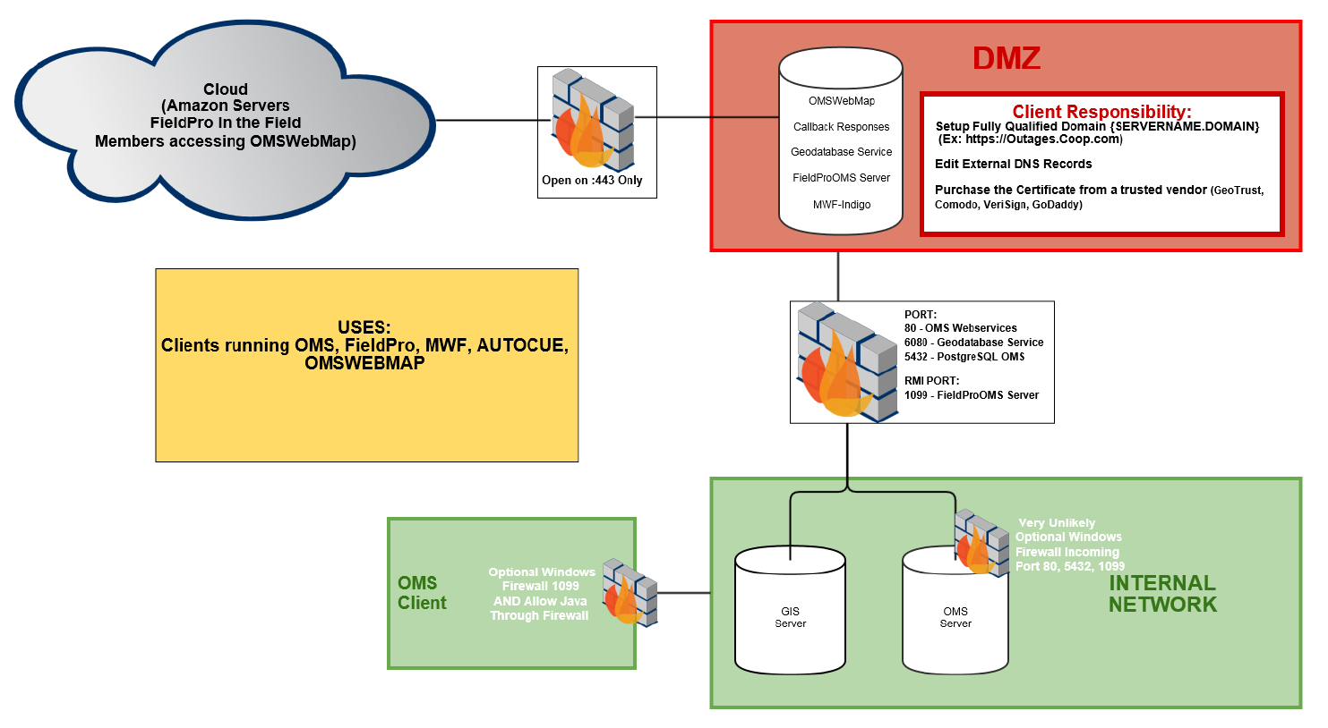
Futura IVR Architecture
Notes:
We have a new secure architecture that we are encouraging all of our clients to implement when going in with public facing products such as OMSWebMap, FieldPro OMS, and FuturaIVR.
This diagram shows all of the components, and portage, that will have you ready for onboarding any public facing Futura products down the line.
We’ll again take a look at this architecture in the context of Futura IVR, and following a callback response through the system.
<click>
The Cloud Service will return a response to the FuturaIVR Handler webservice hosted on the public facing DMZ.
<click>
The responses will come into the machine on port :443 using the secure HTTPS protocol. ***Note that this will require a few responsibilities on your side.
You will need to purchase a fully qualified domain, edit external DNS records, and purchase an SSL from a trusted vendor.
<click>
The handler webservice on the DMZ will pass the response back to the OMS_IVR webservice on the OMS Server using port :80 internally.
From there the OMS Model will receive the callback response and process the transaction accordingly.
<click>
The OMS Client machine will then be able to pickup the response from the OMS Model.

Slide 8

Futura IVR - Prerequisites
SEDC’s AutoCue IVR
Internet-facing server to host Futura IVR webservice
Amazon EC2 IP ranges opened in firewall*
UPN v36 SP4 or later
Requires configuration by both SEDC and Futura
Notes:
For the complete solution, there are a few pre-requistites.
You must have AutoCue IVR in place to leverage the full FuturaIVR solution.
<click>
You will need an internet-facing service to host the Futura IVR Webservice
<click>
And / Or A range of Amazon EC2 IP’s opened in the firewall.
<click>
You must be on UPN v32 SP4 or later
<click>
The full solution requires configuration by both SEDC and Futura.

Slide 9
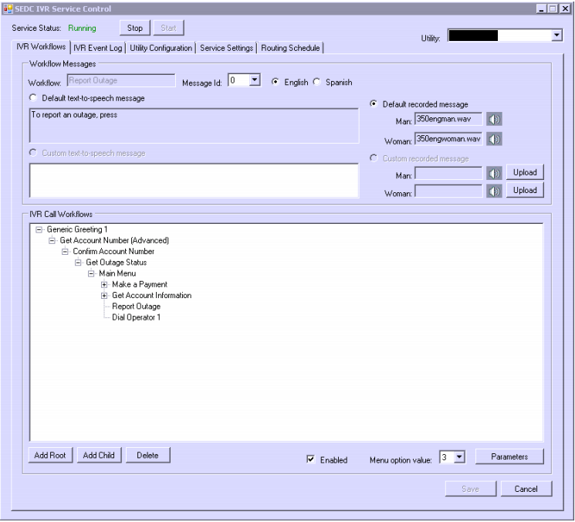
AutoCue IVR
Easy to modify IVR call tree
Easy to select messages and add recordings
Fast deployment
Pay-as-you-go
Notes:
The AutoCue IVR system has an easy to modify IVR call tree.
<click>
It is easy to select messages and add recordings to the system.
<click>
It offers a fast deployment time.
<click> You can Pay-as-you-go based on the call volume that passes through the sytem.

Slide 10

How it Works
SEDC purchases an IVR phone number from our cloud service.
Cloud service intercepts call when IVR number is dialed.
Cloud service communicates with your BPP server to get instructions and process input from the caller.
Notes:
SEDC will purchase an IVR phone number from the cloud service.
<click>
Cloud service intercepts call when the IVR number is dialed.
<click>
The cloud service then communicates with your BPP server to get instructions and process input from the caller.

Slide 11

IVR Call Features
Choose English or Spanish
Make payments using credit card, credit card profile, or E-Check profile
Get extensive account information
Request a payment arrangement
Transfer to an operator (and extension)
Switch to text feature
Interactive text messaging
Report an Outage
Notes:
There are a number of options available to your customers in the AutoCue IVR system.
<click>
They can choose English or Spanish.
<click>
Make payments using a credit card, credit card profile, o E-Check profile.
<click>
Get extensive account information.
<click>
Request a payment arrangement
<click>
Transfer to an operator (and extensions) within the utility
<click>
Switch to text feature
<click>
Interactive Text messaging
<click> REPORT AN OUTAGE!

Slide 12
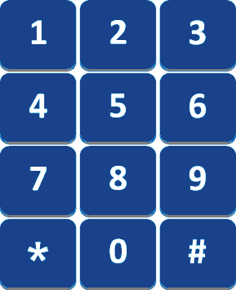
Reporting an Outage in AutoCue IVR
IVR: “To report an outage, press 4”
Caller: Presses 4
IVR: “If you would like to receive a phone call when your outage is restored, please press 1. If you would like to receive a text message when your outage is restored, please press 2. If you do not want to be contacted when your outage is restored, please press 3.”
Caller: Presses 1
Notes:
To report an outage in the AutoCue system, customers typically will select the outage option.
<click>
Here the system is setup to Press 4 to report an outage so the caller would hear “To report an outage, press 4”.
<click> The caller would then Press 4 on their touchtone phones.
<click>
The IVR would then proceed to the CallBack options configured in the system. Typically they would have the option to request a call or text back once the outage is restored, or to simply not be contacted.
<click>
In this instance lets assume the customer wants a voice call back. They would press 1 in order to request a voice phone call once their outage is restored.
<click>
After that, FuturaIVR will take over and process those requested callbacks on case restoral, or based on user interaction in OMS Client.

Slide 13

Outage Status Reporting
Automatically checks OMS for outage status of caller’s location
Reads a message to the caller if an outage
Can use a text-to-speech or pre-recorded message
Notes:
AutoCue also provides a mechanism that automatically checks OMS for the outage status of the caller’s location. This is usually done as part of the outage reporting process.
<click>
AutoCue will read a message to the caller to notify them they are in a known outage prior to logging the outage call.
<click>
You can use text-to-speech or a pre-recorded message from one of your employees.

Slide 14
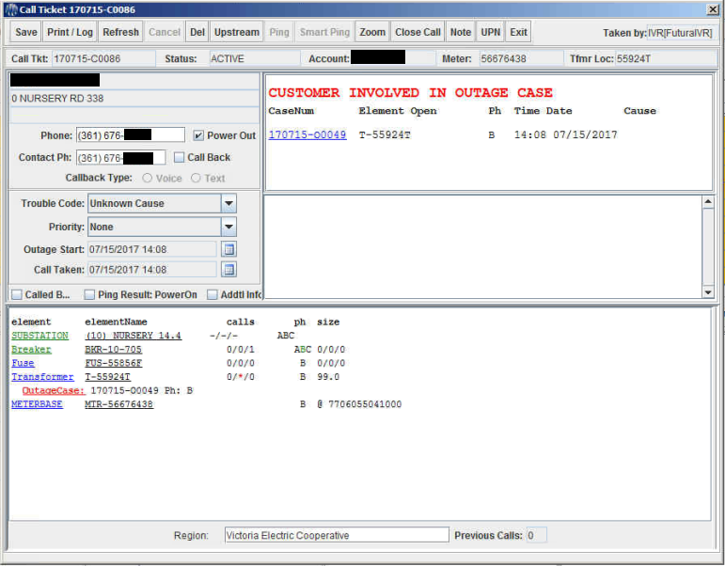
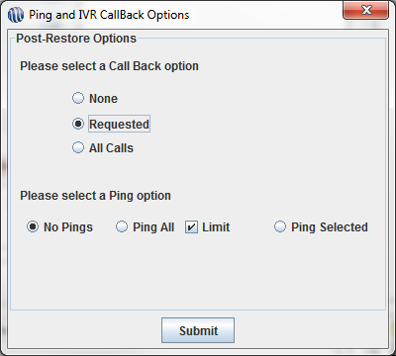
Futura IVR
AutoCue calls come into FuturaOMS
AutoCue places calls into our system over the OMS_IVR_Webservice
Taken By ‘FuturaIVR’
CallBack requests from AutoCue handled by FuturaIVR
Voice Phone Call or SMS Text Message options for callbacks
Callbacks issued on case restoral to requested, all calls, or none.
Notes:
Outage reports are made in AutoCue and placed into OMS as ‘power out’ calls.
<click>
These calls come in over the OMS_IVR_Webservice hosted internally on your OMS Server.
<click>
Call tickets that come over from Auto Cue will show that they were “Taken By FuturaIVR”.
<click>
When a user enters an Outage Report in Auto Cue, they have the option to request a callback in regard to their outage restoration. Those callbacks will be handled by FuturaIVR.
<click>
They have the option to receive a voice phone call or an SMS / Text Message depending on their preference.
<click>
When a case is restored, OMS Client operators have the option to issue “callbacks” to those that calls that requested a callback, all calls, or none at all.

Slide 15
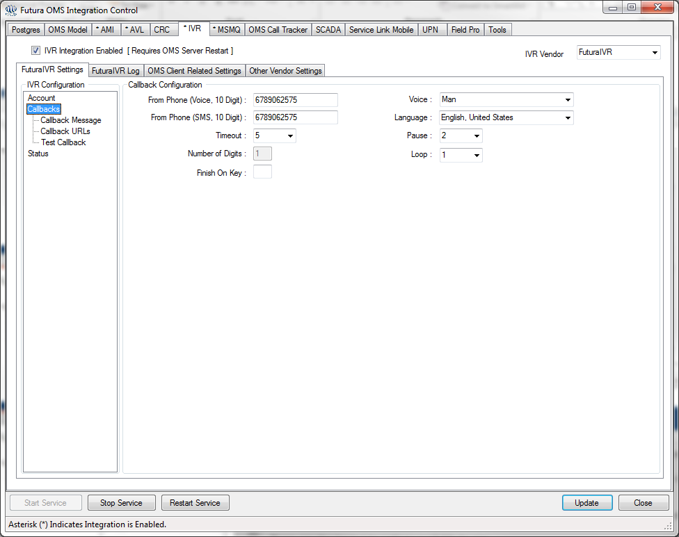
Futura IVR
Callbacks
Issued from a Local Number
Male / Female voice
Pre-Recorded Message
Language options
Notes:
FuturaIVR settings are managed in Futura OMS Integration Control.
Here we are taking a look at the various callback parameters you will have access to.
<click>
When a voice callback goes out in FuturaIVR, they can be issued from a local number we have reserved/registered with the cloud service.
Customers are more likely to answer or respond to an established local number. We can even spoof the callback number for voice calls to show the number for your office on the caller ID.
Customers would be able to recognize the call is coming from their Electric Coop as opposed to a long distance number coming from another party.
Text/SMS messages will still have to use the default local number we reserve for the AutoCue system as the “From” number.
With FuturaIVR you have direct access to configure your IVR system from Futura Integration Control on your OMS Server.
<click>
The voice callback has Male / Female voice options.
<click>
You also have the option to pre-record your own messages using someone at your Utility as the voice.
<click> There are also language options available to you if you use the text to speech functionality to create your messages.
<click>
Here is a better view of the FuturaIVR settings tab in Integration Control.
You can see where the From Phone values are set, the voice type dropdown, language dropdown, etc.

Slide 16
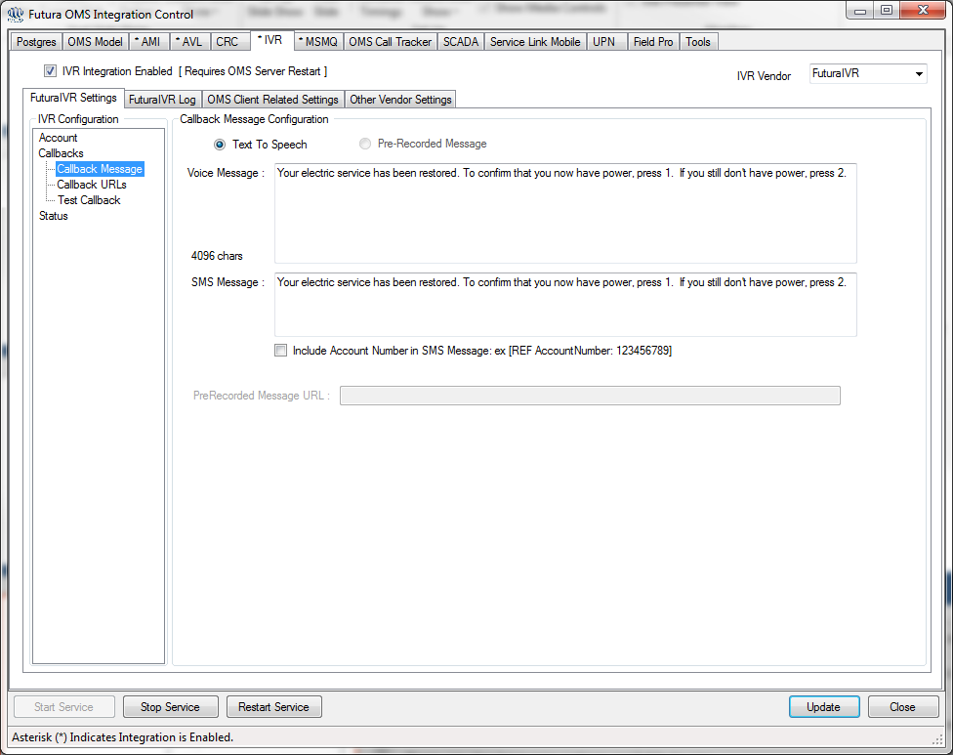
Futura IVR
Callback Responses
Confirm Power Restoral
Customizable Prompts
Voice Prompt
SMS Prompt
Power still out response
Places Call back into OMS
FuturaIVR_Handlers web service
Notes:
The callbacks will prompt the recipient for a response depending on their power situation, we would call this the callback response.
Callback Responses <click> confirm power restoral automatically.
<click>
The content of the messages your customers receive is customizable for both Voice Callbacks and SMS Callbacks.
Instead of having to contact a 3rd party IVR, you will have direct access to customize your messages from your OMS Server.
<click>
If a customer responds that their power is still out, a call will be placed back into OMS <click> over the FuturaIVR_Handlers webserivces.
Remember this is the webservice that is exposed to the EC2 instances, or “the cloud”. This allows a callback response to return to OMS from the cloud.
<click>
For voice messages, <click> you can simply type in the message you want to issue or choose a pre-recorded message to load.
This gives you a lot of flexibility in the types of messages we are able to communicate to your members. Having access to these settings “in-house” makes changes quick and easy.
<click> SMS text messages are also configured from Integration Control. Simply type out the text you would like to include in your SMS message.
You can also check the box to include the account number the messages is in reference to. May be useful for members who have more than one account number to know which account the message is in reference to.
Typically customers will be prompted to enter or reply with a 1 if power is back on and 2 if power is still out.
Again these responses provide a mechanism to automatically confirm outage restoration and immediately find out if there is a secondary outage in the area if a consumer is still without power.

Slide 17
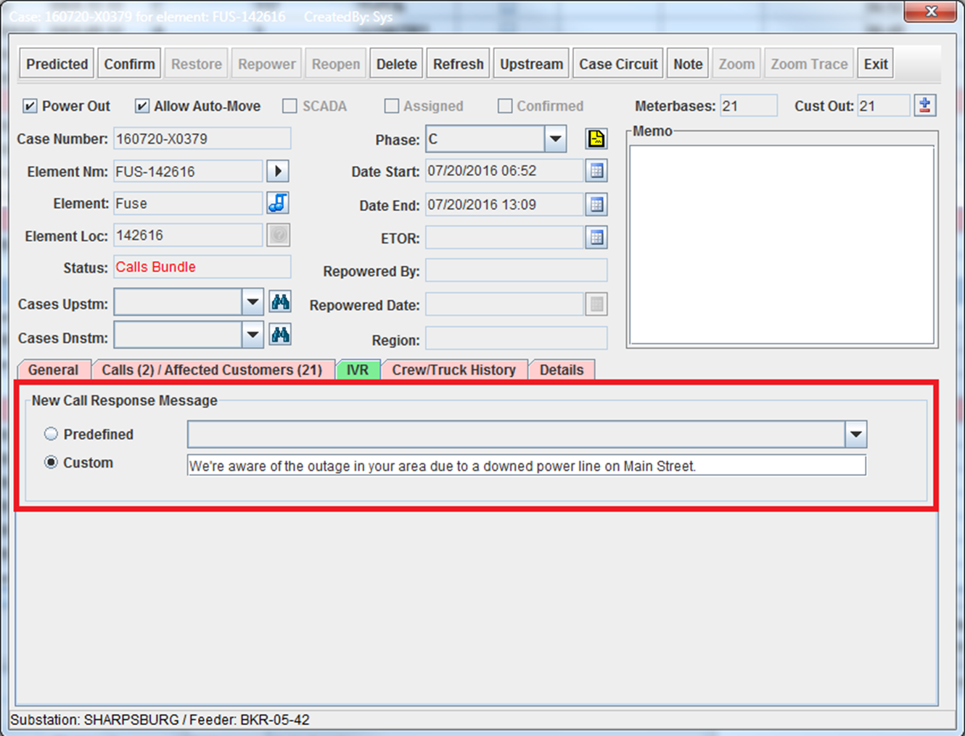
Futura IVR
Call Message on Status Check
Configure on the fly from Case ticket.
Predefined Message
Custom Message
More personal message
Details about a specific outage
Notes:
FuturaIVR can provide a message to your customers on Status Check.
<click>
Messages can be configured, on the fly, within the case ticket dialog in OMS.
Here we have opened up a case ticket and gone to the IVR subtab in Green.
<click>
You will have the option to use one of the predefined messages you have in your system, or you can enter <click> a custom message that contains information pertinent to that particular outage.
This is the message that callers will receive if they are involved in this outage and calling into the system.
<click>
A custom message can provide a more personal message with <click> details about a particular outage.

Slide 18
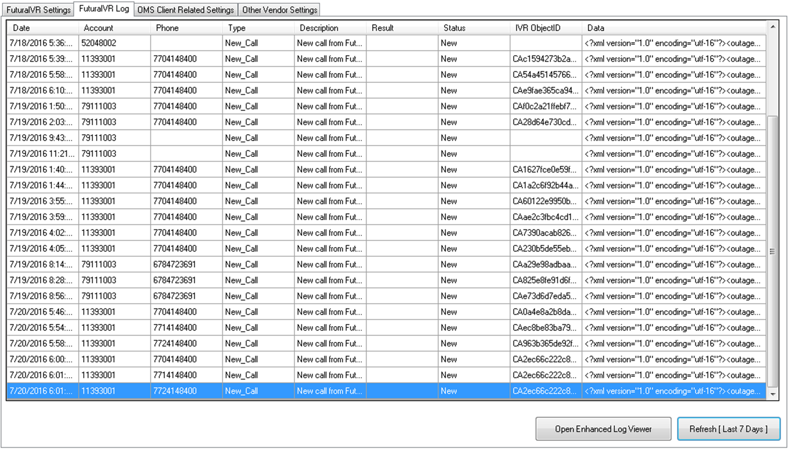
Futura IVR
FuturaIVR Logging
Robust Logging of IVR Activity
All incoming Calls
All outgoing Callbacks
All PowerResponse transactions
Futura Integration Control
User Interface for IVR Logging
Notes:
All FuturaIVR transactions are recorded in the OMS Postgres Database.
<click>
This allows for robust logging of all IVR Activity and you will have direct access to it!
You will be able to see:
<click> All Incoming Calls
<click> Outgoing Callbacks
<click> All PowerResponse transactions coming back into the system.
<click>
Logging is also accessed from Futura Integration Control on the OMS Server. This is your user interface for IVR logging.
<click>
If you wish to access more detailed Logging, we have the Enhanced Log Viewer <click> show button from this dialog.

Slide 19
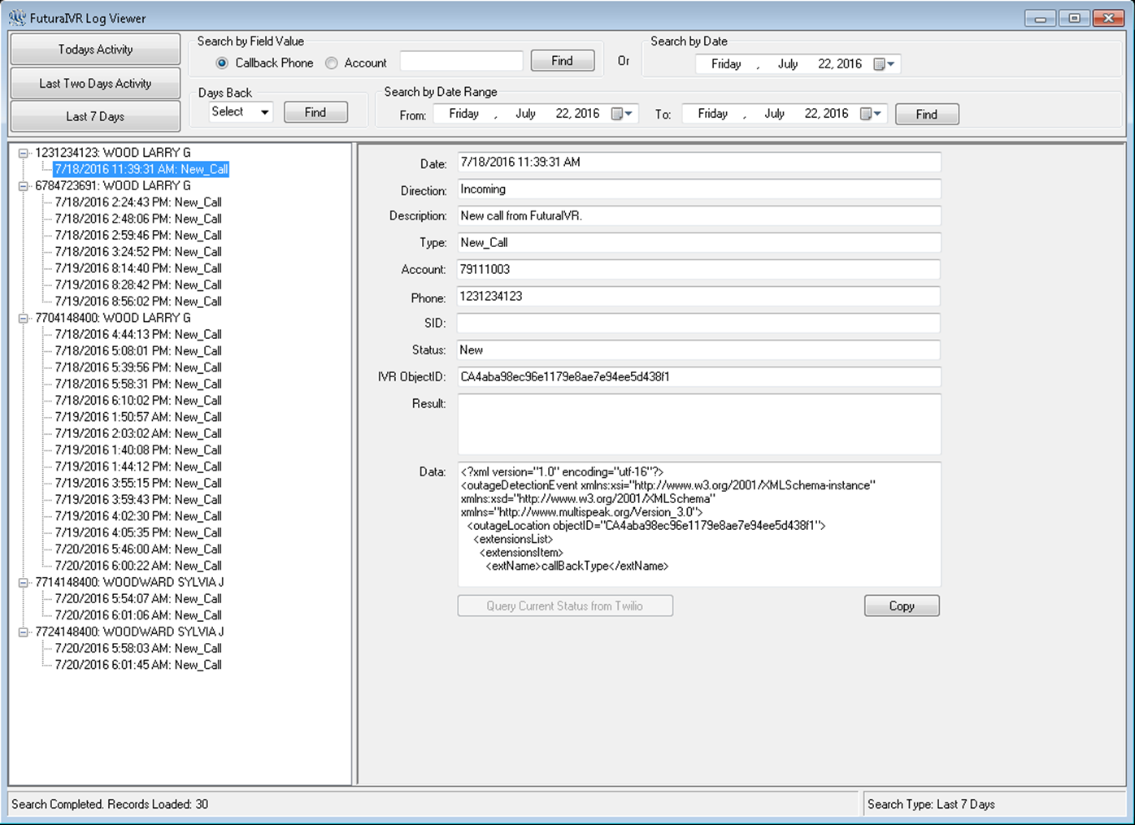
Futura IVR
Enhanced Log Viewer
Historic IVR Activity
Search By Field
Callback Phone
Account
Search By Date
Search By Days Back
Search By Date Range
See transaction details
Notes:
The Enhanced FuturaIVR Log Viewer will enable you to view FuturaIVR activity in a nice easy to use interface.
<click>
You will be able to see Historic IVR activity.
You will also have a number of ways to search for past transactions.
<click> Search By the Callback Phone number of Account number fields
<click> Search By Date
<click> Search By Days Back
<click> Search By Date Range
This enables you to narrow down your list of transactions for a certain time period to hone in on a specific one.
<click>
You will be able to see details of the transaction in an easy to read format, in case you need to verify activity in your IVR.

Slide 20
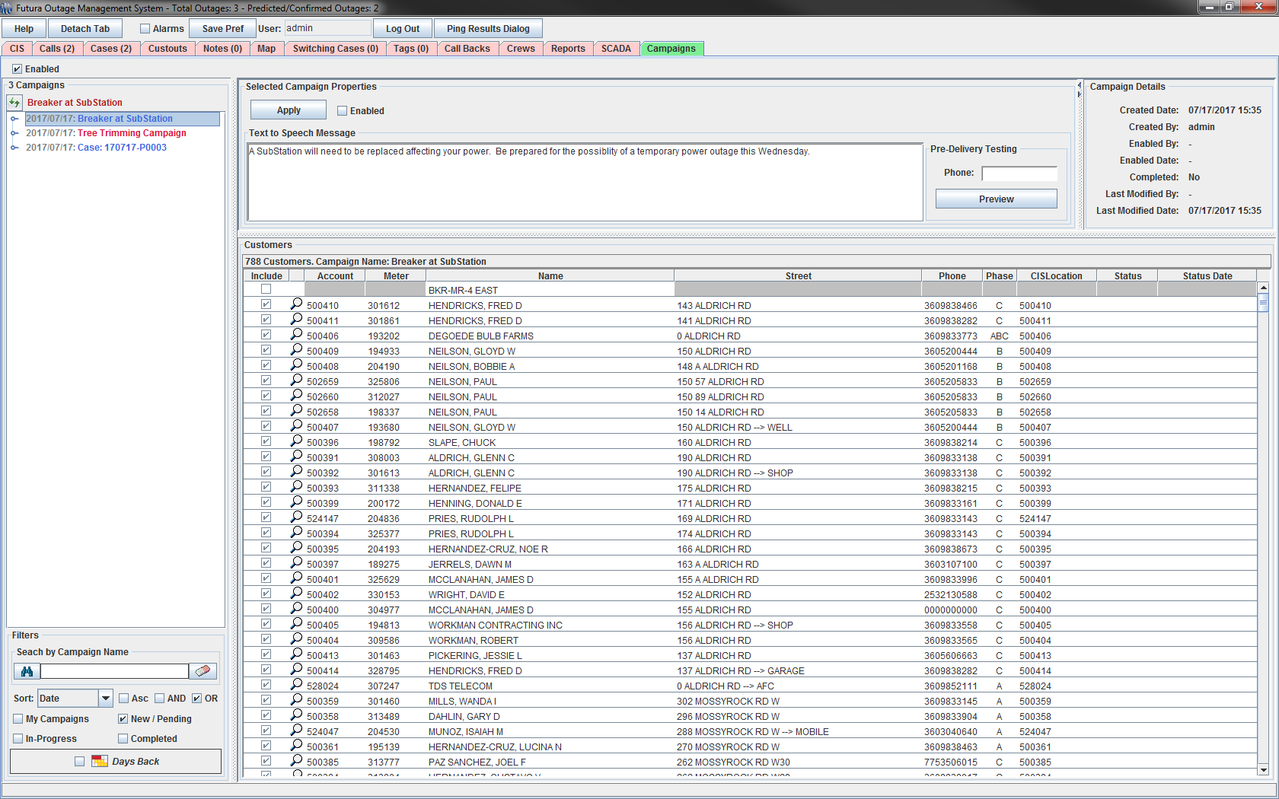
Futura IVR – Campaigns!
OMS Client
Campaigns Tab
Manage Campaigns
View /Export Lists
Notes:
With FuturaIVR you will also be able to utilize new call Campaign functionality that is built into OMS. This solution will enable you to issue mass calls campaigns to your consumers to notify them of planned maintenance in a given area.
<click>
OMS Client will feature a new Campaigns tab that will make it a breeze to keep your clients informed on future maintenance or outage conditions occurring on your system.
<click>
This interface is devoted to creating and managing your FuturaIVR campaigns.
<click>
You can View / Export consumer lists and monitor the status of outgoing calls / messages from this interface.

Slide 21
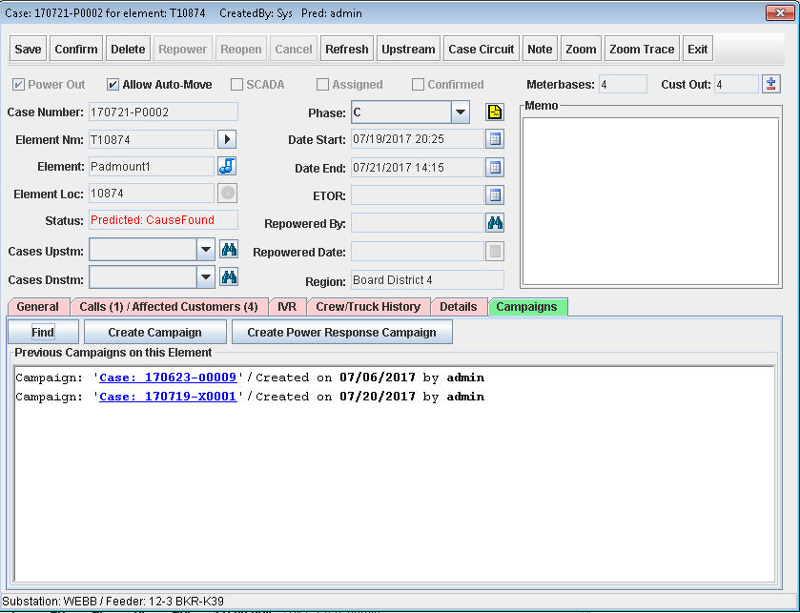
Futura IVR – Campaigns!
Case Ticket
Campaigns SubTab
View Previous Campaigns
Create Campaign
Create Power Response Campaign
Notes:
Campaign functionality will also be available directly from the Case ticket in OMS under the <click> Campaigns subtab.
<click>
You will be able to search for previous campaigns on the same device.
<click>
You can Create a new campaign for an outage directly from the Case ticket quickly.
<click>
You can even trigger a Power Response campaign to poll affected consumers for their outage status similar to the way callbacks work in OMS.

Slide 22
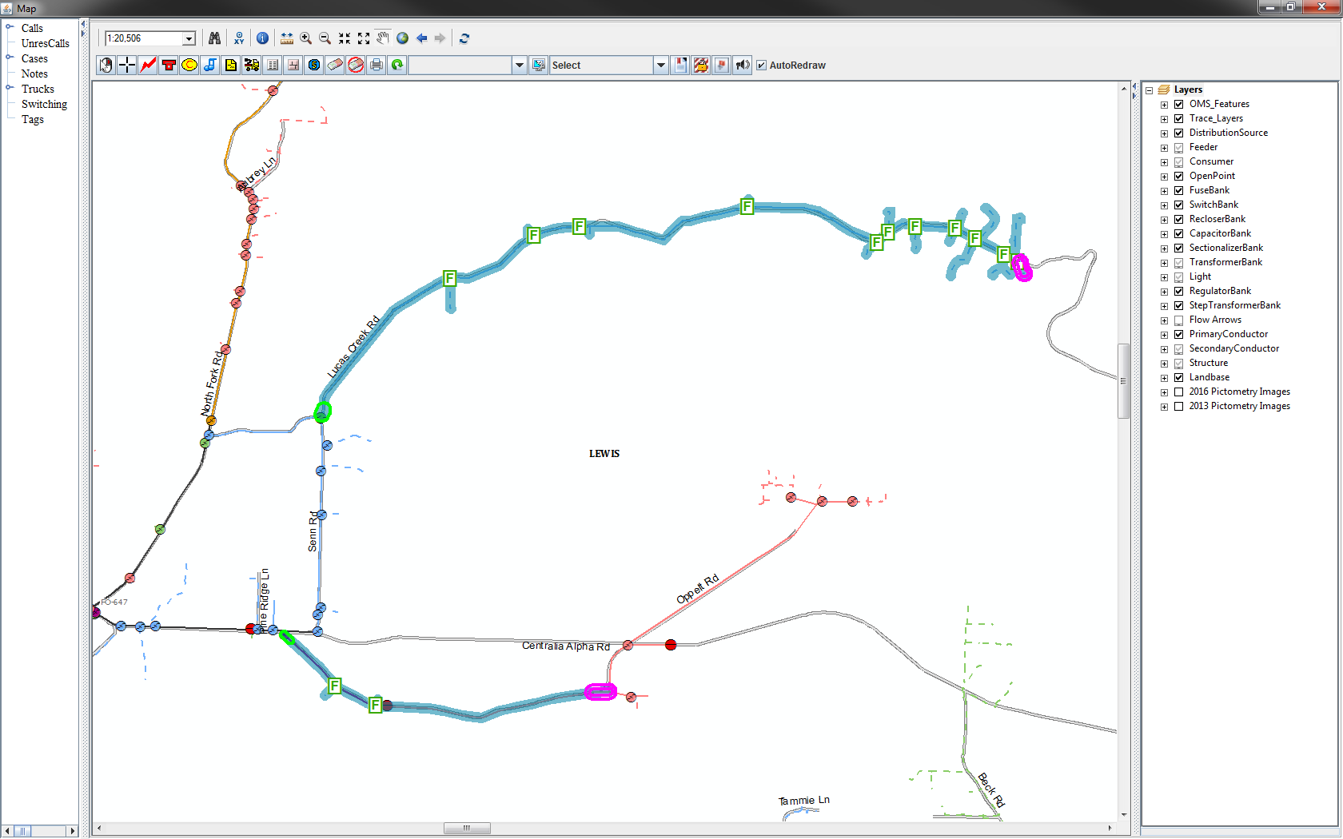
Futura IVR – Campaigns!
Map Tab
Select Multiple Start and End Points from Map
2+ segments, 1 campaign
Notes:
Another interesting feature of campaigns is that you can create campaigns using the Map Tab in OMS.
<click>
This allows you to select multiple start and end points to tailor the consumers involved in the campaign visually from the map of your distribution.
<click>
In this example tree trimming is scheduled along a couple different sections of line in the same general area and the same time period. We have selected 2 segments to participate in one campaign.

Slide 23

Review
Joint effort between SEDC and Futura
AutoCue / Futura IVR
AutoCue places calls into OMS
FuturaIVR handles Callbacks and Outage Status Requests
Provides automatic restoral confirmation
Identifies secondary issues before crews leave the area
New Campaigns in OMS
Keep your customers informed
Notes:
<click>
This solution is joint effort between SEDC and Futura
<click>
The two components are AutoCue and FuturaIVR respectively.
<click>
AutoCue places the calls, Futura IVR handles the callbacks after outage restoral.
<click>
FuturaIVR handles callbacks and outage status requests made within AutoCue.
<click>
This provides automatic restoral confirmation and can help <click> identify secondary issues before crews leave an area.
<click> New Campaigns in OMS keep your customers informed and confident in the utility.

Slide 24
Recap
Benefits of AutoCue:
Benefits of Futura IVR:
Cloud Infrastructure
Low Startup Cost
Extremely Reliable
Pay-as-you-go
Easy to modify IVR call tree
Easy to select messages and add recordings
Fast deployment
Direct Access:
IVR Configuration
IVR Logging
Callbacks issued from a Local Number
Calls and Callbacks handled automatically
Automatic Outage Restoral Confirmation
Notes:
There are many benefits to this joint solution.
<click>
With AutoCue, the cloud infrastructure provides a low startup cost for an extremely reliable solution. You then pay-as-you-go based on your call volume.
<click>
It is easy to modify your IVR call tree and <click> easy to select messages or add recordings.
<click>
All of this comes with a fast deployment time.
<click> With FuturaIVR, you will have direct access to your IVR configuration and <click> IVR logging. You will not have to depend on a third party.
<click>
Callbacks in FuturaIVR will be issued from a Local Number which is great for customer engagement.
<click>
Calls and Callbacks are handled automatically for you.
<click>
You get Automatic Outage Restoral Confirmation that will keep you ahead of any secondary outages before your crew leaves the area.

Slide 25
QUESTIONS?

