Slide 1
Figures for DART docs

Slide 2
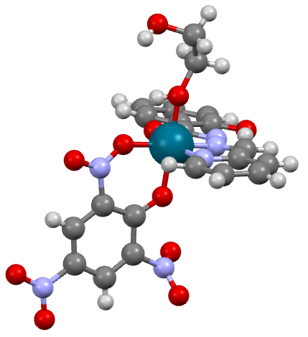
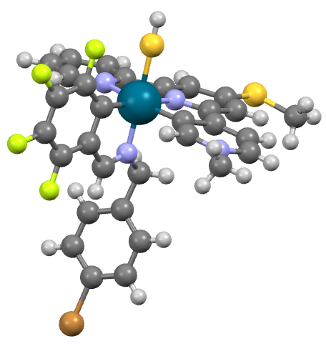
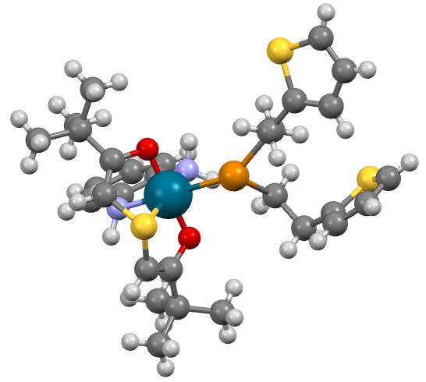
Quickstart: DART output without filters
AMAPIHOJ
YOZEPECO
HOKEHAYA

Slide 3
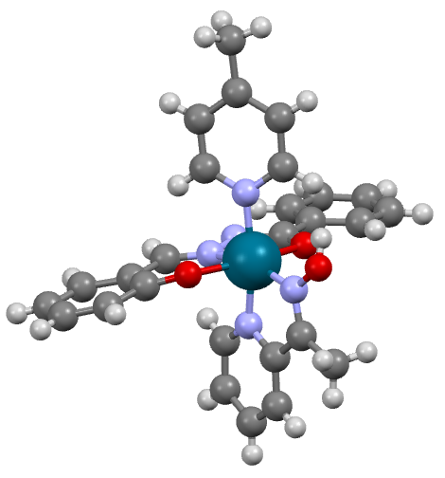
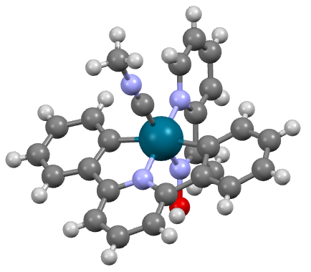
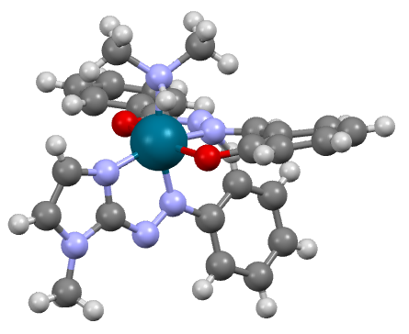
Quickstart: DART output with filters
ITUXUGEB
CIGIBENA
WOREDEKI

