Slide 1
Figures for DART docs

Slide 2
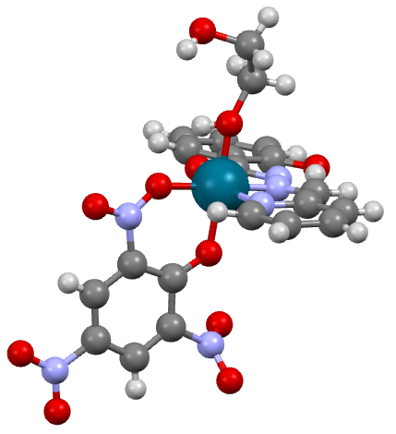
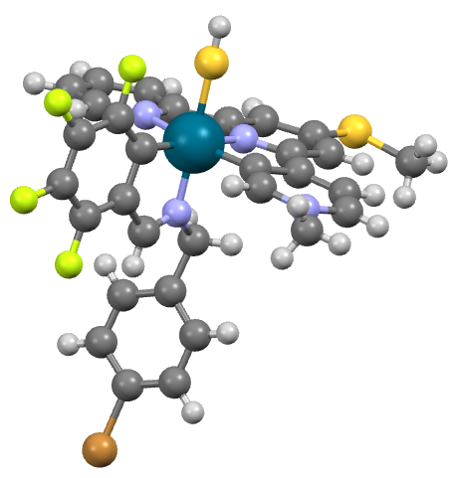
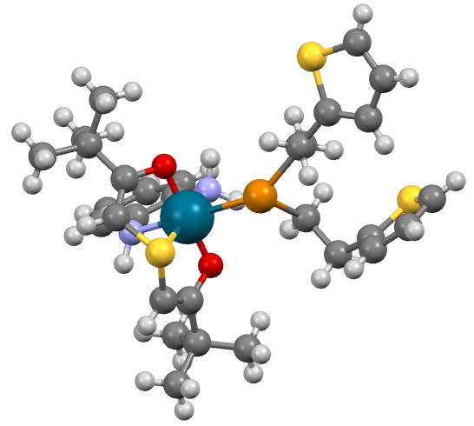
Quickstart: DART output without filters
AMAPIHOJ
YOZEPECO
HOKEHAYA

Slide 3
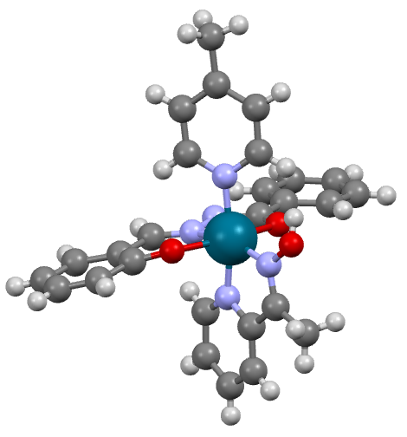
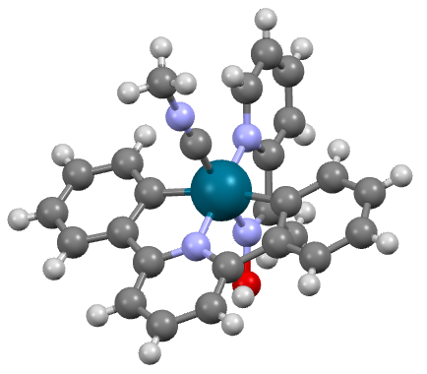
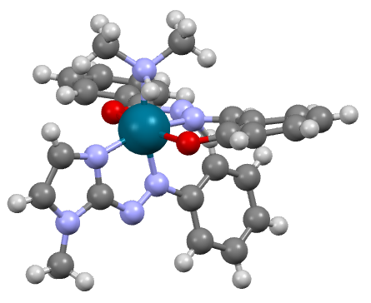
Quickstart: DART output with filters
ITUXUGEB
CIGIBENA
WOREDEKI

Slide 4
MetaLig: Bar chart of metal centers
8000
6000
Number of Ligands
4000
First row transition metals
Other Metals
2000
8000
Pd
Ni
Pt
Zn
Fe
Ru
Mn
Au
Rh
Ir
Mo
Re
Ti
Cr
V
W
Hg
Zr
U
Y
Dy
La
Ta
Ce
Er
Hf
Sc
Gd
Tc
Lu
Ho
Cu
Co
Ag
Cd
Os
Eu
Tm
Pu
Yb
Sm
Nd
Tb
Nb
Th
Pr
No
Metal Center

Slide 5
MetaLig: Bar chart of donors
8000
6000
4000
Number of Ligands
Other
2000
2000
1
2
3
4
5
Ligand Denticity

