Slide 1
PASSWORD GENERATOR SUBMITTED BY : CO21306 : Akshit Chhikara CO21315 : Chetan Kumar
SUBMITTED TO : Dr. Sarabjeet Singh

Slide 2
Basic Information
The password generator program is made using C++.
This program generates random password as per the need of the user.
The program benefits the user by providing a strong password for his/her online accounts.
This program can also be used in automatic account initialisation softwares.
The passwords generated by this program will provide protection from hackers.

Slide 3
How to use it ?
The program will first greet user with the title.
Then it will ask user to enter the length of password.
Program will then provide user with option to add - lowercase, uppercase, numbers and special characters – to the password.
The user will answer these questions by entering – ‘y’ for yes and ‘n’ for no.
After these steps, the program will generate a random password.
Finally, program will ask user if he/she would like a new password.

Slide 4
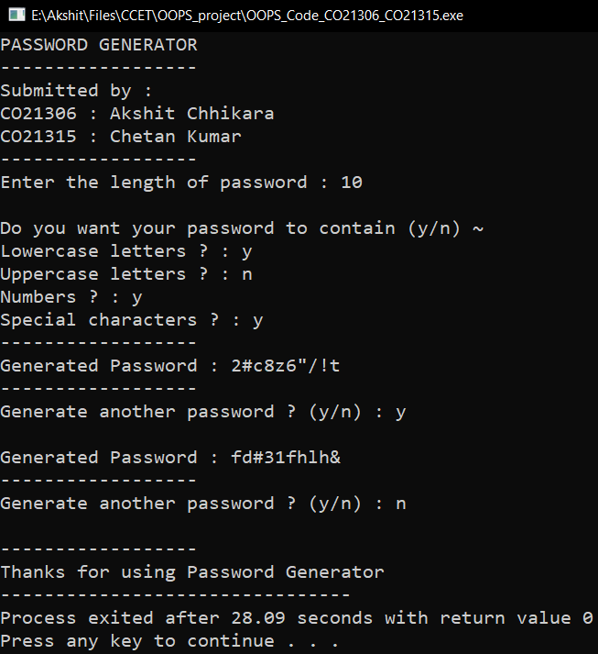
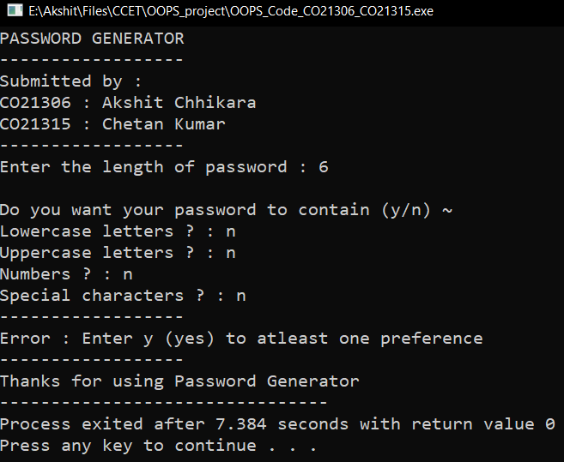
Use Cases :

