Slide 1
Matching Methods for Covariate Adjustment in R
Nicholas J. Ollberding, PhD
Associate Professor
Division of Biostatistics and Epidemiology
Cincinnati Children’s Hospital Medical Center
E-mail: nicholas.ollberding@cchmc.org

Slide 2


Goals
Background on confounding bias and benefits and limitations of matching methods
Introduction to common matching methods and how to implement them in
MatchIt package
Exact, MD, PS, Optimal
Outcome estimation after matching

Slide 3
Acknowledgements
Daniel E. Ho, Kosuke Imai, Gary King, Elizabeth A. Stuart (2011). MatchIt: Nonparametric Preprocessing for Parametric Causal Inference. Journal of Statistical Software, Vol. 42, No. 8, pp. 1-28. doi.org/10.18637/jss.v042.i08
https://cran.r-project.org/web/packages/MatchIt/index.html
Greifer N, Stuart EA. Matching Methods for Confounder Adjustment: An Addition to the Epidemiologist's Toolbox. Epidemiol Rev. 2022 Jan 14;43(1):118-129. doi:10.1093/epirev/mxab003. PMID: 34109972; PMCID: PMC9005055.
Paul Rosenbaum. Design of Observational Studies (2nd edition). 2020.

Slide 4
Why Do We Care About the Analysis of Observational Data?
Need to make evidence-based decisions about comparative effectiveness and/or safety
Ideally decisions informed by randomized trials
RCTs often not available due to resource, cost, or ethical constraints
Analyze observational data to inform decision making
confounding bias
selection bias, interference, positivity and consistency violations, etc.
Miguel Hernan, Armitage Lecture, 2019

Slide 5
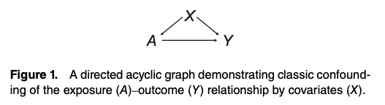
Confounding Bias in Observational Studies
Goal to obtain effect estimate of an exposure on an outcome that is free of confounding bias
- no open backdoor paths from exposure to outcome
Lots of options to do this for studies with treatment, set of pre-treatment covariates, and outcome
matching methods
stratification
outcome regression
weighting methods (i.e., IPTW)
Greifer and Stuart. Epidemiol Rev. 2022

Slide 6
Benefits of Matching
Transparent, simple, and convincing
focus on suitability of other assumptions required for inference
Separation between the design and analysis phases
matching performed without need of outcome data
allows for registration of design prior to analysis
Reduces model dependency*
no need to model
matching before modeling reduces model dependency
may reduce variance
*Ho et. al. Matching as Nonparametric Preprocessing for Reducing Model Dependence in Parametric Causal Inference. Political Analysis (2007) .
Notes:
Easy to explain to a broad audience

Slide 7
Limitations of Matching Methods
Low bias/high variance estimators
reduced precision of estimates and statistical power
Change the estimand of interest
most target the ATT or ATM
Limited utility
best developed for point treatments with two exposure levels
can expand to multiple treatments and time points
Matching is performed only on observables

Slide 8
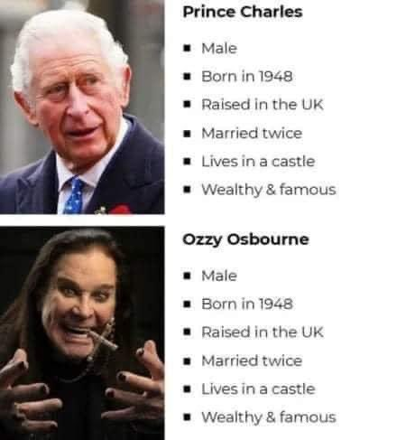
Limitations of Matching on Observables
Prince of England
Prince of Darkness
Found this on twitter and have no idea to attribute it to!

Slide 9
Steps in Matched Analysis
Step 1: perform distance-based matching on selected covariates
Step 2: assess covariate balance in matched sample
modify matching method as needed to achieve balance
Step 3: estimate treatment effect after matching
Step 4: conduct sensitivity analysis to unmeasured confounding

Slide 10
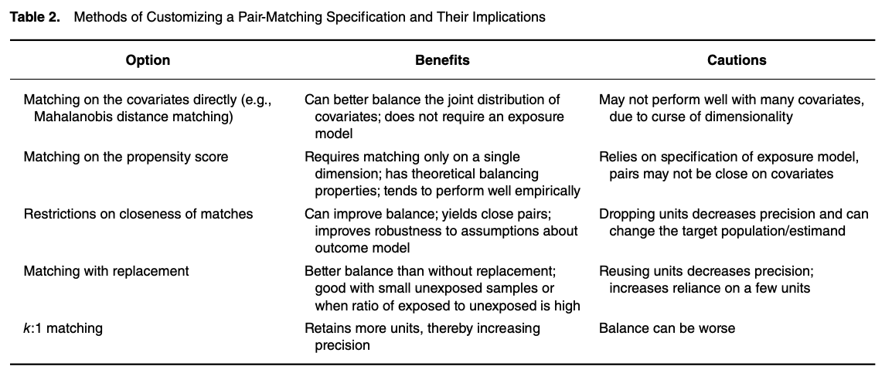
Lots of Options!
Greifer and Stuart. Epidemiol Rev. 2022

Slide 11
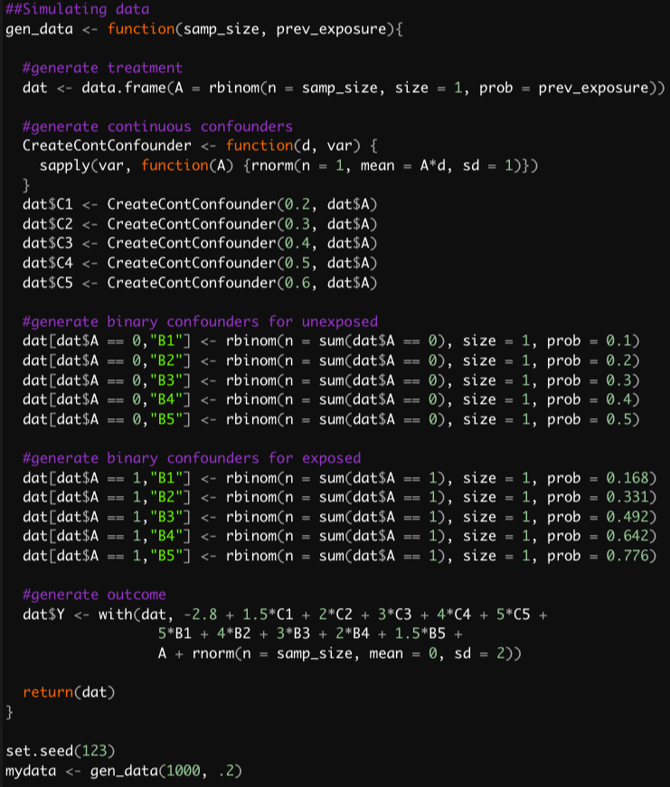
Simulated Data
Sample size: n = 1000
Exposure status: 20% exposed
10 baseline confounders:
- 5 continuous and 5 binary
- confounding varies from modest to severe (0.2 to 0.6 SMD)
Continuous outcome with true difference between groups of 1 unit
No repeated measures, missing data, etc.
Peter Austin. Biometrical Journal 51 (2009).
Code at: https://rpubs.com/kaz_yos/confounder1

Slide 12
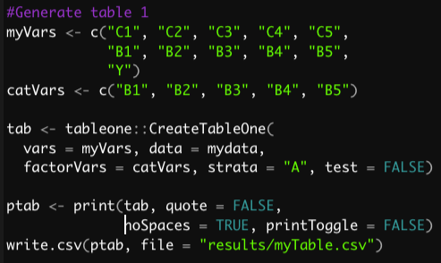
Covariate Distribution According to Exposure Status
 | Unexposed (n = 802) | Exposed (n=198)
C1, mean (SD) | 0.04 (1.01) | 0.11 (0.98)
C2, mean (SD) | 0.02 (1.00) | 0.20 (0.93)
C3, mean (SD) | 0.01 (1.00) | 0.37 (1.00)
C4, mean (SD) | 0.00 (1.01) | 0.39 (0.96)
C5, mean (SD) | 0.01 (0.98) | 0.56 (0.99)
B1 = 1 (%) | 79 (9.9) | 31 (15.7)
B2 = 1 (%) | 170 (21.2) | 65 (32.8)
B3 = 1 (%) | 239 (29.8) | 95 (48.0)
B4 = 1 (%) | 305 (38.0) | 138 (69.7)
B5 = 1 (%) | 383 (47.8) | 158 (79.8)
Y, mean (SD) | 1.15 (8.35) | 10.29 (8.96)
Yoshida and Bartel (2021). Tableone. Version 0.13.0.

Slide 13
Exact Matching
Simple and powerful matching method
Matches each treated unit to all possible control units with the same values on all covariates
confounding due to measured covariates is eliminated within matched strata
non-parametric (i.e., no reliance on correctly specified model, etc.)
strata without both treated and control units discarded
Rarely used (alone) in practice due to curse of dimensionality

Slide 14
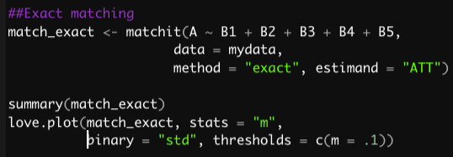
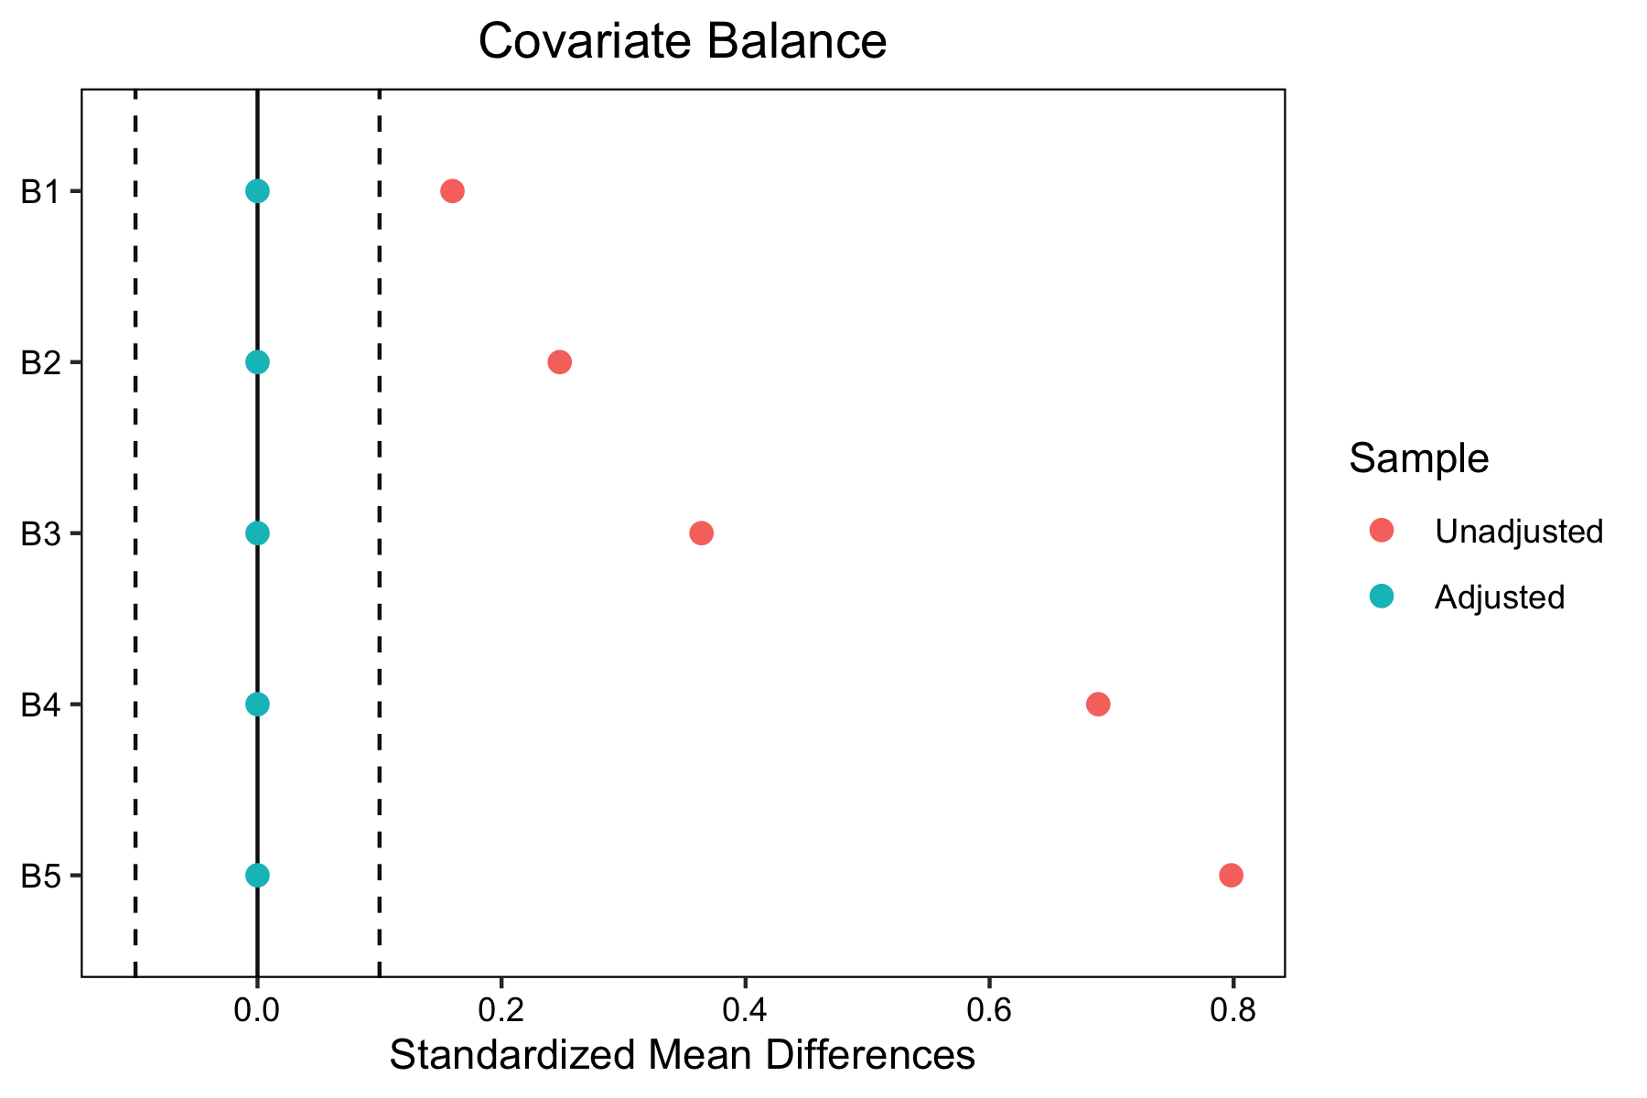
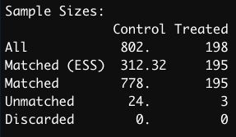
Exact Matching in R
Notes:
the effective sample size (ESS) is the size of an unweighted sample carrying approximately the same precision as the weighted sample in question
When weights scaled to 1 = n / (1 + var in weighted sample)

Slide 15
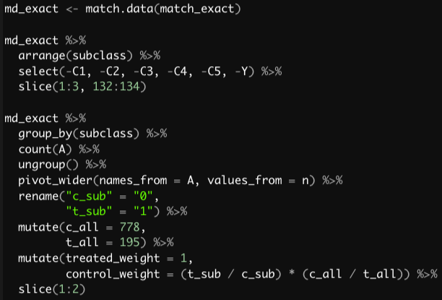
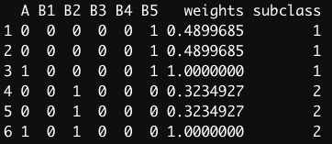

Matching as Stratification and Weighting
Exact matching produces strata of treated and controls that have identical covariate values
Effect estimates within strata are unconfounded
Need to average estimates over all strata while accounting for the numbers in each
Weights let us do this
All treated assigned weight of 1
Control weight is strata specific: (# treated in strata / # controls in strata) * (total controls / total treated)

Slide 16
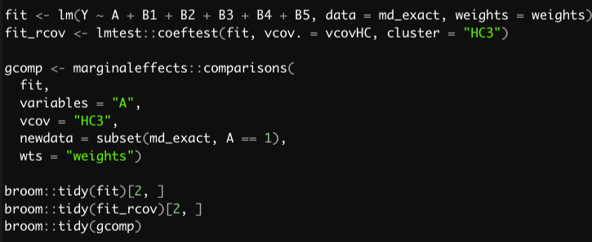
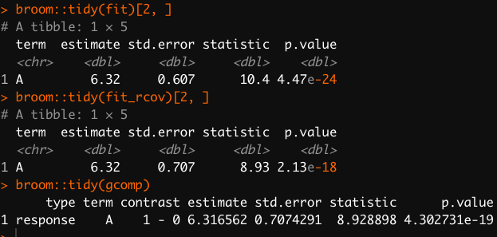
Estimating Effects After Exact Matching
Common approach is to regress outcome on exposure in model that includes matching factors and weights
Robust standard errors can be used to account for matching
G-computation is an approach to get marginal estimates for non-collapsible effect measures or models with interactions
https://kosukeimai.github.io/MatchIt/articles/estimating-effects.html
Notes:
Come back and explain why need robust SEs

Slide 17
Coarsened Exact Matching
CEM is exact matching after “coarsening” variables before matching
- Collapsing levels of categorical variables
Binning of continuous of variables
Benefit is substantive knowledge can be used to coarsen data and still perform exact matching
Often not viable solution with many covariates
Iacus, Stefano M., Gary King, and Giuseppe Porro. 2012. “Causal Inference
Without Balance Checking: Coarsened Exact Matching.”
Political Analysis 20 (1): 1–24. https://doi.org/10.1093/pan/mpr013.

Slide 18
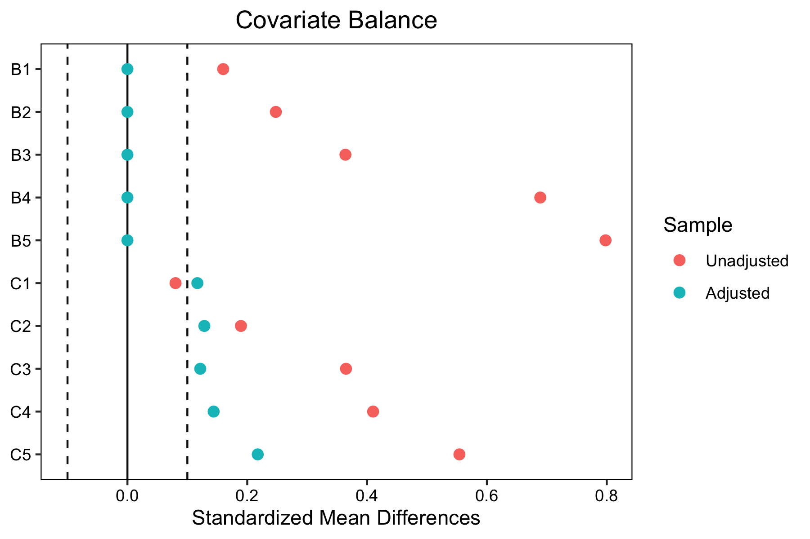
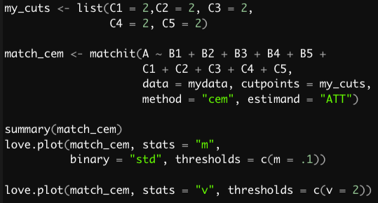
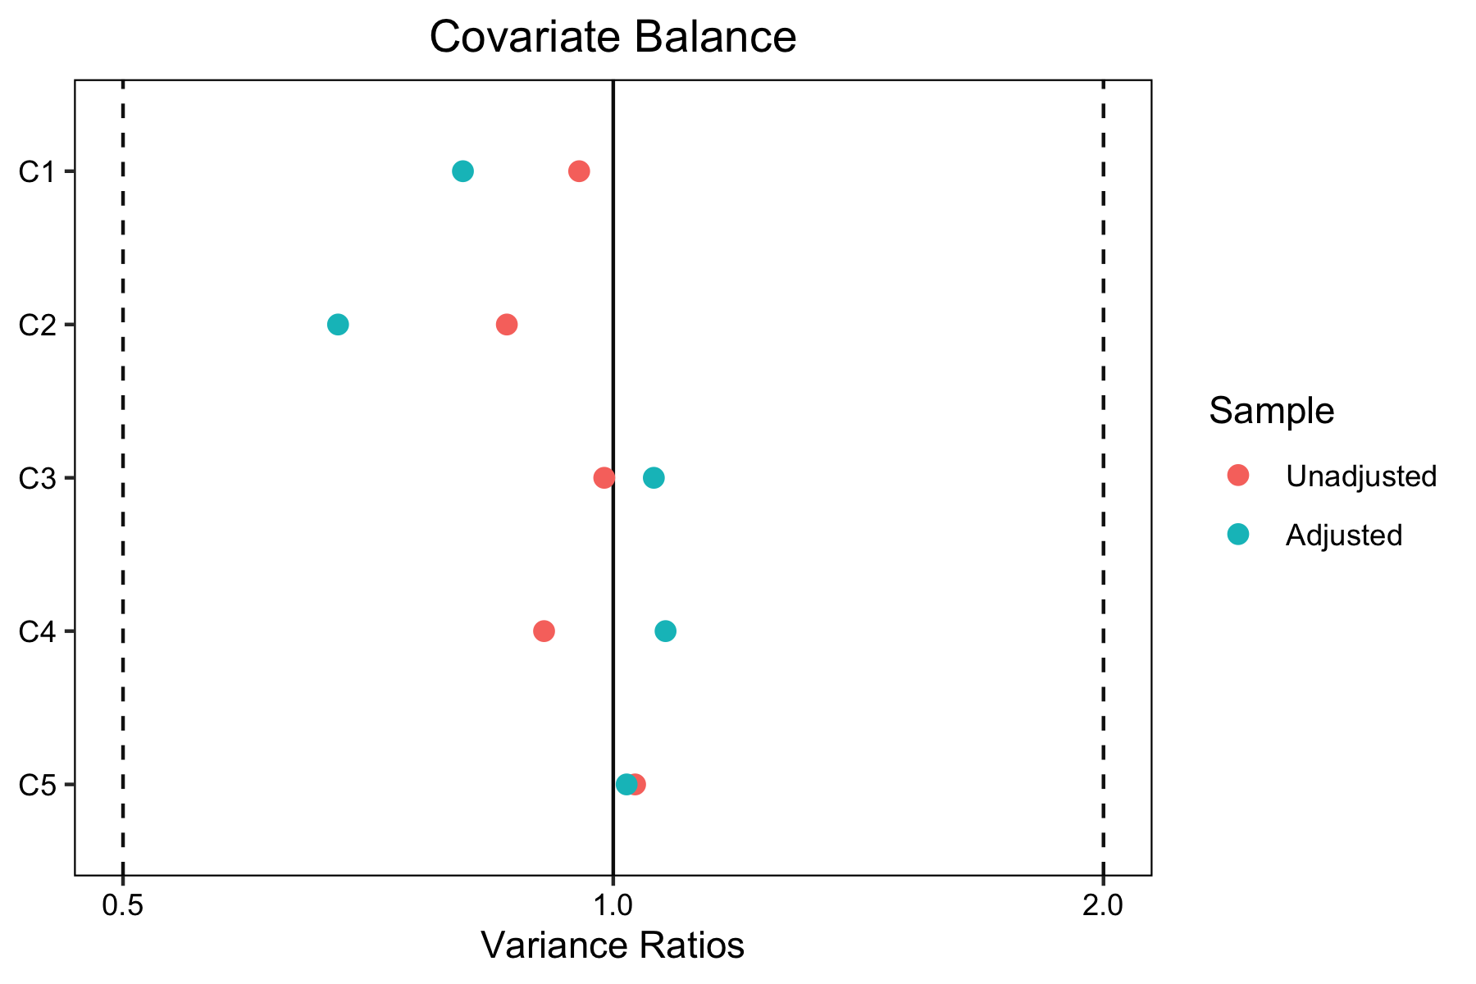
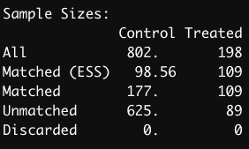
CEM in R
Cutpoints automatic or user-defined
Automatic calls nclass.Sturges() by default
Creates 11 bins per CV @ n=1000
Returns n=2 matches

Slide 19
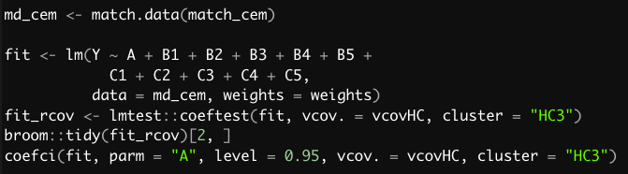
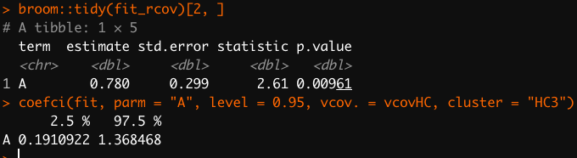
Estimating Effects After CEM
Same approach as for exact matching
Output matched dataset
Account for weights
Bias reduced relative to exact matching on categorical covariates only
CEM prior to regression commonly used
95% CI contains true effect

Slide 20
Mahalanobis Distance
Provides a measure of how similar two subjects are in terms of their covariate distributions (i.e., covariate proximity)
MD = 0 would reflect identical covariate values
Similar to Euclidian distance except considers correlations between variables
incorporates transpose of the covariance matrix in calculation
handles variables of different types and scales
robust version performed on ranks
Benefit is that MD creates pairs close on covariate values
- limitation is that may not perform well in high dimensions
Notes:
https://stats.stackexchange.com/questions/511294/what-are-the-pros-and-cons-of-using-mahalanobis-distance-instead-of-propensity-s
Through the transpose of the covariance matrix
scale-free Euclidean distance; I think if have all CVs and scale to mean 0 and SD 1; MD and Euclidian are the same
For two units to have a Mahalanobis distance of 0, they must have identical covariate values. Large more dispariate
PS just gives balance overall (King paradox etc)

Slide 21
Nearest Neighbor Matching
Greedy matching: for each treated unit select closest eligible control
no consideration to how other units will be or have been paired
does not aim to optimize any criterion
Most common form of matching
Order in which the treated units are paired must be specified
reordering can change the matched pairs
matchIt default is descending order from the highest PS
allows matching those with greatest difficulty in finding close matches first
K:1 matches each treated to a control and then cycles through list again
https://cran.r-project.org/web/packages/MatchIt/vignettes/matching-methods.html#nearest-neighbor-matching-method-nearest
Notes:
(often performs very well)

Slide 22
Caliper Restrictions
Caliper defines the maximum distance allowable for matching two units
- a caliper can be though of as a ring around each unit that limits to which other units that unit can be paired*
Commonly applied to the propensity score
can be applied to other distances or on the raw scale
Typically improves balance on observed covariates
- trimming of treated subjects shifts estimand from ATT to ATM
*https://cran.r-project.org/web/packages/MatchIt/vignettes/matching-methods.html#caliper-matching-caliper

Slide 23
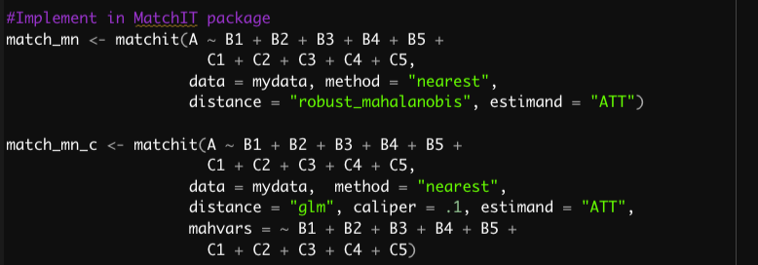
Mahalanobis Distance Matching in R 1:1 nearest neighbor matching

Slide 24
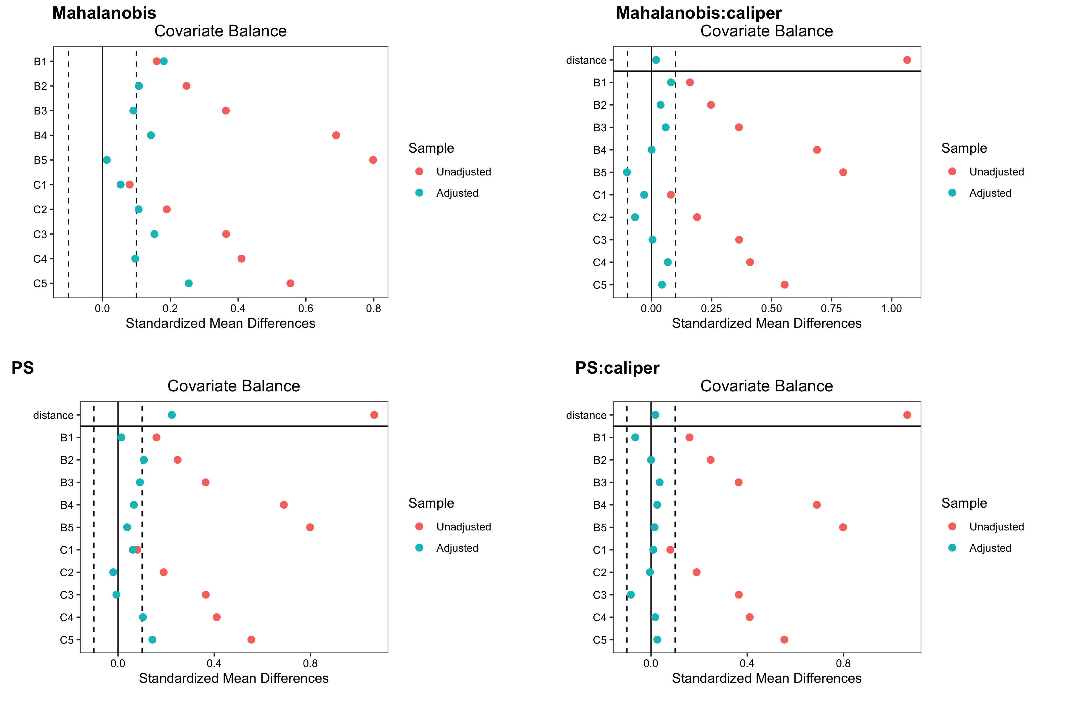
Mahalanobis Distance Matching in R 1:1 nearest neighbor matching

Slide 25
Propensity Score Distance
Conditional probability of treatment given the observed covariates: Pr(A_{i} =1 | x_{i})
Exposure status independent of treatment within strata of PS
balances exposed and unexposed groups on measured covariates
Used to overcome high-dimensionality problem
Not known and must be estimated from the data
- tautology: the estimated PS is appropriate if it balances covariates

Slide 26
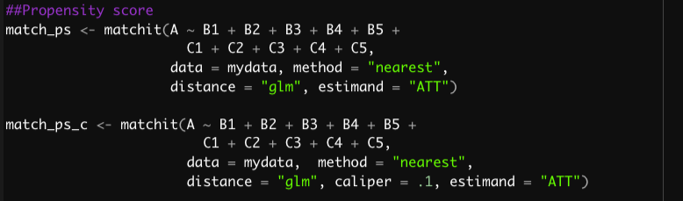
PS Matching in R 1:1 nearest neighbor matching

Slide 27
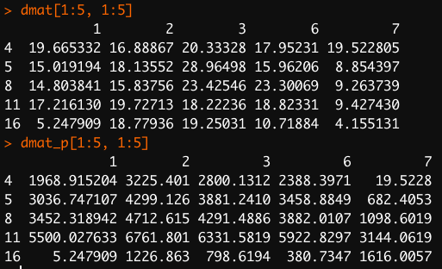
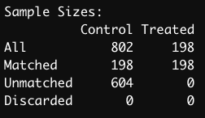
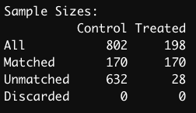
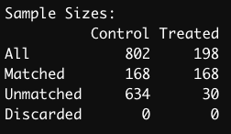
Impact of Imposing Caliper
robust Mahalanobis distances
Mahalanobis
Mahalanobis: caliper
Propensity score
Propensity score: caliper
- Rows are treated and columns potential controls to match
- Penalty adds distance to those outside of caliper region making match less likely
- matchIT sets distance to ∞ for those outside of caliper to prevent matching
- Treated subject dropped when no control is within the selected caliper range

Slide 28
PS Matching in R 1:1 nearest neighbor matching

Slide 29
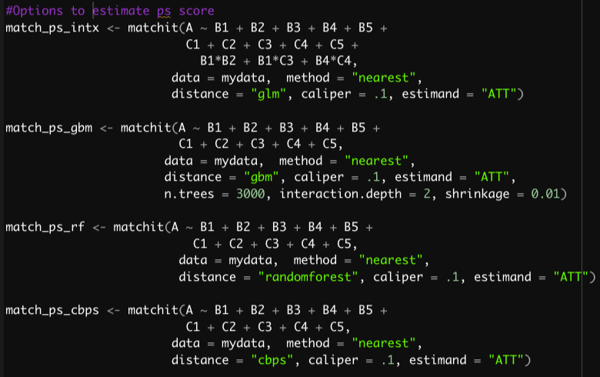
Options to Estimate Propensity Score
MatchIT package has build-in support for:
GLM, GAM, elastic nets, GBM, random forests, classification trees, single-hidden-layer neural network, BART, CBPS
Propensity scores computed outside of package
- Stacked ensembles via SuperLearner or tidymodels

Slide 30
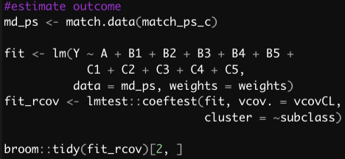
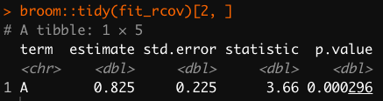
Estimating Effects After 1:1 Matching
1:1 matching results in weights of 1 for each treated and control
No need to account for in weights in outcome model
Account for pair matching using cluster robust standard errors
Common to estimate effect with paired t-test or rank-sum after 1:1 matching
less efficient
residual bias
Notes:
Weights all 1 so no need to account for; doesn’t hurt if you want to learn one workflow

Slide 31
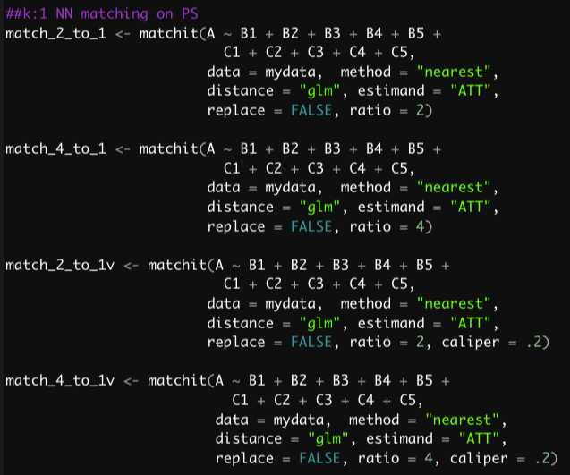
K:1 Matching
Can match more than 1 control to each treated unit
ratio can be fixed or varied
with or without replacement
Retain larger sample for analysis
may increase statistical precision and power
may come at cost of worse covariate balance
2:1 matching often performs well in simulations

Slide 32
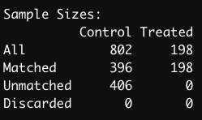
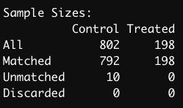
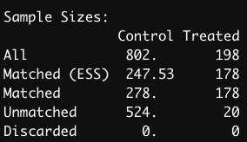
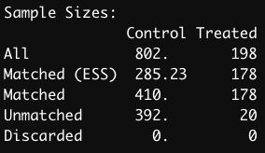
K:1 Matched Sample Sizes
2:1 fixed
4:1 fixed
2:1 fixed
4:1 fixed
Control | Treated | Pairs
2 | 1 | 198
Control | Treated | Pairs
4 | 1 | 198
2:1 variable
2:1 variable
Control | Treated | Pairs
1 | 1 | 78
2 | 1 | 100
Control | Treated | Pairs
1 | 1 | 78
2 | 1 | 29
3 | 1 | 10
4 | 1 | 61
2:1 variable
4:1 variable
replace = FALSE set to limit the number of times same control unit used
caliper set to restrict matches allowing or variable ratio matching
effective sample size highlights diminishing return of adding more control units

Slide 33
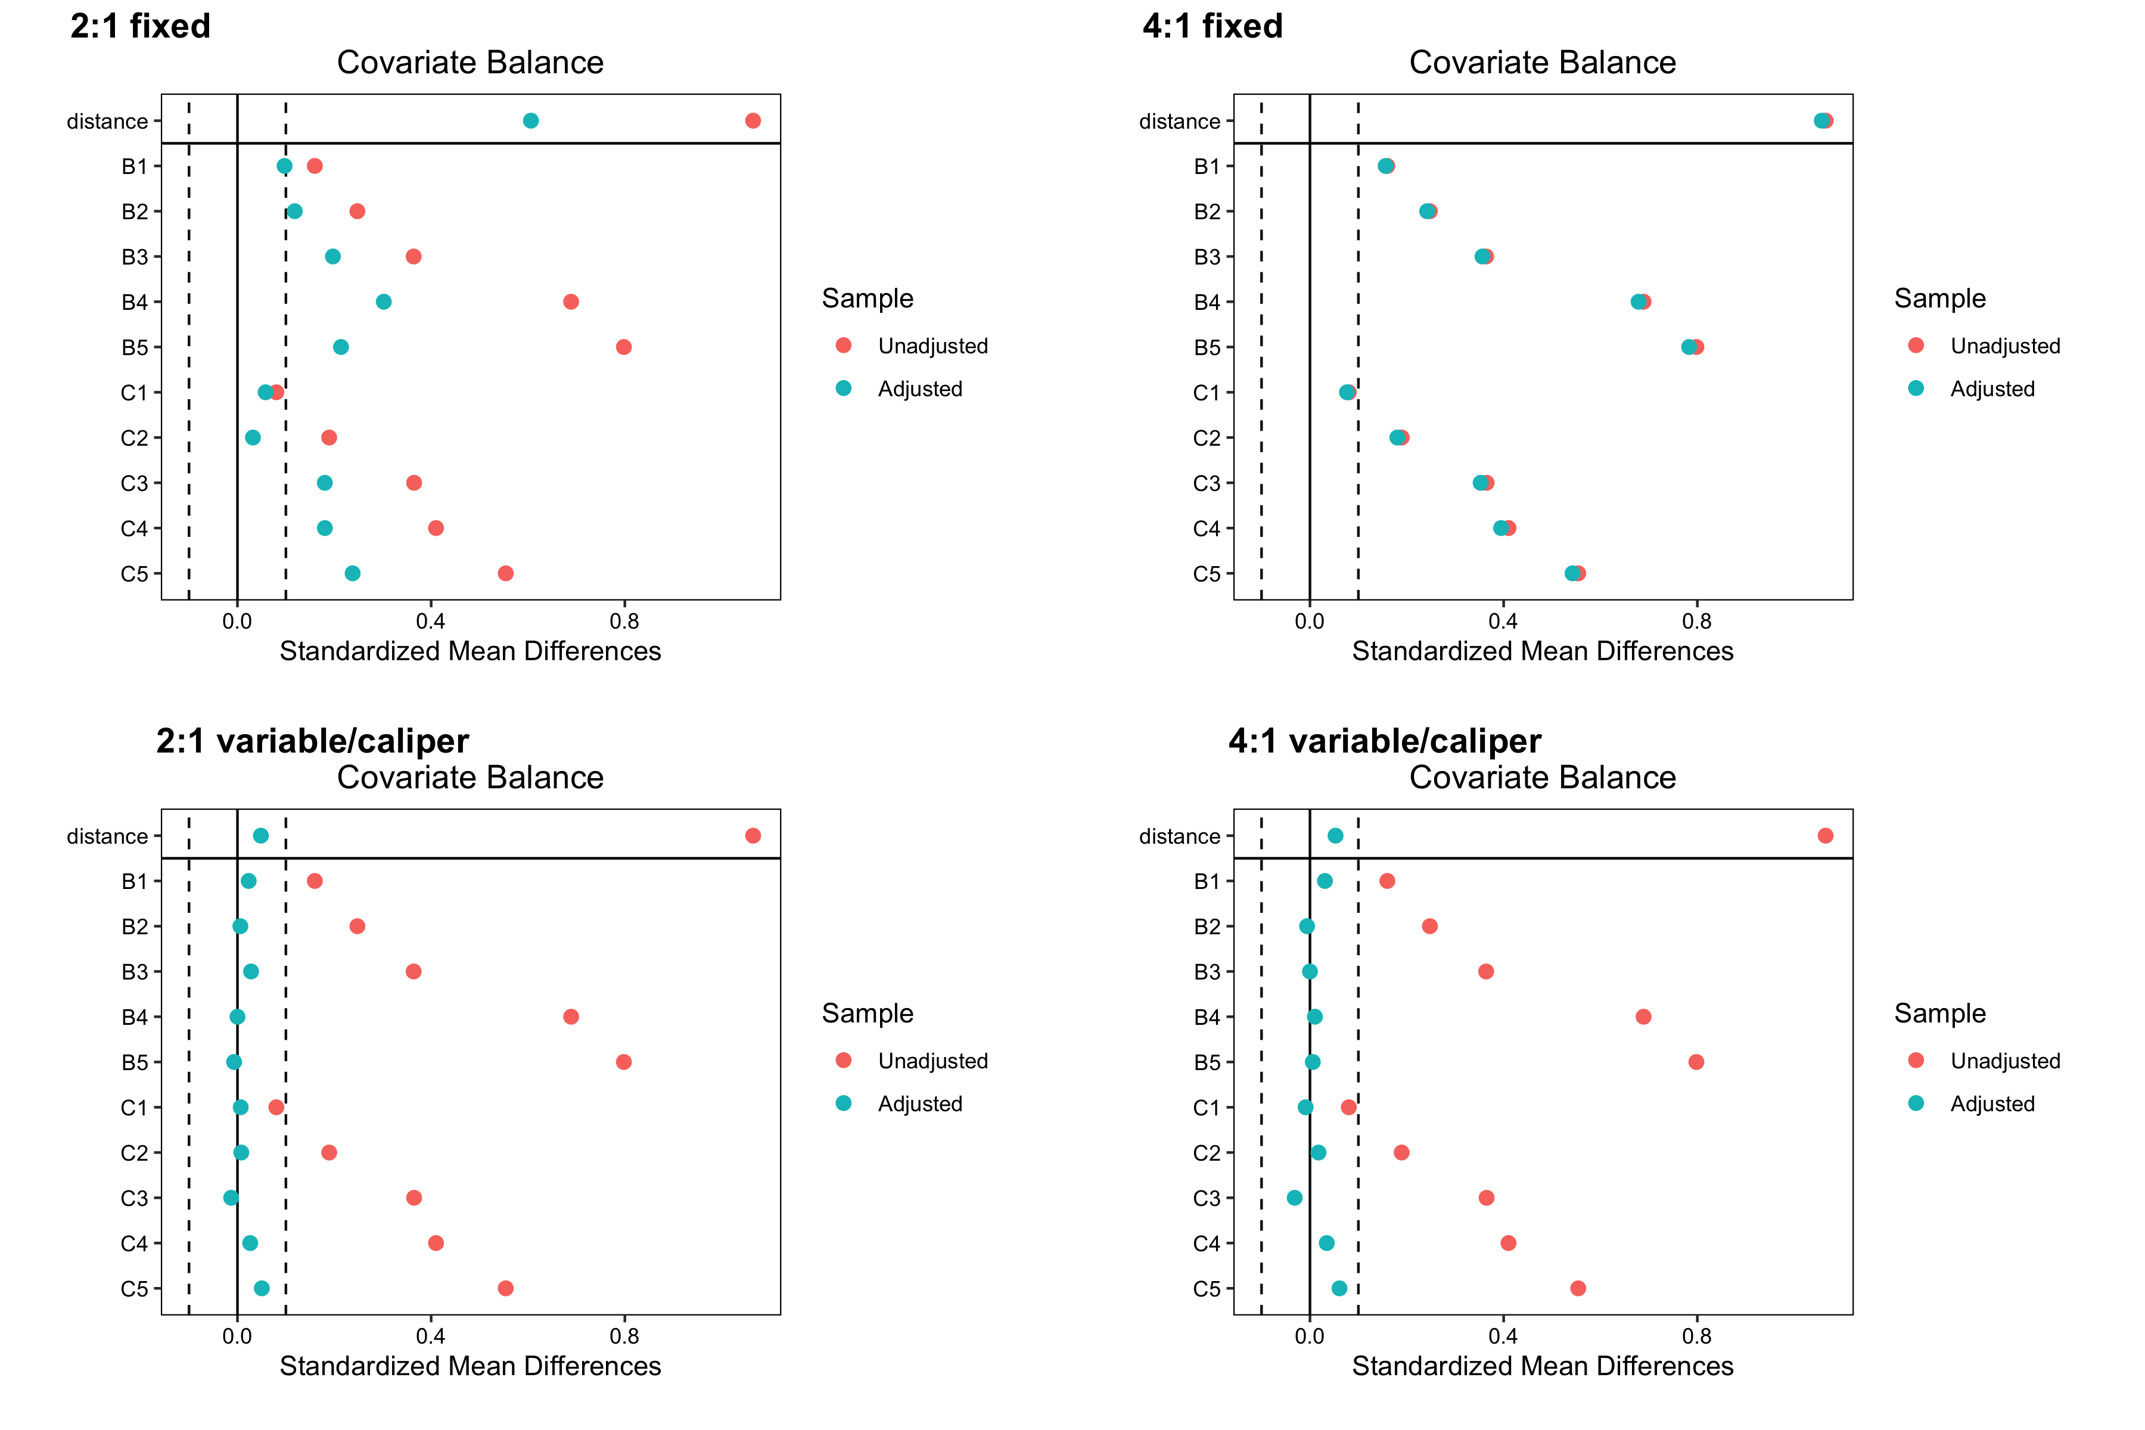
K:1 Covariate Balance

Slide 34
Optimal Matching
Pairing of treated and control units that selects matches by optimizing some overall criterion
MatchIt minimizes sum of absolute pair distances in matched sample
calls optmatch::fullmatch() function
Advantage: matching order not required and extreme within-pair distances less likely
Can return better pairs than greedy matching
often little difference in practice
caliper restriction not available
https://cran.r-project.org/web/packages/MatchIt/vignettes/matching-methods.html#optimal-pair-matching-method-optimal

Slide 35
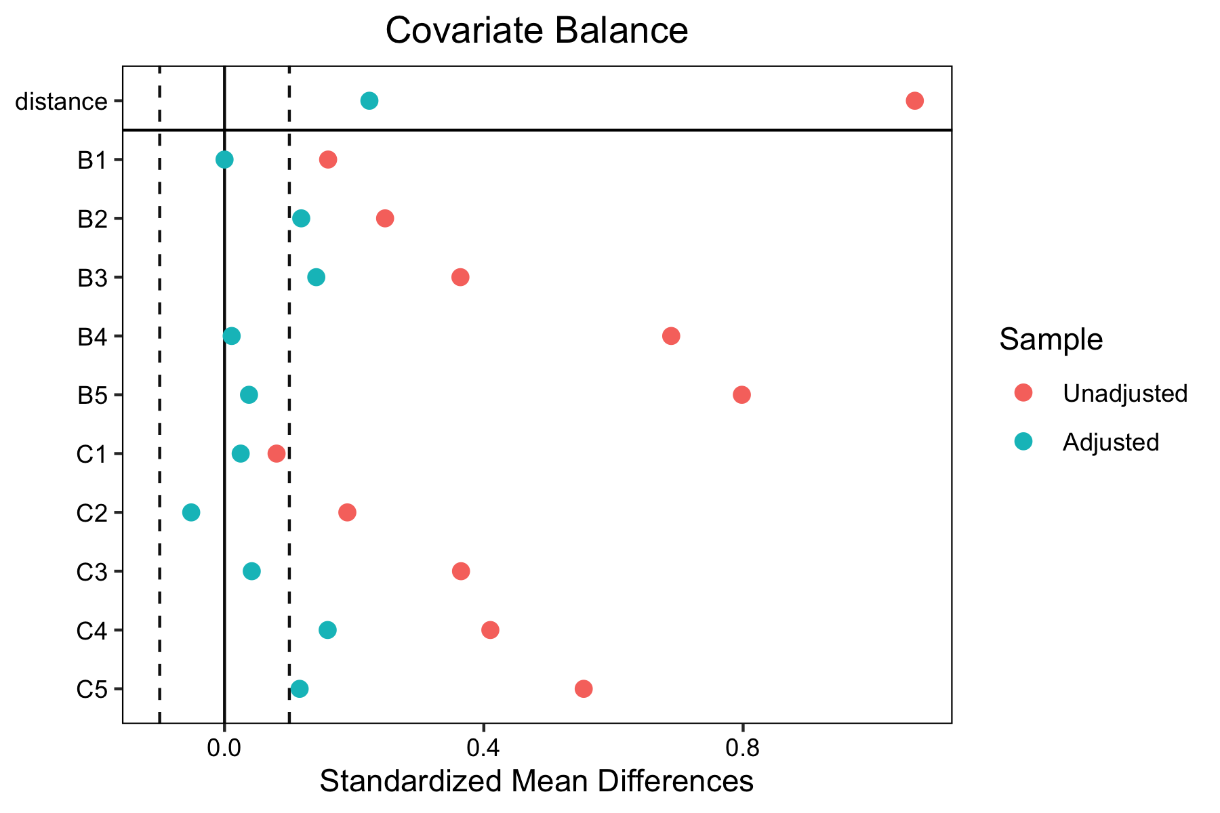
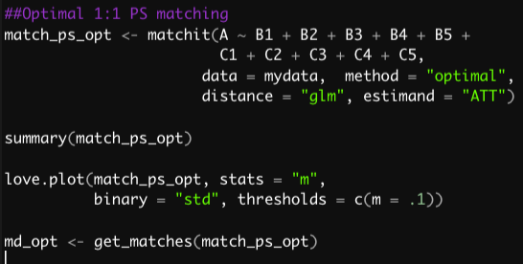
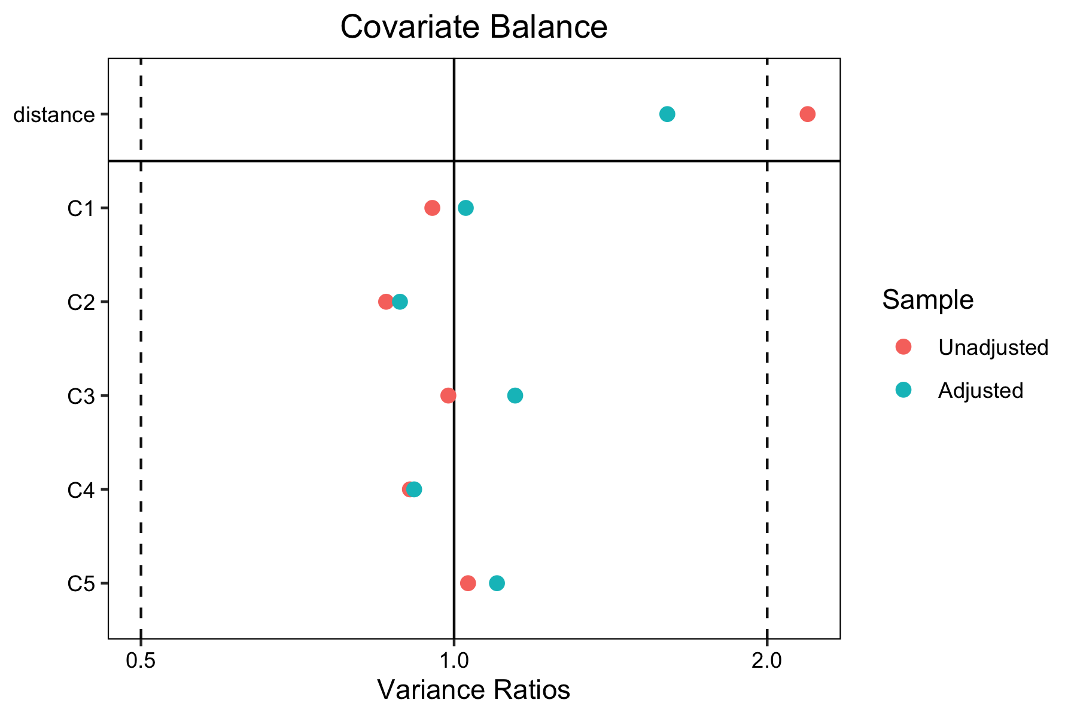
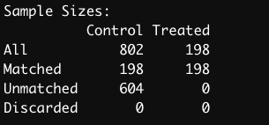
Optimal Pairwise Matching in R

Slide 36
Optimal Full Matching
Assigns every treated and control unit to one subclass
where every subclass contains at least one treated and control unit
Number of subclasses (and units within subclasses) selected to minimize within-subclass distances in matched sample
distance is commonly the PS
Generate weights based on subclass membership
weights used to estimate a weighted treatment effect
more robust than IPTW since PS used to generate subclass (rather than weight)
can be used to estimate the ATE
effective sample size often reduced due to weights
https://cran.r-project.org/web/packages/MatchIt/vignettes/matching-methods.html#optimal-full-matching-method-full
Notes:
not to form the weights directly

Slide 37
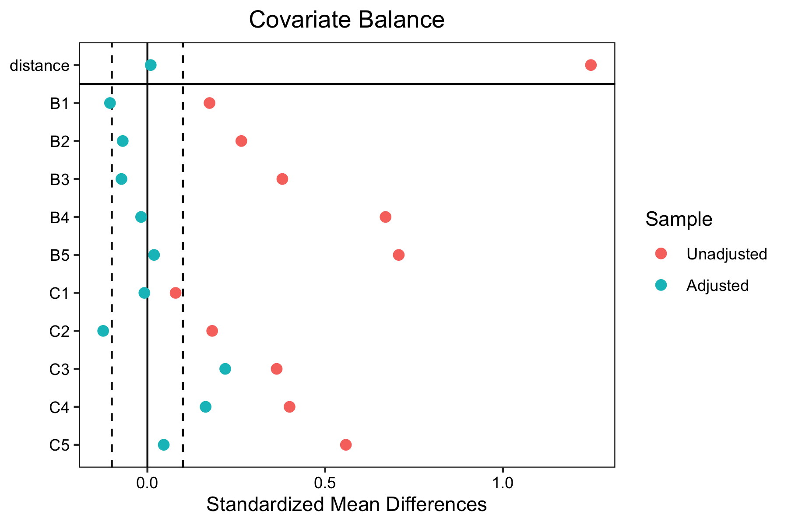
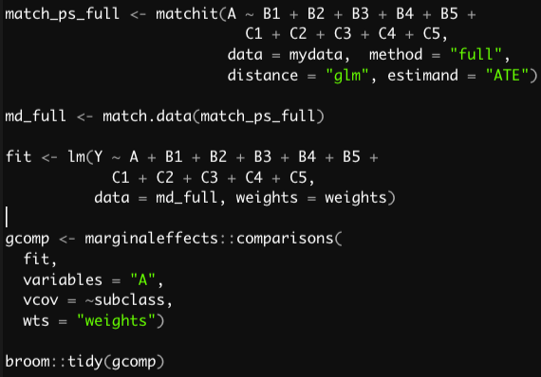
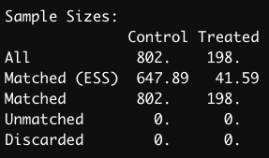
Optimal Full Matching in R: ATE

Slide 38
Other Optimization Approaches
Genetic matching
uses a genetic algorithm to find an optimal scaling factor for a generalized Mahalanobis distance
nearest neighbor matching on the scaled MD
scaling selected using balance tests for the covariates in the matched sample
Cardinality matching
uses optimization to select largest subset of units providing balance constraints on mean differences
constraints selected by user
balances covariate values directly
can pair match in subsample to improve precision
Notes:
Describe what is this scaling factor

Slide 39
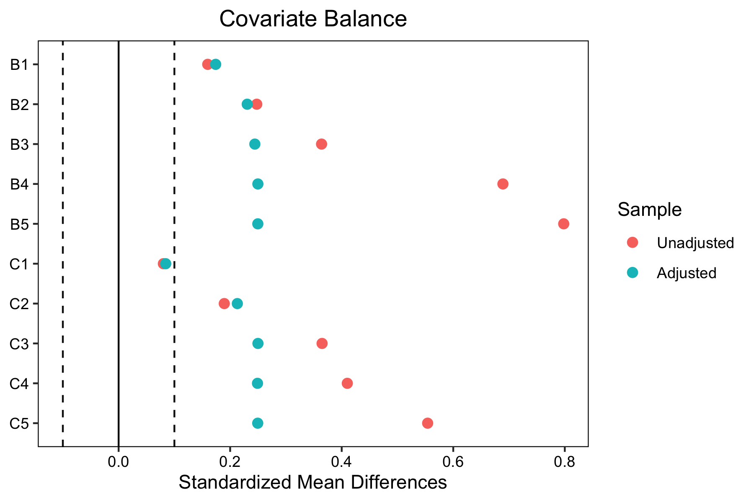
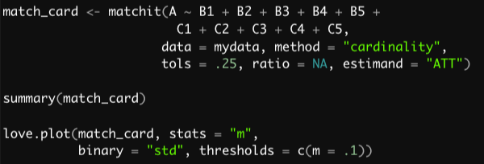
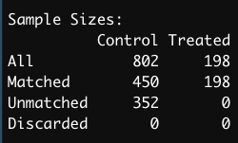
Cardinality Matching in R

Slide 40
Assessing Bias and Power of Matching Methods
Collaborative work often involves small samples and rare exposures
interested in bias/variance trade-off of matching and weighting
Reducing bias is paramount
what good is a precise estimate of a biased parameter
design phase approaches may provide some benefit
Running simulations of n = 100 to 500 and prev. exposure of 10% to 25%
high (same as before) and lower levels of confounding bias

Slide 41
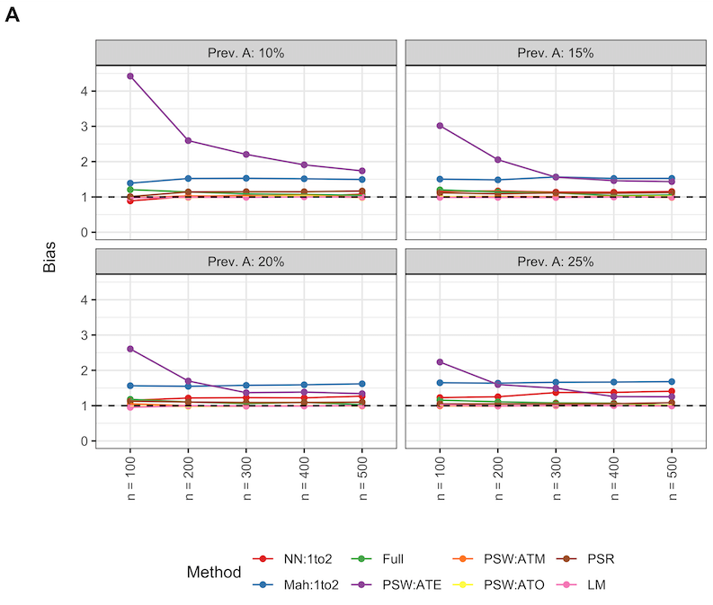
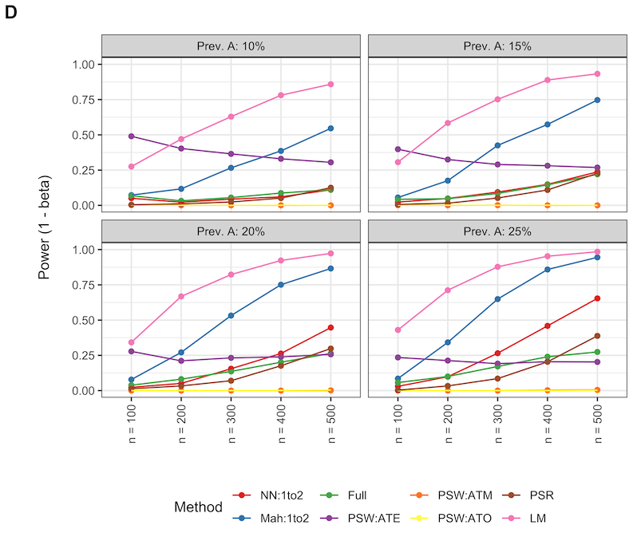
High Confounding Scenario

Slide 42
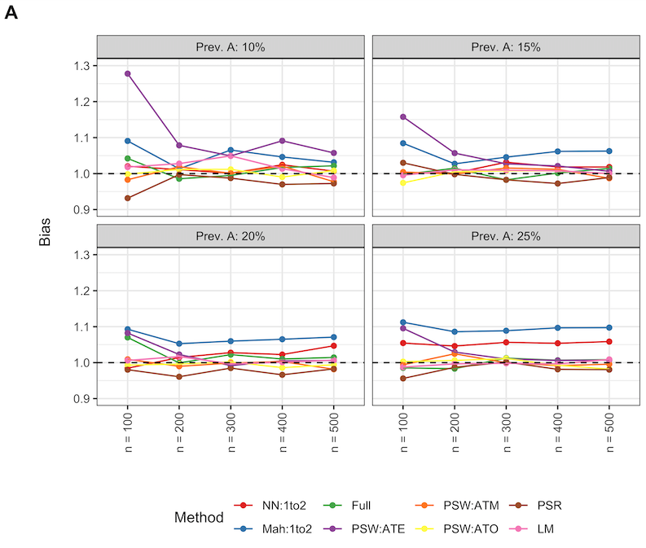
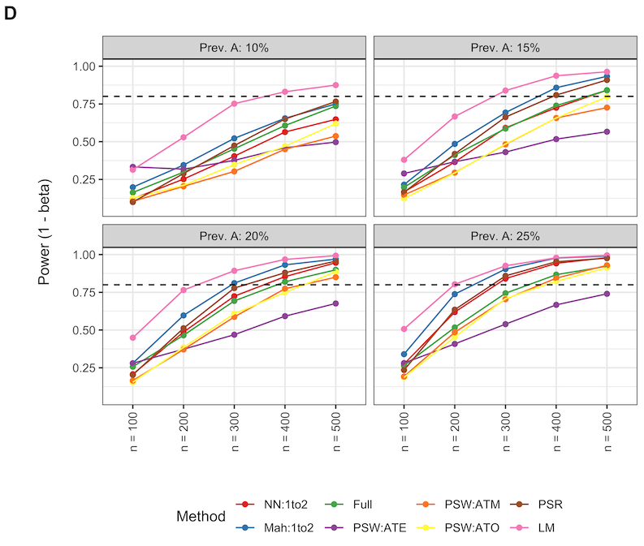
Low Confounding Scenario

Slide 43
Summary
Adjustment for covariates should be transparent, simple, and convincing
matching allows observational analyses to be restructured to resemble simple experiments
May come at the cost of some loss of precision and estimand
trade-off may be acceptable in some scenarios
matching prior to regression may reduce model dependency
MatchIT package makes matching easy

