Slide 1
CCI
Common Communication Interface

Slide 2
Outline
Current APIs
Design Goals
CCI Overview
Status and Evaluation

Slide 3
Current APIs
Sockets
MPI
Specialized

Slide 4
Sockets
Most widely used
Simple API
Robustness (failure tolerant)
Implicit buffering
Stream and datagram modes
Connection and connectionless modes
Client/server semantics for connection mode

Slide 5
Sockets
No collective operations
Both sends and receives are buffered
Calls return immediately if buffer space is available
Buffering requires more CPU work which can result in lower throughput
Sockets & SOCK_STREAM inhereit well-known TCP performance constraints related to scaling window and BW-delay product
Reliable, Ordered delivery and assumes mostly ordered on the wire

Slide 6
MPI
Dominant interface in HPC
Provides maximum scalability
Richer (i.e. more complicated) API
Point-to-point, collective, and one-sided
Blocking and non-blocking
Synchronous, asynchronous, and ready modes

Slide 7
MPI
No notion of connections
Uses communication group (communicators)
May include all process (MPI_COMM_WORLD)
Or subsets of processes
Assumes static lists of processes are known a priori
Does provide a notion of dynamic process mgt
MPI_Comm_accept(), MPI_Comm_connect()
But is less mature and much less used
Imposes high overhead, not performant

Slide 8
MPI
Point-to-point implementations use two modes depending on message size
Eager (buffer before sending)
Rendezvous (receive buffer posted before sending)
Each MPI switches modes at different sizes depending on the network being used
May be tunable, but users don’t want to tune
May lead to buffer overruns or OOM on the receiver

Slide 9
MPI
Does not specify underlying network protocol
Each MPI implements a NAL
Typically support Sockets and one or more vendor specific APIs
Less mature than Sockets
Well-defined standard
but implementations vary

Slide 10
MPI
Rigid fault model
Default mode is all errors trigger abort
Optionally may have errors return
Not clear how to handle missing peers
Assumes reliable delivery
Requires ordered matching, but not ordered completion

Slide 11
Specialized APIs
OFA Verbs
Cray/Sandia’s Portals
Qlogics’s PSM
Myricom’s MX
LBL’s GASnet
DAPL
IBM’s LAPI and DCMF
Others

Slide 12
OFA Verbs
Based on earlier VIA spec
Does not specify API, just Verbs
Multiple vendor APIs initially
Coalesced into Open-Fabrics Association (OFA)
Two-sided and one-sided
Always asynchronous
Reliable and unreliable
Connection and connectionless modes
Communication requires registered memory
Queue-Pair represents logical connection

Slide 13
Portals
One-sided (Put/Get)
Uses tags to steer messages to buffers
Connectionless
Underlying NALs maintain necessary connection state
Most commonly used on large HPC systems
Lustre distributed filesystem NAL, LNET, was originally based on Portals

Slide 14
Myricom MX and Qlogic PSM
Similar two-sided, matching API
Designed to support MPI
Eager for small messages
Zero-copy, rendezvous for large messages
Semi-connectionless
Target does accept connection requests
Sender connects before sending
Reliable, in-order matching with out-of-order completion (like MPI)

Slide 15
IBM LAPI and DCMF
Designed for RS-series and BlueGene P/Q
Some support outside of IBM exists
One-sided and two-sided
Contiguous and non-contiguous memory layout
Transparent link aggregation
DCMF supports ARMCI, GA, MPI, collectives

Slide 16
Design Goals
To support all communication needs
Service-oriented
Peer-to-peer
Client/Server
HPC
Notes:
Take the best of what is available

Slide 17
Design Goals
In order to meet this objective, an API must provide the following
Portability
Simplicity
Performance
Scalability
Robustness
Notes:
Take the best of what is available

Slide 18
Portability
Developers have limited resources and want to avoid continuously porting
Wish to avoid vendor-specific lock-in
Vendors don’t have resources to port all middleware
Sockets and MPI are highly portable
Any new API needs to be as well

Slide 19
Simplicity
Must not be so complicated that only experts can use it fully
Finding the right balance of functions
MPI provides over 300
Most developers use a small subset
Complexity tends to make code larger
Larger code is harder to debug and maintain

Slide 20
Simplicity
Lines of code for the Byte Transfer Layer in Open-MPI
BTL | Lines of Code
Elan | 1,656
MX | 2,333
Portals | 2,469
GM | 2,779
Sockets (TCP) | 4,192
UDAPL | 6,208
OpenIB (Verbs) | 21,574
Notes:
Verbs is 5x larger than Sockets and 8-13x larger than vendor interfaces

Slide 21
Performance
Modern networks leverage common techniques
OS-bypass
Reduces latency, removes interrupts from critical path
Zero-copy
Reduces CPU overhead, increases bandwidth, requires pinning, synchronous in nature
One-Sided
Often confused with zero-copy, allow communication to complete without target process participation
Asynchronous operations
Decouples communication initiation from completion, allows overlap of communication and computation

Slide 22
Scalability
Leadership-class HPC systems moving to 10^6 nodes and 10^9 cores
Large cloud computing centers are fast approaching as well
Time and space overhead cannot grow linearly with number of partners
Sockets (TCP_STREAM) requires new buffers and file handle per peer
MPI scales better but will be stretched on newer systems
Verbs initially scaled poorly due to the QP model
Improvements include connect-on-demand, dynamic buffer management, and sahred receive queues
Ideally, buffer management and polling overhead would be constant regardless of number of peers

Slide 23
Robustness
Failures occur more frequently, proportional to the size of the system
How well does the API handle failures?
MPI aborts by default
Several efforts to provide fault-tolerance
Limited success
Sockets and Verbs fare better
Both use connections to represent state of communication channels
Connections limit fault handling to one peer and does not negatively impact the entire process
Both, however, associate buffers with connections which limits scalability

Slide 24
Robustness
Reliability is often viewed as a means to improve robustness
Some applications, however, do not need the overhead associated with providing reliability
Media content delivery (IPTV)
High Frequency Trading (HFT)
System health monitoring
They may tolerate unreliable unicast and/or multicast
Ideally, an API would provide different levels of connection reliablity and support for multicast

Slide 25
CCI API
Endpoints
Connections
Active Messages
Remote Memory Access
Notes:
CCI leverages Endpoints to transparently manage buffering, message demultiplexing and notifications. It uses connections to represent the state of communication channels between endpoints, with minimal footprint. Communications between endpoints use either Active Messages (AM) or Remote Memory Access (RMA) operations, depending on data size and the desired buffering semantic.

Slide 26
Endpoints
Virtualized instance of a device
Logical source and destination of all communication
Complete container of resources
Send and receive queues and associated buffers
Notification via events

Slide 27
Endpoints
Process may poll or block for event notification
cci_get_event() to poll endpoint or
Use OS-specific handle with select(), poll(), epoll(), kqueue(), etc.
Events include send, recv, connection establishment, etc.

Slide 28
Endpoints
Events may contain resources such as receive buffers
Resource ownership transfer to the process when the event is retrieved
The process returns the resource to CCI via return_event()
Expected to be returned in a timely manner
May be returned out of order

Slide 29
rc = cci_get_event(endpoint, &event);
if (rc == CCI_SUCCESS) {
switch (event.type) {
case CCI_EVENT_SEND:
/* process send completion */
context = event.send.context;
break;
case CCI_EVENT_RECV:
/* can access message in place or copy it to app buffer */
buffer = event.recv.data_ptr;
length = event.recv.data_len;
sender = event.recv.connection;
/* for example, send it back */
cci_send(sender, buffer, length, NULL, 0);
break;
case CCI_EVENT_CONNECT_REQUEST:
/* accept connection on server */
cci_accept(event, &connection);
break;
case CCI_EVENT_CONNECT_SUCCESS:
/* new connection is established */
connection = event.connect_success.connection;
break;
default:
printf("Unknown CCI event!\n");
}
cci_return_event(event);
}

Slide 30
Connections
Per peer - a single endpoint can handle many connections
May have multiple connections to the same peer
Use client/server model similar to Sockets and RDMA-CM
Represents reliability and order attributes
Reliable with Ordered completion (RO)
Reliable with Unordered completion (RU)
Unreliable with Unordered completion (UU)
Multicast Send (MC_TX)
Multicast Receive (MC_RX)

Slide 31
Berkeley Active Messages
No posted receives
Used handlers based on address header
No additional progress until handler returned
Internally managed buffers
No RMA

Slide 32
CCI Active Messages
No posted receives, uses internal buffers
Receive event instead of handler
Points to data
Data may be inspected, modified, and/or sent in-place
Data may be copied out if needed long term
Limited in size – ideally MTU sized
No segmenting/reassembly
Notes:
MTU size and combined with multi-path fabrics and out-of-order delivery allow for greater performance.

Slide 33
Remote Memory Access
Active messages are not enough
But they are enough to allow setup of RMA
Zero-copy when supported
Require memory registration
No intra-message order guarantee
No last byte written last
Write or Read with an optional Fence

Slide 34
Status and Evaluation
Three proof-of-concept implementations
Sockets
Portals 3.3
MX
Sockets
Uses UDP with one socket per endpoint
Implements reliability when required
Implements AM, RMA Write

Slide 35
Status and Evaluation
Portals 3.3
Implements multiple endpoints using match bits
Portals assumes reliability
CCI requests acks for reliable connections
Implements AM, RMA Write, Read, and Fence
MX
Implements AM only
CCI requests rendevous when reliability is requested

Slide 40
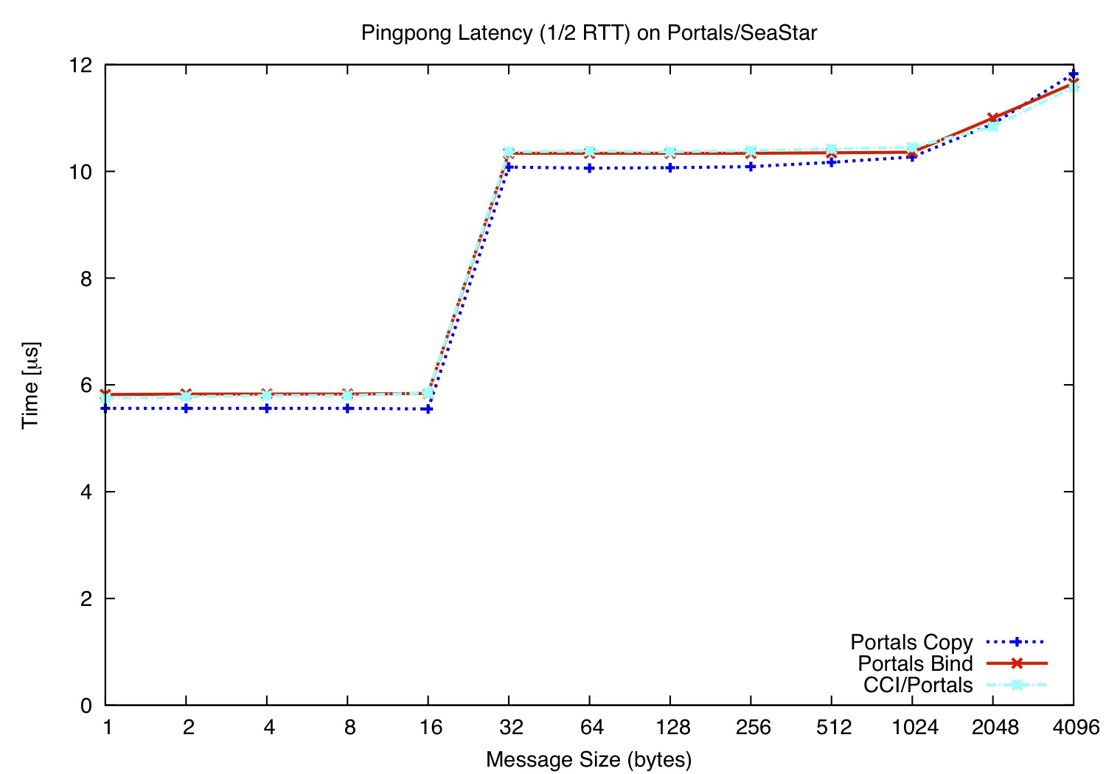

Slide 41
Caveats:
Portals provides matching
Portals provides thread-safety
CCI/SS requires progress thread

Slide 42
Caveats:
Portals provides matching
Portals provides thread-safety
CCI/SS requires progress thread

