Slide 1
CCI
Common
Communication
Interface
Scott Atchley, David Dillow, Galen Shipman
Oak Ridge National Laboratory
Patrick Geoffray
Myricom
Jeffrey Squyres
Cisco Systems, Inc.
George Bosilca
University of Tennessee
Ronald Minnich
Sandia National Laboratories, Livermore

Slide 2

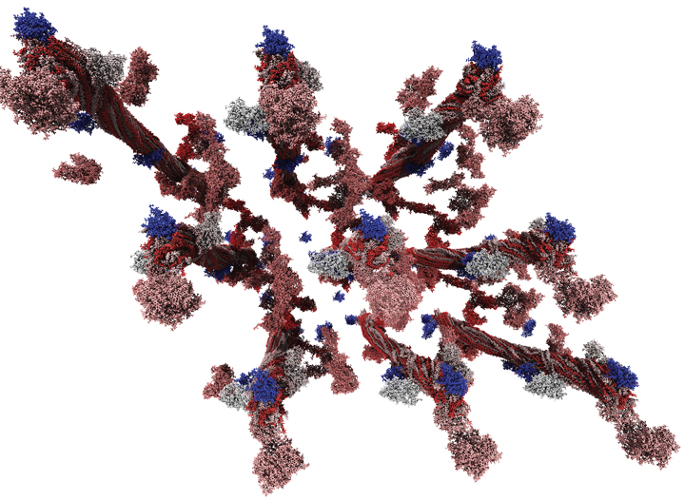
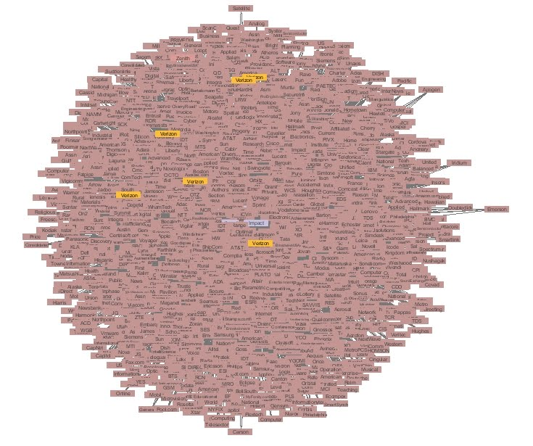
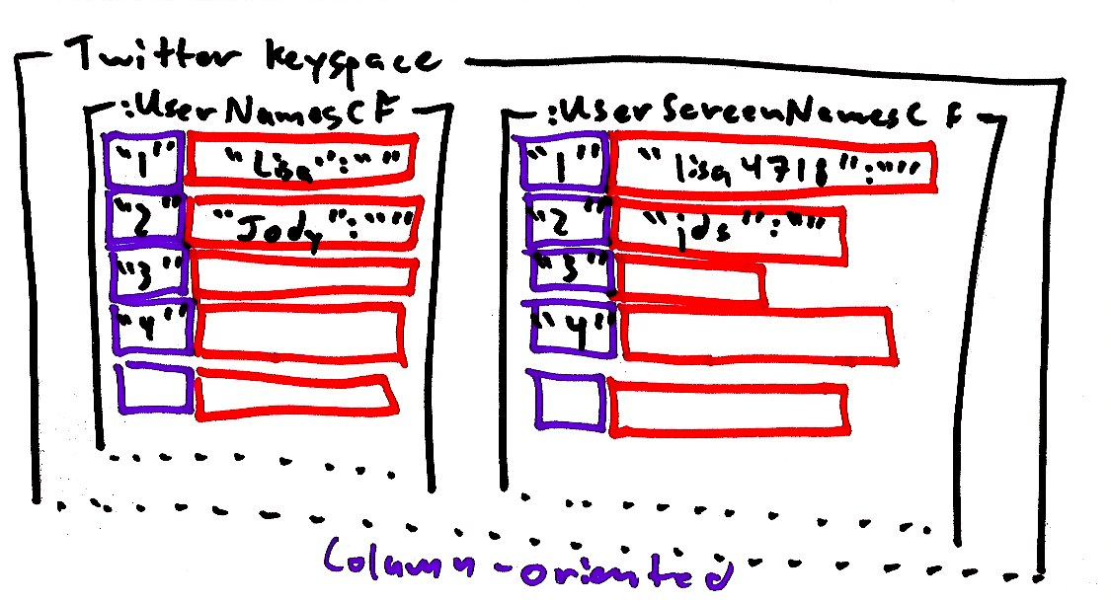
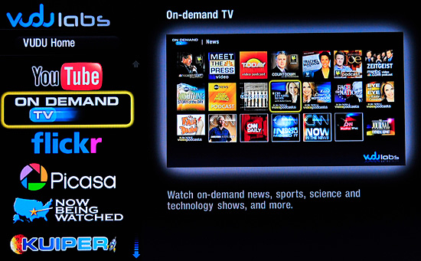
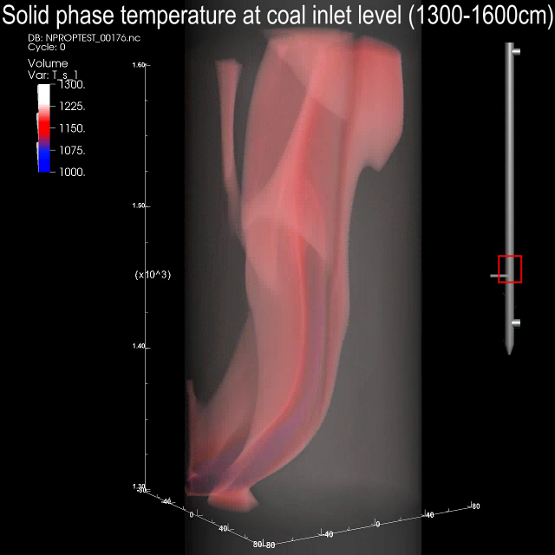


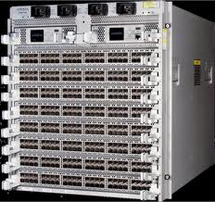
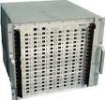
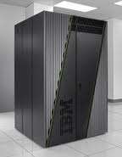
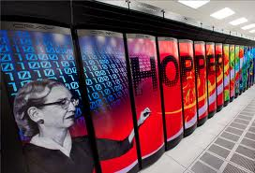

Adding insulation can save you money
Application Domains
Networking Technologies

Slide 3
Applications are increasingly data-driven distributed services.
These applications may control only one side of the pipe…
Common language: IP on the wire, Socket interface on the host.
Applications: web services, media delivery, trading exchange.
Not going away, way too much legacy.
Or both sides of the pipe
No required wire protocol or programing interface.
Applications: back-ends, database, storage
Memcached, Big Table, Cassandra.
Socket interface hinders networking innovation.
Many vendor-specific interfaces available (dead or alive).
Notes:
Service Oriented Architectures Data intensive applications
Inter process communications

Slide 4
What if you control both sides ?
Application developers either:
Stick with Sockets.
See substantially less benefit from current generation network technologies.
Lock themselves with a vendor-specific interface.
Support a number of different interfaces.
Requires deep expertise in multiple low-level network APIs
Network vendors either:
Port Sockets on their low-level interface.
Limited performance.
Push their interface as the solution.
Everybody loves a good lock-in.
Support a number of different applications.
High support costs relative to potential revenue for niche applications.
We propose CCI to satisfy both application developers’ and network vendors’ needs.

Slide 5
CCI design goals
Performance
Utilize OS-bypass, zero-copy, one-sided, asynchronous operations if available.
Performance portable across host-based implementations and high-end offloaded implementations.
Portability
Developers have limited resources.
Provide common abstraction across a wide-variety of networking technologies.
Avoid vendor lock-in through a vendor neutral API.
Simplicity
Must not be so complicated that only experts can use it.
Provide the right balance of functionality without sacrificing simplicity.
Complexity tends to increase code size and maintenance cost.

Slide 6
CCI design goals
Scalability
Dynamic process management: peers come and go – not statically known a priori.
Approaching 10^6 nodes and 10^9 cores.
Time (polling) and space (buffer) cannot grow linearly with number of peers.
Robustness
Failures increase with component count.
Need to contain faults to a single peer (i.e. fault isolation).

Slide 7
The landscape
Sockets
MPI
Specialized
Notes:
I would stick to one slide for Socket an one for MPI, focusing on semantic differences. I would not present the various specialized ones, just one to show the semantic differences (matching, etc.).

Slide 8
Sockets
Most widely used
Simple API
Robustness (failure tolerant)
Implicit buffering
Ubiquitous
Unable to exploit many of the features of current-generation networking technologies
Cannot support zero-copy
Does not scale
In time: linear polling or interrupts.
In space: per socket resources.
Notes:
Epoll (in kernel, requires interrupt)
Could use UDP but no reliability

Slide 9
MPI
Designed as a bridge between application developers’ and network vendors’ needs in the High Performance Computing market
Standardization began nearly two decades ago
MPI is the de-facto standard in HPC, Why not elsewhere?
High level of complexity
200+ functions in MPI-1, 300+ in MPI-2
Original standard ignored dynamic environments
Added later but not widely adopted
Rigid fault model
Common fault case is abort execution of entire distributed application
Robust fault tolerance requires use of MPI dynamic process management (see above)
Notes:
Need to bridge was there, the solution was developed but it is narrow in scope (HPC only)
Later attempts to address dynamic environments have not been widely adopted

Slide 10
Specialized APIs abound
OFA Verbs
High level of complexity, vendor lock-in is a concern
Cray/Sandia’s Portals
Highly specialized interface targeted towards HPC (MPI, SHMEM, UPC)
Qlogics’s PSM
Highly specialized interface targeted towards MPI
Myricom’s MX
Highly specialized interface targeted towards MPI
IBM’s LAPI and DCMF
Limited support outside of IBM network technologies
DAPL
Limited support outside of iWARP capable devices
LBL’s GASnet
Designed specifically for the needs of UPC
ARMCI
Designed specifically for the needs of Global Arrays
LNET
Designed specifically for the needs of Lustre.
BMI
Designed specifically for the needs of PVFS

Slide 11
Summing up the landscape
 | Sockets | MPI | Specialized APIs
Portability | + | + | -
Simplicity | + | - | Varies
Performance | - | + | +
Scalability | - | + | Varies
Robustness | + | - | Varies

Slide 12
CCI Overview
Endpoints
Connections
Communication
Active Messages
Remote Memory Access

Slide 13
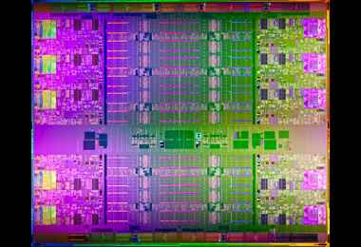
CCI Endpoints
Virtualized instance of a device – src/sink of communication
Complete container of resources – queues and buffers
Process may poll or block for event notification
Events for send, recv, connection establishment, etc.
Events may contain resources such as receive buffers
Resource ownership transfers to the process when the event is retrieved
The process eventually returns the event to CCI
Expected to be returned in a timely manner
May be returned out of order
Intel E7

Slide 14
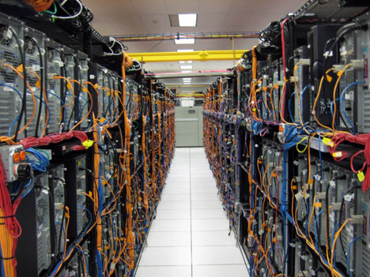
CCI Connections
Per peer - a single endpoint can handle many connections
Lightweight – no dedicated buffers (~120B/peer)
May have multiple connections to the same peer
Use client/server model similar to Sockets and RDMA-CM
Represents reliability and order attributes
Reliable with Ordered completion (RO)
Reliable with Unordered completion (RU)
Unreliable with Unordered completion (UU)
Multicast Send (MC_TX)
Multicast Receive (MC_RX)
Facebook data center

Slide 15
Active Messages
Berkeley AM
No posted receives
Handlers run based on address in header
No adittional progress until handler completes
Internally managed buffers
CCI Active Messages
No posted receives, uses internal buffers
Events only, no handlers
Event includes pointer to data, its length, and the connection (peer)
May be inspected, modified, and/or sent in-place
May be copied out if needed long term
Limited in size – ideally MTU sized
No segmenting/reassembly

Slide 16
CCI RMA
Active messages are not enough
But they are enough to allow setup of RMA
Zero-copy when supported
Require memory registration
No intra-message order guarantee
No last byte written last
Write or Read with an optional Fence

Slide 17
Status and Evaluation
Three Four proof-of-concept implementations
Sockets, MX, Portals 3.3, Native SeaStar
Sockets
Uses UDP with one socket per endpoint
Implements reliability when required
Implements AM, RMA Write
MX
Implements AM only
CCI requests rendezvous when reliability is requested

Slide 18
Status and Evaluation
Portals 3.3
Implements multiple endpoints using match bits
Portals assumes reliability
CCI requests acks for reliable connections
Implements AM, RMA Write, Read, and Fence
Native SeaStar
Implements AM only
Working on adding RMA

Slide 19
CCI/MX Performance

Slide 20
CCI/Portals Performance

Slide 21
Native SeaStar Performance
Caveats:
Portals provides matching and thread-safety
Portals running on CNL, not Catamount
CCI/SS may require progress thread

Slide 22
Conclusion
Distributed apps need
Performance - low latency, high throughput
To support transient peers and to isolate peer failures
To support large numbers of peers with bounded resources
Portable, simple network interface
CCI aims to satisfy these needs
Uses endpoints to bound time and space resources
Uses connections to provide peer fault isolation
Uses low-overhead active messages for small/control messages
Uses RMA for bulk movement and zero-copy semantics
Provides good performance
Simple API
CCI Next steps
Finish fleshing out TCP and native Portals implementations
Work is underway to provide Cray GNI, IBM Blue Gene, and InfiniBand Verbs support

Slide 23
ATTIC
This is all stuff we likely won’t present

Slide 24
Outline
What do distributed applications need?
Current APIs
CCI Overview
Status and Evaluation
Conclusion

Slide 25
Simplicity Example
BTL | Lines of Code
Elan | 1,656
MX | 2,333
Portals | 2,469
GM | 2,779
Sockets (TCP) | 4,192
UDAPL | 6,208
OpenIB (Verbs) | 21,574

Slide 26
OFA Verbs
Based on earlier VIA spec
Does not specify API, just Verbs
Multiple vendor APIs initially
Coalesced into Open-Fabrics Association (OFA)
Two-sided and one-sided
Always asynchronous
Reliable and unreliable
Connection and connectionless modes
Communication requires registered memory
Queue-Pair represents logical connection

Slide 27
Portals
One-sided (Put/Get)
Uses tags to steer messages to buffers
Connectionless
Underlying NALs maintain necessary connection state
Most commonly used on large HPC systems
Lustre distributed file system NAL, LNET, was originally based on Portals

Slide 28
Myricom MX and Qlogic PSM
Similar two-sided, matching API
Designed to support MPI
Eager for small messages
Zero-copy, rendezvous for large messages
Semi-connectionless
Target does accept connection requests
Sender connects before sending
Reliable, in-order matching with out-of-order completion (like MPI)

Slide 29
IBM LAPI and DCMF
Designed for RS-series and BlueGene P/Q
Some support outside of IBM exists
One-sided and two-sided
Contiguous and non-contiguous memory layout
Transparent link aggregation
DCMF supports ARMCI, GA, MPI, collectives

