Slide 1
CCI
Common
Communication
Interface
Scott Atchley, David Dillow, Galen Shipman
Oak Ridge National Laboratory
Patrick Geoffray
Myricom
Jeffrey Squyres
Cisco Systems, Inc.
George Bosilca
University of Tennessee
Ronald Minnich
Sandia National Laboratories, Livermore

Slide 2
Applications are increasingly data-driven distributed services.
These applications may control only one side of the pipe…
Common language: IP on the wire, Socket interface on the host.
Applications: web services, media delivery, trading exchange.
Not going away, way too much legacy.
Or both sides of the pipe
No required wire protocol or programing interface.
Applications: back-ends, database, storage
Memcached, Big Table, Cassandra.
Socket interface hinders networking innovation.
Many vendor-specific interfaces available (dead or alive).
Notes:
Service Oriented Architectures Data intensive applications
Inter process communications

Slide 3
What if you control both sides ?
Application developers either:
Stick with Sockets.
See substantially less benefit from current generation network technologies.
Lock themselves with a vendor-specific interface.
Support a number of different interfaces.
Requires deep expertise in multiple low-level network APIs
Network vendors either:
Port Sockets on their low-level interface.
Limited performance.
Push their interface as the solution.
Everybody loves a good lock-in.
Support a number of different applications.
High support costs relative to potential revenue for niche applications.

Slide 4
Sockets
Most widely used
Simple API
Robustness (failure tolerant)
Implicit buffering
Ubiquitous
Unable to exploit many of the features of current-generation networking technologies
Cannot support zero-copy
Does not scale
In time: linear polling or interrupts.
In space: per socket resources.
Notes:
Epoll (in kernel, requires interrupt)
Could use UDP but no reliability

Slide 5
MPI
Designed as a bridge between application developers’ and network vendors’ needs in the High Performance Computing market
Standardization began nearly two decades ago
MPI is the de-facto standard in HPC, Why not elsewhere?
High level of complexity
200+ functions in MPI-1, 300+ in MPI-2
Original standard ignored dynamic environments
Added later but not widely adopted
Rigid fault model
Common fault case is abort execution of entire distributed application
Robust fault tolerance requires use of MPI dynamic process management (see above)
Notes:
Need to bridge was there, the solution was developed but it is narrow in scope (HPC only)
Later attempts to address dynamic environments have not been widely adopted

Slide 6
Specialized APIs abound
OFA Verbs
High level of complexity, vendor lock-in is a concern
Cray/Sandia’s Portals
Highly specialized interface targeted towards HPC (MPI, SHMEM, UPC)
Qlogics’s PSM
Highly specialized interface targeted towards MPI
Myricom’s MX
Highly specialized interface targeted towards MPI
IBM’s LAPI and DCMF
Limited support outside of IBM network technologies
DAPL
Limited support outside of iWARP capable devices
LBL’s GASnet
Designed specifically for the needs of UPC
ARMCI
Designed specifically for the needs of Global Arrays
LNET
Designed specifically for the needs of Lustre.
BMI
Designed specifically for the needs of PVFS

Slide 7
Summing up the landscape
 | Sockets | MPI | Specialized APIs
Portability | ✔ | ✔ | ✗
Simplicity | ✔ | ✗ | Varies
Performance | ✗ | ✔ | ✔
Scalability | ✗ | ✔ | Varies
Robustness | ✔ | ✗ | Varies

Slide 8

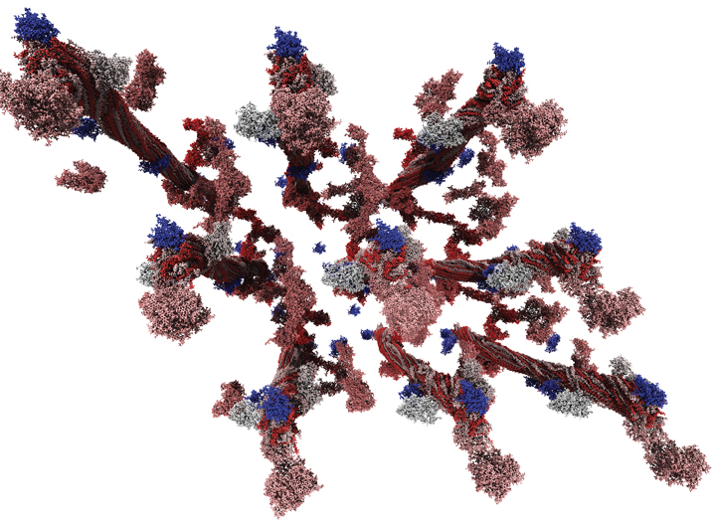
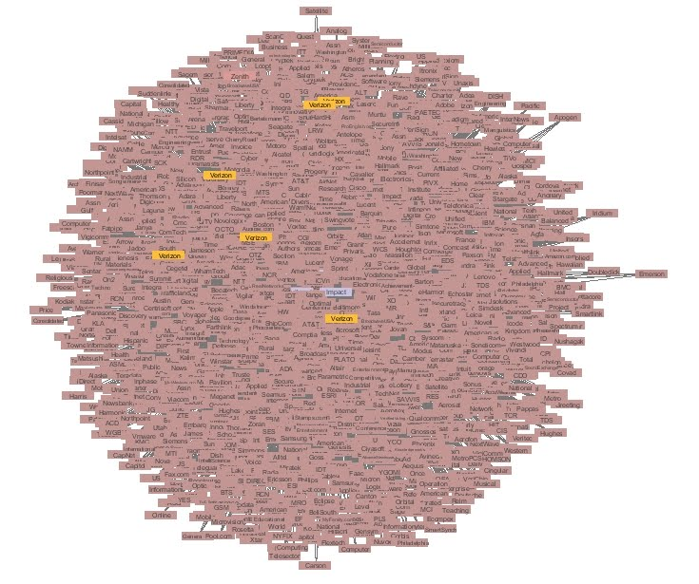
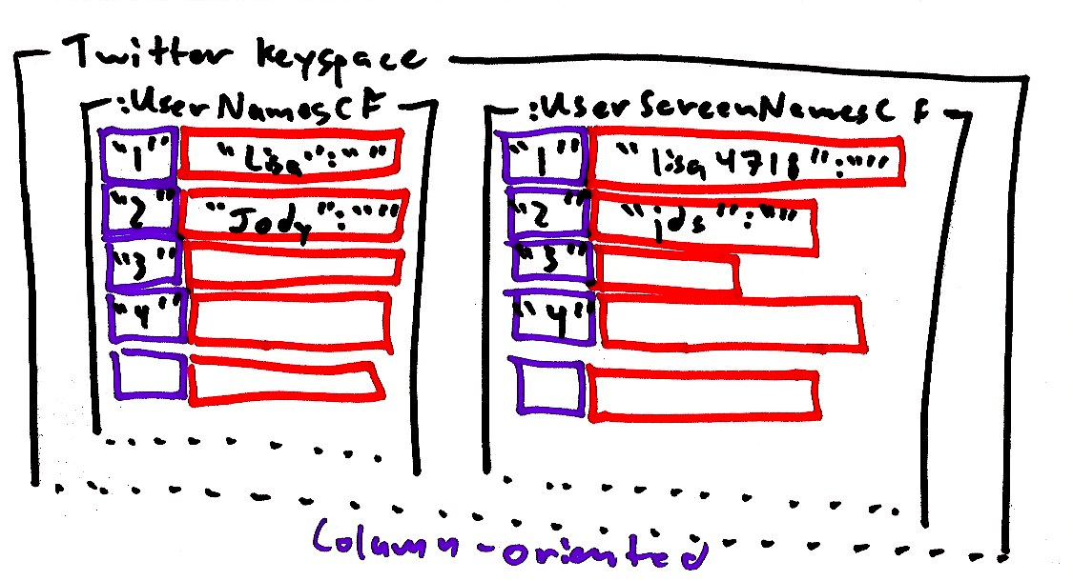
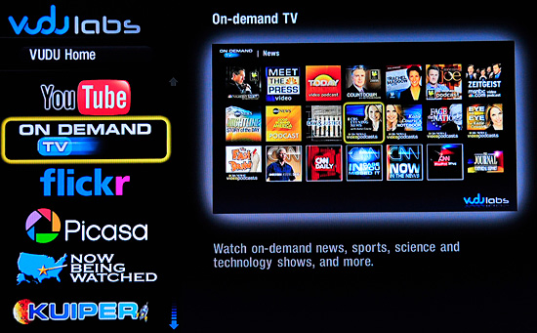
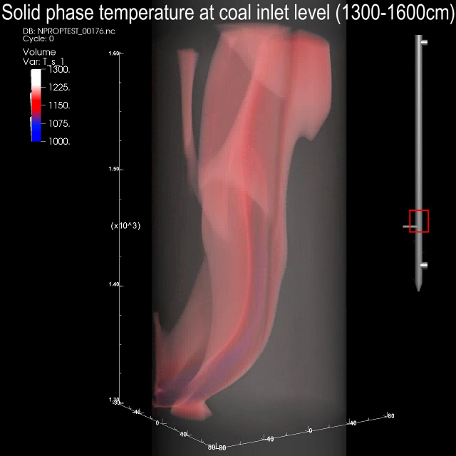


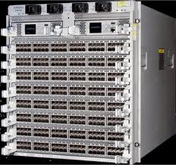
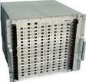
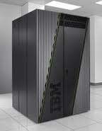
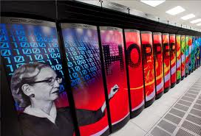

Bridging two communities
Application Developers
Networking Technology
Vendors
Notes:
We propose CCI to satisfy both application developers’ and network vendors’ needs.

Slide 9
CCI design goals
Performance
Can leverage OS-bypass, zero-copy, one-sided, async ops.
Portability
Developers have limited resources.
Avoid vendor lock-in through a vendor neutral API.
Simplicity
Must not be so complicated that only experts can use it.
Complexity tends to increase code size and maintenance cost.
Scalability
Dynamic process management: peers come and go – not statically known a priori.
Time (polling) and space (buffer) cannot grow linearly with number of peers.
Robustness
Need to contain faults to a single peer (i.e. fault isolation).
Notes:
Performance:
performance portable across host-based implementations and high-end offloaded implementations.
Portability:
Provide common abstraction across a wide-variety of networking technologies.
Simplicity:
Provide the right balance of functionality without sacrificing simplicity.
Scalability:
Approaching 10^6 nodes, 10^9 cores
Robustness:
Failures increase with component count.

Slide 10
CCI Overview
Endpoints
Connections
Communication
Active Messages
Remote Memory Access
Notes:
All resources are in the endpoint (shared)

Slide 11
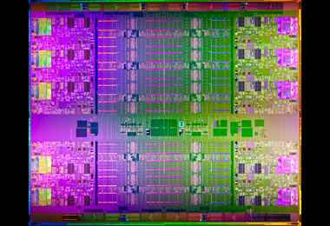
CCI Endpoints
Virtualized instance of a device – src/sink of communication
Complete container of resources – queues and buffers
An event driven model
Application may poll or block
Events include send, recv, connection establishment, etc.
Events may contain resources such as buffers
Resource ownership transfers to the application when the event is retrieved
May be returned out of order
Intel E7

Slide 12
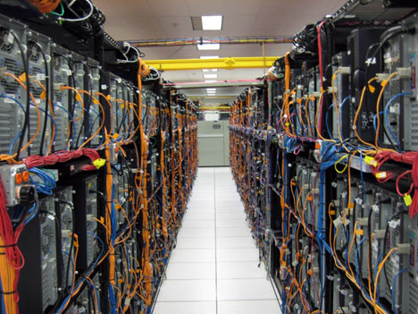
CCI Connections
Per peer - a single endpoint can handle many connections
Scalable
no per-peer send/recv buffers
no per-peer event queues
May have multiple connections to the same peer
Use client/server connection model similar to Sockets
Represents reliability and order attributes
Reliable with Ordered completion (RO)
Reliable with Unordered completion (RU)
Unreliable with Unordered completion (UU)
Multicast Send (MC_TX)
Multicast Receive (MC_RX)
Facebook data center
Notes:
Not requiring order enables efficient mutli-rail, high-radix network toplogies, and dynamic routing without specialized hardware
Unreliable unordered – enables applications with strict timing constraints that are incompatible with reliable implementations (if my pricing update from the exchange is retransmitted it might as well be dropped)

Slide 13
Active Messages
Always buffered on both send and receive side
Library manages buffers, not the application
Events only, no handlers on receives
True handlers are the devil incarnate
Event includes pointer to data and the connection (peer)
Message may be processed in-place
Even forwarded in-place
May be copied out if needed long term
Limited in size
Ideally MTU size to avoid segmenting/reassembly
Notes:
Message may be Forwarded, Modified, Sent in place

Slide 14
Remote Memory Access (RMA)
RMA communication for bulk-data transfer
Zero-copy when available
One-sided operation
Active message model used for RMA synchronization
Requires explicit memory registration
Provides broad portability
Simplified security model
No intra-message or inter-message order guarantee
No last byte written last
Optional inter-message ordering fence
May be combined with immediate delivery of AM

Slide 15
Status and Evaluation
Three Four proof-of-concept implementations
Sockets, MX, Portals 3.3, Native SeaStar
Sockets
Uses UDP with one socket per endpoint, Implements reliability when required
Implements AM, RMA Write
MX
Implements AM only
Portals 3.3
Implements multiple endpoints using match bits
Implements AM, RMA Write, Read, and Fence
Native SeaStar
Implements AM only
Working on adding RMA

Slide 16
CCI/MX Performance

Slide 17
CCI/Portals Performance

Slide 18
Native SeaStar Performance
Caveats:
Portals provides matching and thread-safety
Portals running on CNL, not Catamount
CCI/SS may require progress thread

Slide 19
Benefits of a common bridge
Application Developers
Network Technology Vendors
Decrease complexity
Port once, run everywhere
Encourage competition among vendors
Fosters innovation
Improves cost effectiveness
Mitigates technical and business risk of single vendor solution
Increases total addressable market
Deliver performance to the masses
Ability to expose innovation through a modern API
Reduces costs
Eliminate per application support
Leverage community development of core API
Enables an ecosystem
Notes:
Like MPI did for HPC

Slide 20
Conclusion
Distributed apps need
Performance - low latency, high throughput
To support transient peers and to isolate peer failures
To support large numbers of peers with bounded resources
Portable, simple network interface
CCI aims to satisfy these needs
Uses endpoints to bound time and space resources
Uses connections to provide peer fault isolation
Uses low-overhead active messages for small/control messages
Uses RMA for bulk movement and zero-copy semantics
Provides good performance
Simple API
CCI Next steps
Finish fleshing out TCP and native Portals implementations
Work is underway to provide Cray GNI, IBM Blue Gene, and InfiniBand Verbs support

Slide 21
Call for participation!
We are a bunch of engineers
We don’t have a website
We don’t have a logo
We don’t have a glossy white-paper
But… We do have deep expertise in communication libraries
We also have a community development model
Code is currently hosted on a private git-hub
License model is BSD/Apache style license
Contributor agreement is Apache style
If you want to help contribute please contact us
Notes:
We have over 100 years in combined experience, but we aren’t yet old enough to realize the magnitude of this task, and we know what source-routing is.

Slide 22
ATTIC
This is all stuff we likely won’t present

Slide 23
Outline
What do distributed applications need?
Current APIs
CCI Overview
Status and Evaluation
Conclusion

Slide 24
Simplicity Example
BTL | Lines of Code
Elan | 1,656
MX | 2,333
Portals | 2,469
GM | 2,779
Sockets (TCP) | 4,192
UDAPL | 6,208
OpenIB (Verbs) | 21,574

Slide 25
OFA Verbs
Based on earlier VIA spec
Does not specify API, just Verbs
Multiple vendor APIs initially
Coalesced into Open-Fabrics Association (OFA)
Two-sided and one-sided
Always asynchronous
Reliable and unreliable
Connection and connectionless modes
Communication requires registered memory
Queue-Pair represents logical connection

Slide 26
Portals
One-sided (Put/Get)
Uses tags to steer messages to buffers
Connectionless
Underlying NALs maintain necessary connection state
Most commonly used on large HPC systems
Lustre distributed file system NAL, LNET, was originally based on Portals

Slide 27
Myricom MX and Qlogic PSM
Similar two-sided, matching API
Designed to support MPI
Eager for small messages
Zero-copy, rendezvous for large messages
Semi-connectionless
Target does accept connection requests
Sender connects before sending
Reliable, in-order matching with out-of-order completion (like MPI)

Slide 28
IBM LAPI and DCMF
Designed for RS-series and BlueGene P/Q
Some support outside of IBM exists
One-sided and two-sided
Contiguous and non-contiguous memory layout
Transparent link aggregation
DCMF supports ARMCI, GA, MPI, collectives

