Slide 1
Ten challenges in industrial recommender systems
Zhenhua Dong
Huawei Noah’s Ark Lab
dongzhenhua@huawei.com

Slide 2
Content
Background
Ten Challenges
Conclusion and future

Slide 3
Mission
Huawei’s vision: bring digital to every person, home and organization for a fully connected, intelligent world.
Noah’s ark lab: Building an intelligent world
Computer vision, decision making & reasoning, AI theory, speech and language processing, search & recommendation, AI system, AI application
World wide lab: China, Singapore, U.K., France, Canada, Russia
Recommendation & search research team
Gets the right information to the right people
Research style:
Collaboration with product team: advanced AI for products, practical scenario for RQs
Collaboration with academia: learn from the best

Slide 4







Opportunities
Various recommendation scenarios, serving hundreds of millions of users, tens of millions of items in each day
Product | Scenario
App gallery | App and game recommendation & search
Instant service | Service recommendation
Ads. Platform | CTR/CVR prediction
Browser | News recommendation, search ads.
Music | Songs recommendation & search
Education | Lessons and learning method recommendation
Theme | Theme recommendation and search
GTS | Cases recommendation and search
Internal IT/HR system | Document and staff recommendation and search

Slide 5
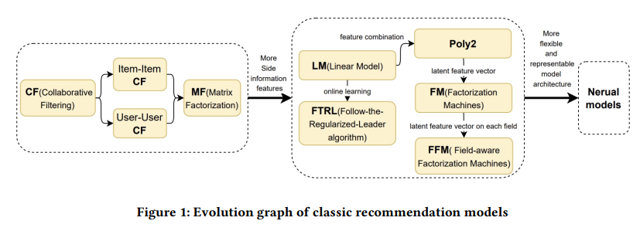
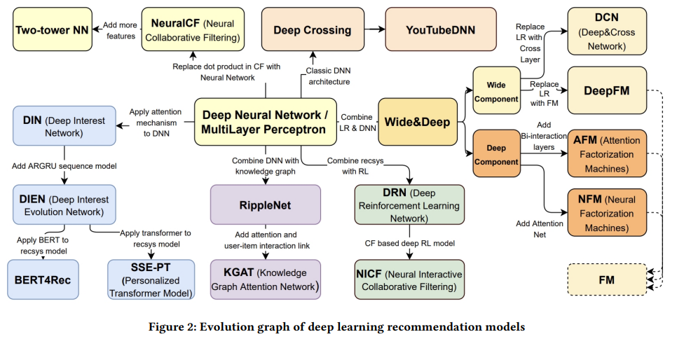
Trends
1992-2023: Academic research and industrial practice are two wheels of horse drawn carriage![1]
Shallow and simple models ➔ Deep and complex models
Accuracy (AUC, CTR) ➔ User experiences (diversity, serendipity, novelty)
[1] A Brief History of Recommender Systems, Zhenhua Dong et. al.

Slide 6
Problems
Missing information
Individual treatment effect
Biases
Based on the great missions, opportunities for practices and technological trends, we summarize 10 challenges of industrial recommender system.
Methods
4. Models reusing
5. Large language model enhancement
6. Multiple modalities
7. Simulations
Goals
8. Lifetime value modeling
9. Trustworthy
10. Win-win ecosystem

Slide 7
Content
Background
Ten Challenges
Conclusion and future

Slide 8
1. Missing information
Research question (RQ): How to handle the missing information in recommender systems?
Missing features (column data)
RecSys may miss some information such as item’s popularity, user’s thought about the item.
RecSys may not know the causal features: user watched a movie for her friend’s suggestion.
Missing samples (raw data)
RecSys exposes only a few items of all items in one interaction.
RecSys can not collect a user’s behaviors in other systems.
Notes:
One specific challenge in recommender system is missing information.

Slide 9

1. Missing information -- solution
Unobserved samples
Observed samples
Counterfactual learning [1].
What would have happened if we have unobserved samples?
Learn imputation model σ(·) with uniformed observed samples
and predict the labels of unobserved samples [2].
Predict the missing features.
More research opportunities:
How to sense users, items and context?
How to nudge users provide more feedback?
Uniform samples
σ(·)
[1] Counterfactual learning for recommender system, RecSys20, Zhenhua Dong et. al.
[2] Unbiased Ad click prediction for position-aware advertising system，RecSys2020, Yuan. BW et. al.

Slide 10
2. Individual treatment effect (ITE)
RQ: How to find the causal attributes of a user’s decision (e.g. click, rate) or preference?
Causal attributes:
Example: both user A and B rate a movie C 5 stars, A likes C for director, B likes C for cast. The same attribute or treatment (director/cast) may have different effects on user’s decision, so it is individual treatment effect.
Accurate causal attribute is helpful to user profiling, explanation, accuracy.
Zhang Yimou
ATE = E(Y=5stars | X = Zhang Yi) - E(Y=5stars | X != Zhang Yi)
Movie C
5 stars
Zhang Yi
ITE_{User=A} = UserA(Y=5stars | X = Zhang Yi) - UserA(Y=5stars | X != Zhang Yi)
Notes:
The second specific challenge in recommender system is individual treatment effect.
CCCE makes use of the individual observation as evidence and find the causal attributes under some assumptions.
It is still a primary work.

Slide 11

2. Individual treatment effect -- solution
Conditional counterfactual causal effect (CCCE)[1]:
Given the variable set V = {X,Y,Z}, the evidence W=w, causes Xs, the CCCE of Xs on Y is defined as:
Assumptions:
No confounding: no unobserved confounders, ignorability.
Monotonicity: the causes cannot prevent the effect.
More research opportunities:
How to compute ITE under more generalized assumptions?
How to nudge users actively explain their preferences?
[1] Conditional counterfactual causal effect for individual attribution, UAI23, Ruiqi Zhao et. al.

Slide 12
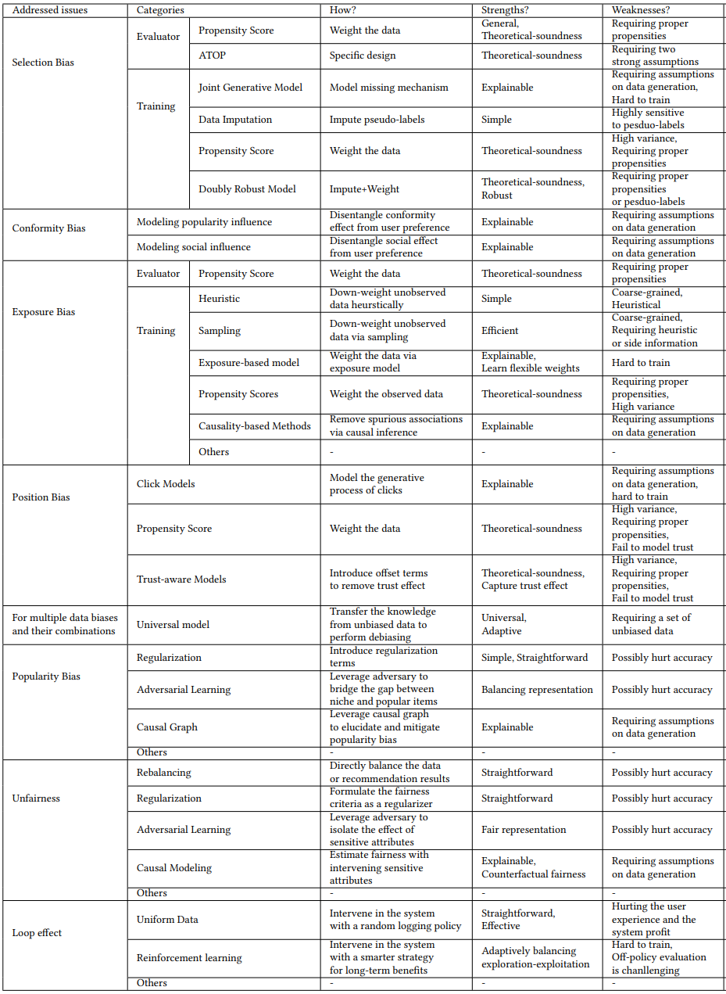
3. Biases
RQ: How to mitigate the biases in recommender systems?
There are so many biases in recommender systems [1] due to missing information, confounders and closed feedback loop.
[1] Bias and Debias in Recommender System: A Survey and Future Directions, TOIS2023, Jiawei Chen et. al.
Notes:
The third specific challenge in recommender system is bias.
There are many biases in recommender system. Researchers from academia and industry create many methods to analyze the biases and debias, such as causal analysis, IPS, doubly robust methods.
While there are many research opportunities:
We find some new biases in recommender system like duration bias, trust bias, confounder bias.
How to collect unbiased data?
How to train an unbiased model?
How to evaluate the biases?

Slide 13

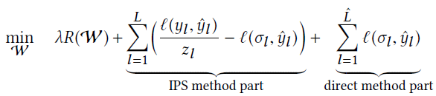
3. Biases -- solution
Causal analysis: potential outcome model [1], structural causal model.
Inverse propensity score:
Doubly robust methods [2]:
More research opportunities:
How to handle new biases such as duration bias, trust bias, confounder bias?
How to collect unbiased data, train unbiased models and evaluate the biases?
Z_{l}= 𝑃 (𝑥, 𝑦)/𝑄(𝑥, 𝑦)
[1] On the Opportunity of Causal Learning in Recommendation Systems: Foundation, Estimation, Prediction and Challenges, IJCAI22, Peng Wu et. al.
[2] A generalized doubly robust learning framework for debiasing post-click conversion rate prediction, KDD22, Quanyu Dai et. al.

Slide 14
4. Model reusing
RQ: How to reuse the historical models efficiently?
The industrial recommendation models should be updated with recent data for better performance, but the historical models are always underutilized.
Solutions:
Online learning
Ensemble learning
Machine unlearning
Learnware
Notes:
The third specific challenge in recommender system is models reusing.
The current industrial recommendation models should be retrained with recent data for better performance, in the mean time, the historical models are always underutilized, even waste. It wastes a lot of resources and time.
In our recsys work, we propose an idea: “data is model and model is data”, and create a model inversed data synthesis framework, which can inverse a few representative samples from historical models. Then we combine the inversed samples with the recent samples, and train a more powerful models for CTR prediction.
But it is still a primary work, more opportunities for model reusing.

Slide 15
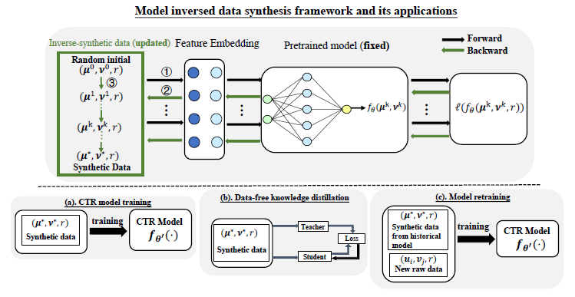
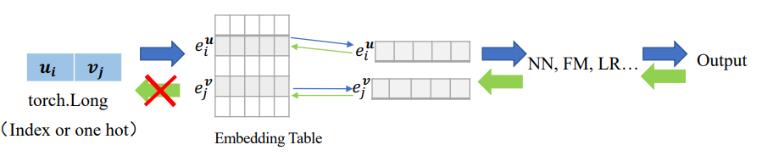
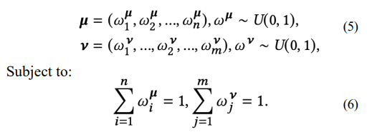

4. Model reusing -- solutions
Model inversed data synthesis framework [1].
More research opportunities:
Memory mechanism for recommendation.
Can we train large recommendation models like large language model?
Optimization:
[1] Data-free Knowledge Distillation for Reusing Recommendation Models , RecSys23, Cheng Wang et. al.

Slide 16
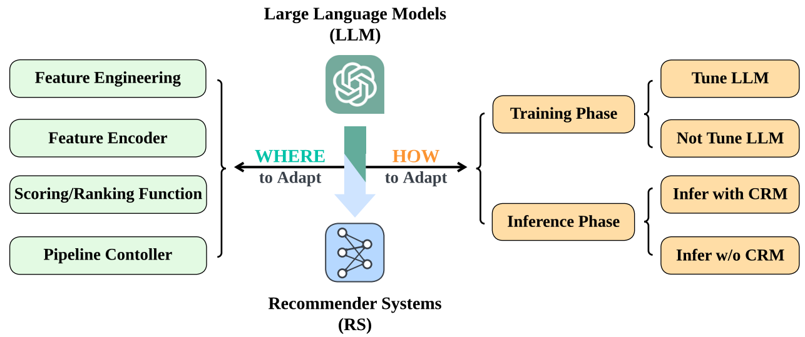
5. Large language model enhanced recommendation
RQ: ChatGPT has demonstrated great capabilities of LLMs, how to improve recommendation with large language models?
Solutions[1]:
Where: feature, embedding, prediction, controller.
How: fine tune, collaboration with classic models.
[1] How Can Recommender Systems Benefit from Large Language Models: A Survey, Jianghao Lin et. al.
Notes:
The third specific challenge in recommender system is models reusing.
The current industrial recommendation models should be retrained with recent data for better performance, in the mean time, the historical models are always underutilized, even waste. It wastes a lot of resources and time.
In our recsys work, we propose an idea: “data is model and model is data”, and create a model inversed data synthesis framework, which can inverse a few representative samples from historical models. Then we combine the inversed samples with the recent samples, and train a more powerful models for CTR prediction.
But it is still a primary work, more opportunities for model reusing.

Slide 17
5. Large language model enhanced recommendation
Three phrases of LLM enhanced recommendation [1]:
Phrase 1: as component of existing recommendation → current recommendation
Phrase 2: users interact with LLMs → conversational recommendation
Phrase 3: LLM based agent → personalized task agent
Let us to embrace LLM:
“It does not matter if you love it or not
It is standing right there
With no emotion
Not going to change” By Sangs-Rgyas Rgya Mtsho
[1] Large Language Models and Recommender Systems: Opportunities and Challenges, Chengxiang Zhai, CIKM2023, Workshop on Recommendation with Generative Models.

Slide 18
6. Simulation
RQ: How to model user preference with simulation?
User modeling is a classical and hard research direction
ACM UMAP is 31 years old, many research topics have been studied.
User modeling is still hard since people and context are complex, e.g. in some ads. scenarios, the CTR is less than 1%.
Simulation: a new paradigm
AI4Science: mathematics, physics, chemistry, biology.
Automatic drive: generate data, simulation experiment.
Recommender system: RL based simulation [1].
[1] Virtual-Taobao: Virtualizing Real-world Online Retail Environment for Reinforcement Learning, Jing-Cheng Shi,AAAI19
Notes:
The next specific challenge in recommender system is multiple modalities.

Slide 19
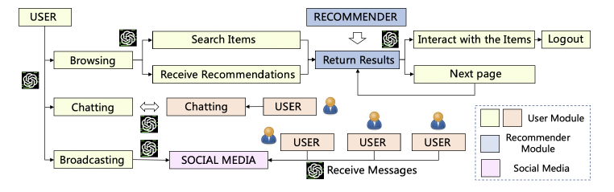
6. Simulation
LLM based simulation: RecAgent [1]: a digital twin of recommender system, simulate user behaviors, align with real human understanding.
More opportunities:
How to simulate more users and more behaviors efficiently and accurately?
How to evaluate the simulation?
[1] RecAgent: A Novel Simulation Paradigm for Recommender Systems, Lei Wang et. al.

Slide 20
7. Multiple modalities
RQ: How to align the user preference modality to content modality?
Classic recommendation trains models are trained by preference modality data like user behavior, which is good at modeling the collaborative signals.
Content modalities, such as text, image and video, are good at content semantic understanding and representation.
There is a huge gap between preference modality and content modalities leads to minor improvements in recommendation.
Notes:
The next specific challenge in recommender system is multiple modalities.

Slide 21
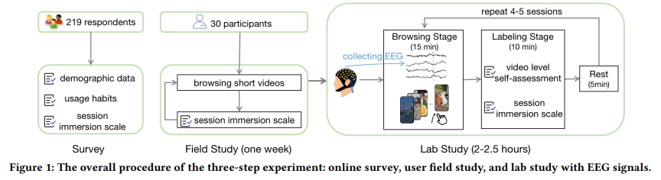
7. Multiple modalities: Solution
EEG for immersion recognition [1]
More opportunities:
Deeply understanding about the different modalities and their relation to user’s preferences and decisions.
Recommendation focused pre-trained multi-modalities methods
[1] Understanding User Immersion in Online Short Video Interaction, CIKM23, Zhiyu He et. al.

Slide 22
8. Lifetime value modeling
RQ: How to predict users’ long term satisfaction?
Most recommendation studies focus on optimizing short term objectives, such as click, rating, dwell time, which can not align the goal to improve users’ long term satisfaction like deep conversion task.
Challenges of LTV prediction
Sparse
Long-tailed
Noisy
Volatile: promotion
Miss information about futures
Notes:
The next specific challenge in recommender system is multiple modalities.

Slide 23
8. Lifetime value modeling: solution
Solution: in the tutorial [1], we introduce the definitions and scenarios of LTV, some typical LTV prediction techniques, and products practices.
There are still many hard problems:
Delayed and sparse feedbacks.
Cold start, offline evaluation, multi-task optimizations.
LTV methods
Models
System
Probabilistic model based
Machine learning based
Multi-stage
End-to-end
[1] Tutorial -- Customer Lifetime Value Prediction: Towards the Paradigm Shift of Recommender System Objectives, RecSys23, Chuhan Wu et. al.

Slide 24
9. Trustworthy
RQ: How to build trustworthy recommender systems?
We consider 8 perspectives:
Accountability
Security
Fairness
Privacy
Robustness
Most current recommender systems focus on the accuracy, which is not enough to be a trustworthy recommender system.
Transparency
Assisting or serving people
Long term enhancement of the happiness of human, society and environment
Notes:
The next specific challenge in recommender system is multiple modalities.

Slide 25
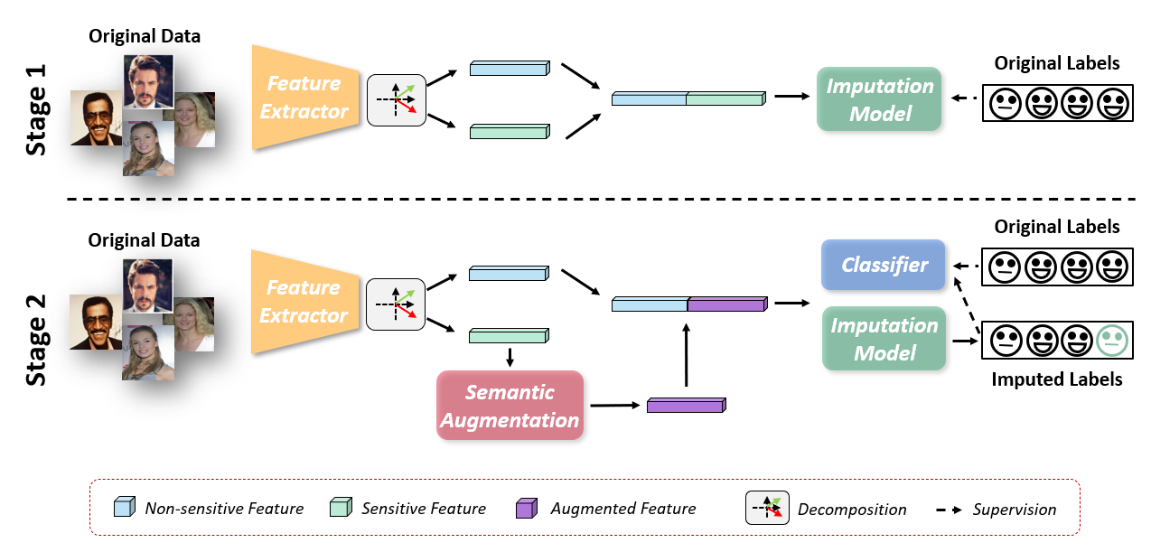
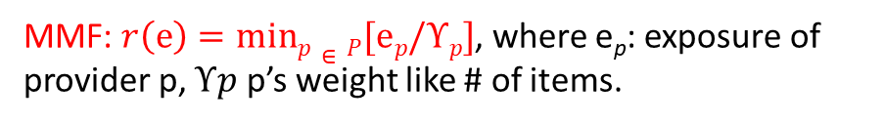

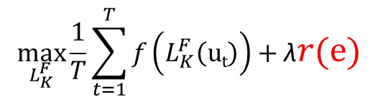
9. Trustworthy: fairness
User Fairness: Counterfactual data augmentation for fairness [1]
Provider fairness: Provider-Max-Min Fairness for Ranking [2]
MMF: $r\left(e\right)=minp∈P[ep/Υp]$, where e_{p}: exposure of provider p, $Υp$ p’s weight like # of items.
Trade-off between ranking accuracy and fairness:
$$\max_{L_{K}^{F}}{\frac{1}{T}\sum_{t=1}^{T}{f\left(L_{K}^{F}\left(ut\right)\right)+\text{λ}r\left(e\right)}}$$
$s.t. e≤Υ$ ➔ restrict largest exposures
We hope more scholars can help industry to define and build trustworthy and social good recommender systems from wider perspectives such as society, economy, user-centric, ecological systems and natural environments.
[1] Fair-CDA: Continuous and Directional Augmentation for Group Fairness, Rui Sun et. al. AAAI23
[2] P-MMF: Provider Max-min Fairness Re-ranking in Recommender System, Chen Xu et. al. WWW23

Slide 26
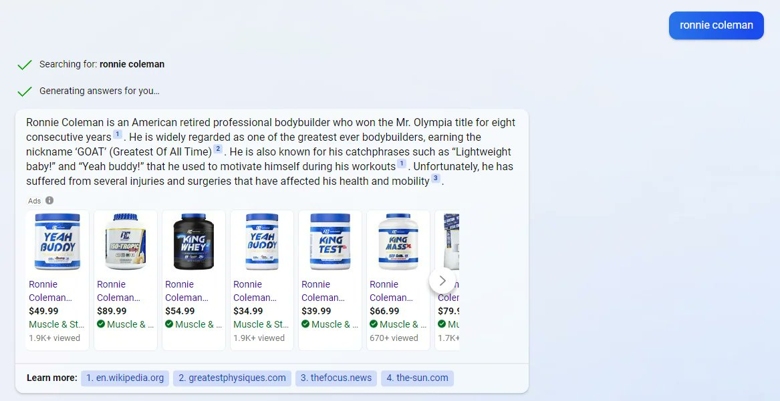
10. Win-win ecosystem
RQ: How to satisfy multi-stakeholders in dialog based IR or RecSys?
Mainly 4 kinds of stakeholders:
Users
Content providers(CP)
Information system
Advertisers.
Example of multi-party interaction for conversational search and recommendation
User question
LLM produces answers and marks references
Advertisements
URLs for content providers
Notes:
The next specific challenge in recommender system is multiple modalities.

Slide 27
10. Win-win ecosystem
Dialog based IR or RecSys can directly provide answer and satisfy users’ request.
However, there are some key challenges for each stakeholder:
Content providers: How to protect their intellectual property and benefits?
Advertisers: How to appropriately expose the Ads. during the dialog?
Users: How to ensure the generated information is objective and accountable?
Information system: How to design win-win interactions and mechanisms for long-term benefits?
Notes:
The next specific challenge in recommender system is multiple modalities.

Slide 28
Content
Background
Ten Challenges
Conclusion and future

Slide 29
The challenges
Challenge | Matter
Missing information | Sensor more information about user, item and context
Individual treatment | Know causal features
Bias | Unbiased data, unbiased model and unbiased inference
Model reusing | Retrieve the historical models
Large language model | Enhance the world knowledge, semantic and dialog ability
Multiple modalities | Involve more modalities to understand user, item and context
Simulation | Digital twin of recommender system
Lifetime value modeling | Model user experiences
Trustworthy | Social good
Win-win ecosystem | Long term satisfaction for multi-stakeholders

Slide 30
More challenges in ChaSpark
There are many other challenges in recommender systems, we would like to offer collaborative opportunities and resources with academia.
More interesting challenges can be founded in ChaSpark[1].
黄大年茶思屋
“慢下来，想一想，所思之物，便是研究的起点和归宿”
——黄大年
[1] https://www.chaspark.com/#/questions/sparks?lang=en

Slide 31



About future
Future intelligent user-centric services/agents
British butler: server master with long term serving experiences
Teacher: educate new and useful knowledge and benefit lifelong growth
JARVIS, Baymax, Samantha …
There is a huge gap between vision and reality, but the gap means great research opportunities.
[1] A Brief History of Recommender Systems, Zhenhua Dong et. al.

Slide 32
Acknowledgements
Collaborative scholars from academia
Talent lab mates from of Huawei Noah’s Ark lab
Diligent colleagues from Huawei product teams

Slide 33
Thanks Q&A

