Slide 1
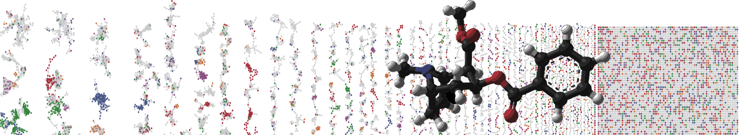


GNPS Molecular Network:
Advanced Annotation Overview
Louis Felix Nothias
University of California - San Diego
ENTER SLIDES AUTHORS HERE: Ming Wang, Louis Felix Nothias, …

Slide 2
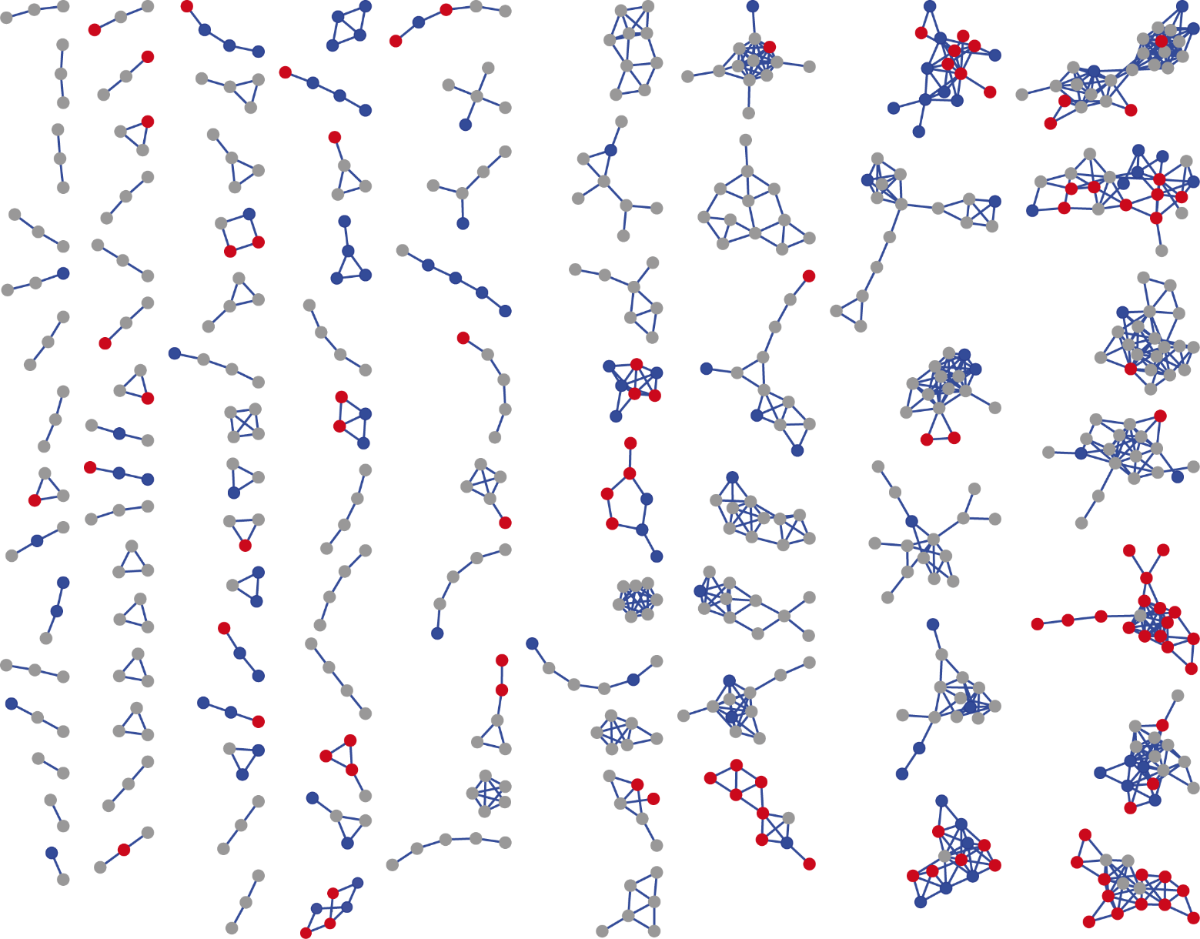
What’s next ?
Polyketides
Library Hit B
Diterpenes
Macrolides

Slide 3
Enriching molecular networks annotation
MULTI-OMICS INTEGRATION
STATISTICAL ANALYSIS
PUTATIVE ANNOTATION
Rel. quantification
Structure annotation
Microbial molecules
Feature-Based
Molecular
Networking GNPS
NAP @GNPS
Paper - Documentation
DEREPLICATOR @GNPS
Paper - Documentation
SIRIUS
Paper - Documentation
MetaMiner @GNPS
Paper - Documentation
(MS-DIAL, MZmine2,
OpenMS, XCMS)
Docs – GNPS workflow
Annotating unknown
Integration
MetWork
Paper - Documentation
MolNetEnhancer
Paper - GitHub
Statistics
MetaboAnalysis.ca
Qiime2.org
Mass2LDA @GNPS
Paper - Documentation
Notes:
https://github.com/mohimanilab/MetaMiner/releases/tag/metaminer-2.4.0

