Slide 1

NTT-Gym
The A Team

Slide 2
Tasks
Our Approach
Demo
Summary
Future Work

Slide 3
Tasks
Our Approach
Demo
Summary
Future Work

Slide 4

Tasks: NTT-Gym Website
Web Application for a gym
3 Parts: Admin – Client – Email

Slide 5
Tasks: Admin
Managing:
Users
Subscriptions
Workouts
Rooms
Timetable Entries

Slide 6
Tasks: Trainers
A more restrictive Admin
Managing:
Timetable Entries
Clients:
Registration
Managing Client Subscriptions
Managing Schedule

Slide 7
Tasks: Clients
Overview of Trainers & Subscriptions
Rating
Schedule Management

Slide 8
Task
Our Approach
Demo
Summary
Future Work

Slide 9
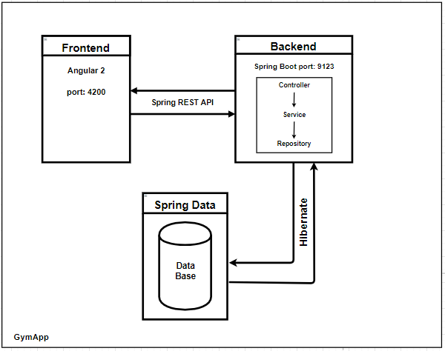
3 Tier Architecture

Slide 10
Client Layer
Angular 2 Web App
Spring REST
Spring Security

Slide 11
Application Layer
Spring Boot
Repository ⬄ Service ⬄ Controller
Embedded Tomcat
Maven Profile

Slide 12
Data Layer
Spring Data
JPA Repository (Hibernate)
MySQL Server

Slide 13
Task
Our Approach
Demo
Summary
Future Work

Slide 14
Task
Our Approach
Demo
Summary
Future Work

Slide 15
Summary
Easy to use Web Application for a gym
3 Products in Backlog
3 Tier Architecture:
Client Layer: Angular 2
Application Layer: Spring Boot
Data Layer: MySQL Server

Slide 16
Result
Smart
Sexy
Secure

Slide 17
Future Work
Live Chat & Support
Online Payments
Workout Presentation Videos
Gallery of gym resources
Home: recommendations
Health Blog
eShop
Personal Trainer choice

Slide 18
Questions

