Slide 1
PO Delay Root Cause Analyzer
An executive approach to supply-chain delay diagnosis
400
88.8%
100%
POs · 39 columns
reason agreement
stage accuracy
Notes:
Opening framing: who is presenting, which evaluation this sits in (colloquium, mentor deliverable #106), and expected duration. Only moment to set the executive tone before the technical audit.

Slide 2
AGENDA
Fifteen sections
01
Summary
08
Diego View — exception management
02
Phase 1 — Data Pipeline & Quality
09
Ravi View — network intelligence
03
Problem
10
Phase 4 — Application Architecture
04
Solution — decoupled architecture
11
Live demo
05
Phase 3 — LLM Integration
12
Telegram integration
06
Taxonomy & classification rules
13
Validation & metrics
07
Phase 2 — Classification Engine
14
Conclusions
15
Roadmap / future work
Gray = technical deep-dives
Notes:
The 14 points cover the 10 rubric criteria. The four (technical) slides directly answer the highest-weighted criterion — Delay Taxonomy & Rule-Based Classification, 20% — which landed weak in v1. Every phase of the pipeline now gets its own technical evidence, not just the executive narrative.

Slide 3
SUMMARY
A retrospective audit that classifies and explains PO delays
Timestamps are the source of truth — not human annotation, which the mentor reports is ~20% wrong.
400 → 247
~20%
361 + 39
POs analysed → late
human annotation is wrong
reliable + flagged
39 columns; the 247 late POs are the population the system explains.
So REASON_DSC is treated as a claim to audit, not ground truth.
Quality without dropping rows: 12 temporal inversions + 27 missing trailer time, isolated by flag.
Notes:
The source-of-truth point is the thesis that carries the whole project — state it slowly here, the rest of the presentation takes it as established. Source: explicacion-proyecto.en.md (Executive Summary, Phase 1).

Slide 4
PHASE 1 · TECHNICAL
Data Pipeline & Quality
Recalculated, not trusted
Argmax, not fixed priority
"Late Shipment" discarded
Indicators are recomputed from audit timestamps ( *_calc ), never from the precalc flags — end-to-end traceability, no black box.
When segments overlap, the primary is the largest excess over its own threshold. The rest survive in a multi-cause vector — not discarded.
The README column doesn't exist; the proxy fires 0% on real data. Vendor blame is already covered by STA Push.
Notes:
This is the exact point a panelist may ask 'why don't you use the rule from the original README?' — the answer is here, with the two independent reasons for the discard, no need to improvise. Source: ARD-01/02/24.

Slide 5
PROBLEM
Noisy annotations, and LLMs that invent narratives over raw data
~20%
↯
?
Human inconsistency
Generic AI narratives
No accountability
Staff annotations blame the visible link and miss the real responsible stage.
An LLM pointed at raw data produces plausible-sounding but unauditable prose.
Without a defensible root cause, corrective action targets the wrong party.
Notes:
Human inconsistency (~20%) is the hook that justifies the whole project — the gap the timestamp source of truth (Phase 1) closes. Connect both slides in delivery even though they share no on-screen content.

Slide 6
SOLUTION
Decoupled architecture
Four phases separate the numerical ground truth from the narrative analysis: statistics diagnose, the LLM interprets.
→
→
RULES
LLM
OUTPUT
Establish the ground truth
Interpret, never recompute
A 5-key JSON
All arithmetic on dates and hours. Fully deterministic.
The prompt forbids recalculating figures and requires citing them verbatim.
Root cause · action · severity · reason match · confidence.
Production: few-shot ×3 (Vendor · Carrier · DC) · temperature 0.9 · gpt-4o-mini
Notes:
Emphasize the division of labor — rules do all the arithmetic, the LLM only drafts prose over an already-resolved diagnosis — because that is what makes the explanation auditable. Source: explicacion-proyecto.en.md (Phase 3).

Slide 7
PHASE 3 · TECHNICAL
LLM Integration
Few-shot design, hardened
Temperature swept 0.3 → 0.9
One example per stage, plus a "HOW TO REASON" block: authority of stage_primary over REASON_DSC , never the reverse.
Before hardening: no sensitivity — a prompt problem, not sampling. After: action diversity rose 0.312 → 0.567 . Production = 0.9.
Secrets & multi-provider
One structured schema
Keys live only in .env . Backend is swappable: OpenAI, Claude, DeepSeek.
The same 5-key JSON that Phase 4 consumes downstream — no reshaping.
Notes:
This is the slide to defend why the LLM 'doesn't hallucinate' to a skeptical panelist — prompt design and temperature measurement are reproducible evidence, not a promise. If asked why 0.9, the diversity table is in ARD-13. Source: ARD-11/12/13/14.

Slide 8
CLASSIFICATION
Four stages, decided by excess over a window
Thresholds are backed by sensitivity analysis, not hand-picked: vendor 24h · carrier 8h · yard 4h · dock 6h.
Distribution over the 247 late POs
Vendor 53.0%
16.2%
15.0%
15.8%
Vendor 131
Carrier 40
DC 37
Indeterminate 39 (15 no-data + 24 no-dominant-cause)
Deterministic severity
HIGH if hot & delay > 3d · LOW if < 1d · MEDIUM otherwise → MEDIUM 131 · LOW 82 · HIGH 34
Notes:
'Not hand-picked' is defensible with the sensitivity table in 02_clasif_reglas_negocio/README.md if a panelist asks why 24h and not another number. Source: explicacion-proyecto.en.md (Phase 2).

Slide 9
PHASE 2 · TECHNICAL
Classification Engine
Vendor by direct signal
Indeterminate, made auditable
STA Push (APPROVED_DT > STA_DT) covers 100% of the dataset — including the 27 POs with no trailer record, which a residual model could not resolve.
Two exclusive sub-criteria: sin_datos (15, a datum is missing) vs. sin_causa_dominante (24, complete data, no segment over threshold). Never attribution by elimination.
Notes:
Emphasize that 'Indeterminate' is not a bucket for system errors — every PO in it has an auditable, distinct reason documented in the data itself (indeterminado_substage). Source: ARD-03b, ARD-07.

Slide 10
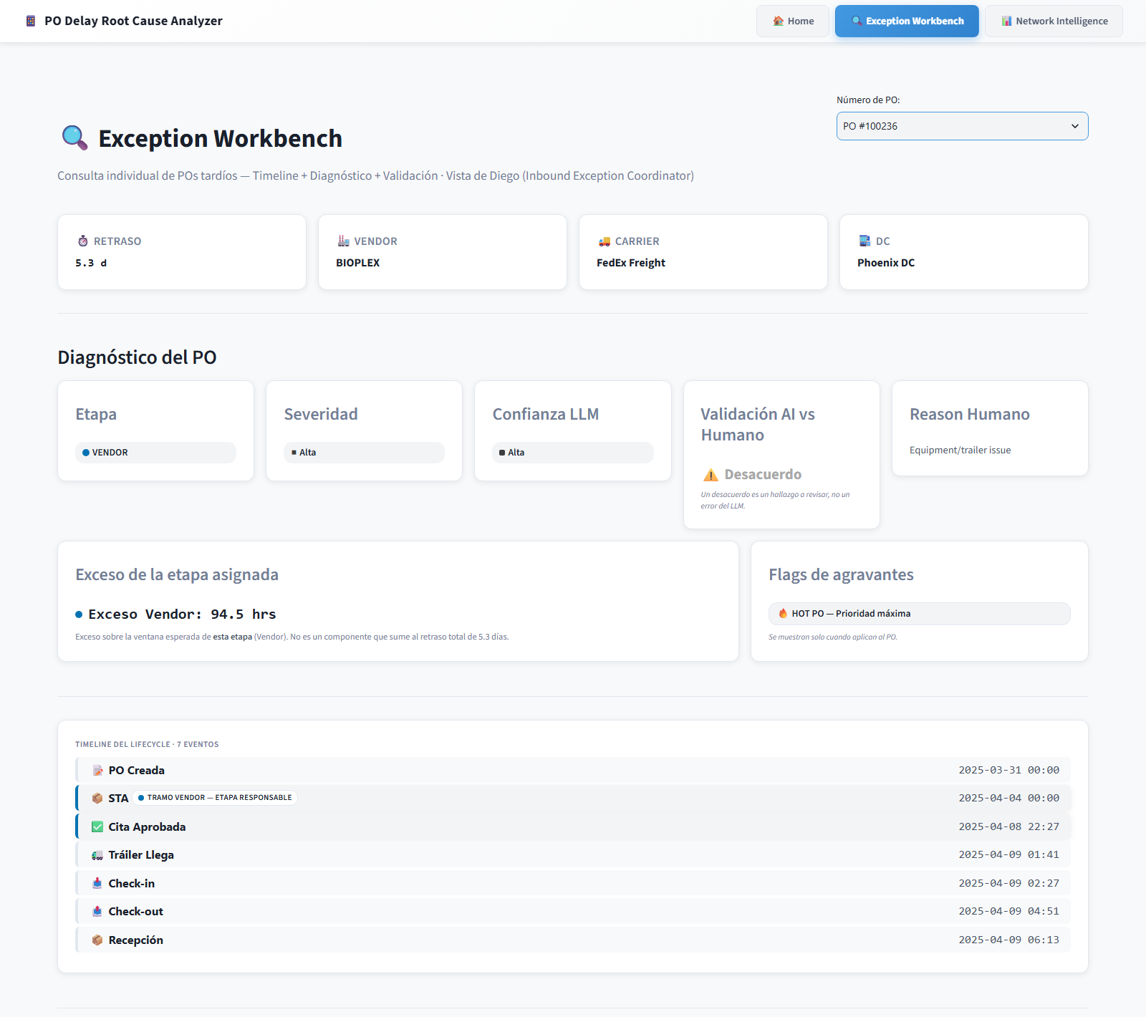
PERSONA A · DIEGO
Exception Workbench
Individual management of late POs, case by case: search by number, then identity + diagnosis cards, then the life-cycle timeline with the responsible segment highlighted.
▸
LLM root cause: hypothesis, evidence, 3-step plan (immediate / corrective / preventive).
▸
Validation flag vs. human REASON_DSC — a disagreement is a finding, not an error.
▸
Tier-2 differential: alternate hypothesis + the discriminant step.
5/5
explanation quality (20/20) vs. mentor threshold 4/5
Notes:
This is the view used in the live demo — don't dwell on text, it will be shown running. The discriminant step in the differential panel is a good hook if a panelist asks 'so what does someone actually do with this?' — the answer is literally that field. Source: user_personas.en.md (Persona A).

Slide 11
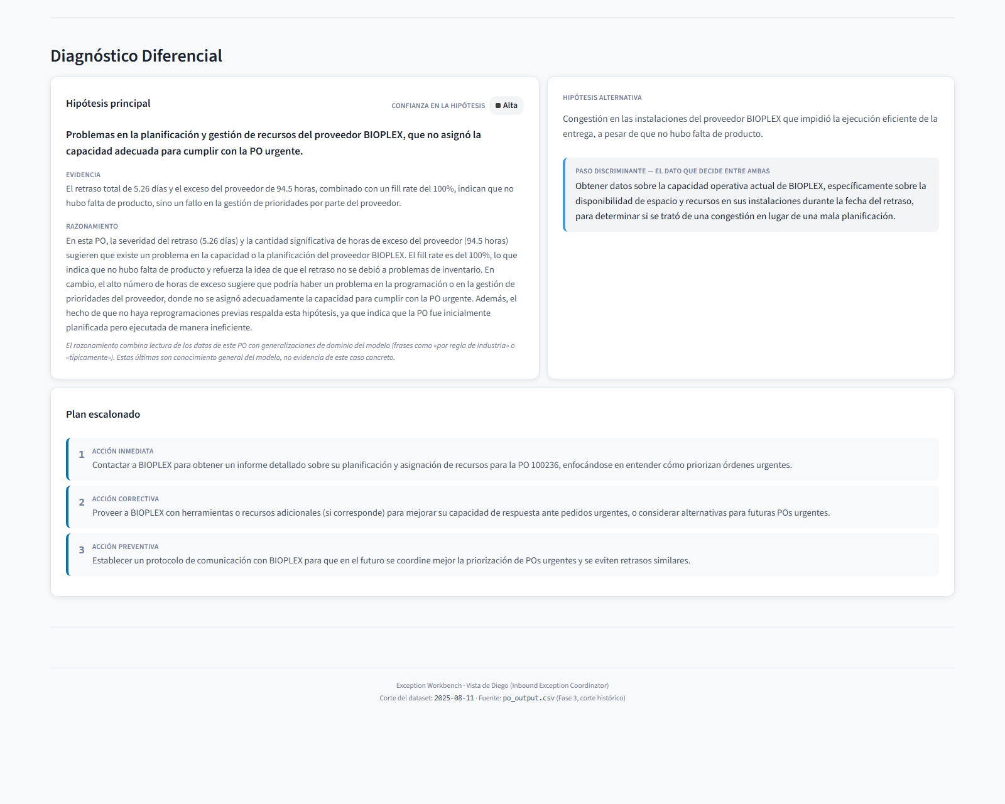
DIEGO VIEW · TIER-2
Differential diagnosis (tier-2)
Notes:
The tier-2 differential diagnosis: main hypothesis vs. alternative, and the discriminant step — the concrete datum that would decide between them. This is what an operator acts on.

Slide 12
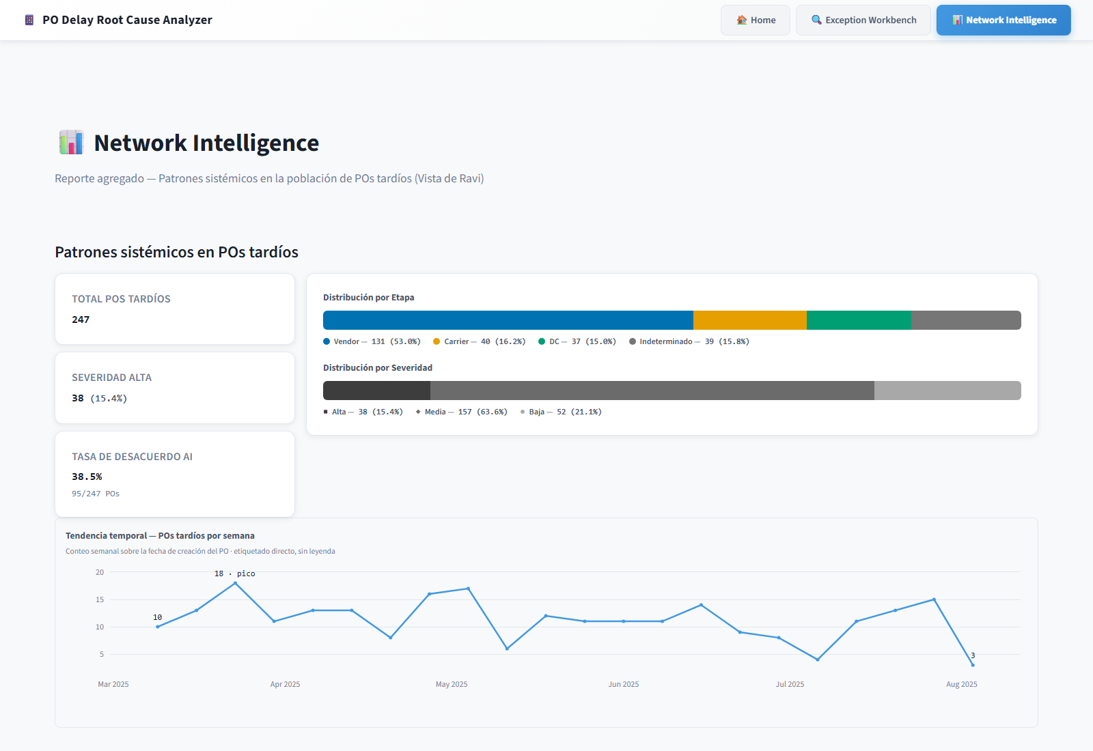
PERSONA B · RAVI
Network Intelligence
Aggregate analysis of the whole late-PO population by systemic pattern: distribution by stage and severity, temporal trend, then entity scorecards for vendors, carriers and DCs.
▸
AI-vs-human disagreement rate as a first-class KPI.
▸
Drill-down from the disagreement table straight into the Diego view.
TWO FIGURES — DON'T CONFLATE
The live 38.5% KPI is the per-PO llm_coincide_con_reason — related to, but not the canonical 88.8% reason agreement.
Notes:
This view is the starting point of the live demo; the drill-down into Diego is literally the flow that will be shown. Source: user_personas.en.md (Persona B).

Slide 13
PHASE 4 · TECHNICAL
Application Architecture
One F3→F4 contract
Design system by task
Second channel: Telegram
po_output.csv , 33 cols: base 16 + tier-1 (8) + tier-2 (9). The app only reads — it never recomputes.
Okabe-Ito palette (color-blind safe) for stage; severity by luminance + icon. Munzner & Cleveland-McGill, not aesthetics.
Fixed commands (/po /kpi /hot ) over the same contract, no LLM at query time.
Notes:
Bridge into the Demo slide — what will be shown live runs on exactly this data contract and design system, not on a mockup. Source: ARD-17/20/21.

Slide 14
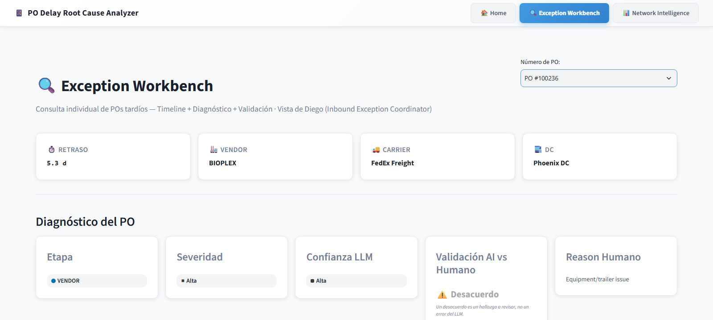
LIVE DEMO
PO #100236
BIOPLEX · Vendor · an urgent ("hot") PO, severity HIGH. The DC logged "Equipment/trailer issue" — the computation says Vendor, with a 94.5-hour excess.
Ravi pattern
→
drill-down
→
Diego diagnosis
No API calls — everything reads from already-generated artifacts.
Notes:
The full step-by-step script lives in guion-demo.en.md — this slide is only the hook before switching to the real application. Flow: Ravi aggregate → drill-down → full diagnosis in Diego. No API calls.

Slide 15
TELEGRAM INTEGRATION
A second front-end over the same data
Ravi gets a HOT alert without opening the browser. /po 100236 replies with the same diagnosis as the Diego view — read from the same CSV.
Risk alerts, pushed
Fixed commands, no LLM
Detects a HIGH-severity PO and sends the root cause automatically, with a direct link into the web app.
Not the deferred conversational chatbot — this is a query surface over the contract, already in production.
Notes:
If asked, distinguish this bot (fixed commands, no LLM at query time, already in production) from the conversational diagnostic chatbot — open-ended reasoning over the dataset — which is explicitly deferred. Confusing the two would overstate the deliverable.

Slide 16
VALIDATION & METRICS
Validation and metrics
METRIC
VALUE
MENTOR THRESHOLD
Stage accuracy
100% (208/208)
> 80% ✅
Reason agreement
88.8% (174/196)
central finding
Severity ranking
100% (14/14)
> 95% ✅
LLM explanation quality
5/5 (20/20)
4/5 ✅
Notes:
This slide replaces v1's single loose '88%' on Conclusions with the three metrics the mentor actually measures against, plus the quality benchmark as a fourth. Denominators answer different questions — see metricas-proyecto.en.md. Source: metricas + validacion-y-qa.en.md (Layer C).

Slide 17
CONCLUSIONS
Data-driven decisions, not perceptions
88.8%
reason agreement between the computation and the human expert.
↹
Total separation of responsibilities: statistics diagnoses, the LLM interprets.
⚡
The dashboard always serves instant answers — nothing is recomputed on the fly.
📎
Every figure is backed by formal, versioned documentation: SRS, SAD, and the full ADR record.
Notes:
The last point is new and closes the argument that nothing shown is improvised — a complete documentation trail sits behind every figure and every rule.

Slide 18
ROADMAP / FUTURE WORK
Stated scope decisions, no date commitment
The deliverable is evaluated on the current app, not on promises. Dates were evaluated and discarded (Option C of ARD-25).
Localization (ES/EN app)
Themes / dark mode
Conversational chatbot (#160)
Categorical fields are already code; the app assigns the label. The real cost is the LLM's free text, generated in Spanish.
Locked to light: Streamlit allows no instant manual CSS toggle. A faithful dark mode needs a presentation layer outside Streamlit.
Deferred, distinct from the delivered Telegram bot: open-ended Q&A with the LLM reasoning over the dataset at query time.
Notes:
If a panelist asks 'why no dark mode?' or 'why not bilingual?', the answer is that it is a documented scope decision, not an oversight — committing to dates was evaluated and discarded (Option C of ARD-25) to avoid raising the presentation's risk with calendar promises. Source: ARD-25.

