Slide 1
Language
Computational Cognitive Neuroscience
Randall O’Reilly

Slide 2
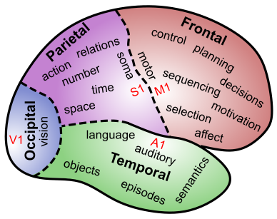
Language Involves all of Cognition
Perception: hearing & reading words
Attention: picking out words, speakers from many
Motor: speech, writing, etc
Memory: semantics, specific content – how do you encode plot of a book?
Executive Function: maintaining context, planning speech, syntax structure..

Slide 3
Language is Special
Symbols
Syntax
Temporally-extended sequences
Cultural transmission
Embedded levels of structure:
“The horse raced past the barn fell”
"Isn't it true that example-sentences that people that you know produce are more likely to be accepted?”

Slide 4
Language Controversies
How special is language: just co-opting existing neural mechs vs. innate language modules?
Rules vs. regularities: is there anything special about rule-like behavior in language?
Spelling to sound: Exceptions also have sub-rules..
Overregularization (add “-ed” = “goed”) – evidence of rule system coming online?
Truly variable-like behavior? Generative, abstract.

Slide 5
What is Truly Novel?
Pure syntax: “Adj Adj Noun Verb Adverb”
“Colorless green ideas sleep furiously”
But: “Newly formed bland ideas are inexpressible in an infuriating way.”
“It can only be the thought of verdure to come, which prompts us in the autumn to buy these dormant white lumps of vegetable matter covered by a brown papery skin, and lovingly to plant them and care for them. It is a marvel to me that under this cover they are labouring unseen at such a rate within to give us the sudden awesome beauty of spring flowering bulbs. While winter reigns the earth reposes but these colourless green ideas sleep furiously.”
“’Twas brillig, and the slithy toves..”
But each word has some overlap with real words..

Slide 6
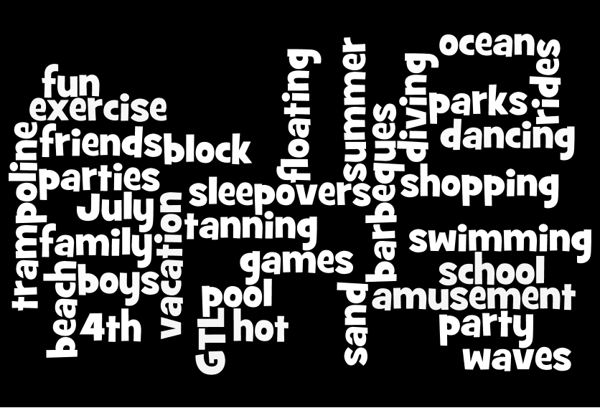
Time and Language
Distributed representation broken down and sent over a sequential channel:
The summer is a fun time for going to the beach, dancing, …

Slide 7
Distributed Reps of Words
I cnduo't bvleiee taht I culod aulaclty uesdtannrd waht I was rdnaieg. Unisg the icndeblire pweor of the hmuan mnid, aocdcrnig to rseecrah at Cmabrigde Uinervtisy, it dseno't mttaer in waht oderr the lterets in a wrod are, the olny irpoamtnt tihng is taht the frsit and lsat ltteer be in the rhgit pclae. The rset can be a taotl mses and you can sitll raed it whoutit a pboerlm. Tihs is bucseae the huamn mnid deos not raed ervey ltteer by istlef, but the wrod as a wlohe. Aaznmig, huh? Yaeh and I awlyas tghhuot slelinpg was ipmorantt! See if yuor fdreins can raed tihs too.

Slide 8
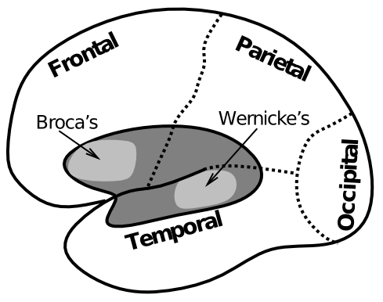
Biology of Language

Slide 9
Example of Wernicke’s Aphasia
"How are you today?”:
"Gossiping O.K. and Lords and cricket and England and Scotland battles. I don't know. Hypertension and two won cricket, bowling, batting, and catch, poor old things, cancellations maybe gossiping, cancellations, arm and argument, finishing bowling.”
https://www.youtube.com/watch?v=aVhYN7NTIKU

Slide 10
Wernicke’s Aphasia
End of the football. It influence the football right here. It crawls and it comes in, see? The end of it. Oh, we got a lot of these, see?
Well, it's playable in the government. You don't understand it, but it pauses in the long very cumbersome and it comes source in the country out through. All the under it, see, comes up, finally it comes up here and goes out... It comes in and comes out and BING That's a good free throw, see?
That's a good throw slow mosey fire, fire. See slows it cold or it gives or kicks out or bing or whatever it is, we has no for football farther down. It's just pulling, see, but they say feel good. I guess it reminds you half dead or I don't even know.
Where do you live? If you live, you appear, see. Where do you leave? Where do you live is, well friends are front and center here around here.
Yes. Right here. Rest of the hearing. How many? Holy Christmas! Oh about a hundred, let's see about a hundred and thirty. About Forty. Gosh, what time is it? One plus five...

Slide 11
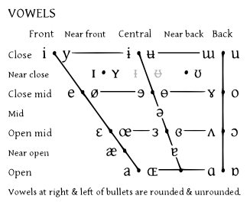
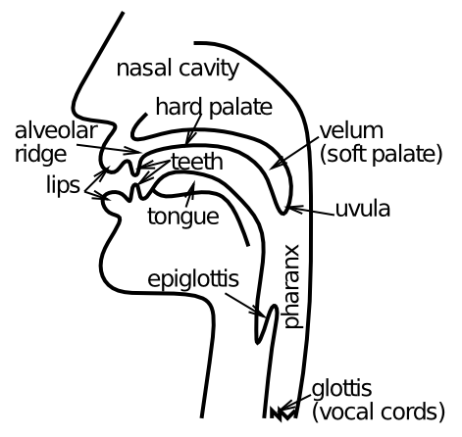
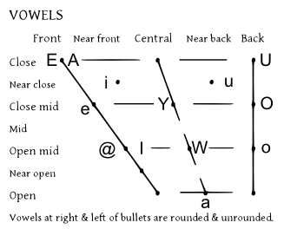
Speech Output

Slide 12
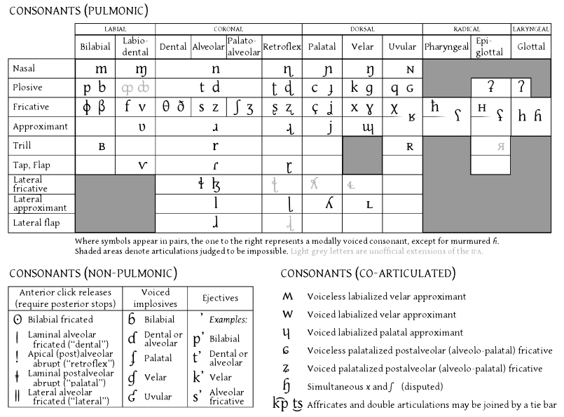
Speech Output

Slide 13
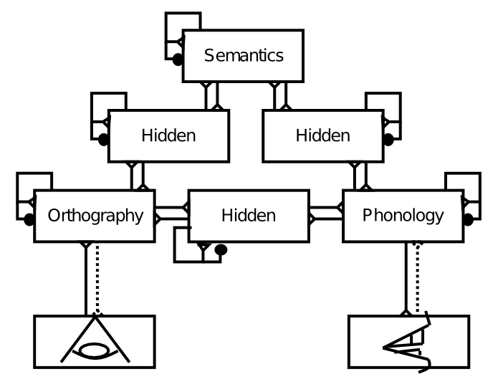
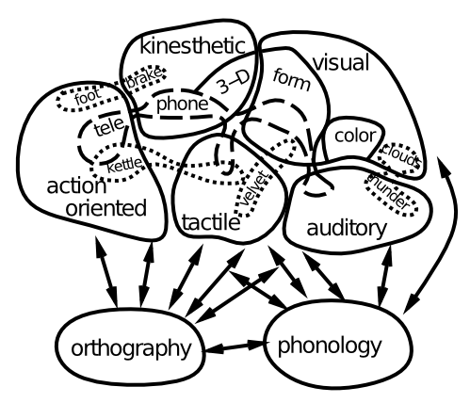
Reading: The “Triangle Model”
NOTE: There is no single “lexicon”, no “word units”

Slide 14
Acquired Dyslexia
Phonological: nonword (“nust”) errors
Deep: phono + semantic errors (“dog” -> “cat”) + visual errors (“dog” -> “dot”)
Surface: exception (“yacht”) errors + visual errors + impaired semantic access

Slide 15
Regularities & Exceptions
Pronounce “bint”
(c.f., mint, hint vs. mind, find vs. pint)
English pronunciation has partial, context-dependent regularities (“rules”?)

Slide 16
Reading = Object Recognition
Invariance: b = “b” regardless
Context dependence: i depends on neighbors (just like any visual features in object)

Slide 17
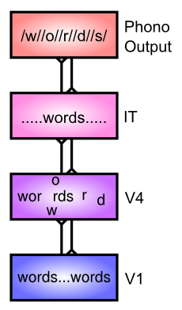

Slide 18
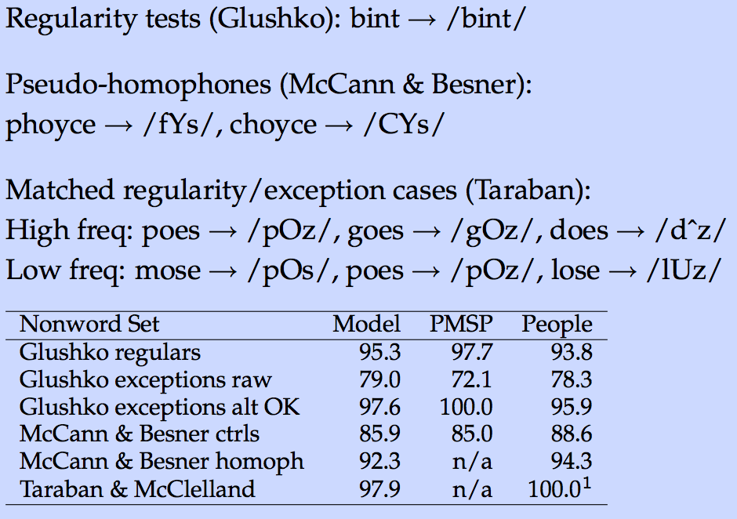
Nonword Performance

Slide 19
Semantics

Slide 20
Word Statistics
Can you infer word meaning from the company it keeps??
Yes! Latent Semantic Analysis (LSA)
Just like V1 RF model – extract statistical structure from natural correlations in language

Slide 21
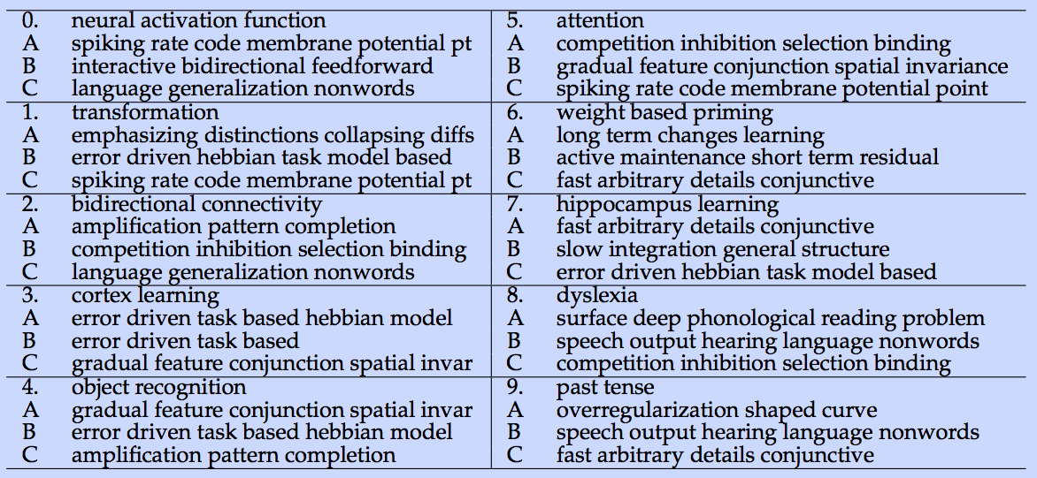
Multiple Choice Quiz

Slide 22
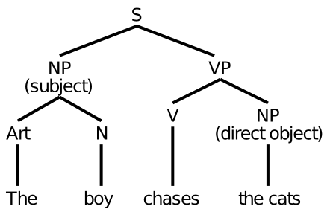
Sentences and Syntax
Is this how it really works??

Slide 23
Those Pesky Time Flies..
Time flies like an arrow.
Fruit flies like a banana.
The slippers were found by the nosy dog.
The slippers were found by the sleeping dog.
Syntax depends on semantics very deeply..

Slide 24
The “Gestalt” Alternative
Just try to get the gist of what the sentence is saying:
G. W. Bush:
“Families is where our nation finds hope, where wings take dream.”
Does this really work? How?

Slide 25
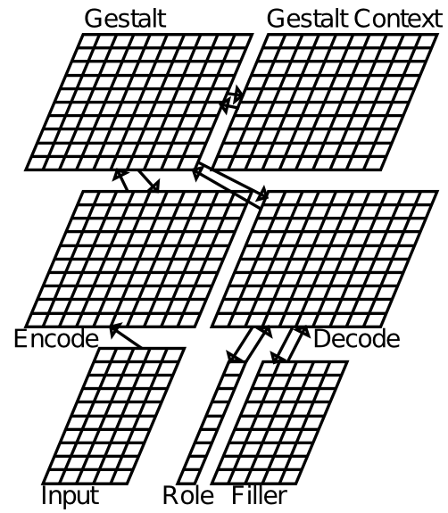
Sentence Gestalt Model

Slide 26
SG Toy World
People: busdriver (adult male), teacher, (adult female), schoolgirl, pitcher (boy). adult, child, someone also used.
Actions: eat, drink, stir, spread, kiss, give, hit, throw, drive, rise.
Objects: spot (the dog), steak, soup, ice cream, crackers, jelly, iced tea, kool aid, spoon, knife, finger, rose, bat (animal), bat (baseball), ball (sphere), ball (party), bus, pitcher, fur.
Locations: kitchen, living room, shed, park.

Slide 27
SG Example/Probe Sentences
Active semantic: The schoolgirl stirred the kool-aid with a spoon. (kool-aid can only be the patient, not the agent of this sentence)
Active syntactic: The busdriver gave the rose to the teacher. (teacher could be either patient or agent -- word order syntax determines it).
Passive semantic: The jelly was spread by the busdriver with the knife. (jelly can't be agent, so must be patient)
Passive syntactic: The teacher was kissed by the busdriver. vs. The busdriver kissed the teacher. (either teacher or busdriver could be agent, syntax alone determines which it is).
Word ambiguity: The busdriver threw the ball in the park., The teacher threw the ball in the living room. (ball is ambiguous, but semantically, busdriver throws balls in park, while teacher throws balls in living room)

Slide 28
SG Example/Probe Sentences
Concept instantiation: The teacher kissed someone. (male). (teacher always kisses a male -- has model picked up on this?)
Role elaboration: The schoolgirl ate crackers. (with finger); The schoolgirl ate. (soup) (these are predominant cases)
Online update: The child ate soup with daintiness. vs. The pitcher ate soup with daintiness. (schoolgirl usually eats soup, so ambiguous child is resolved as schoolgirl in first case after seeing soup, but specific input of pitcher in second case prevents this updating).
Conflict: The adult drank iced-tea in the kitchen. (living-room) (iced-tea is always had in the living room).

Slide 29
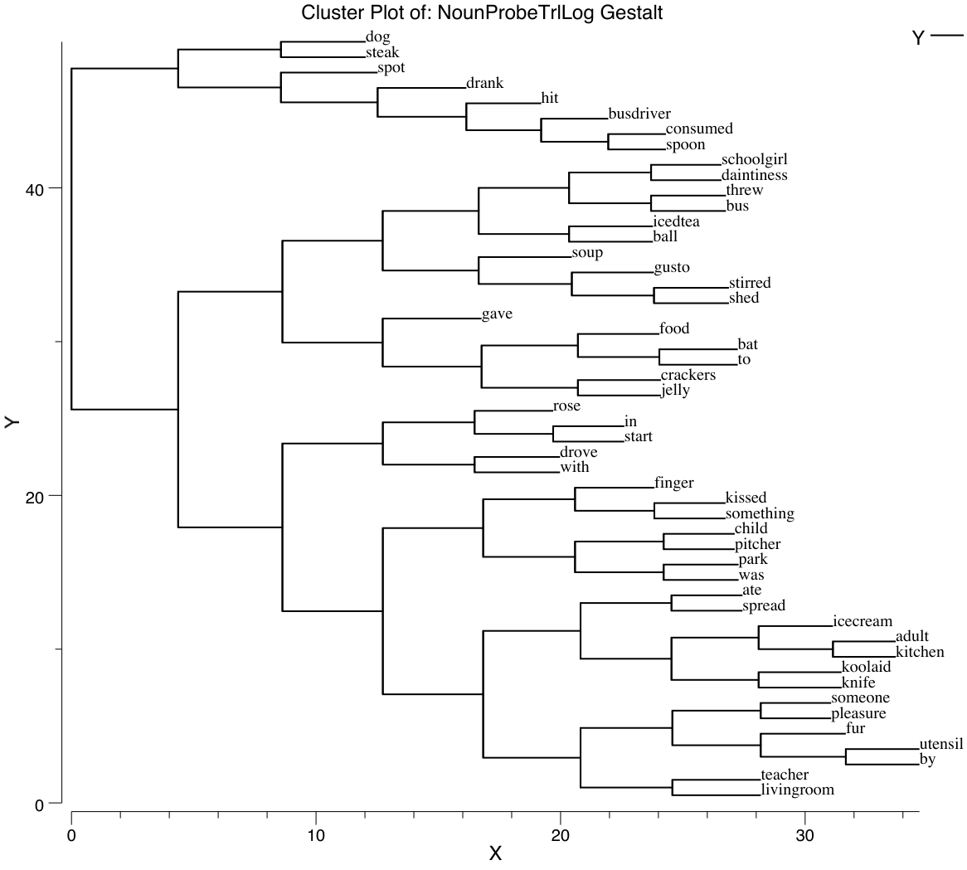
Gestalt Representations

Slide 30
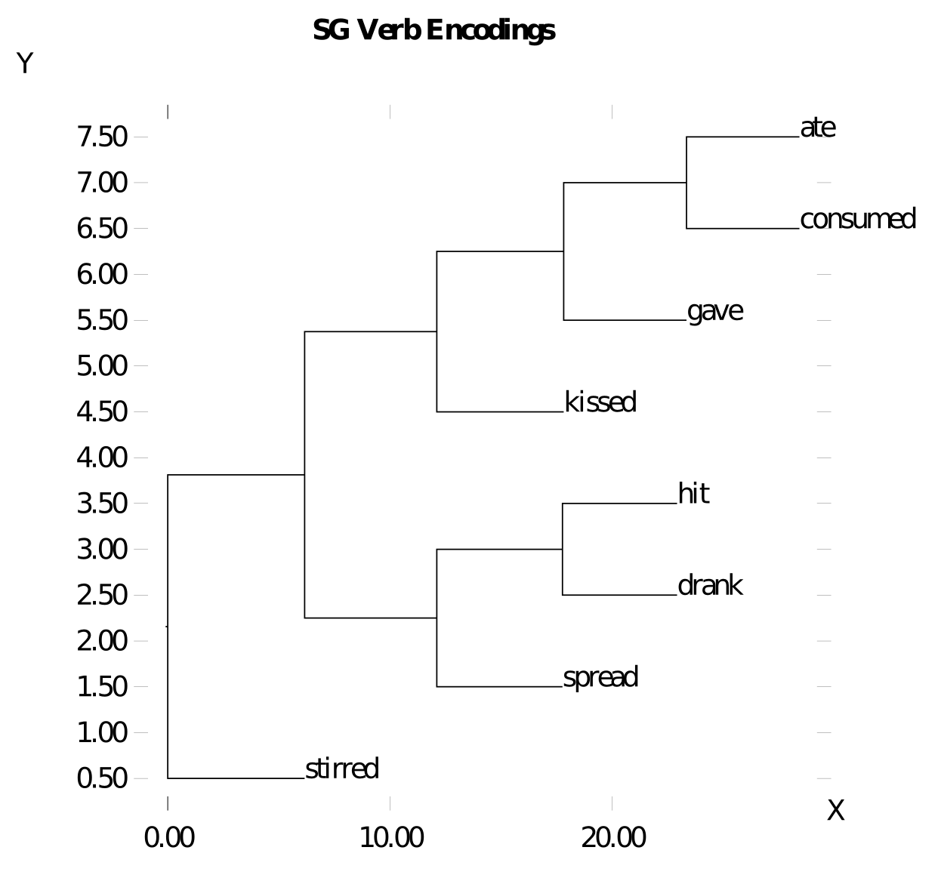
Gestalt Representations

Slide 31
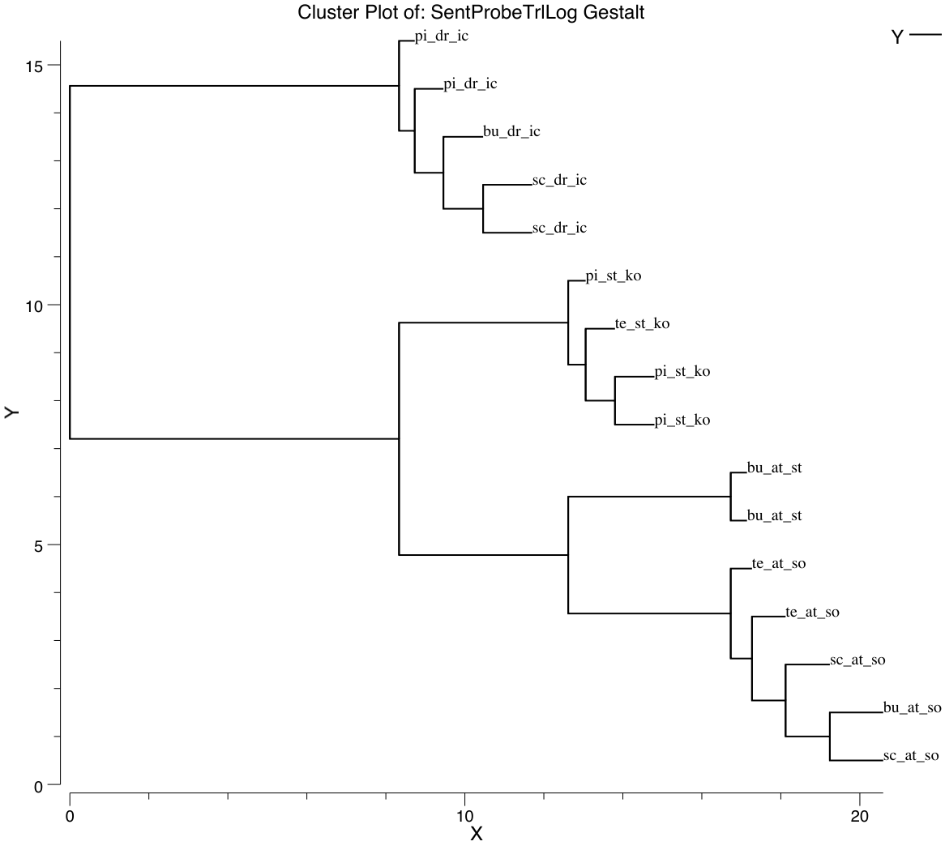
Gestalt Representations

Slide 32
