Slide 1
Executive Function
Computational Cognitive Neuroscience
Randall O’Reilly

Slide 2
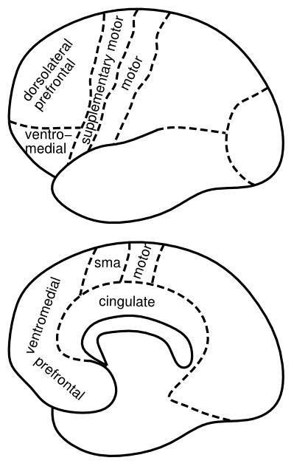
Who is in Charge of your Brain??
Prefrontal Cortex?
Integrates:
Cognitive Control
Planning
Motivation
Reward processing
Decision making

Slide 3

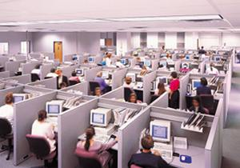
Key Idea: Top-Down Biasing
PFC active maintenance provides top-down biasing of posterior-cortical processing

Slide 4
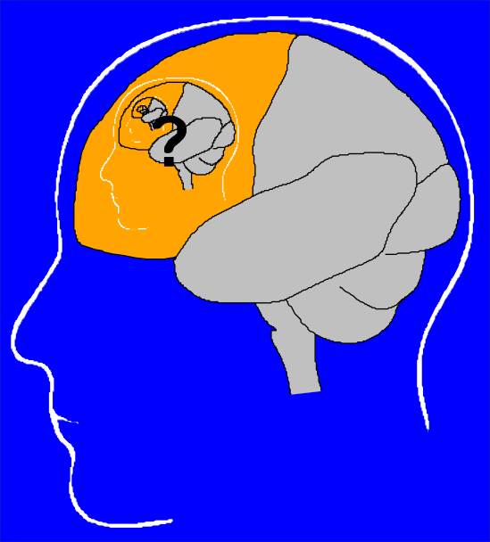
The Homunculus Problem

Slide 5
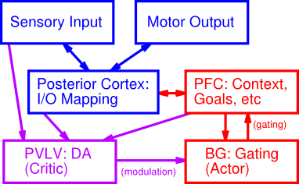
It Takes a Network..

Slide 6
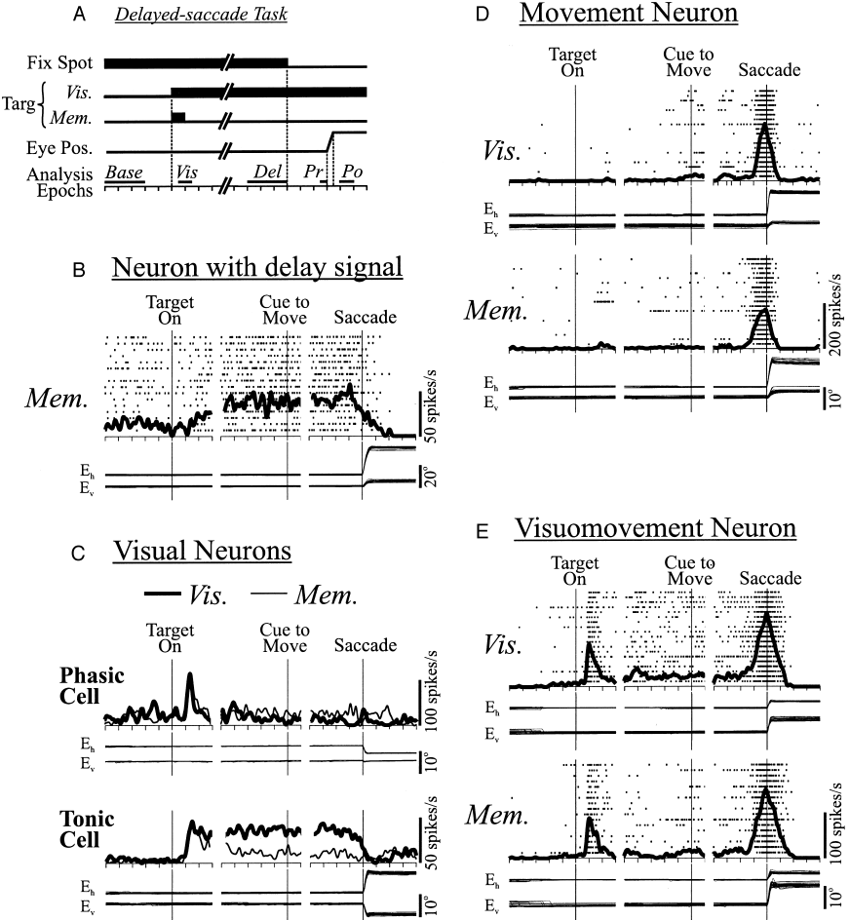
PFC Does Active Maintenance

Slide 7
Active Maintenance Can Do it All
Cognitive Control
Maintained activity drives top-down biasing
Planning
Think about things that are not there (future)
Motivation
Maintain goals
Reward processing
Maintain possible outcomes
Decision making
Maintain alternatives

Slide 8
The Need for Robust Maintenance
"Every sound has to be an earthquake or tidal wave that topples governments and changes national boundaries and mutates whole species so they suddenly drift off the planet, across galaxies, only to return, years later, when nobody wants to know them cause their credit rating's bad or because they can't do the Mashed Potatoes.” - MFU by HC, 1998
Subjective experience of PFC lesion: dreaming!

Slide 9
Stroop Task: Top Down Biasing
RED

Slide 10
Stroop Task: Top Down Biasing
GREEN

Slide 11
Stroop Task: Top Down Biasing
RED

Slide 12
Stroop Task: Top Down Biasing
GREEN

Slide 13
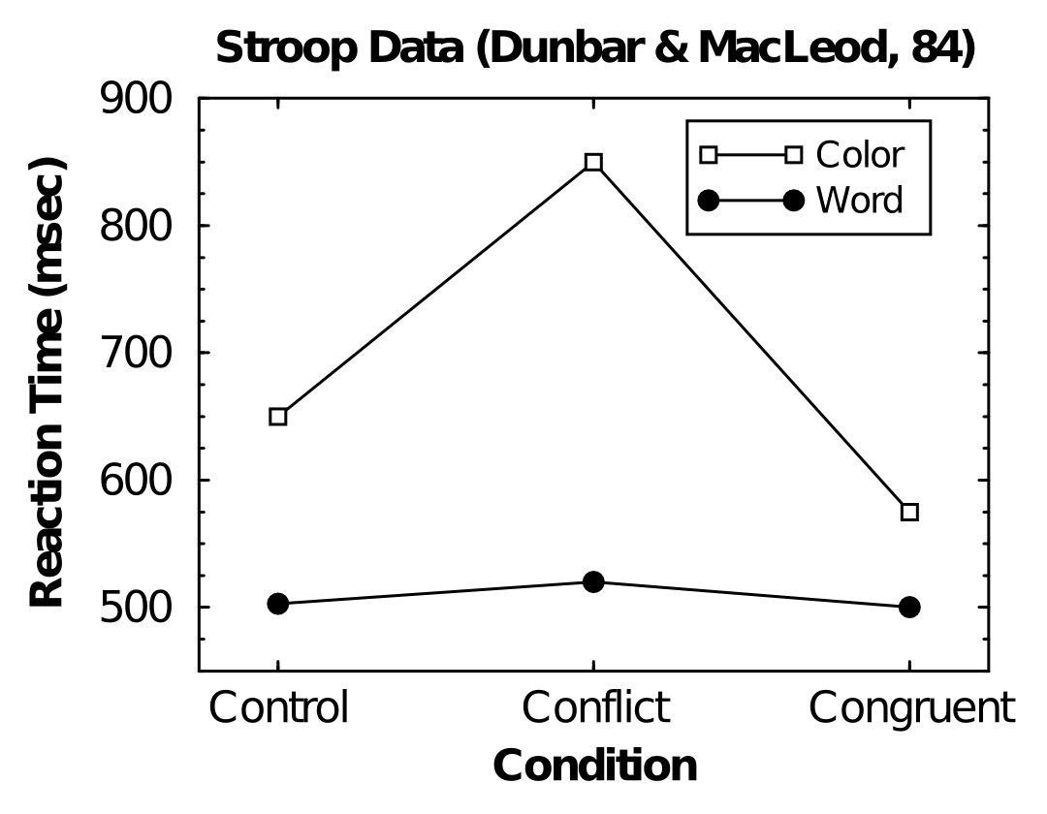
Asymmetric Conflict

Slide 14
Robust Active Maintenance
In Stroop model, we just clamp PFC units on..
What makes them “clamped” in the real brain?
BG!

Slide 15
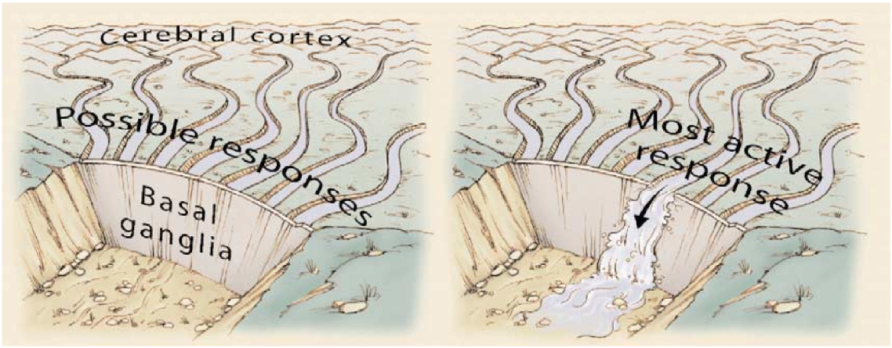
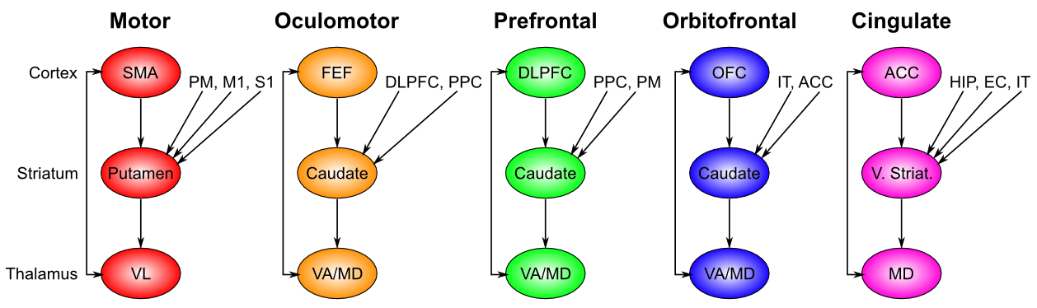
Motor Gating => Cognitive Gating

Slide 16
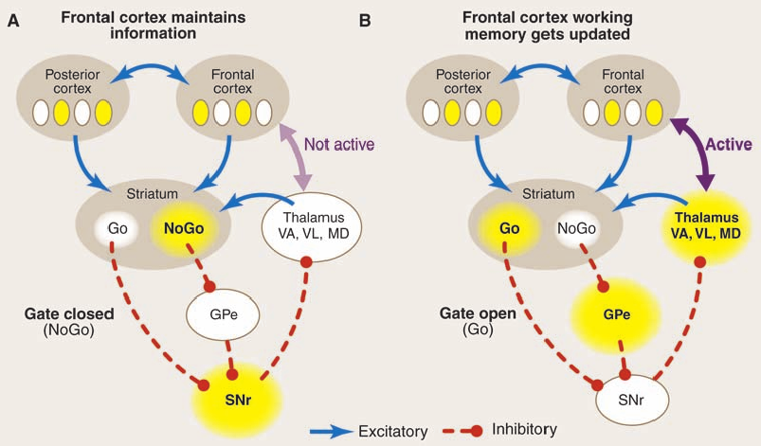
Dynamic, Adaptive Gating (BG)
Toggles PFC bistable states
Resembles transistor logic gate!

Slide 17
PBWM System

Slide 18
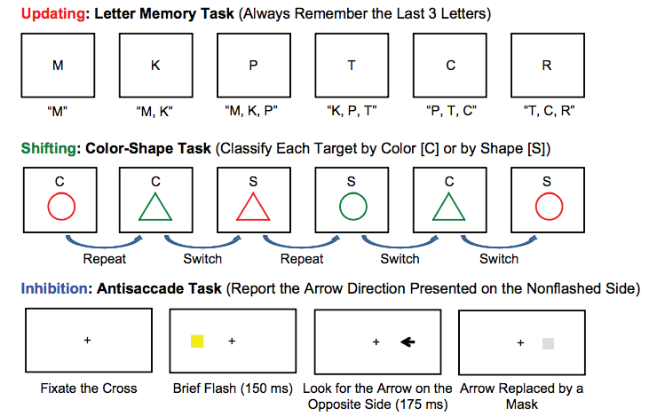
Examples of different EF tasks
Notes:
Updating – you are putting the letters in working memory & updating as different letters come along
Shifting: You are switching between the relevant rule (color or shape)
Inhibition: You want to look for the arrow on the opposite side that is being cued- this involves inhibiting your “automatic” response to look places when cued

Slide 19
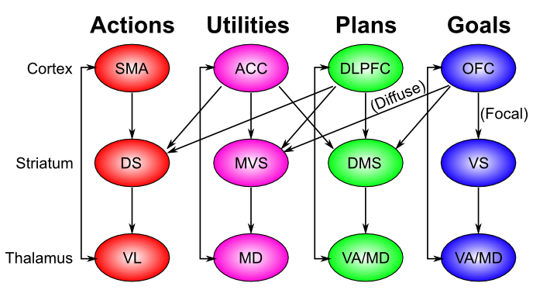
Chain of Command..

Slide 20
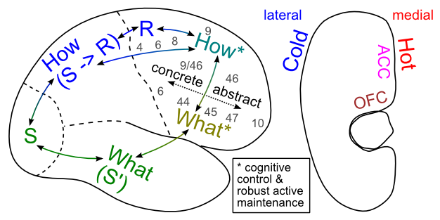
Executive Function

Slide 21
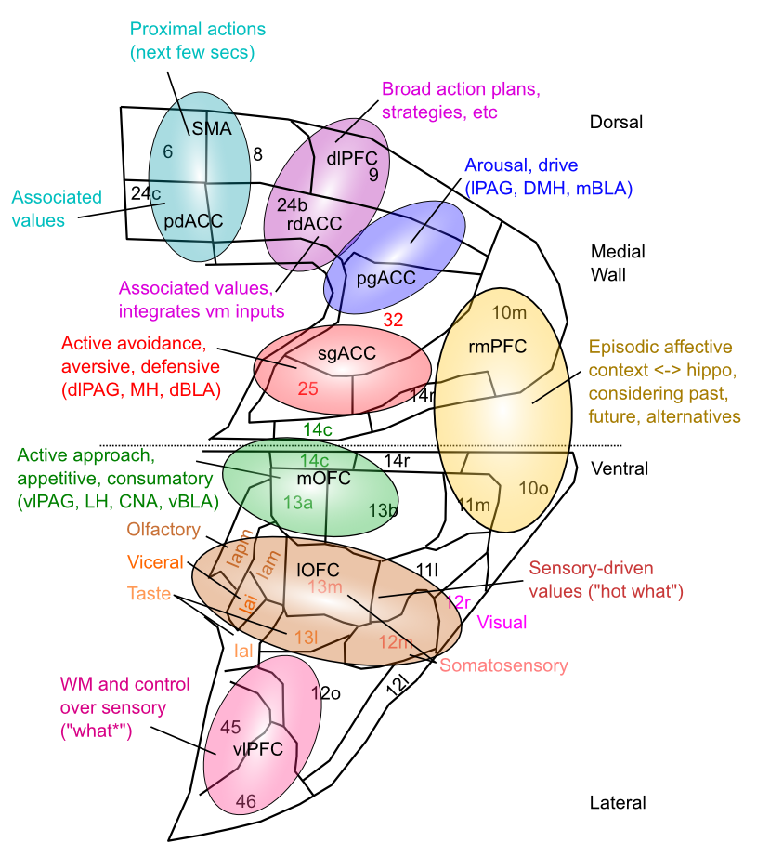
Medial Frontal Map of Values This is your emotional life

Slide 22
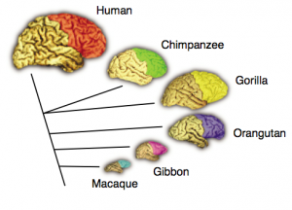
Prefrontal cortex across species
Notes:
The prefrontal cortex (also called neocortex), is most developed in humans. In the graphic below, you can see that monkeys, especially chimpanzees and gorillas also have a prefrontal cortex

Slide 23
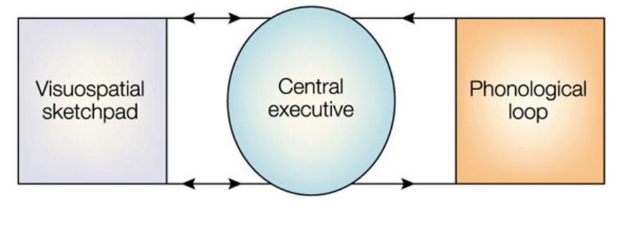
Baddeley/Hitch model
Influential account of working memory
Phonological loop: Hold information for a few seconds, maintain through rehearsal
Central executive: Switch & focus attention
Visuospatial sketchpad: ongoing manipulation of visual/spatial items
Notes:
http://link.springer.com/article/10.1007/s11065-007-9040-z

Slide 24
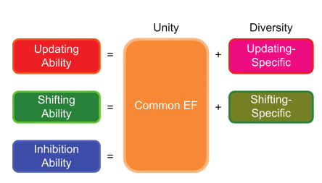
Different parts of EF
Friedman & Miyake, 2012
Notes:
In this “factor” analysis, they compared performance of several updating and shifting tasks to find out what abilities were shared among them
They found a “common” EF ability that correlated with the ability to do all of these tasks, as well as specific updating and shifting abilities that were specific to those types of tasks
Inhibition was not a specific factor, but correlated with common EF

Slide 25
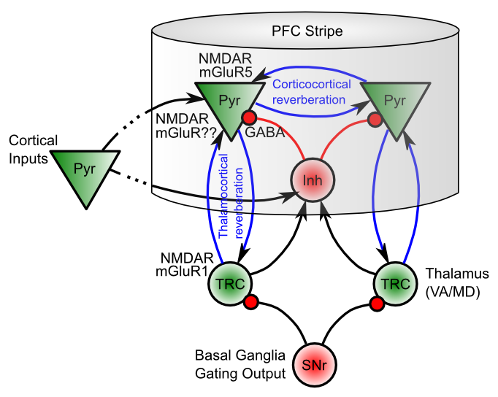
Biological Basis of PBWM

