Slide 1
Brain Areas
Computational Cognitive Neuroscience
Randall O’Reilly

Slide 2
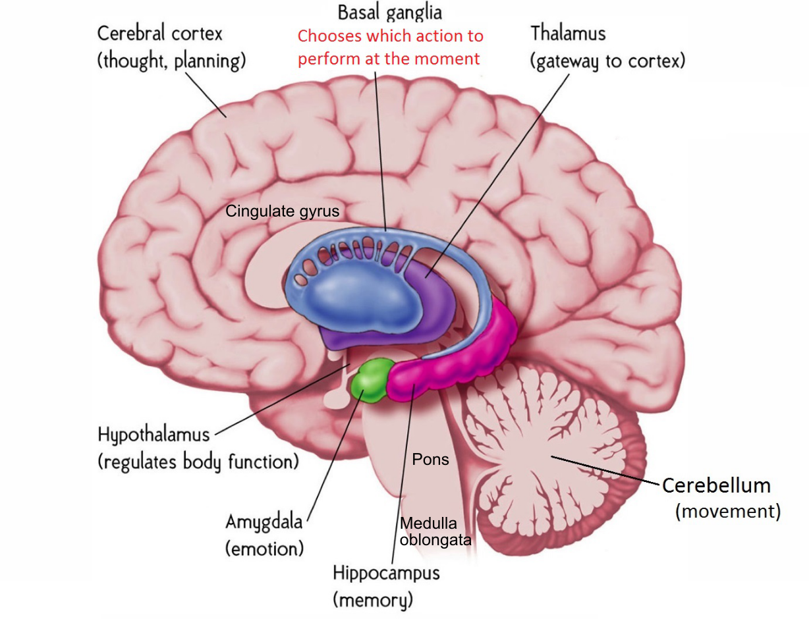
Gross Anatomy

Slide 3
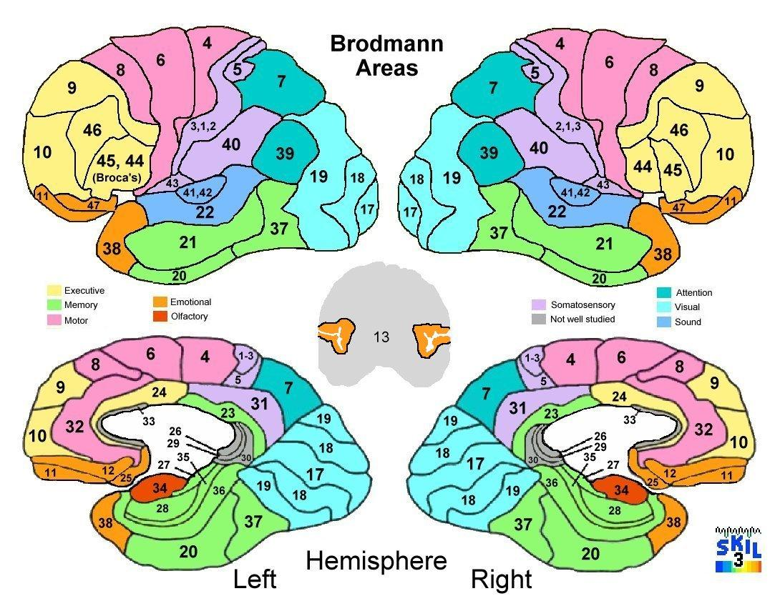

Slide 4
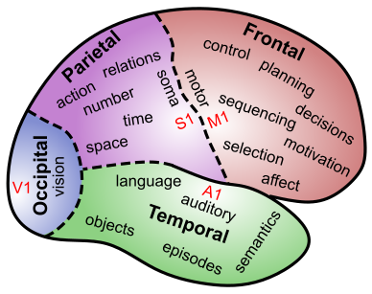
Lobular Functions

Slide 5
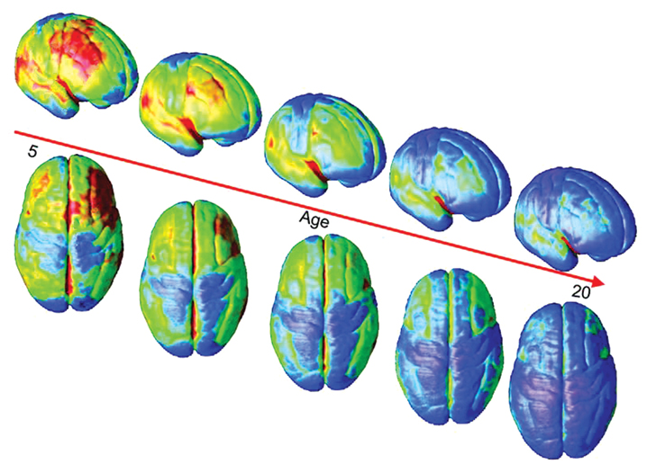
Brain Maturation: Synaptic Pruning
Blue = thinner = more synapses pruned = more mature
Sensory areas mature first, then “higher level” areas; PFC last of all

Slide 6
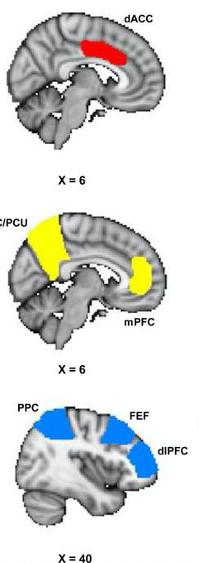
Functional Networks
Salience: “hot” network of medial, ACC, Amygdala, Insula
“Default” network (where your brain likes to go): ruminating, mind-wandering, planning, autobiographical memories (+ hippocampus)
“Control” network: Parietal <-> Frontal network for directing attention, eye movements, manual behavior on cognitive tasks

Slide 7
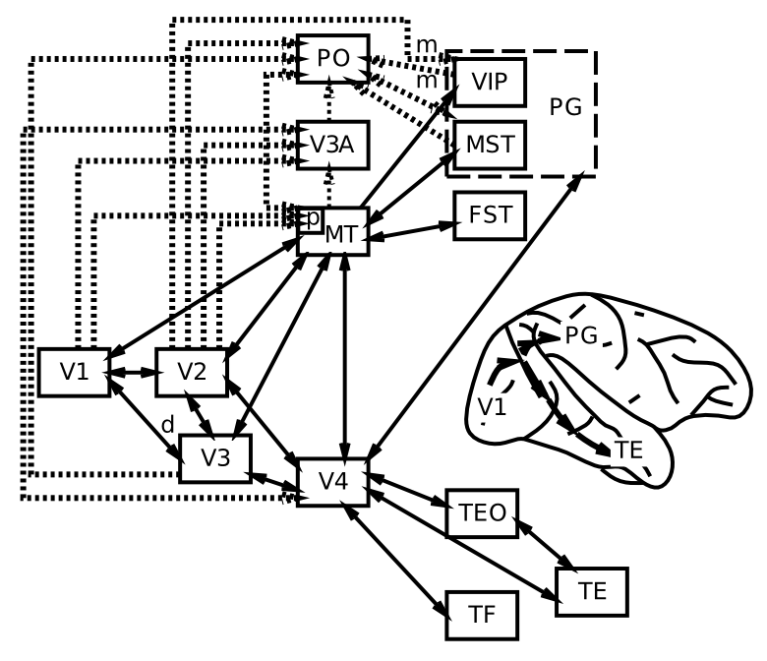
Visual Hierarchy: What vs Where

Slide 8
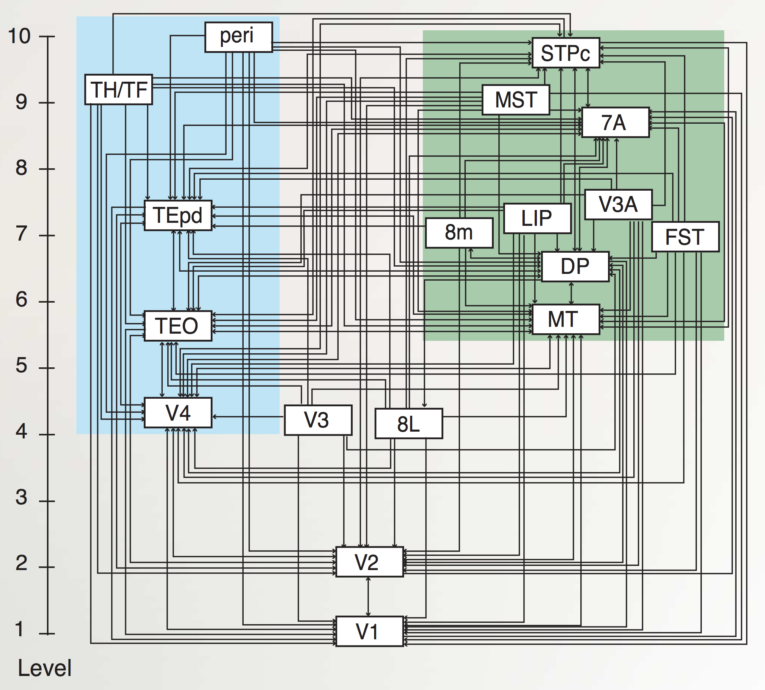
“Van Essen” Hierarchy
TE.. = Temporal
LIP, DP.. = Parietal
8L = Frontal Eye Field
To hippocampus:
TH/F = Parahippo
peri = Perirhinal
Markov et al., 2014

Slide 9
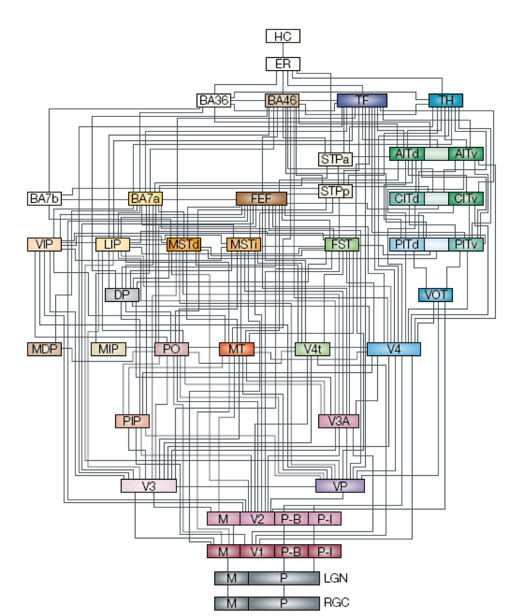

Slide 10
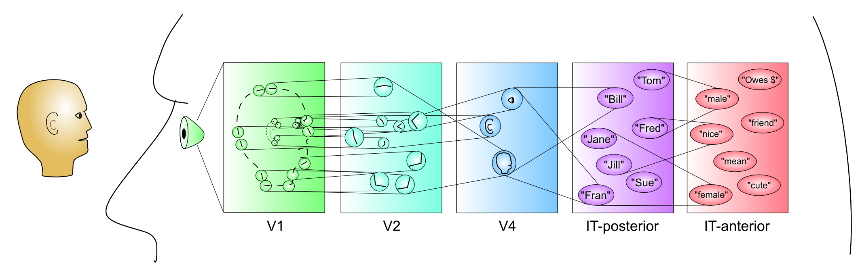
Hierarchy of Detectors..

Slide 11
Learning Rules Across the Brain
Learning Signal
Dynamics
Area | Reward | Error | Self Org | Separator | Integrator | Attractor
Primitive Basal Ganglia | +++ | - - - | - - - | ++ | - | - - -
Cerebellum | - - - | +++ | - - - | +++ | - - - | - - -
Advanced Hippocampus | + | + | +++ | +++ | - - - | +++
Neocortex | ++ | +++ | ++ | - - - | +++ | +++
+ = has to some extent … +++ = defining characteristic – definitely has
- = not likely to have … - - - = definitely does not have

Slide 12
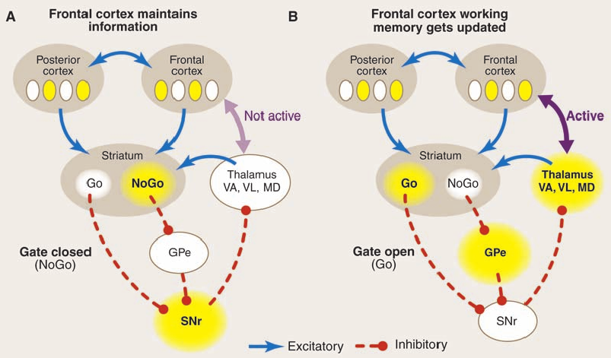
Motor Control: BG, Cerebellum

Slide 13
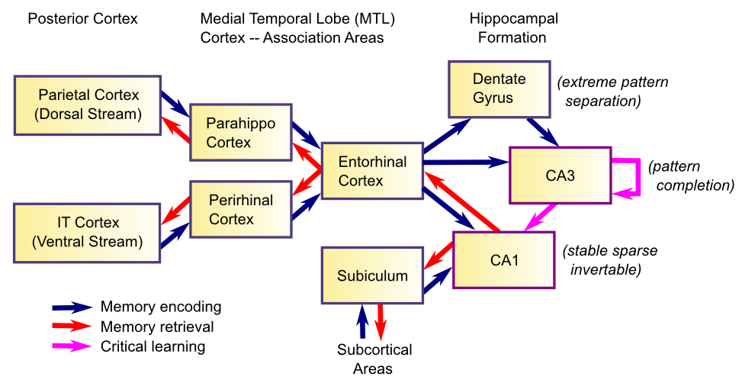
Memory and the Hippocampus

Slide 14
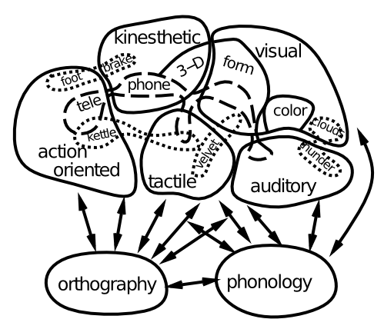
Language
Lots of areas working together..

Slide 15
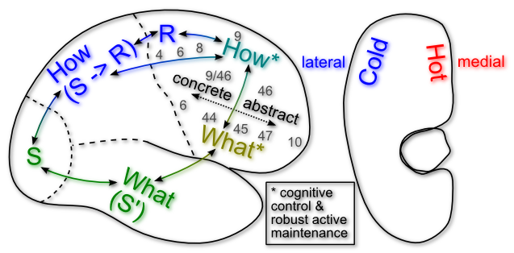
Executive Function

Slide 16
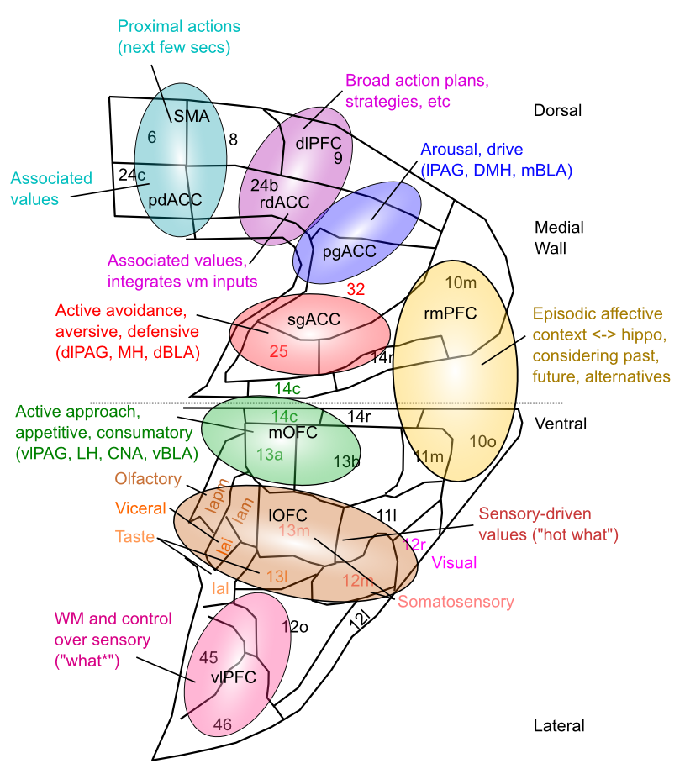
Medial Frontal Map of Values

Slide 17
Neurotransmitter Terms
Agonist: acts like a given neurotransmitter
Antagonist: blocks receptors for given NT
Reuptake: takes NT back out of synapse
Neuromodulator: a broadly-released neurotransmitter that has widespread modulatory effects on the brain

Slide 18
Neuromodulators and Drugs (receptor agonists)
Acetylcholine (ACh): muscles, attention, learning, memory (nicotine)
Dopamine (DA): when to learn, based on reward prediction errors (cocaine)
Norephinephrine (NE): attention, engagement (speed)
Serotonin (5HT): Mood, sleep, appetite, sex, stress (SSRI, LSD = waking dream)
Oxytocin: social modulation, labor (pitocin)
Endorphins, Substance P: pain (heroin)

