Slide 1
Computational Cognitive Neuroscience
PSYC 4175/5175
Randall O’Reilly

Slide 2
How Would You Build It?
If you want to understand how something works, take it apart, then try to put it back together.
We’re going to take the brain apart, an put it back together again.
How would you do it??

Slide 3
Emergence and Learning
With 10,000,000,000 neurons, you can’t build it by hand..
It basically has to build itself (development & learning)
Complexity must emerge from simplicity (not that many genes control brain development..)

Slide 4
Emergence
(Now Imagine 10,000,000,000 gears, each interacting with 10,000 others..

Slide 5
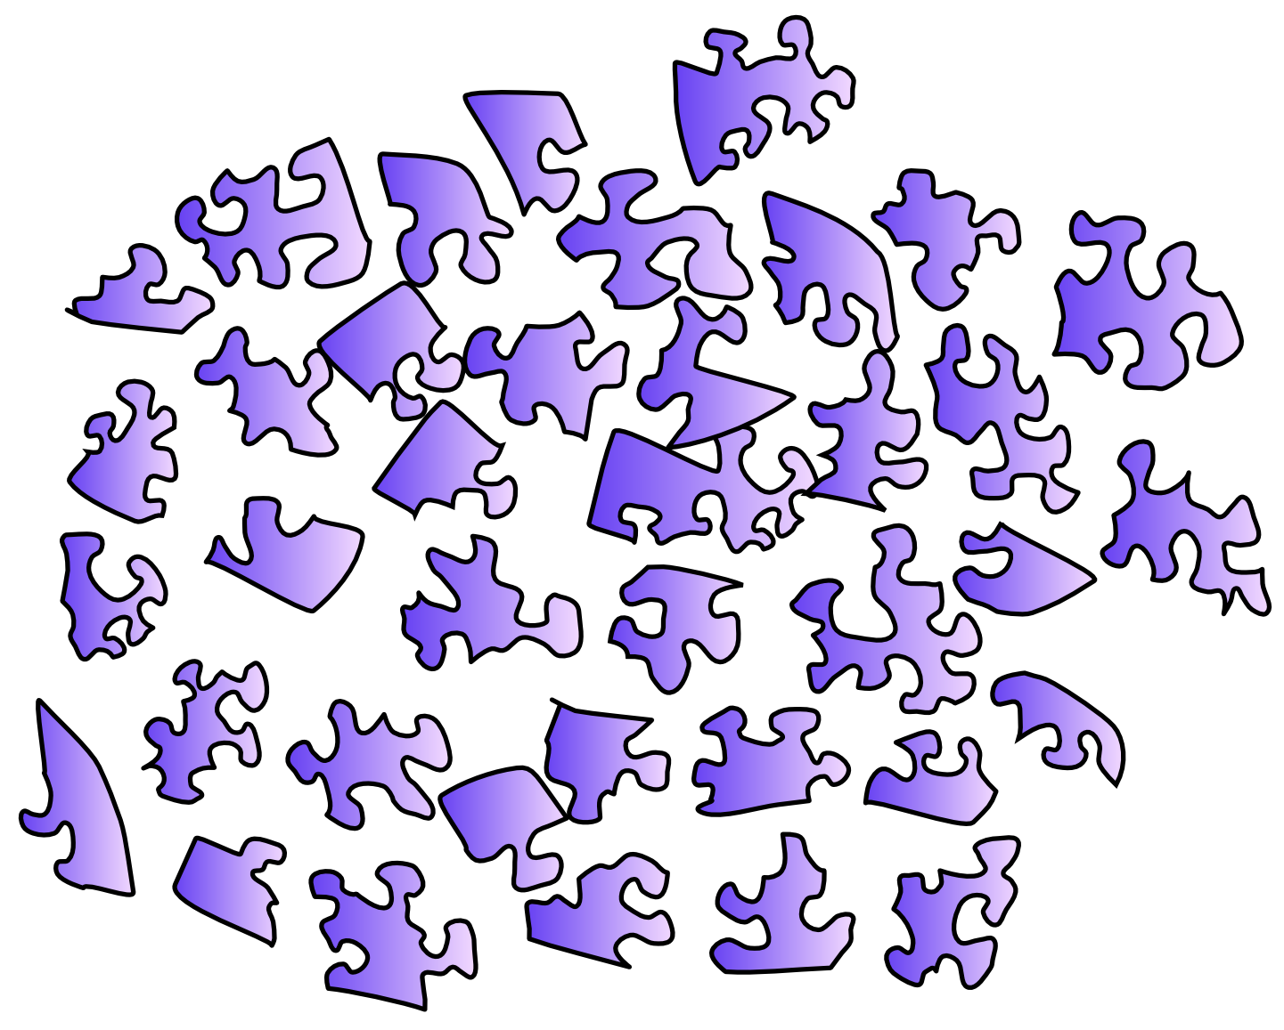
The Problem

Slide 6
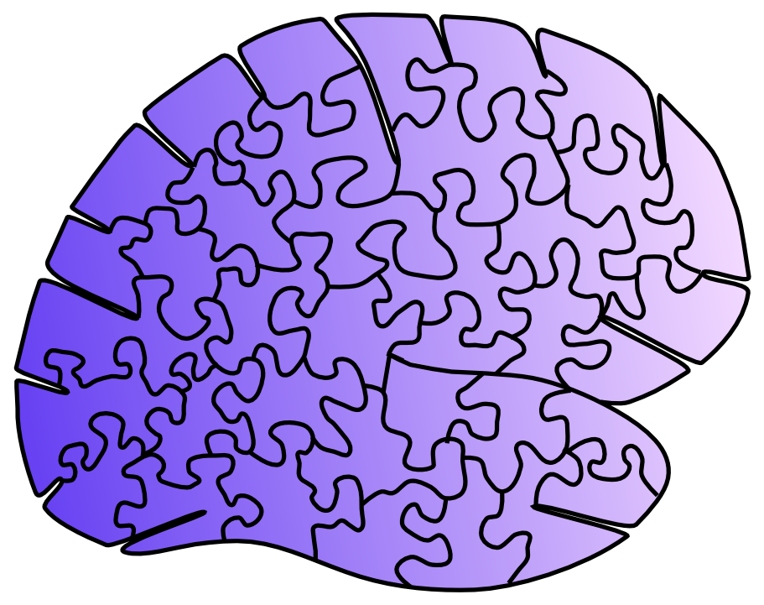
The Problem

Slide 7
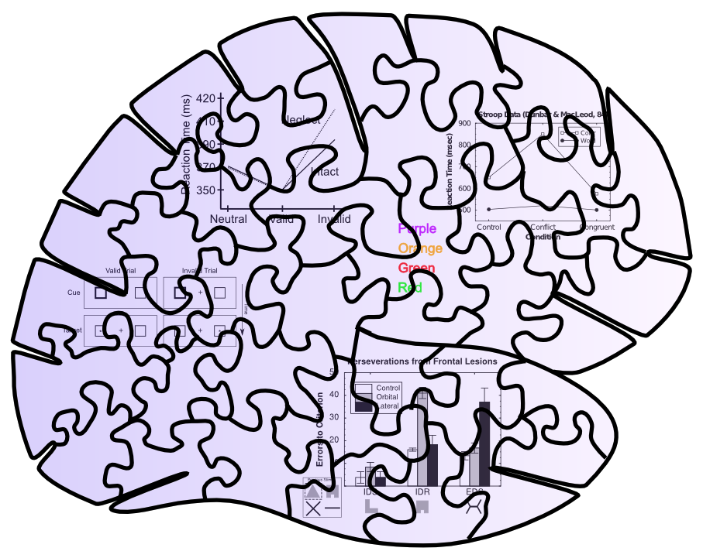
Behavioral Constraints

Slide 8
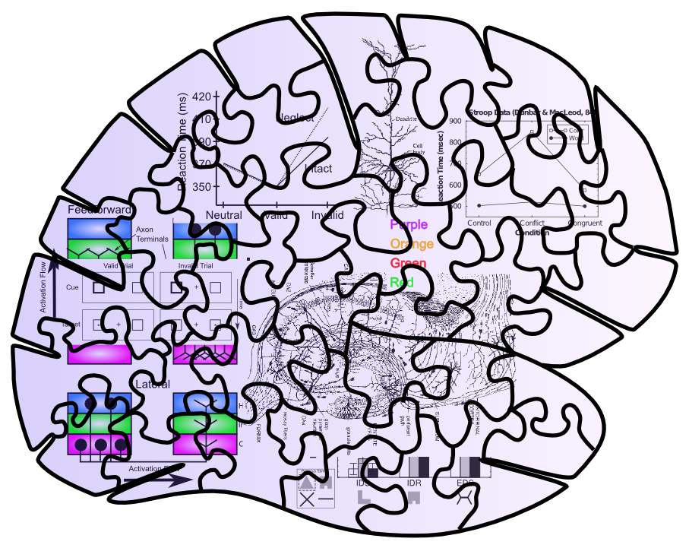
Neuro + Behavioral Constraints

Slide 9
Messy Puzzles are Easier to Solve!!

Slide 10
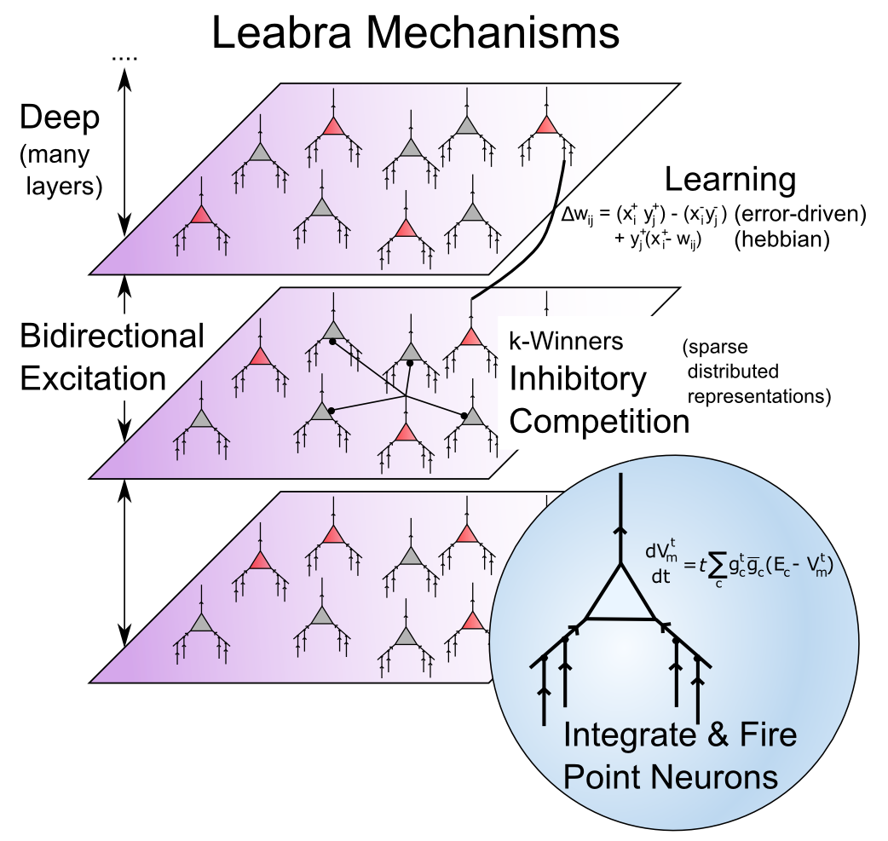
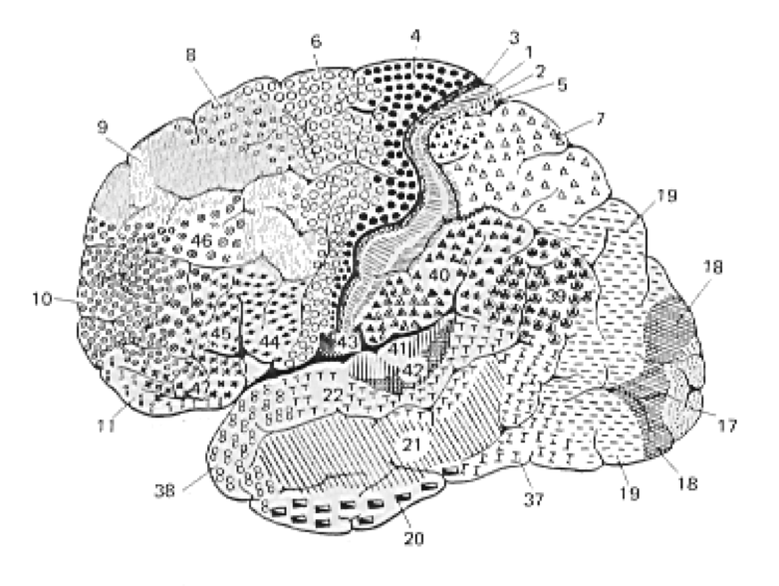
Course Overview
From Neurons to Networks to the Brain/Mind..

Slide 11
Cognitive Phenomena
Visual encoding: A network views natural scenes (mountains, trees, etc.), and develops brain-like ways of encoding them using principles of learning.
Spatial attention: Taking advantage of interactions between two different streams of visual processing, a model focuses its attention in different locations in space, and simulates normal and brain-damaged people.
Episodic memory: Replicating the structure of the hippocampus, a model forms new episodic memories and solves human memory tasks.
Working memory: A neural network with specialized biological mechanisms simulates our working memory capacities (e.g., the ability to mentally juggle a bunch of numbers while trying to multiply multidigit values).

Slide 12
Cognitive Phenomena
Word reading: A network learns to read and pronounce nearly 3,000 English words, and generalizes to novel nonwords (e.g., “mave” or “nust”) just like people do. Damaging a reading model simulates various forms of dyslexia.
Semantic representation: A network “reads” every paragraph in a textbook, acquiring a surprisingly good semantic understanding by noting which words tend to be used together or in similar contexts.
Task directed behavior: A network simulates the “executive” part of the brain, the prefrontal cortex, which keeps us focused on performing the task at hand and protects us from distraction.

