Slide 1
Learning
Computational Cognitive Neuroscience
Randall O’Reilly

Slide 2
Overview of Learning
Biology: synaptic plasticity
Computation:
Self organizing – soaking up statistics
Error-driven – getting the right answers

Slide 3
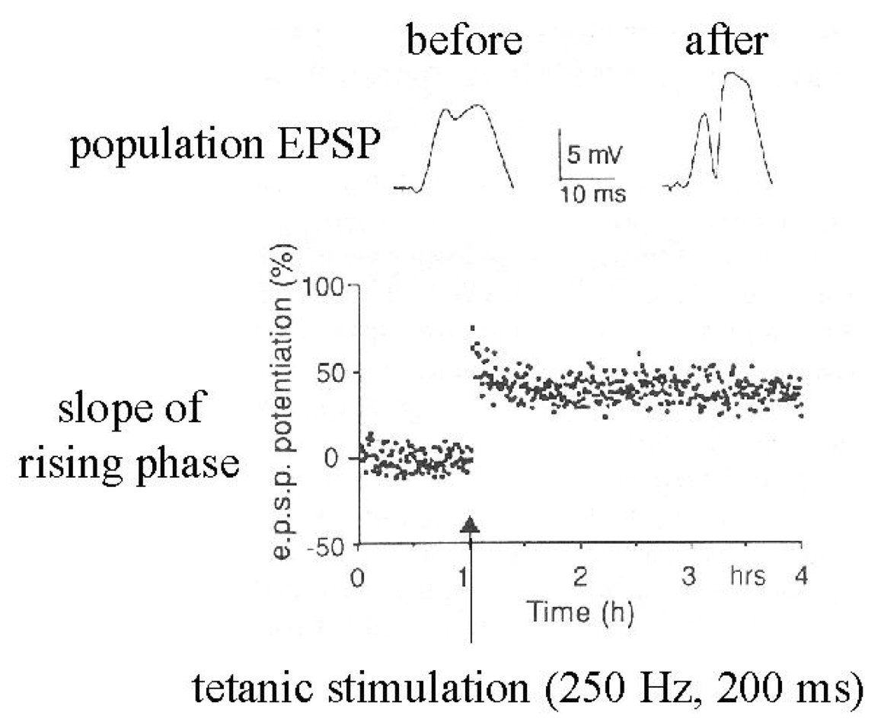
Synapses Change Strength (in response to patterns of activity)

Slide 4
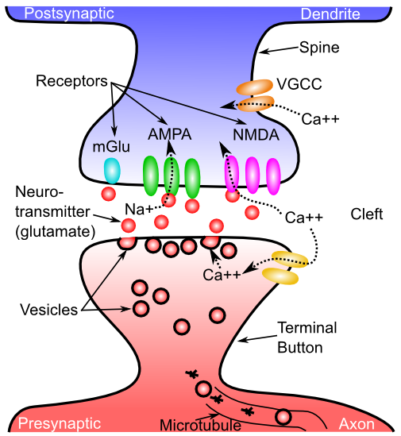
What Changes??

Slide 5
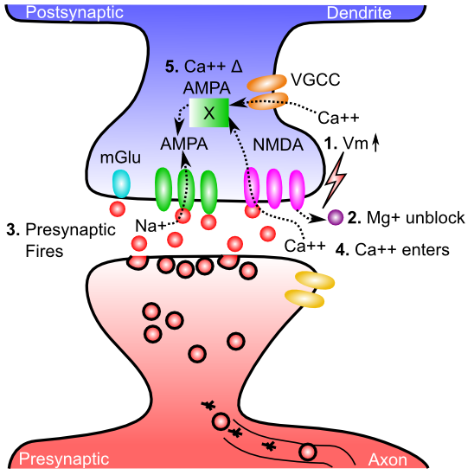
Gettin’ AMPA’d

Slide 6
Opening the NMDA receptor calcium channel
Glutamate
Na+
CA2+
AMPAr
NMDAr
Mg2+

Slide 7
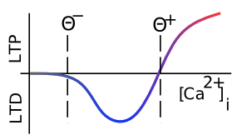
Which Way?

Slide 8
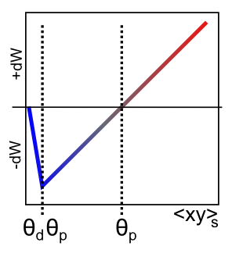
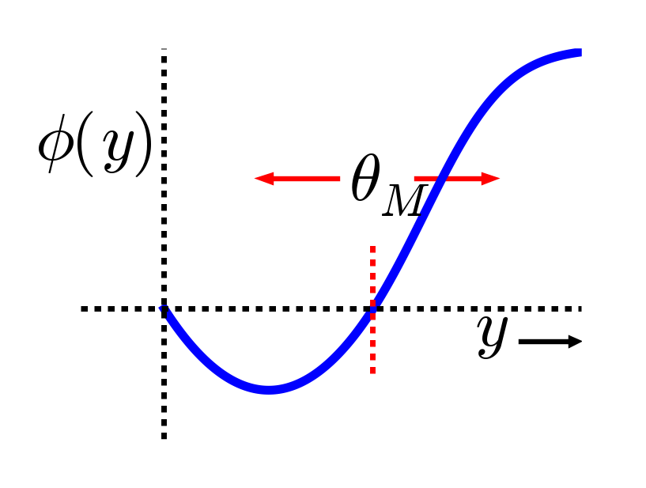
XCAL = Linearized BCM
Bienenstock, Cooper & Munro (1982) – BCM:
adaptive threshold Θ
Lower when less active
Higher when more..
(homeostatic)

Slide 9
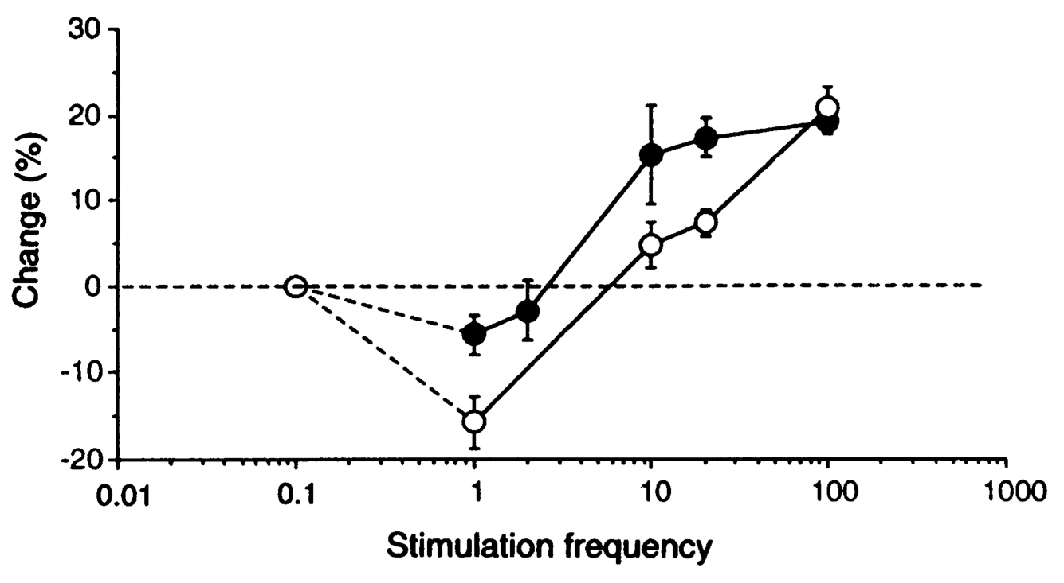
Threshold Does Adapt

Slide 10
Computational: Self-Organizing and Error-Driven
Self-organizing = learn general statistics of the world.
Error-driven = learn from difference between expectation and outcome.
Both can be achieved through XCAL.

Slide 11
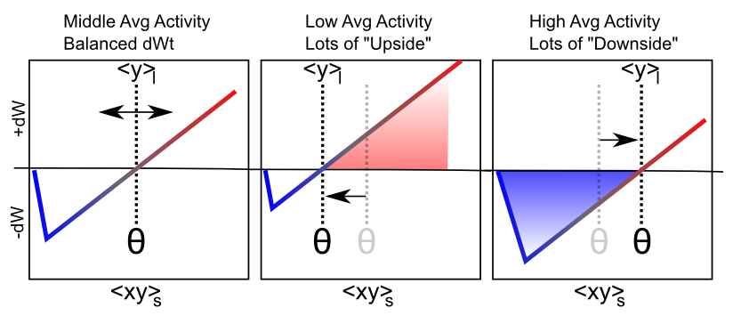
Floating Threshold = Long Term Average Activity (Self Org)

Slide 12
Self Organizing Learning
Inhibitory Competition: only some get to learn
Rich get richer: winners detect even better
But also get more selective (hopefully)
Homeostasis: keeping things more evenly distributed (higher taxes for the rich!)

Slide 13
Limitations of Self-Organizing
Can’t learn to solve challenging problems – driven by statistics, not error..

Slide 14
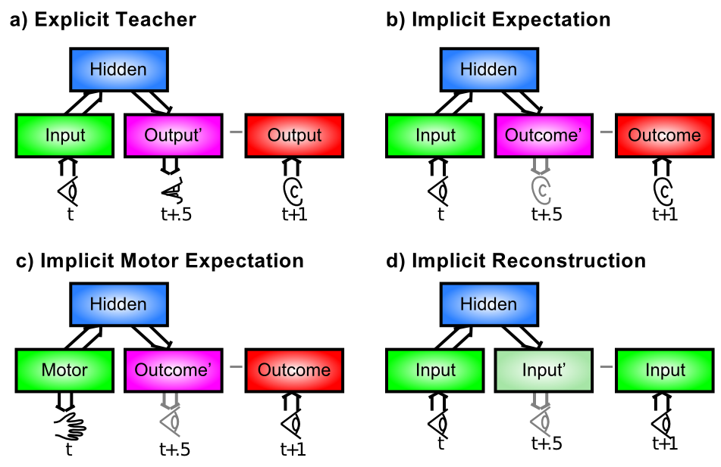
Where Does Error Come From?

Slide 15

Floating Threshold = Medium Term Synaptic Activity (Error-Driven)
dW = Outcome – Expectation = <xy>_{s} - <xy>_{m}

Slide 16
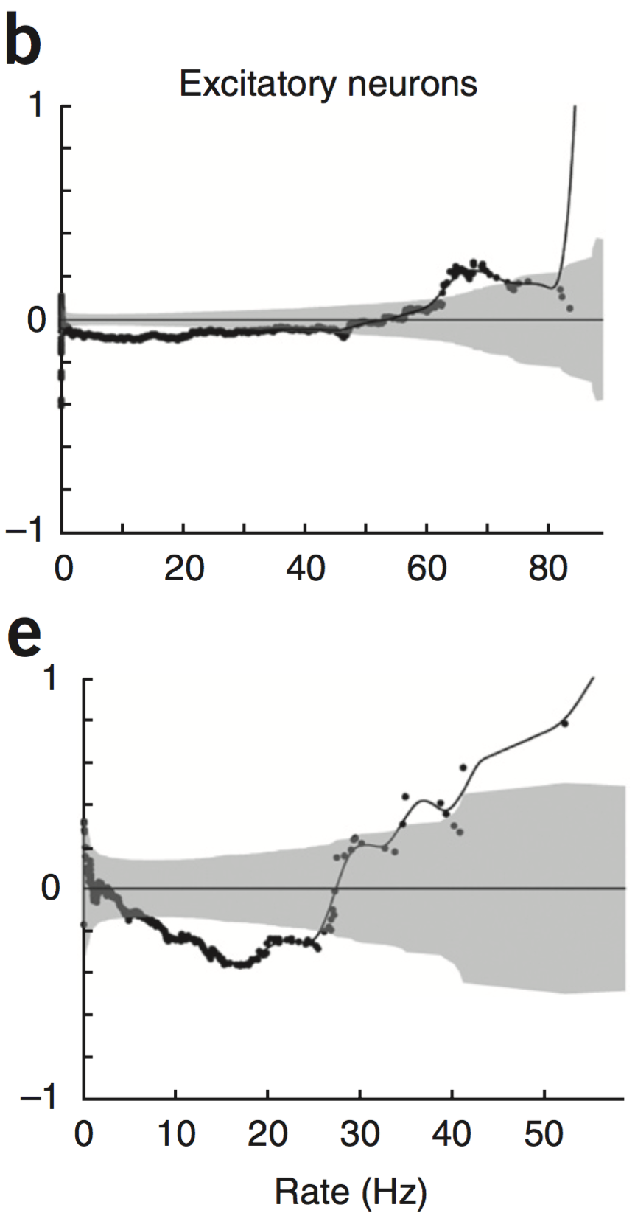
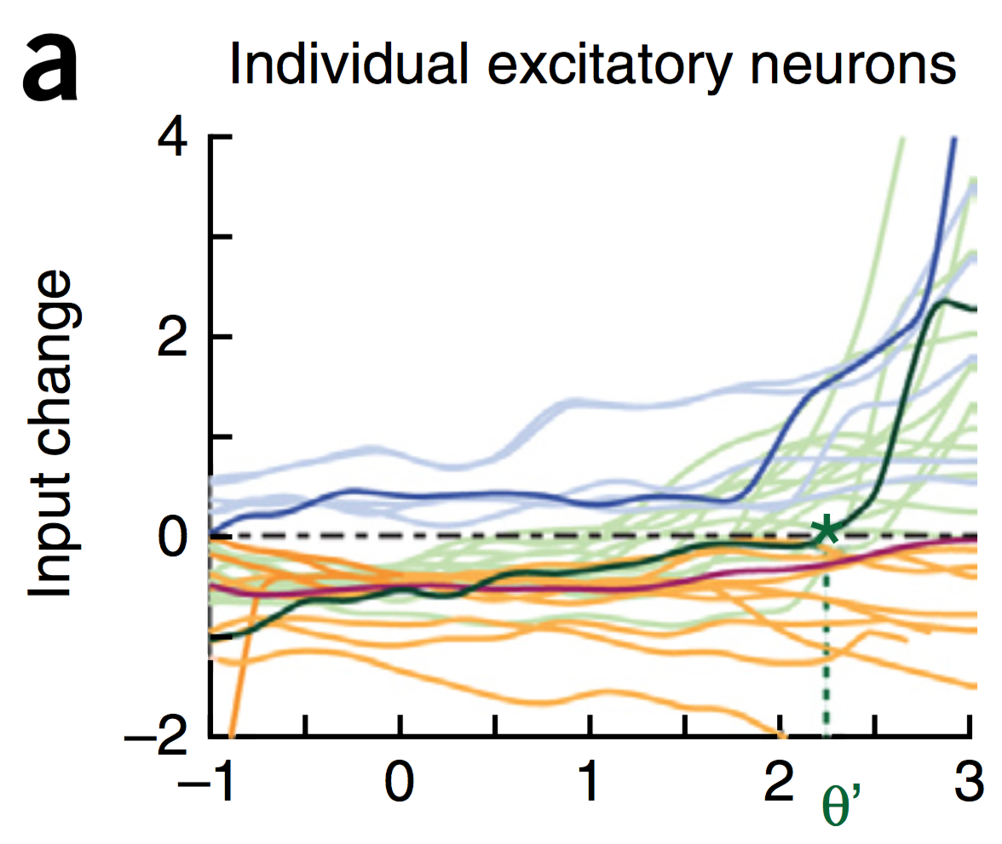
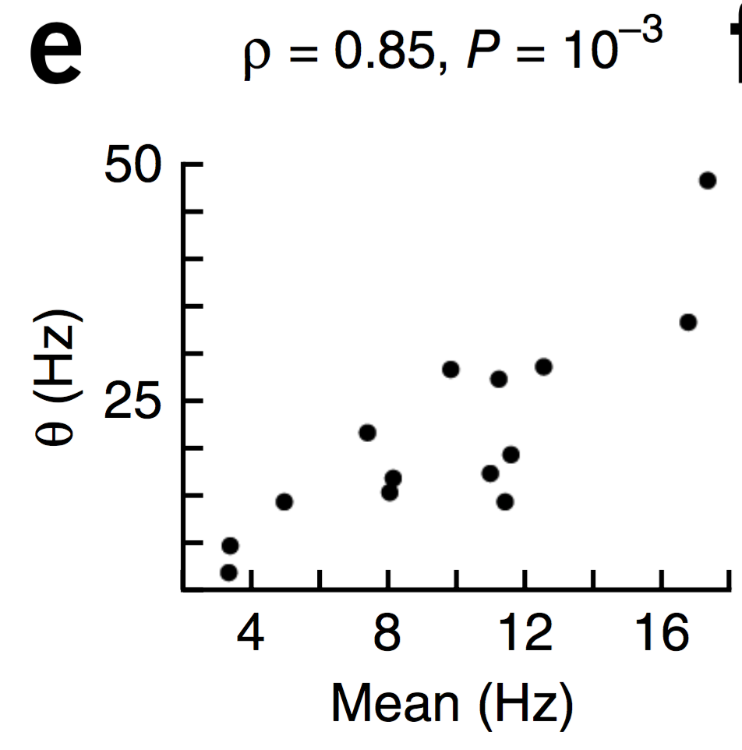
Evidence of Dynamic Thresholds (Lim, McKee, Woloszyn et al., 2015)
b = passive viewing
e = active task
Threshold changes dynamically on a rapid time scale, as a function of short-term activity level!

Slide 17
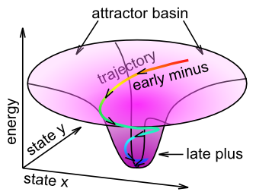
Fast Threshold Adaptation: Late Trains Early
Essence of Err-Driven: dW = outcome - expectation
Notes:
With a linear function, threshold is exactly what is subtracted

Slide 18
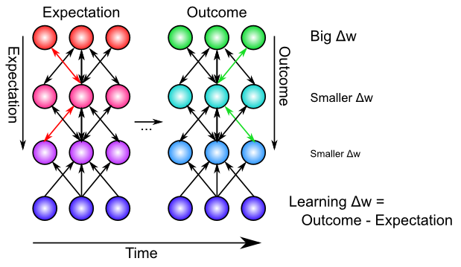
Backpropagation: Mathematics of Error-driven Learning

Slide 19
Backpropagation & GeneRec

Slide 20
GeneRec: Derivative Approximation

Slide 21
Biological Derivation of XCAL Curve
Can use a detailed model of Spike Timing Dependent Plasticity (STDP) to derive the XCAL learning curve
Provides a different perspective on STDP..

Slide 22
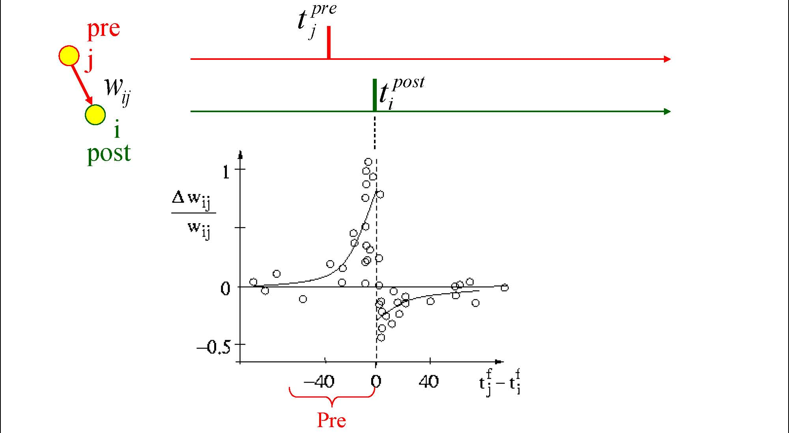
Causal Learning?

Slide 23
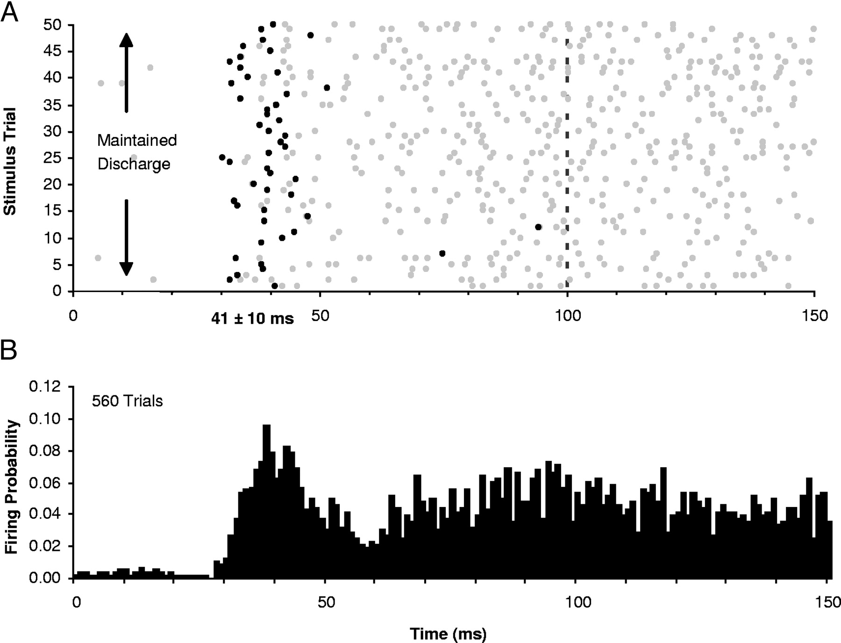
Let’s Get Real..

Slide 24
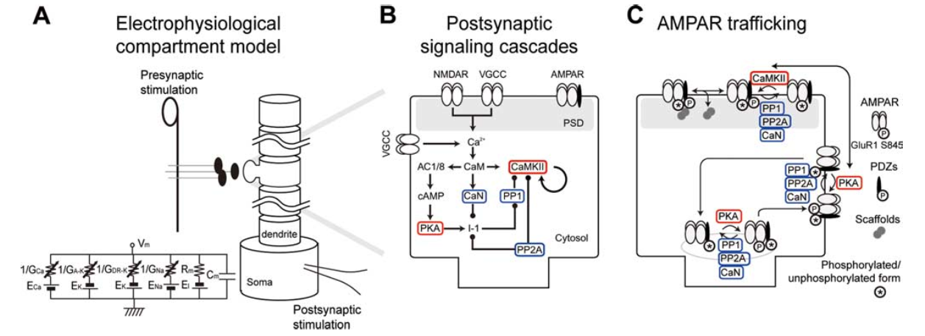
Urakubo et al, 2008 Model
Highly detailed combination of 3 existing strongly-validated models:

Slide 25
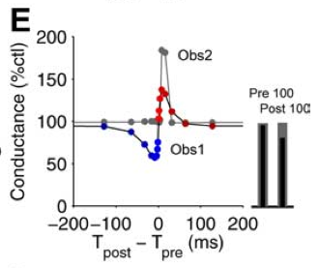
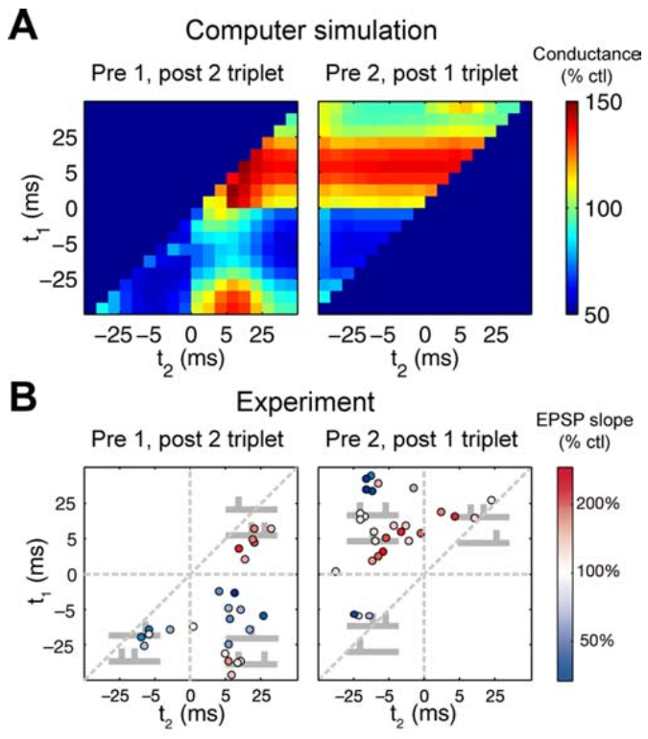
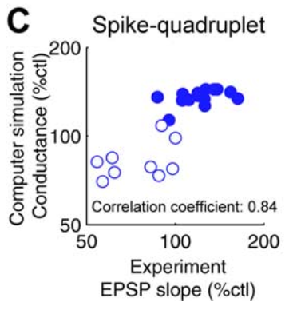
“Allosteric” NMDA Captures STDP (including higher-order and time integration effects)

Slide 26
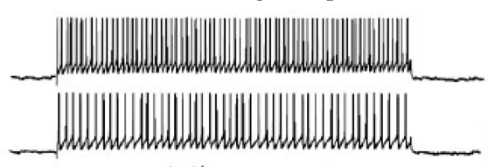
What About Real Spike Trains?

Slide 27
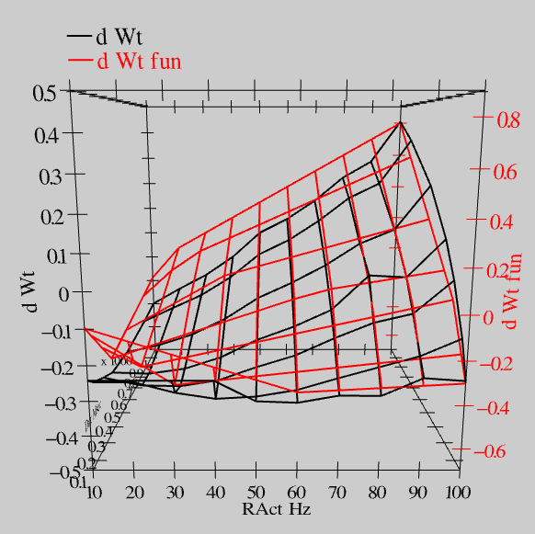
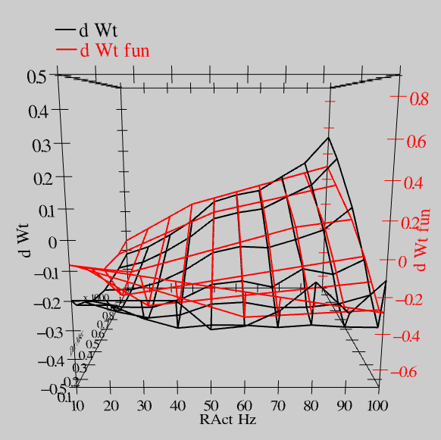
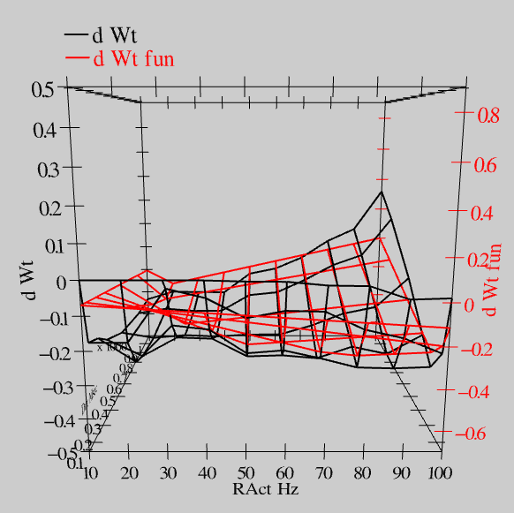
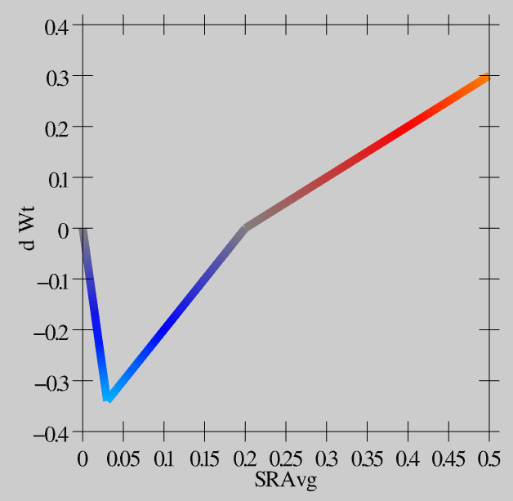
Extended Spike Trains = Emergent Simplicity
S = 100Hz
S = 50Hz
S = 20Hz
dW = f(send * recv) =
(spike rate * duration)
r=.894

Slide 28
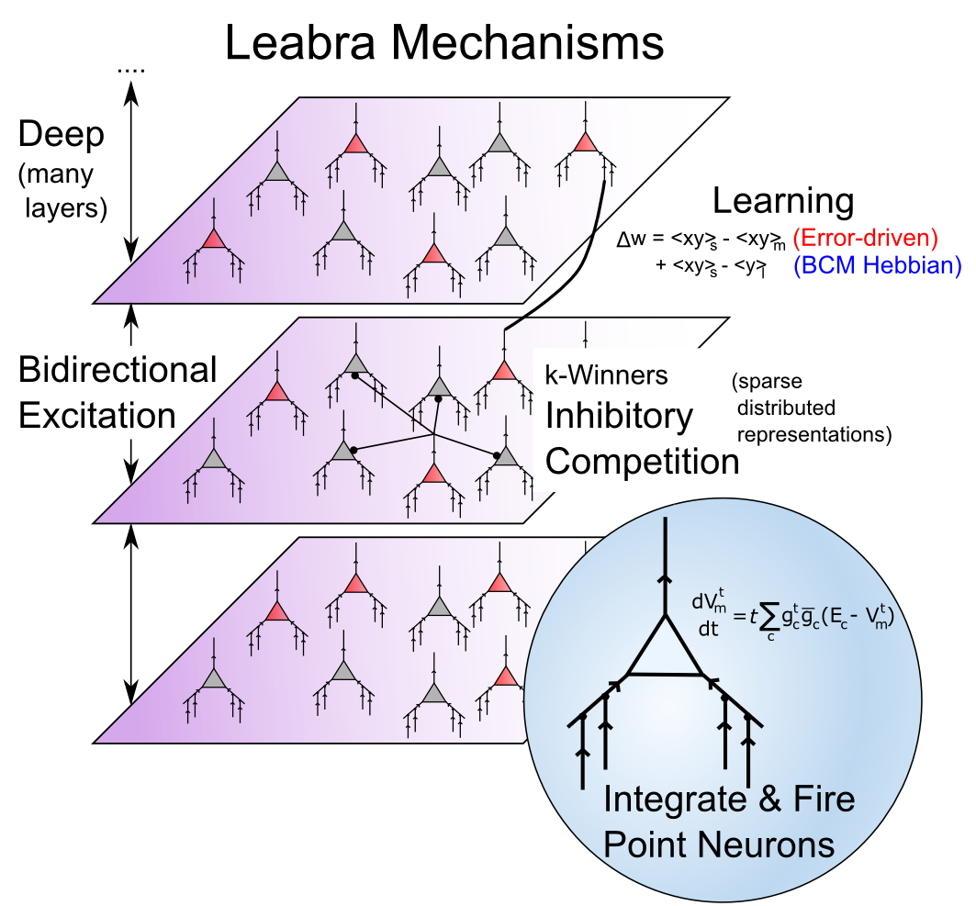
Leabra

Slide 29
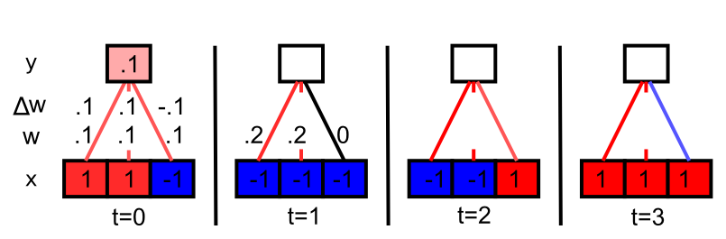
Hebbian Learns Correlations

