Slide 1
Motor Control and Reinforcement Learning
Computational Cognitive Neuroscience
Randall O’Reilly

Slide 2
Learning Rules Across the Brain
Learning Signal
Dynamics
Area | Reward | Error | Self Org | Separator | Integrator | Attractor
Primitive Basal Ganglia | +++ | - - - | - - - | ++ | - | - - -
Cerebellum | - - - | +++ | - - - | +++ | - - - | - - -
Advanced Hippocampus | + | + | +++ | +++ | - - - | +++
Neocortex | ++ | +++ | ++ | - - - | +++ | +++
+ = has to some extent … +++ = defining characteristic – definitely has
- = not likely to have … - - - = definitely does not have

Slide 3
Primitive, Basic Learning..
Learning Signal
Dynamics
Area | Reward | Error | Self Org | Separator | Integrator | Attractor
Primitive Basal Ganglia | +++ | - - - | - - - | ++ | - | - - -
Cerebellum | - - - | +++ | - - - | +++ | - - - | - - -
Reward & Error = most basic learning signals
(self organized learning is a luxury..)
Simplest general solution to any learning problem is a
lookup table = separator

Slide 4
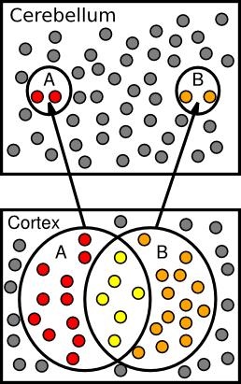
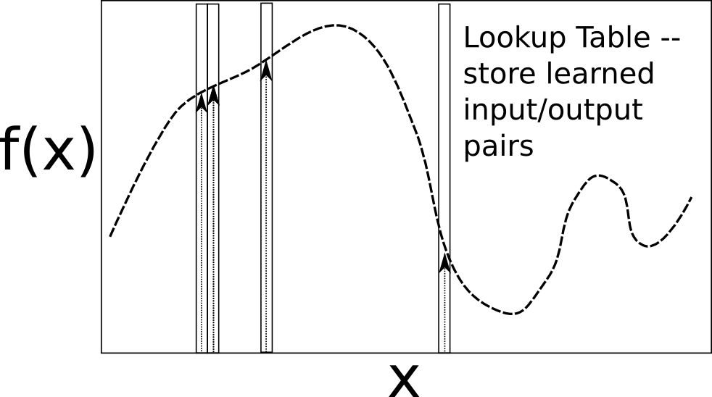
Lookup Table & Pattern Separation

Slide 5
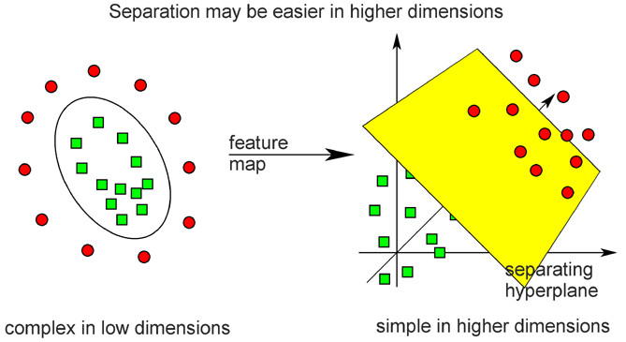
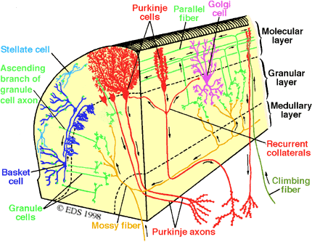
Cerebellar Error-driven Learning
Cerebellum =
Support Vector Machine
Granule cells = high-dimensional encoding (separation)
Purkinje/Olive = delta-rule error-driven learning
Classic ideas from Marr (1969) & Albus (1971)
Notes:
Time delayed weight changes
Can’t do backprop – need to have a generic all-purpose good-enough representation
First wave of computational modelers got the 1st principal component right on *everything*

Slide 6
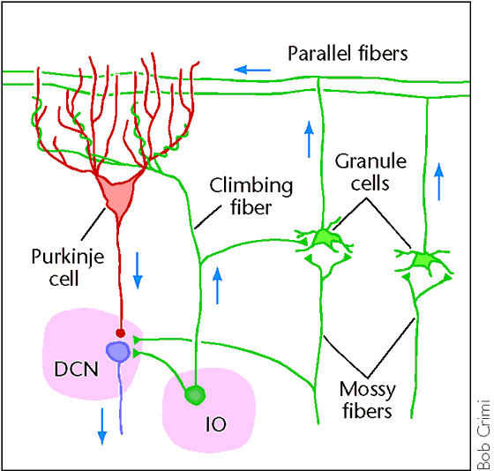
Cerebellum is Feed Forward
Feedforward circuit:
Input (PN) -> granules -> Purkinje -> Output (DCN)
Inhibitory interactions – no attractor dynamics
Key idea: does delta-rule learning bridging small temporal gap:
S(t-100) -> R(t)
^ Error(t+100)

Slide 7
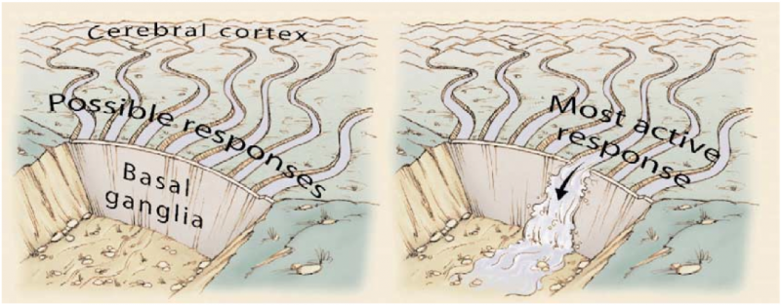
Basal Ganglia and Action Selection

Slide 8
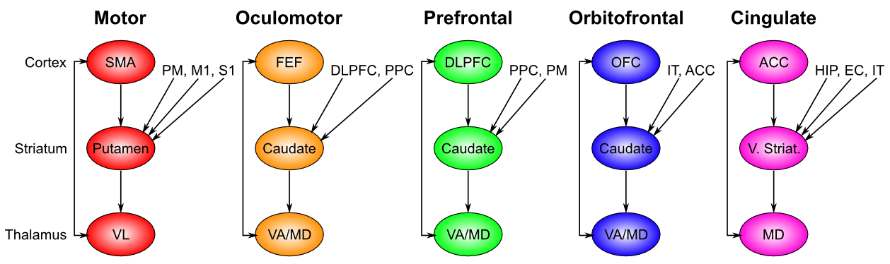
Basal Ganglia: Action Selection
Selects motor and “cognitive” actions across frontal areas

Slide 9
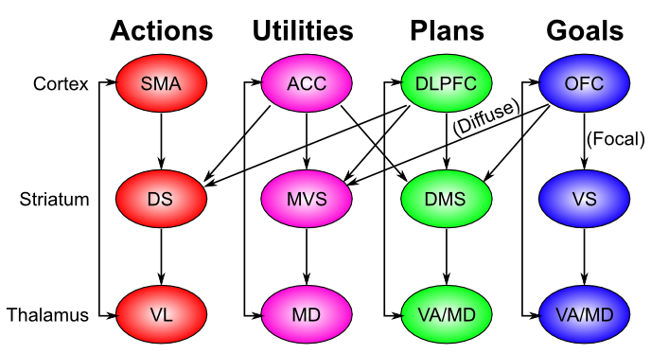
Chain of Command..

Slide 10
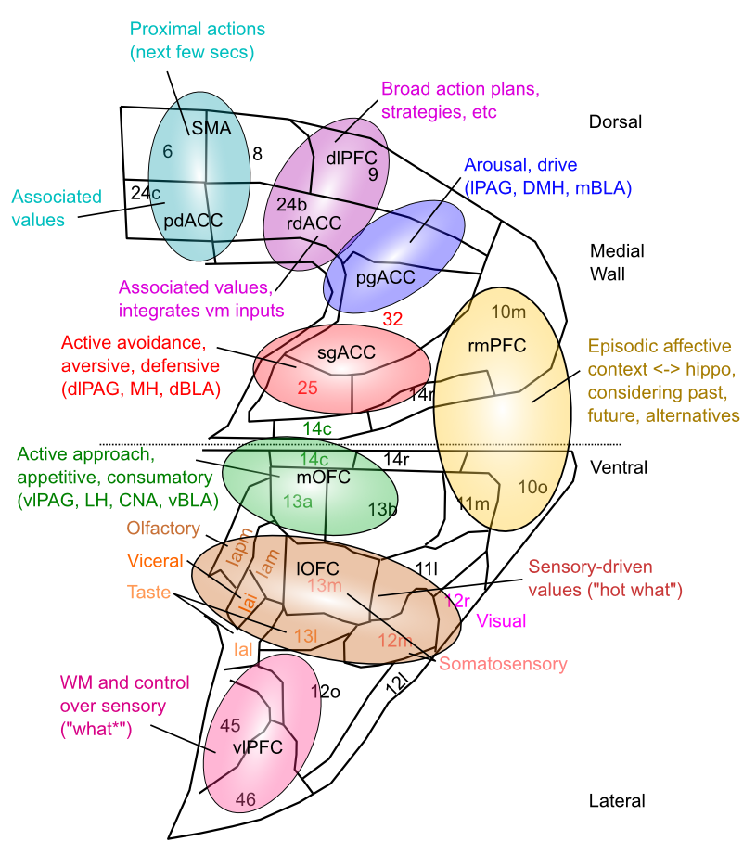
Medial Frontal Map of Values

Slide 11
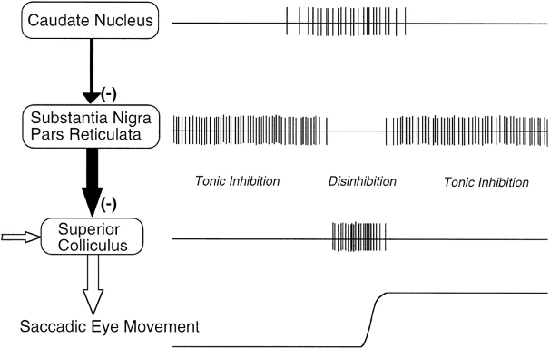
Release from Inhibition

Slide 12
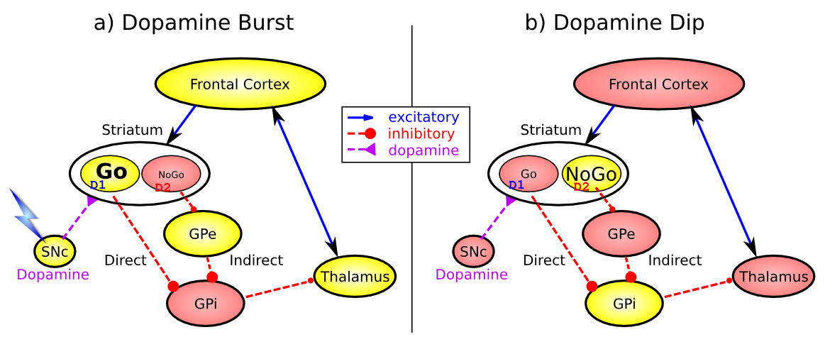
Basal Ganglia Reward Learning (Frank, 2005…; O’Reilly & Frank 2006)
Feedforward, modulatory (disinhibition) on cortex/motor
(same as cerebellum)
Co-opted for higher level cognitive control -> PFC

Slide 13
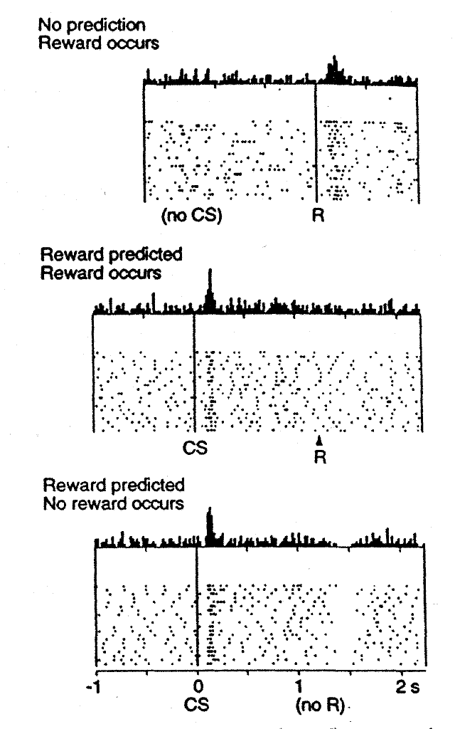


Reinforcement Learning: Dopamine
Rescorla-Wagner / Delta Rule:
But no CS-onset firing – need to
Anticipate the future!
CS-onset = future reward = f

Slide 14





Temporal Differences Learning
<- this is the future!

Slide 15
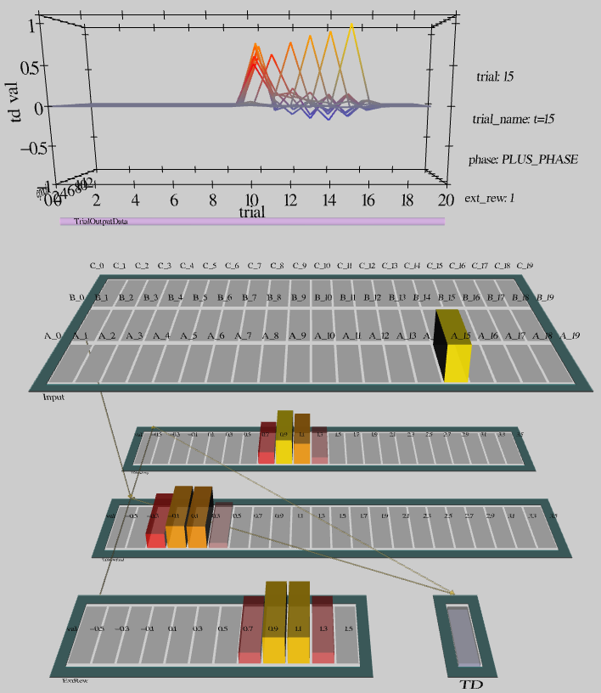
Network Implementation

Slide 16
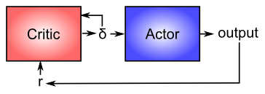
Actor - Critic

Slide 17
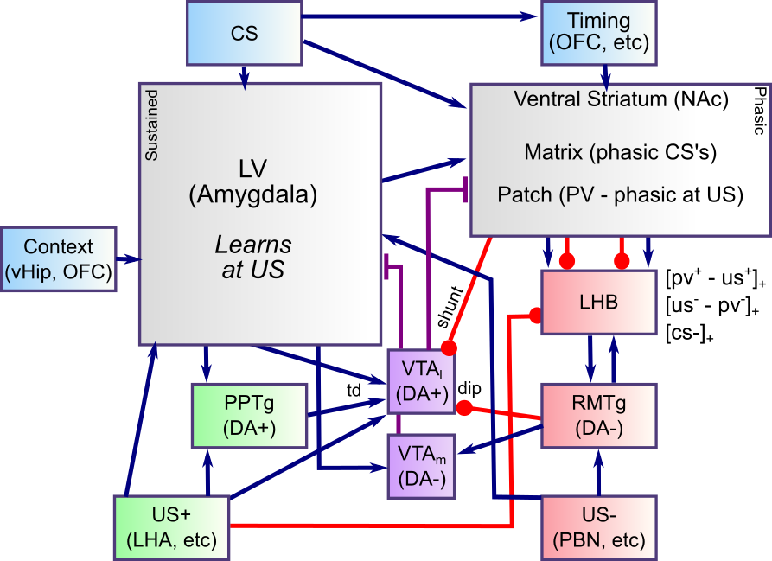
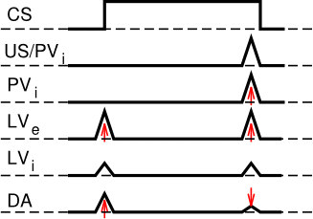
Biology of Dopamine

Slide 18
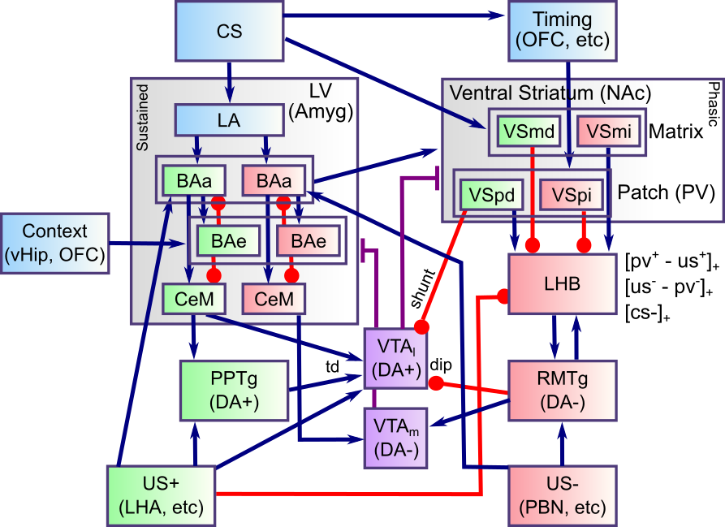
Biology of Dopamine

Slide 19
BG + Cerebellum Capacities
Learn what satisfies basic needs, and what to avoid (BG reward learning)
And what information to maintain in working memory (PFC) to support successful behavior
Learn basic Sensory -> Motor mappings accurately (Cerebellum error-driven learning)
Sensory -> Sensory mappings? (what is going to happen next..)

Slide 20
BG + Cerebellum Incapacities
Generalize knowledge to novel situations
Lookup tables don’t generalize well..
Learn abstract semantics
Statistical regularities, higher-order categories, etc
Encode episodic memories (specific events)
Useful for instance-based reasoning
Plan, anticipate, simulate, etc..
Requires robust working memory

