Slide 1
The Science of Psychology

Slide 2
The Big Questions
How can we possibly use “objective” science to study the subjective mind!?
Is science even objective in the first place??
Historical trends in addressing this question: where are we now, and how did we get here?
What is the full scope of Psychology, and how does it compare to Psychiatry or anything else?

Slide 3
Can Science Study the Mind?
Yes
No
Maybe

Slide 4
The Subjective Vortex..
Is the color “red” you see the same way I see it?
How would you ever test this??

Slide 5
Have you ever..
Convinced anyone of anything they weren’t already prepared to believe?
e.g., Convinced an atheist to believe in God, or a religious person to become an atheist?
or even believe in evolution
or ghosts..?
Or a climate-change-denier to believe in global warming??
Or your S.O. that they are wrong and you are right?

Slide 6
The Brain Has Walls..
We only experience the world through our own perspective: nothing gets in that we don’t let in
Our minds are our own private castles, that we rule with impunity (CCC = Control!)
It is fundamentally threatening to our everything if core, long-held beliefs are challenged

Slide 7

Descartes: Cogito Ergo Sum
I think, therefore I am
Subjective cognition is primary
Solipsism: subjective cognition is all there is!
Dualism: mind is separate from brain

Slide 8
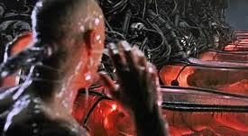
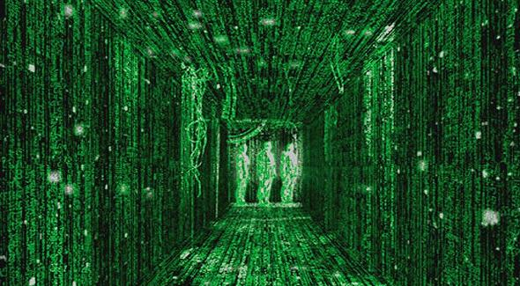
Enter the Matrix..

Slide 9
What do you think?
I have seriously considered possibility that the world is not real
I have thought about the idea, but never taken it seriously
I have never really thought about it (the Matrix is just a silly movie..)

Slide 10
What is “Objective” Knowledge?
What is really fundamentally true?
How do I know what is true and what is not??

Slide 11
Objective Knowledge is a Consensus..
Surprise! There is no “objective” knowledge!
There is only a consensus among those who choose to believe in the power of reproducible scientific experiments and the data they generate, to establish certain facts, that we can then generally accept, even if we can’t all quite agree upon their actual meaning..

Slide 12
Any Believers??
I Believe in Science
I Believe in God
I Believe in both Science and God – in a tie, God wins
I Believe in both Science and God – in a tie, Science wins
I Believe in the Flying Spaghetti Monster / Nothing / Anything..

Slide 13
Full Disclosure..
I believe that that it is so hard to simulate reality with sufficient consistency across all the repeated observations that link the incredibly small with the incredibly huge in extremely reliable, lawful ways, that it is extremely likely that the world of my perception is real.
Furthermore, I find the data in favor of any kind of supreme being to be suspiciously old and out-of-date.
But I want you to believe whatever you want to believe!

Slide 14
The Scientific Method
Have a question / informal observation,
Form a hypothesis, with testable predictions
Collect data, using reproducible procedures
Analyze data: does it support predictions, beyond level of random chance / noise?
Draw conclusions.

Slide 15
The Scientific Method: Critique
make an observation,
form a hypothesis (based on what??)
collect data,
analyze data,
draw conclusions. (yeah, like what??)
Hypotheses and conclusions are subjective, psychological constructs!!*
*Don’t even get me started about measurement in quantum physics!

Slide 16
Consistency (of pudding*..)
Good hypotheses are those that are consistent with good theories, and good theories are those that tie together a large number of observations under a single, hopefully relatively simple, consistent framework.
Unfortunately, human cognition is unbelievably inconsistent!
* The brain

Slide 17
Inconsistent Widely Held Beliefs
God and Science
Republicans: hands off my wallet, but I’m all over your bedroom!
Democrats: get the #!%! out of my bedroom, but let me have your wallet!
Libertarians: hands off everything, but somehow this will turn out different than Somalia..
And don’t even start with actual behavior..

Slide 18
Summary: Science is Hard, Imperfect
And so are relationships, and everything else having to do with actual people..
Psychology is actually the key to really understanding actual science, at many levels.

Slide 19
Retest: Can Science Study the Mind?
Yes
No
Maybe

Slide 20
No Harm in Trying: The History of Psychology
No Psychology in the Ancient World. But plenty of Philosophy:
Buddha: Diagnosed suffering as arising in patterns of thoughts, proscribed treatment (lose the attachments!)
Greeks, etc: Where / what is the mind? Reality real? Nature vs. Nurture / Empiricism. Basis of logic, reasoning. Though <-> emotion. Reason vs. Empiricism.

Slide 21
Rationalism vs. Empiricism
Rationalism: Deduce what is true based on logical principles, axioms, etc. (Descartes)
Empiricism: Learn what is true based on experience. (Locke)
Can’t we all just get along!? Clearly you need both..

Slide 22
Hey, How about some Data!
Wilhelm Wundt (1879): First dude to actually collect scientific data about human behavior! i.e., the first true Psychologist.
But unfortunately, the data was all subjective!
Titchener: structuralism = subjective contents of experience, through introspection
James: functionalism = largely theoretical (vs. experimental) ideas about specific functions of mind, instead of contents.

Slide 23
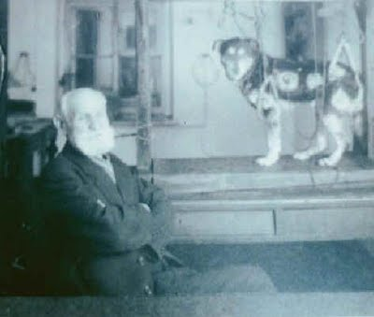
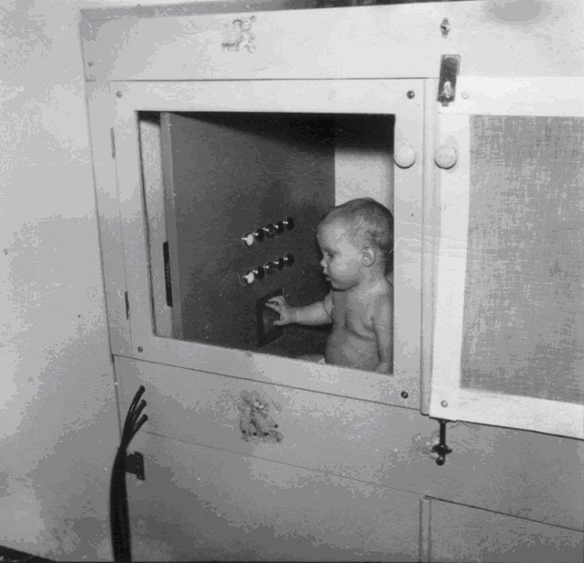
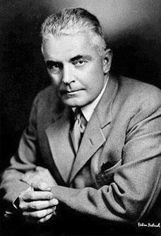
Hey, How about some Objective Data! (1913-1950’s)
Behaviorists: rejection of introspection – can only study and theorize about what is objectively observable: behavior! Stimulus -> Response
Pavlov
Skinner
Watson

Slide 24
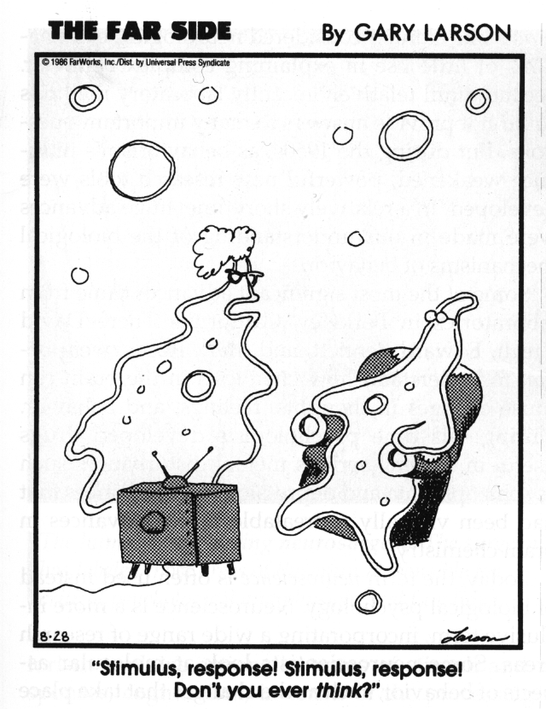
Cognitive Counter-Revolution (1960’s)
Cognitive(ism): Yeah, maybe there is actually something going on inside the mind..

Slide 25
Behaviorism:
Cognitive Psychology:
Stimulus (memorize this list)
lion, onion, Bill, firefighter, carrot, zebra, John, clerk, Tom, nurse, cow
Response (recall)
lion, zebra, cow, onion, carrot, firefighter, clerk , nurse, John, Bill, Tom
Mental Processes
Strategies, grouping, reorganization, etc
Stimuli
Responses
Stimuli
Mental Processes
Responses

Slide 26
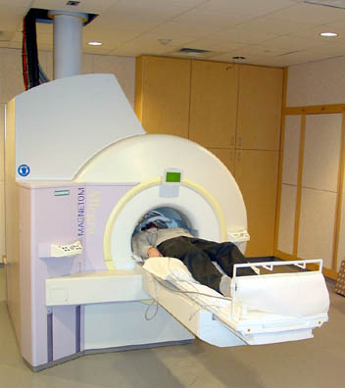
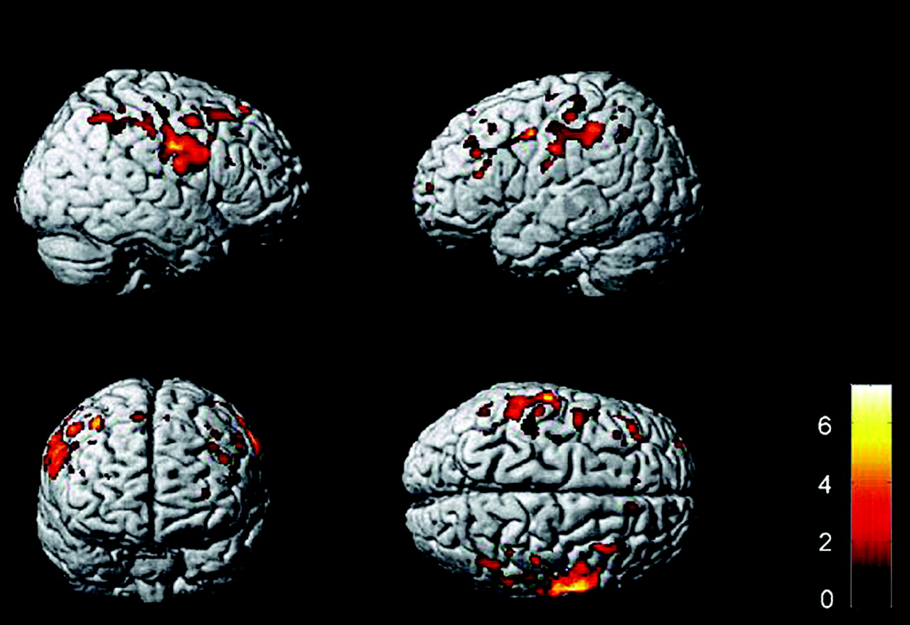
Enter the Brain..
1960’s-80’s: Cognitive “boxology” based on idea that mind is a digital computer (sure, why not..)
1990’s – now: Cognitive Neuroscience!

Slide 27
It took a while, but..
We now have a mature science based on objective data about both behavior and the brain mechanisms that give rise to it!
Internal cognitive processes can be objectively measured in many ways, instead of just making stuff up about how computers might do stuff..

Slide 28
Summary: Four Major Approaches
Internal Factors
Biological
Cognitive
External factors
Behavioral
Sociocultural

Slide 29
Other Historical Trends
Freud and psychoanalysis (1900-1920):
role of the unconscious, tripartite structure: id, ego, superego
Gestalt psychology (1910-1940)
Whole is different than sum of its parts: emergence!
Rogers, Maslow: Humanism (1950’s – now)
Motivation, individual feelings, potential for growth

Slide 30
Crazy Science vs. Sane Science
Crazy: all the different theories!
It’s all just S->R? Mind is a digital computer?
Sane: all the data that was generated.
S->R learning data still very relevant.
Cognitive info processing data very relevant..

Slide 31
The Scientific Method: Critique
make an observation,
form a hypothesis (based on what??)
collect data,
analyze data,
draw conclusions. (yeah, like what??)
Hypotheses and conclusions are subjective, psychological constructs!!*
*Don’t even get me started about measurement in quantum physics!

