Slide 1
The Brain

Slide 2
The Big Questions
What do different parts of the brain do, and how do they work together?
Information flows through neighborhoods..
Different kinds of learning

Slide 3
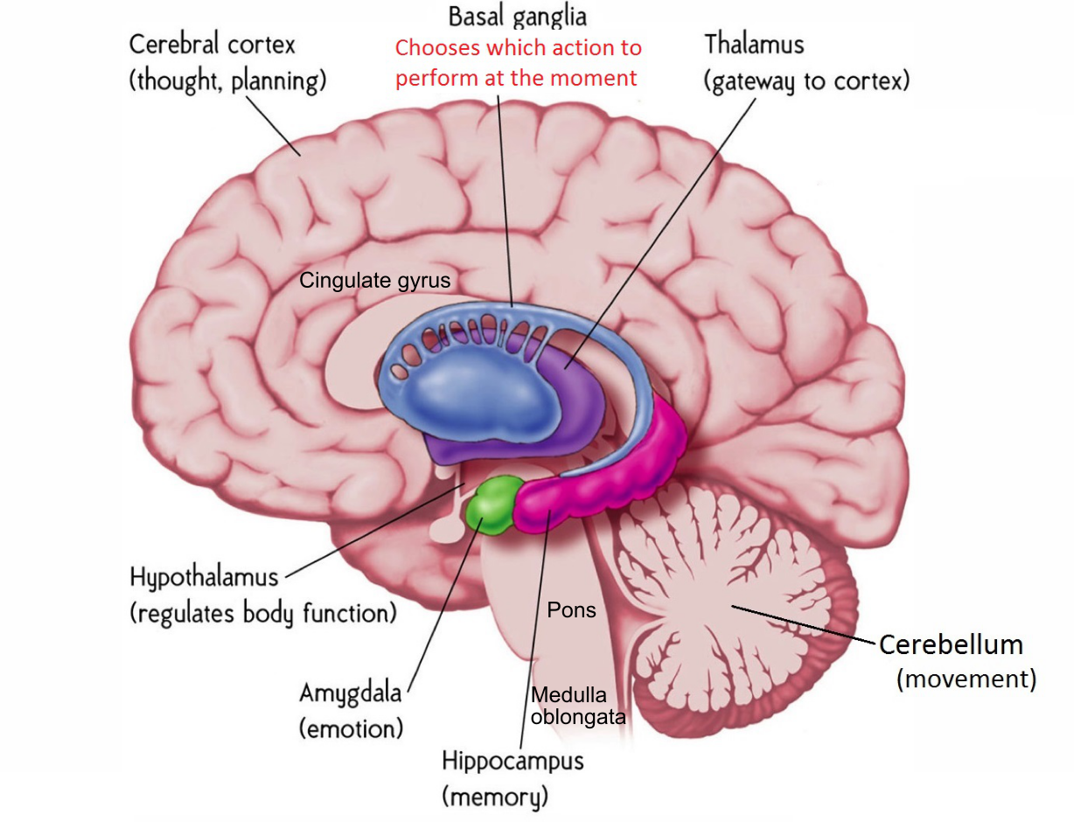
Gross Anatomy

Slide 4
We are Corticocentric..
Cerebral Cortex (Neocortex) is where most of the good stuff happens: cognition, intelligence, knowledge, memory, consciousness, …
Hippocampus (archicortex), Amygdala, Basal Ganglia, Thalamus all interact extensively with neocortex, form tightly integrated subsystems (Limbic system is not super useful construct).
Lots of more specialized brain areas in subcortex, but seriously, who cares.. ☺

Slide 5
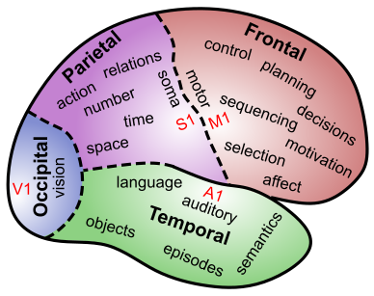
Lobular Functions: Follow the trail..

Slide 6
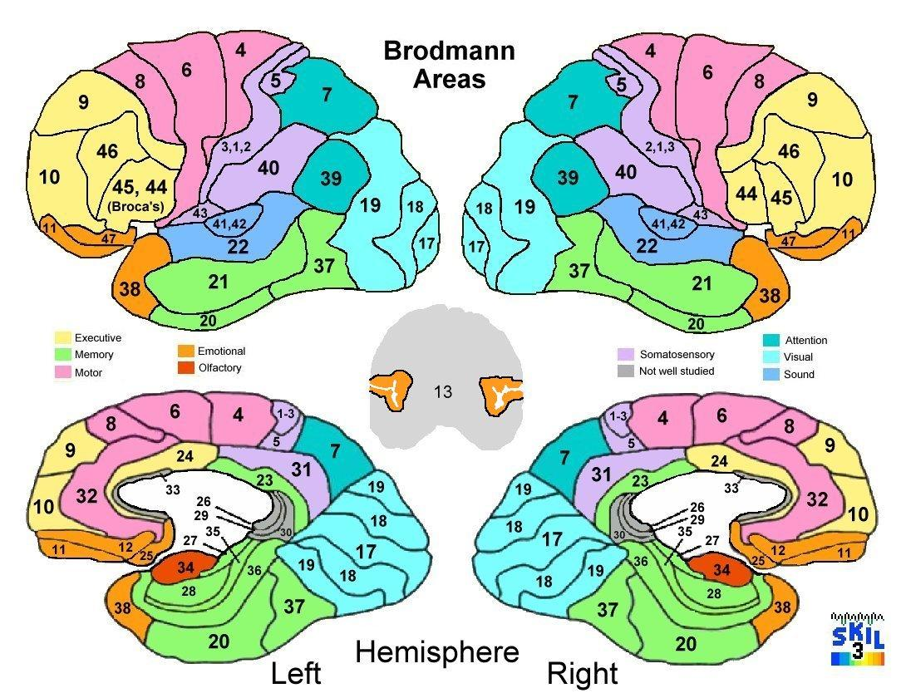

Slide 7
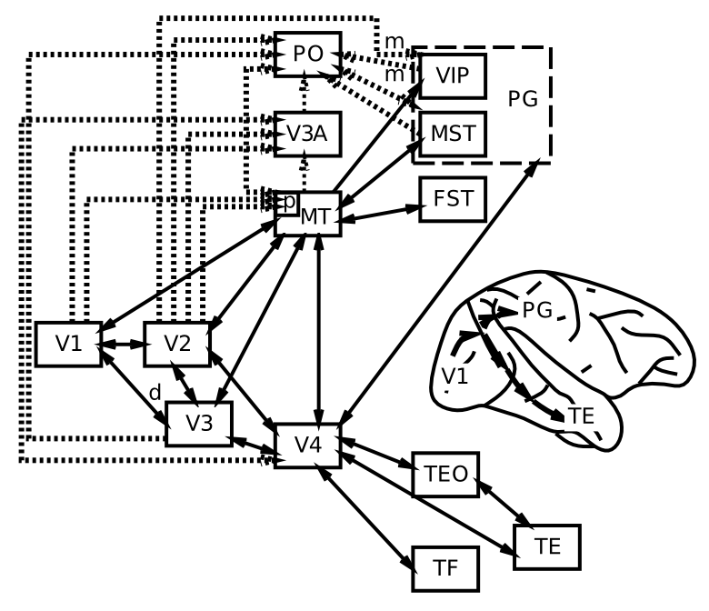
Visual Hierarchy: What vs Where

Slide 8
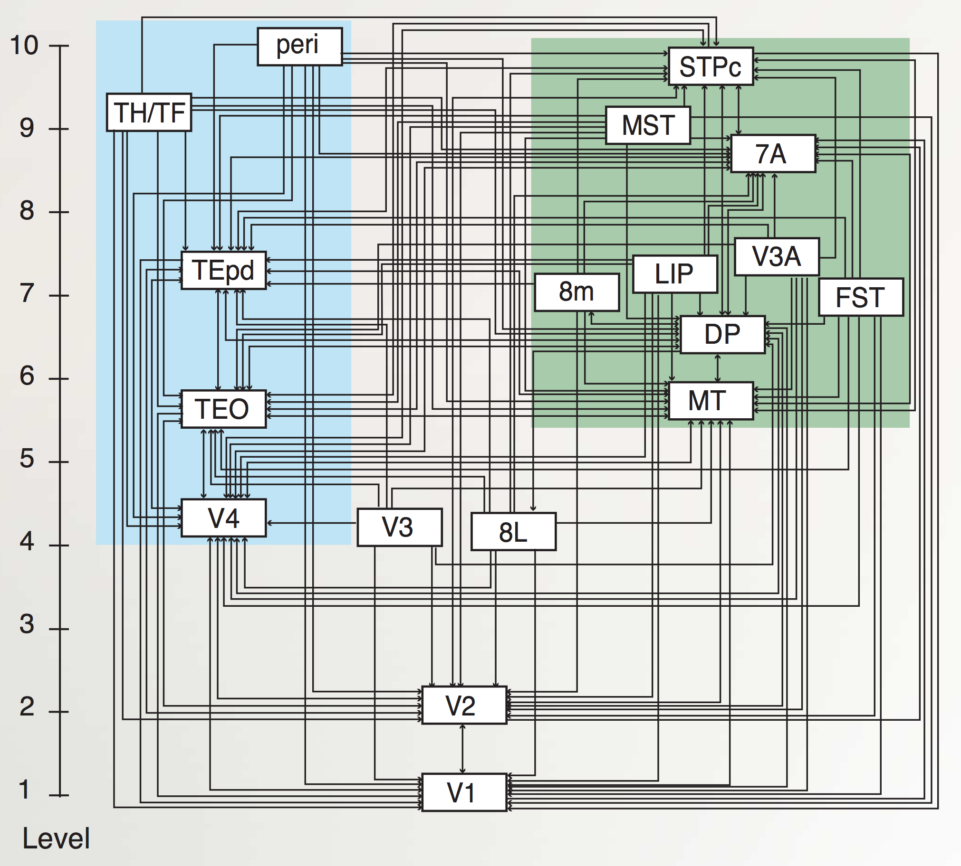
“Van Essen” Hierarchy
TE.. = Temporal
LIP, DP.. = Parietal
8L = Frontal Eye Field
To hippocampus:
TH/F = Parahippo
peri = Perirhinal
Markov et al., 2014

Slide 9
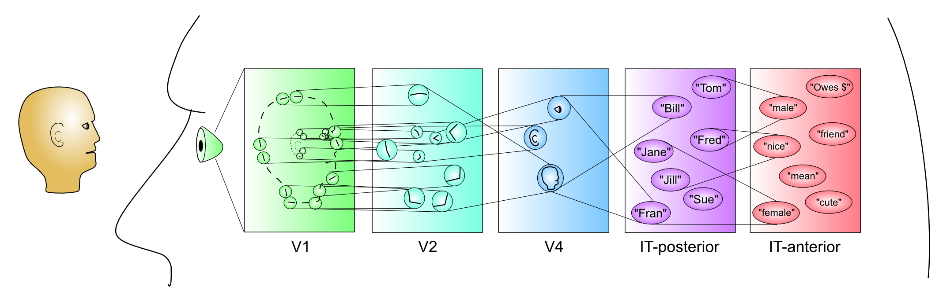
Hierarchy of Detectors (CCC = Compression: abstract, simplify)
Inferior Temporal (IT) cortex has high-level abstractions that are relevant to your life!
It takes a village of neurons to build up these abstractions.

Slide 10
Cortical Organization Summary
Occipital Lobe: vision
Temporal Lobe: object & face recognition, audition, speech, language, semantics
Parietal Lobe: space, number, action, somatosensory
Frontal Lobe: (motor) Control (executive), emotion, motivation
Left / right: not too popular in science now..

Slide 11
Rest of Brain
Hippocampus (archicortex – old cortex): episodic memories (events, facts, this lecture..)
Amygdala: emotions (reward, fear, etc): major controller of dopamine
Basal Ganglia: motor / cognitive initiation based on what has worked in the past (dopamine)
Thalamus: mini-me to cortex, interacts with BG
Cerebellum: tunes up fine motor control

Slide 12
Brain Damage Anyone?
I know someone who has had a stroke or other damage to neocortex:
A. Nope
B. Occipital – visual impairments
C. Temporal – visual, language, semantic knowledge impairments
D. Parietal – spatial neglect, motor control
E. Frontal – behavioral, motor, speech output..

Slide 13
Subcortical Damage
I know someone who has some form of disorder or damage to subcortical brain areas:
A. Basal Ganglia – Parkinson’s, Huntington’s
B. Hippocampus – Alzheimers, epillepsy
C. Cerebellum – motor control (ataxic cerebral palsy)
D. Thalamus – Korsakoff’s syndrome (alcohol)
E. Other (amygdala, pituitary, thyroid..)

Slide 14
Learning Rules Across the Brain
Area | Reward | Error | Self Org
Primitive Basal Ganglia | +++ | - - - | - - -
Cerebellum | - - - | +++ | - - -
Advanced Hippocampus | + | + | +++
Neocortex | ++ | +++ | ++
Learning Signal
+ = has to some extent … +++ = defining characteristic – definitely has
- = not likely to have … - - - = definitely does not have

Slide 15
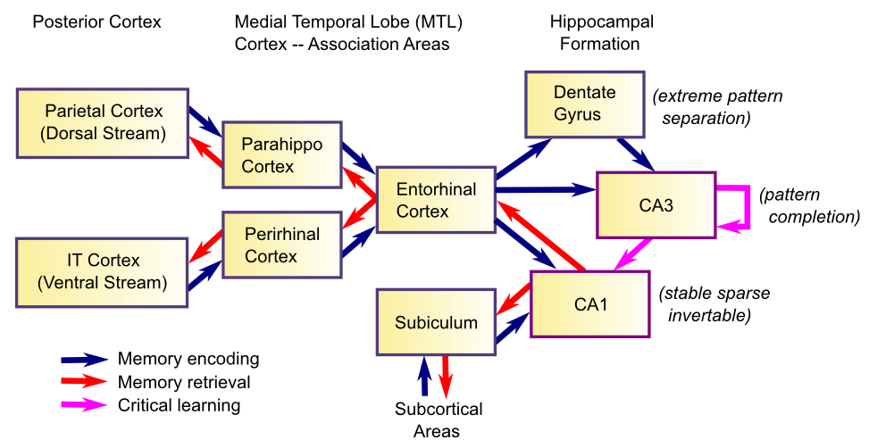
Memory and the Hippocampus
Memory is based on highly Compressed (CCC) summary of cortex – we don’t remember actual details very well!

Slide 16
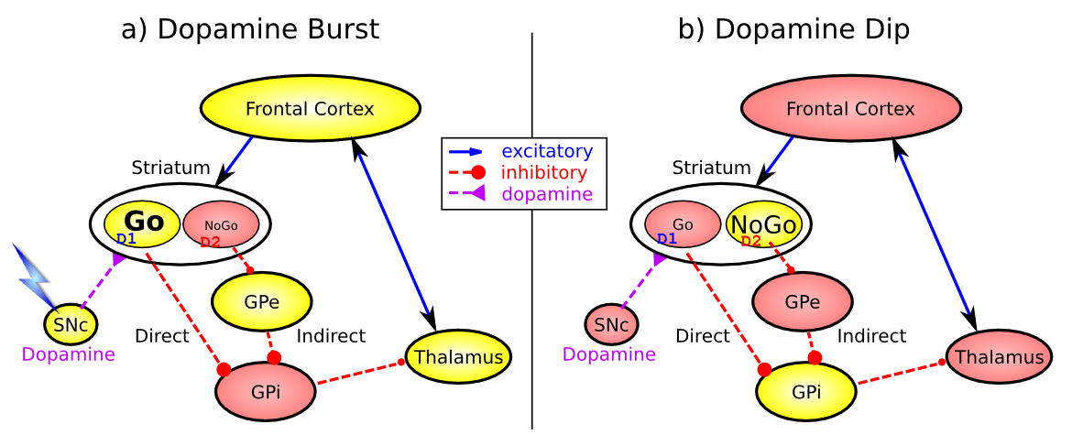
Basal Ganglia: Motor Initiation
Dopamine shapes selection of most rewarding (least punishing) action plan

Slide 17
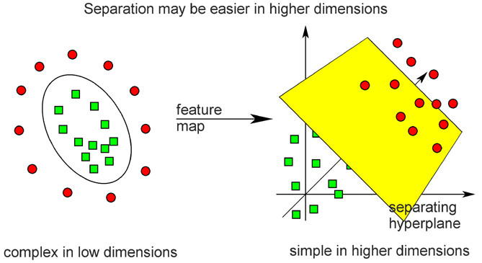
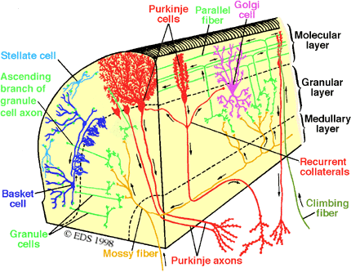
Cerebellar Error-driven Learning
Cerebellum =
Support Vector Machine
Granule cells = high-dimensional encoding (separation)
Purkinje/Olive = delta-rule error-driven learning
Classic ideas from Marr (1969) & Albus (1971)
Notes:
Time delayed weight changes
Can’t do backprop – need to have a generic all-purpose good-enough representation
First wave of computational modelers got the 1st principal component right on *everything*

Slide 18
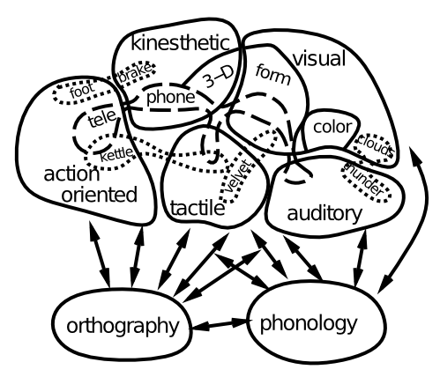
Language = Whole Brain!
Language and higher-level cognition builds on already-learned sensory / motor pathways

Slide 19

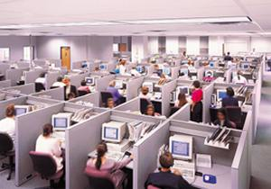
Frontal Executive: Top-Down Biasing CCCC = Control!
PFC active maintenance provides top-down biasing of posterior-cortical processing

Slide 20
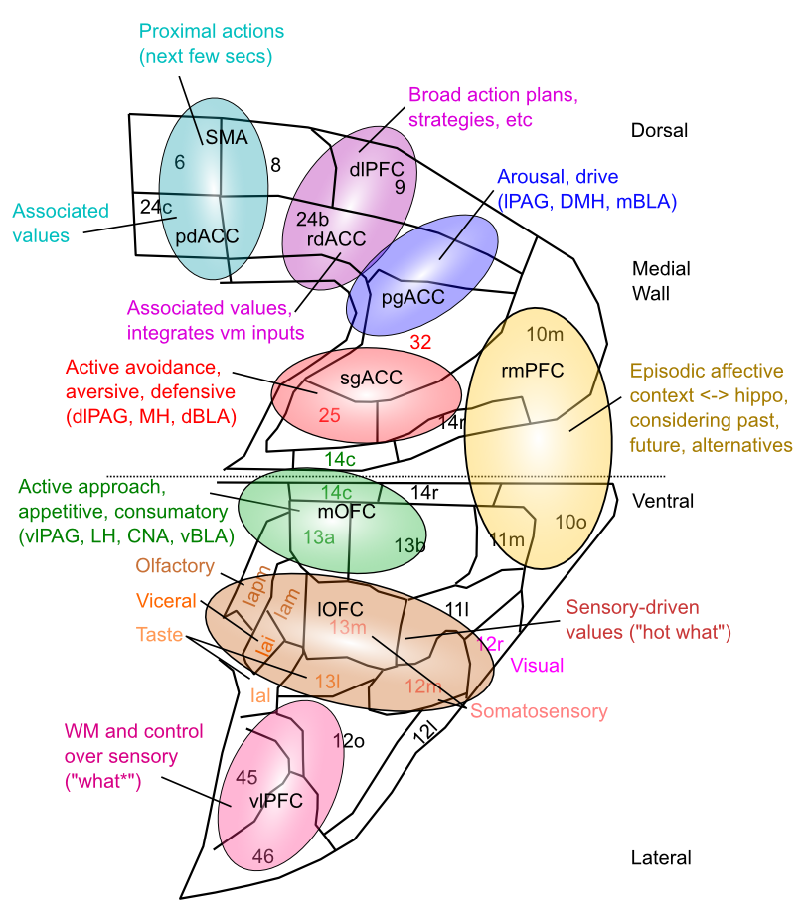
Medial Frontal Map of Values This is your emotional life

