Slide 1
The Neuron

Slide 2
Emergence The soul in the machine..
(Now Imagine 10,000,000,000 gears, each interacting with 10,000 others..)

Slide 3
The Big Questions
What is the fundamental “unit” of cognition, and what does it do??
Neurons: they detect things, and share the results
How can simple detection produce complex cognition?
Hierarchically-organized networks, lots of emergence
What are the biological mechanisms?
Excitation vs. inhibition, salt, and synapses..

Slide 4
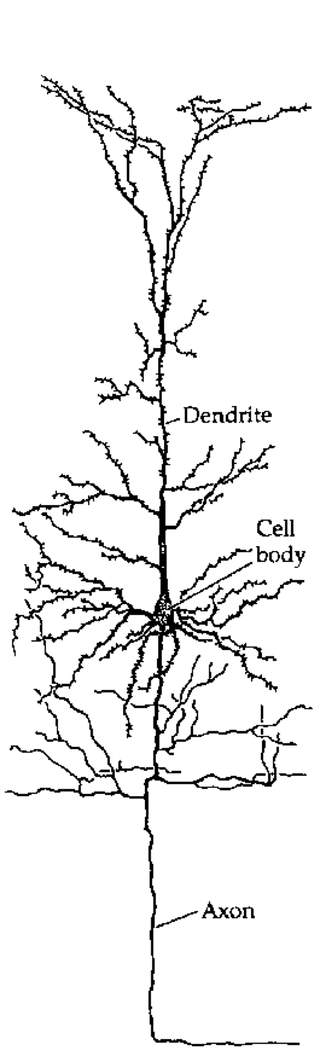
The Basic Unit of Cognition!?

Slide 5
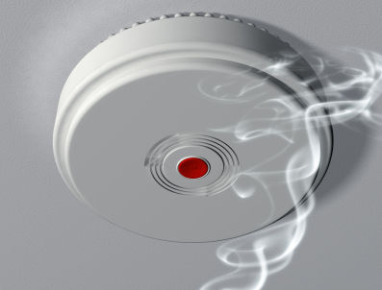
Neurons are Detectors

Slide 6
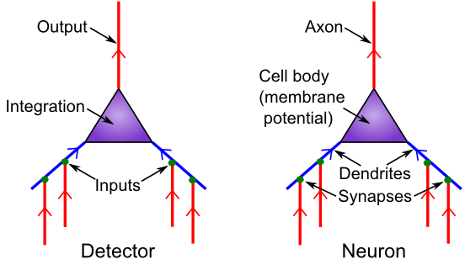
Detector Model
Is it really all just detection?

Slide 7
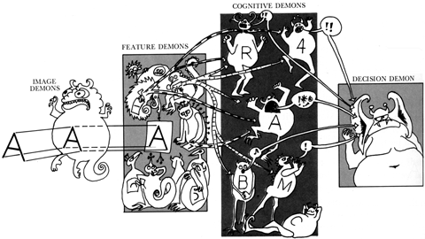
Pandemonium! (Oliver Selfridge)

Slide 8
Feature Demons
Front half of class: Pick which one you want to detect; yell out the number whenever you see it!
Vertical Line: |
Horizontal Line: --
Up-Right Diagonal: /
Up-Left Diagonal: \
Notes:
First half of class just picks which one they want to do – same for second half for cog demons

Slide 9
Cognitive Demons
Back half of class: Pick which one you want to detect, then turn around, and CLICK when you hear it!
T: 1,2
V: 3,4
A: 2,3,4
K: 1,3,4

Slide 10
Testing..
Notes:
Adjust distribution as needed.

Slide 11
Testing..

Slide 12
Testing..

Slide 13
Testing..

Slide 14
Testing..

Slide 15
Testing..

Slide 16
Testing..

Slide 17
Testing..

Slide 18
Testing..

Slide 19
Ooops..

Slide 20
Ooops..

Slide 21
Ooops..

Slide 22
Ooops..

Slide 23
Pandemonium Summary
Maybe you can see how collective action of many detectors, organized hierarchically, could achieve more complex cognition?
But detection needs to be a lot more sophisticated..
CCC: Compression (simplify the inputs), Contrast (highlight important differences)

Slide 24
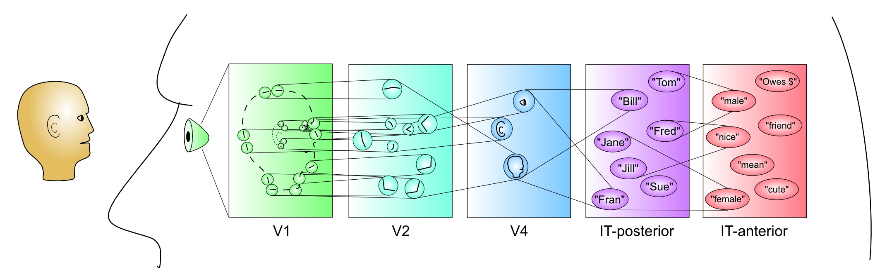
Hierarchy of Detectors (CCC = Compression: abstract, simplify)
Inferior Temporal (IT) cortex has high-level abstractions that are relevant to your life!
It takes a village of neurons to build up these abstractions.

Slide 25
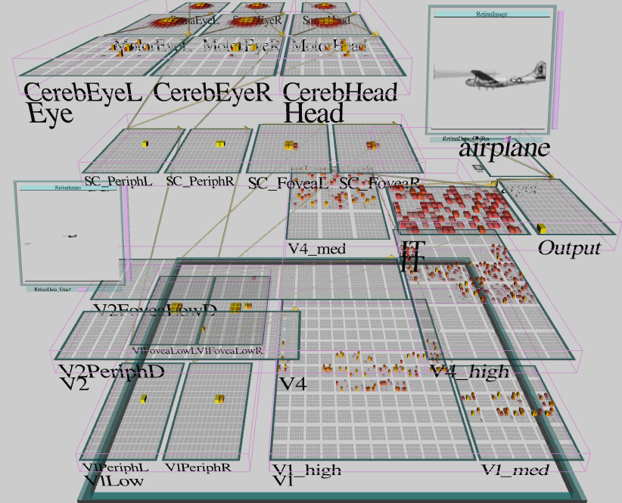
Emer’s Brain: Detection Works!

Slide 26
Back to the Detector Model
How does it actually work?

Slide 27
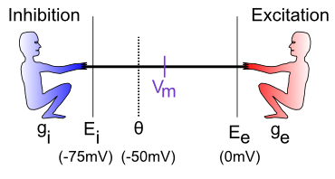
The Tug-of-War
How strongly each guy pulls: I = g (E-Vm) = current
g = how many input channels are open
E = driving potential (pull down for inhibition, up for excitation)
Vm = the “flag” – reflects net balance between two sides

Slide 28
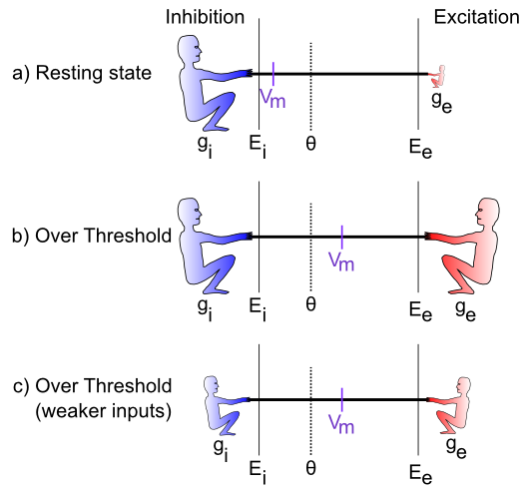
Relative Balance (CCC = Contrast: relative comparison)

Slide 29
Equations (just for fun)!

Slide 30
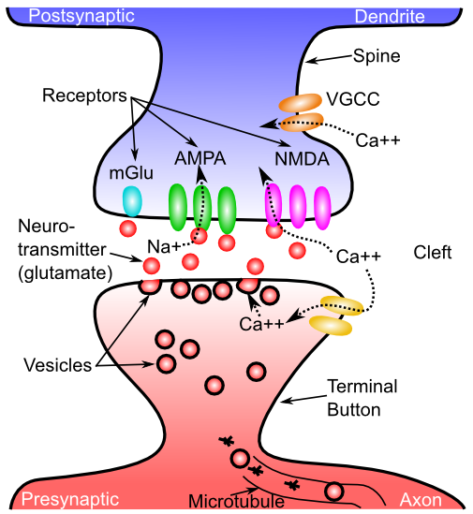
The Synapse

Slide 31
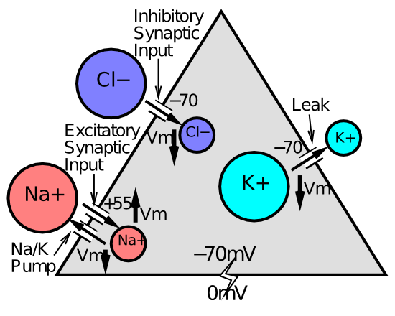
The Full Story..

Slide 32
Neuron Summary
Neurons integrate electrical signals (depolarization) received via synapses on their dendrites, from axons of other neurons
When membrane potential exceeds threshold, action potential (spike) is sent down axon, triggering release of neurotransmitter in synapse, which opens ion channels on receiving (postsynaptic) neuron
GABA is main inhibitory neurotransmitter, Glutamate is main excitatory neurotransmitter

Slide 33
Neurotransmitter Terms
Agonist: acts like a given neurotransmitter
Antagonist: blocks receptors for given NT
Reuptake: takes NT back out of synapse
Neuromodulator: a broadly-released neurotransmitter that has widespread modulatory effects on the brain

Slide 34
Neuromodulators and Drugs (receptor agonists)
Acetylcholine (ACh): muscles, attention, learning, memory (nicotine)
Dopamine (DA): when to learn, based on reward prediction errors (cocaine)
Norephinephrine (NE): attention, engagement (speed)
Serotonin (5HT): Mood, sleep, appetite, sex, stress (SSRI, LSD = waking dream)
Oxytocin: social modulation, labor (pitocin)
Endorphins, Substance P: pain (heroin)

Slide 35
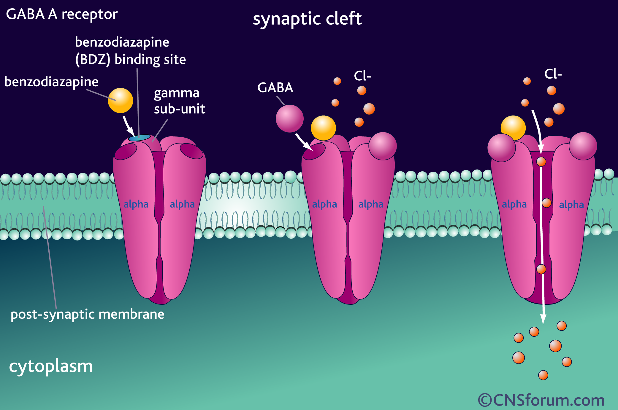
Benzo, Valium, etc
Agonist for GABA inhibitory channels

Slide 36
Let’s Talk about Dugs!
Most psychoactive drugs directly affect basic neural mechanisms, some in easy-to-understand ways.

Slide 37
Lets Talk Drugs..
I have used psychoactive drugs.
I have not used psychoactive drugs.

Slide 38
Rx
I have been diagnosed with a psychological disorder and am taking prescription meds for it.
I am taking prescription meds for a different type of disorder (not psych).
I am not taking prescription meds.

Slide 39
Rx
I am not taking prescription meds.
I am taking prescription meds, and the side effects are…
B. …minimal or nonexistent
C. …moderate
D. …severe

Slide 40
Other Rx
I have taken someone else’s prescription medication.
I have not taken someone else’s prescription medication.

