Slide 1
Memory

Slide 2
The Big Questions / Issues
What is the true taxonomy of memory?
STM vs. LTM, Semantic vs. episodic, etc vs. etc..!
Hippocampus vs. everything else
How can I improve my memory?
Spaced vs. Massed, Context effects, Depth of encoding, method of loci, Testing effect
Is Memory Accurate?
No. Next question?

Slide 3
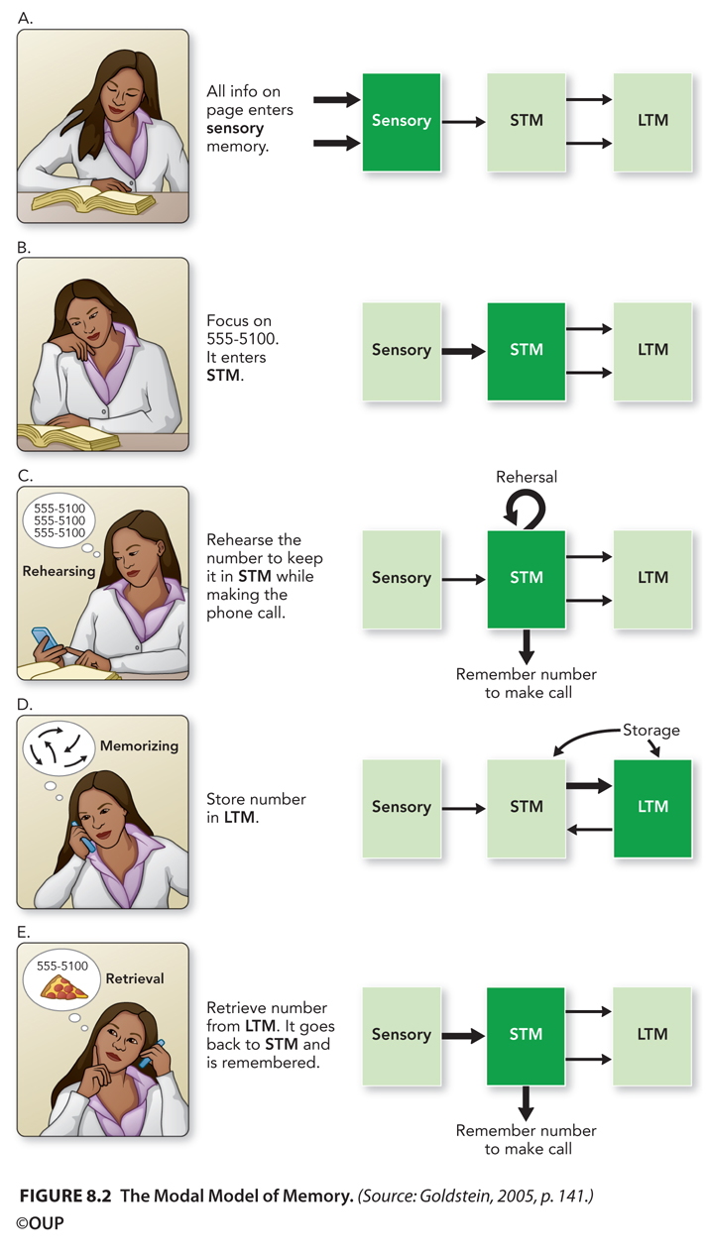
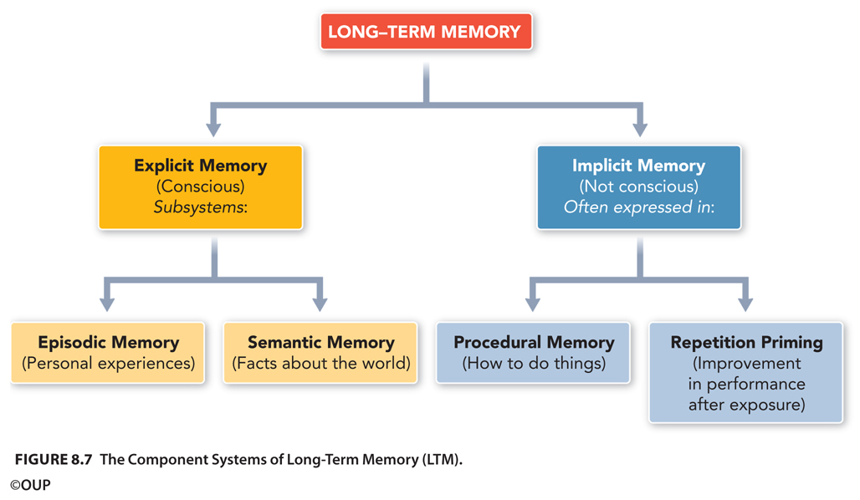
What is memory?

Slide 4
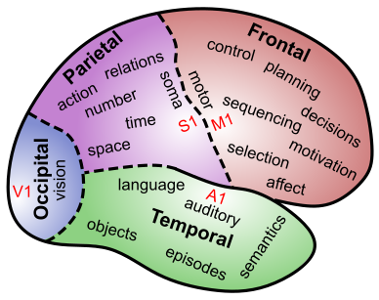
The Brain IS Memory
Memory is located in every single synapse in the brain
There are as many different kinds of memory as there are neurons and synapses and brain areas…

Slide 5
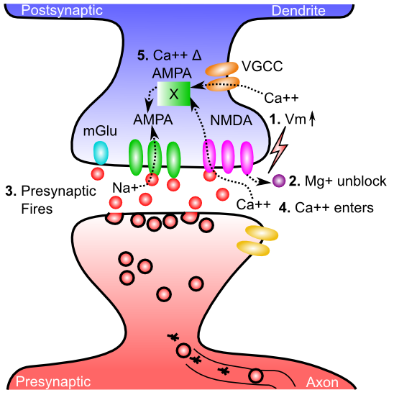
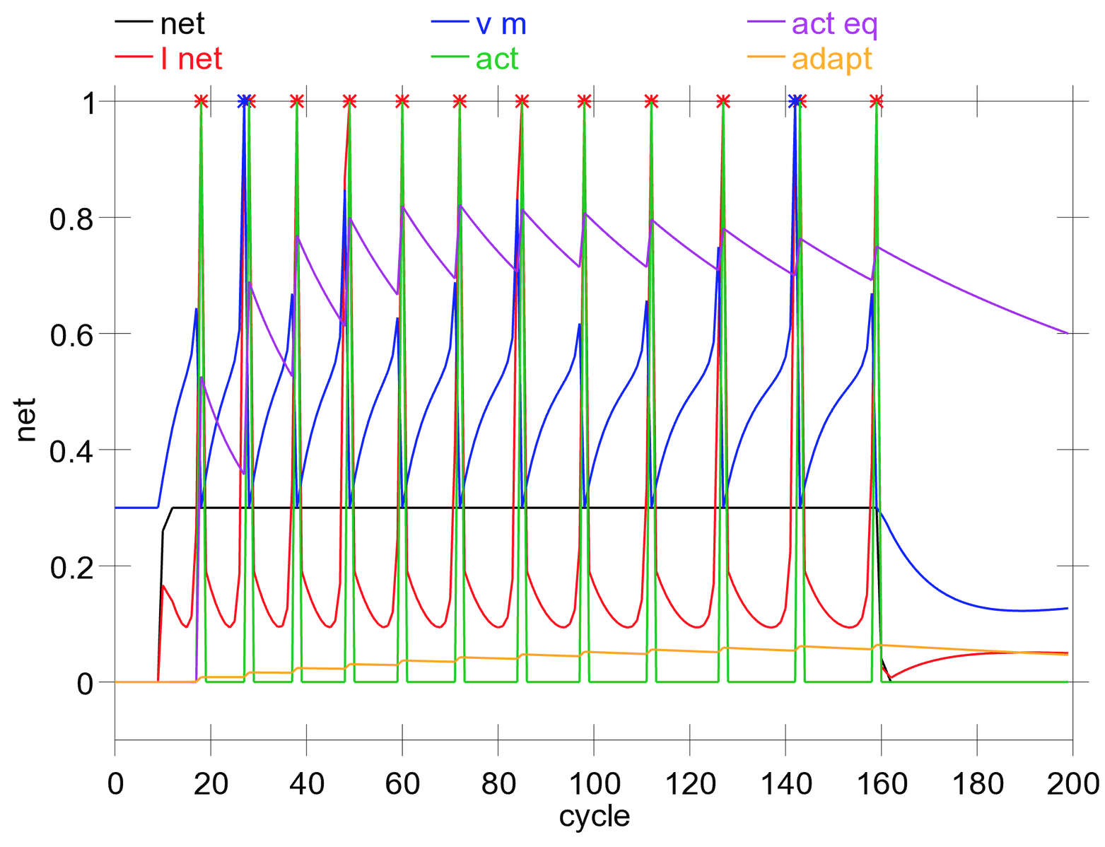
Two Neural Forms of Memory: Activation vs. Synaptic Changes
Activation = Neurons continue to fire action potentials, “remembering” what you were just seeing, thinking
But when firing stops.. You forget..
Synapses change strength (“weight”) as a result of LTP / LTD (learning): this encodes long-term memories that last even after your activation switches to something new..

Slide 6
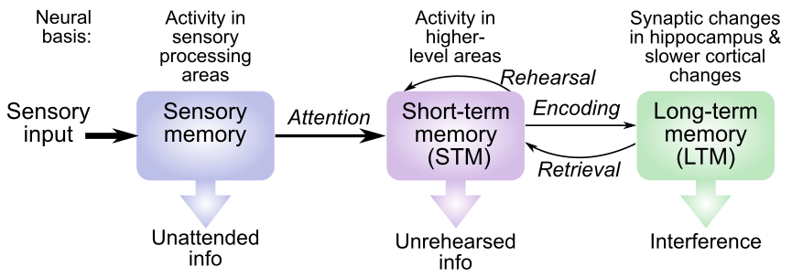
“Modal” Model
Sensory: iconic (visual, < 1 sec), echoic (auditory, < 4 sec)
STM: ~20 seconds max, limited capacity (3-4 really, 5-7 for verbal)
LTM: essentially unlimited capacity

Slide 7
“Modal” Model Dynamics
Sensory & STM do not need to be encoded or retrieved: Active..
LTM does need to be encoded and retrieved: Offline
Sensory -> STM requires attention
STM = transient, needs rehearsal to maintain

Slide 8
“Modal” Model Questions
What are these memory systems, in terms of neurons, etc?
Why do they have these different characteristics?
Are there different forms of each of these things?

Slide 9
Where is Sensory Memory?
Surprise! It is just neural firing in sensory brain areas – those neurons just keep on firing away (briefly..)

Slide 10
Where is Short-Term Memory?
Surprise! It is neural firing in higher level brain areas that represent specific thing you’re remembering – those neurons just keep on firing away (briefly..)

Slide 11
Where is Short-Term Memory?
Extra surprise! And it usually requires contribution from prefrontal cortex – has extra holding power to keep those neurons firing longer!

Slide 12
Where is Long-Term Memory?
Surprise! It is in the relevant brain area(s) that encode the specific information! LTM is the sum total of all those synaptic weight changes!

Slide 13
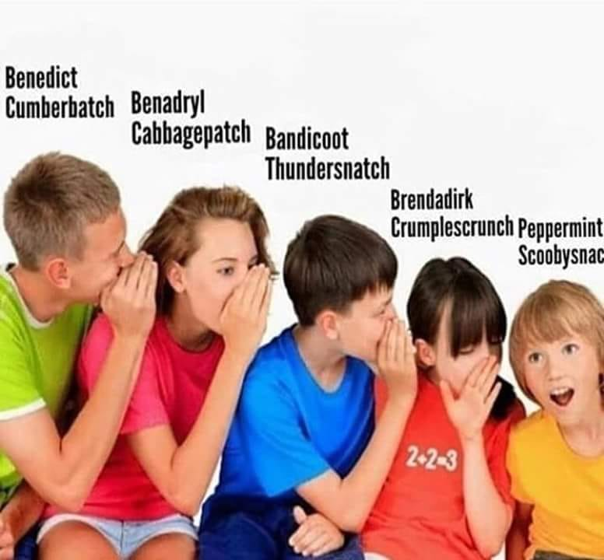
How memories transfer

Slide 14
Organization of LTM
Is this the best way to organize LTM? Can you think of any other ways?

Slide 15
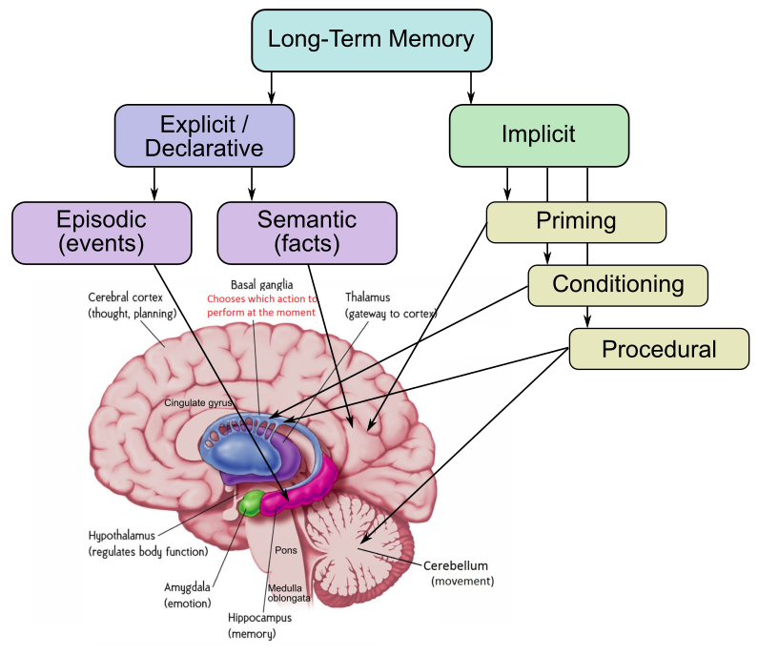
Where is Long-Term Memory?
“Explicit” vs. “Implicit” is unreliable distinction
Episodic = hippocampus
Semantic = rest of brain (mostly)
Procedural = Parietal
Priming happens everywhere..

Slide 16
Learning Rules Across the Brain
Area | Reward | Error | Self Org
Primitive Basal Ganglia | +++ | - - - | - - -
Cerebellum | - - - | +++ | - - -
Advanced Hippocampus | + | + | +++
Neocortex | ++ | +++ | ++
Learning Signal
+ = has to some extent … +++ = defining characteristic – definitely has
- = not likely to have … - - - = definitely does not have
Procedural = Cerebellum, Basal Ganglia
Episodic = Hippocampus
Semantic = Neocortex

Slide 17
This is LTM!

Slide 18
Chunks!
OWA… TAJER… KIAM…
SBCVTMCBNOBH vs. HBONBCMTVCBS
Organizing information into chunks = bigger
Memory Span
SF was able to remember 110 random digits by chunking into running times, etc.

Slide 19
Encoding and Remembering
Deeper encoding = better memory
elaborative encoding (e.g., method of loci – put each thing in its own special place)
Levels of processing: deeper is better!
LTM can be very context dependent (why?)
- state-dependent = a kind of context..
Spaced learning = learning across more contexts – makes memory stronger, more robust!

Slide 20
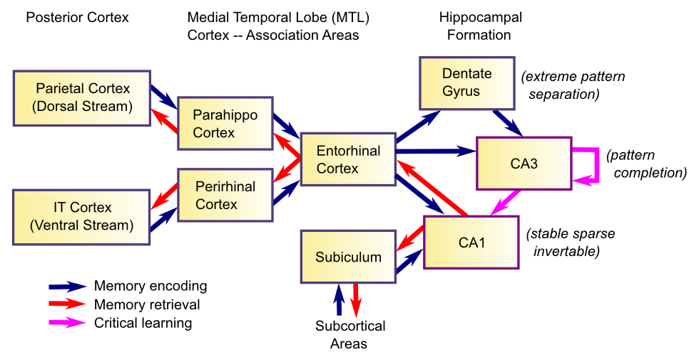
Hippocampal System: why memory is context sensitive

Slide 21
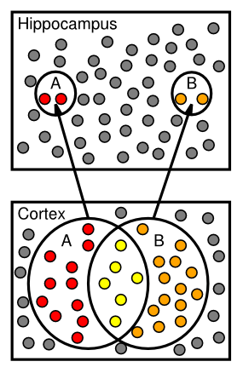
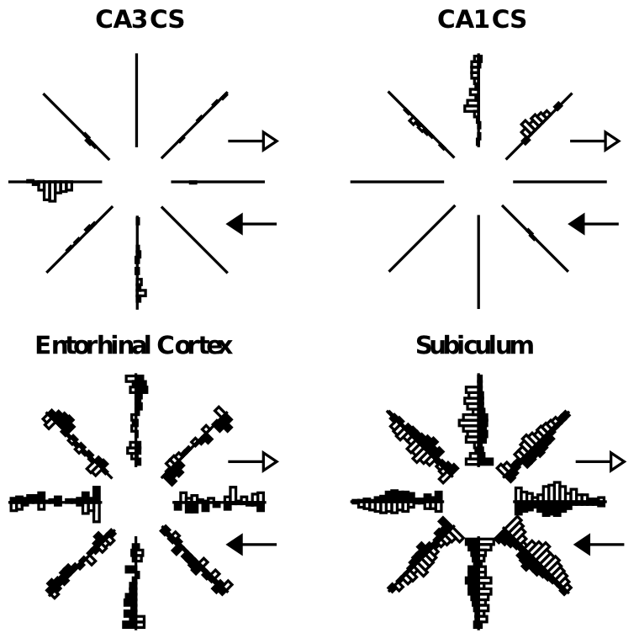
Sparse Activity: Context Specific

Slide 22
How memory actually works
Sensory, STM are just neural firing from seeing and paying attention to stuff: not really “memory”
LTM memory typically starts in the hippocampus: encode disjointed “facts” = “events”
Then slowly, rest of brain soaks up these disjointed facts and organizes them systematically into semantic memory in cortex
This is why it takes 10 years to really learn..

Slide 23
Quiz
If I study drunk, should I take the test drunk?
A. Yes
B. No

Slide 24
Quiz
Should I just cram study right before test, or revisit information over time?
A. Cram (Massed Practice)
B. Space it out

Slide 25
Quiz
Should I encode things deeply, making all kinds of elaborations and associations to other things I know, or just study superficially and try to memorize?
A. Encode deeply
B. Superficial memorization

Slide 26
Quiz
Do quizzes help me remember things better?
A. Yes
B. No

Slide 27
Working Memory vs. STM
Working memory = activity in PFC reflecting stuff you are actively working on
Working memory is a special kind of STM: because PFC is special in not being so easily distractible

Slide 28
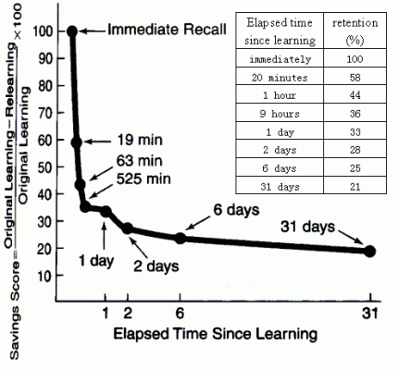
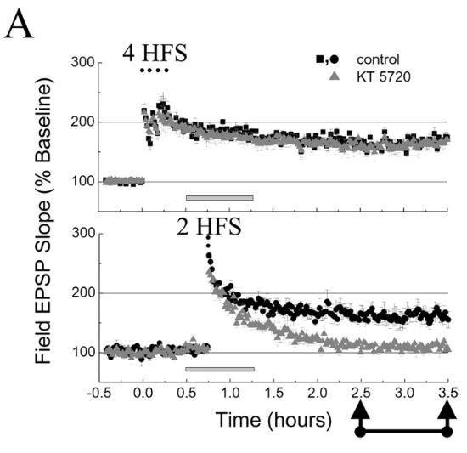
Memory Retention: Decay / Interference

Slide 29
Seven Sins of Memory
Transience: yep, you forget
Absentmindedness: pay attention!
Blocking: tip-of-the-tongue phenomenon
Misattribution: she’s not very nice
Suggestibility: memory implants..
Bias: true memory overwritten by desired memory
Persistence: only the ones you don’t want..

Slide 30
Is Memory Accurate
Why should it be?
Are you a computer or a video tape machine?
Is your perception accurate in the first place?
Ok, but how bad is it?
Change blindness: You are not even encoding much of anything in the first place!
And then you don’t remember much beyond that!

