Slide 1
Lifespan Development

Slide 2
The Big Questions
How do we go from jello to genius?
Babies are complete idiots (Onion headline)
Every one of you is capable of amazing feats of cognition that cannot be captured in current AI – and it all develops automagically – how!?
What forces shape our development?
Social, parental, genetic, etc

Slide 3
Development is Amazing
https://www.youtube.com/watch?v=InPRQNQBj5c
https://www.youtube.com/watch?v=ZTjHLF3xKWo
We are (fascinated by) butterflies: baby you is as different from adult you as a caterpillar and a butterfly!

Slide 4
Babies are Idiots
https://www.youtube.com/watch?v=lhHkJ3InQOE (my son Kai)
https://www.youtube.com/watch?v=0L7xzcvJzZc (my son Max)
Development = big, obvious effects – good window into components of cognition
Here at CU: Yuko Munakata, Eliana Colunga

Slide 5
What Develops, When?
Just think about everything you know:
Sensory-motor skills: recognizing, naming objects, reaching, manipulating, walking, talking, running…
Many animals born with these skills, why do we take so long?
You can’t even control your bowels for 3 full years!?
CCC = Controlling your behavior: first there are no tantrums, then there are, then they get less frequent.
Socialization: mine mine mine! -> share, play together…
And then you go to school, college…

Slide 6
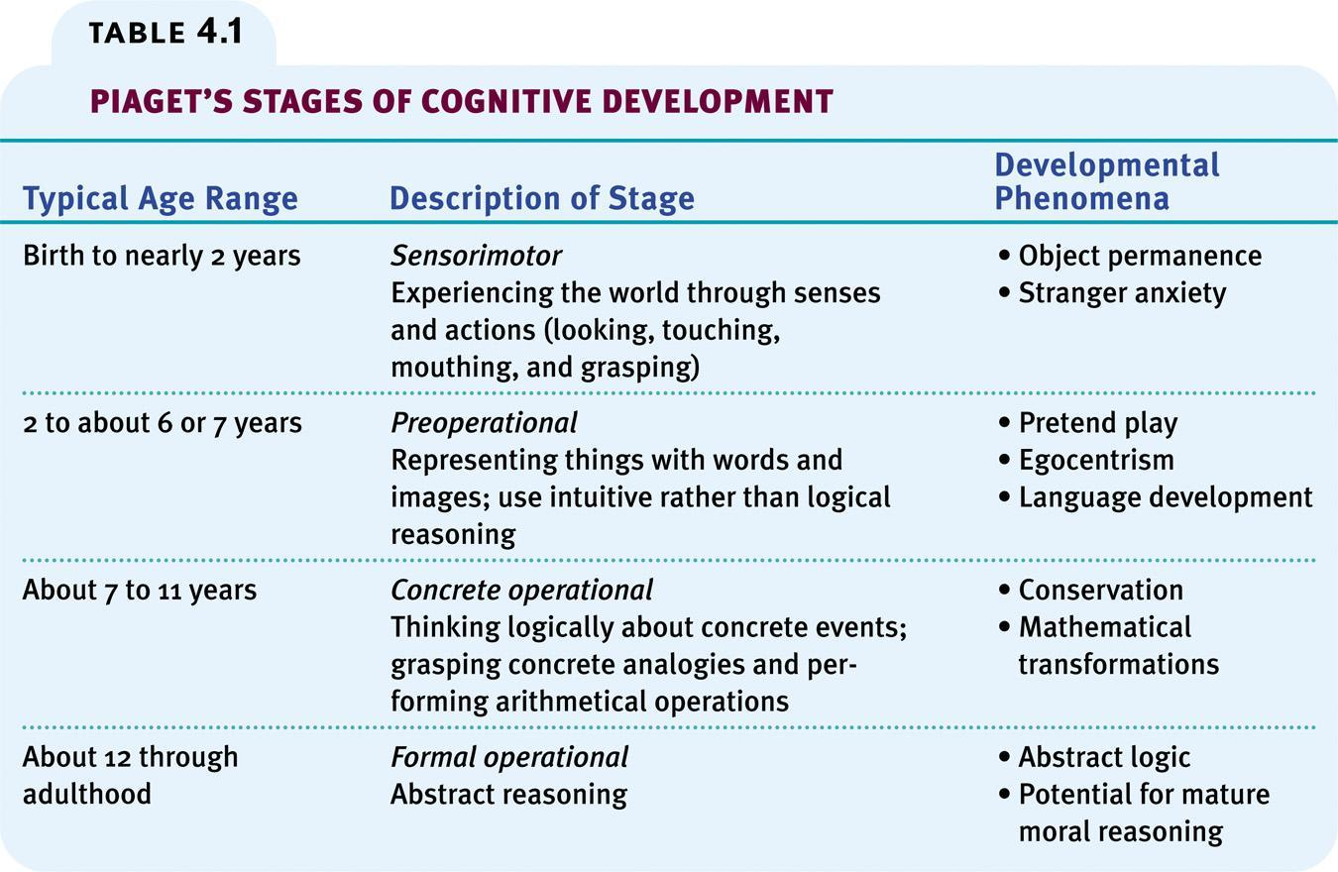
No actual stages.. But useful simplification

Slide 7
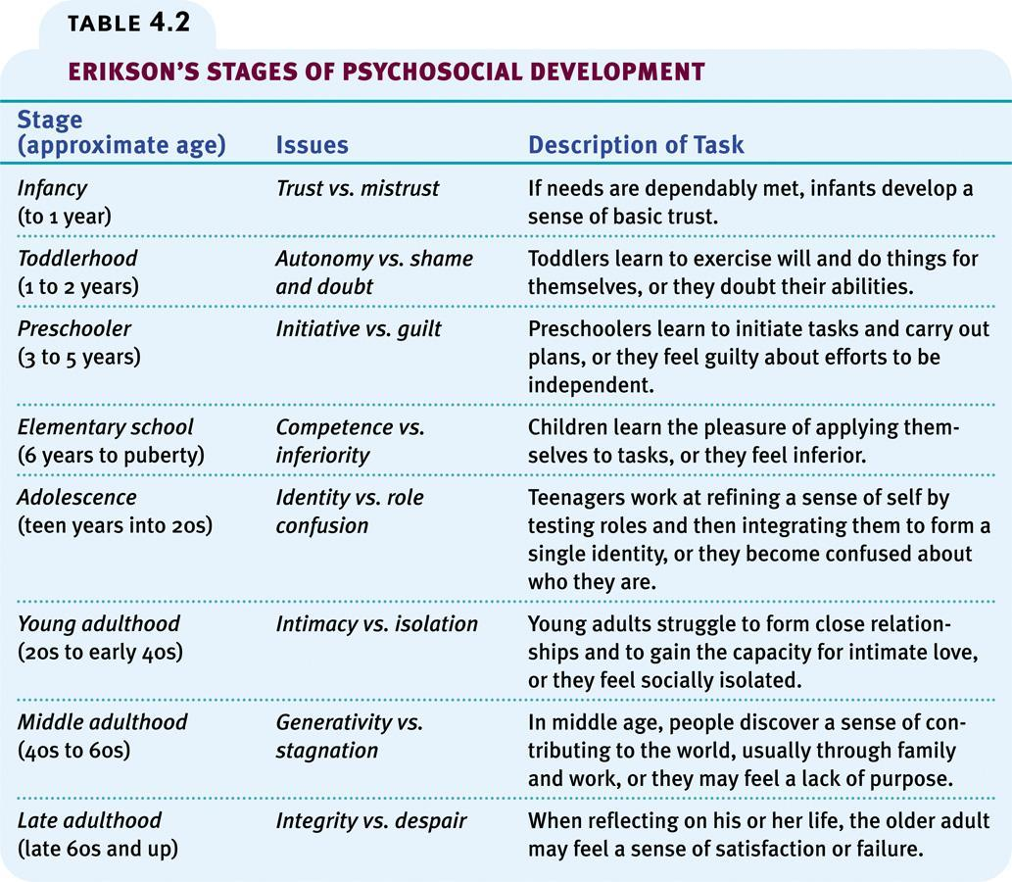

Slide 8
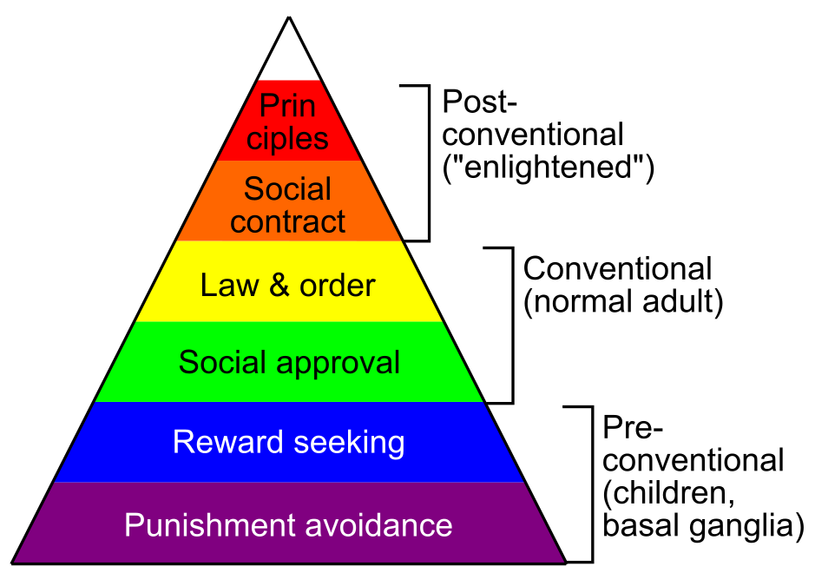
Kohlberg’s moral stages

Slide 9
How Does it Work?
Problem: Truly understanding development requires truly understanding how it all works! (absurd to teach 1 lecture on this topic!)
Brain maturation?
Learning?
Schema assimilation, accommodation? (Piaget)
Internal drives?
External forces (social, parental), schooling?

Slide 10
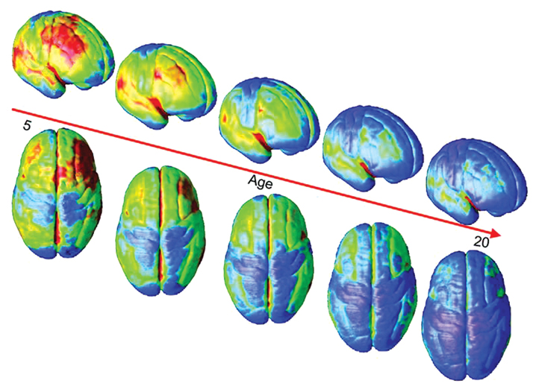
Brain Maturation: Synaptic Pruning
Blue = thinner = more synapses pruned = more mature
Sensory areas mature first, then “higher level” areas; PFC last of all

Slide 11
Early Sensory/Motor Learning
First 6 months: learning to predict what you’ll see next – passive sensory learning about basic physics, object permanence, object shapes, etc
CCC = Compression, Contrast
We have initial computer models of this
E.g.: Objects are solid, Objects only move through contact, Objects travel through space in continuous path.. Spelke et al: Nativism (built-in) vs. learned..
Physics = a “schema”?

Slide 12
Early Sensory/Motor Learning
Then: more active motor grasping and manipulation – starting to learn about self-efficacy
Learning that we can affect the world, prelude to full sense of agency..

Slide 13
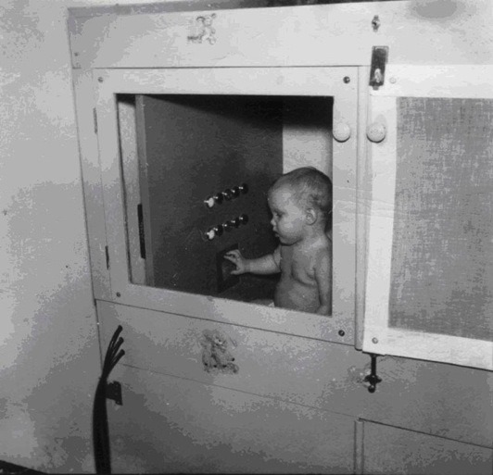
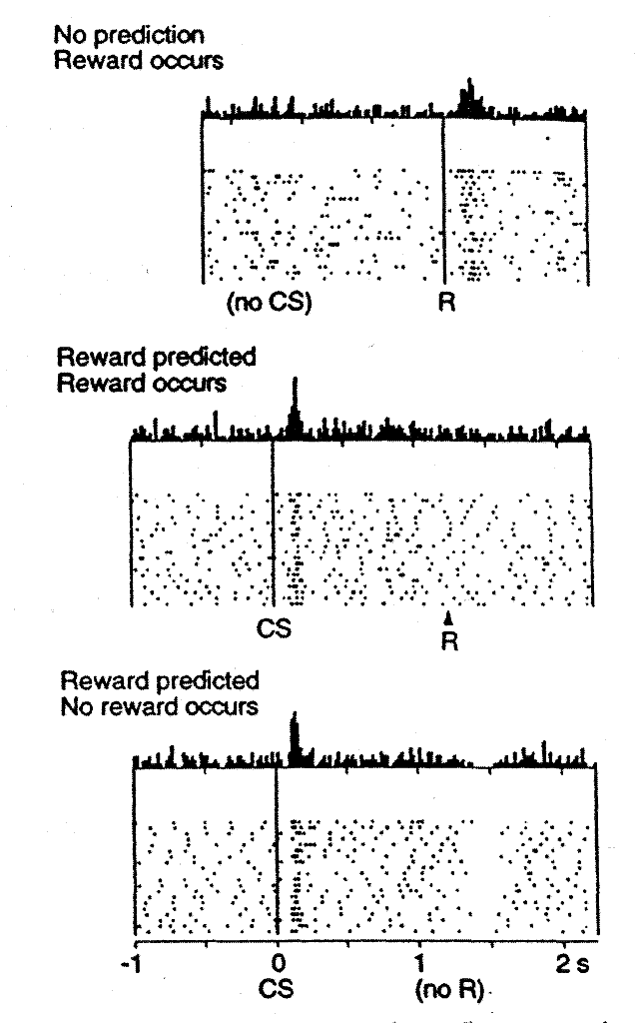
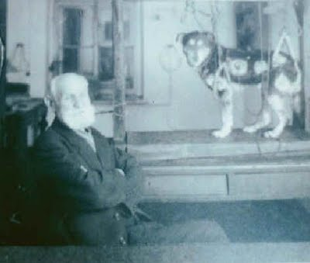
How Much of Learning is Passive?
Pavlov
Skinner
Dopamine

Slide 14
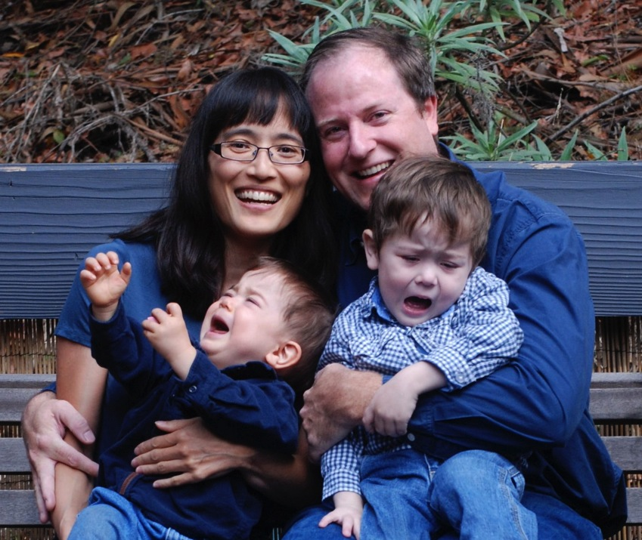
At 2 Years of Age, a Miracle Occurs
Tantrums!!!

Slide 15
Human Learning is Active! CCC = Control!
Kids carefully decide what to try or avoid
Boredom and curiosity drive expansion of abilities over time
Social influences are major: kids especially sensitive to peers – we are herd animals!

Slide 16
Developmental Influences
The most significant influence on my development was:
A. My parents
B. My peers
C. My own drives / personality / interests

Slide 17

The Nurture Assumption
Very little evidence of parental influence on children, beyond genetics
Genetic / environment correlation?
Peers matter the most of environmental influences
Which language to immigrants learn?
Who did you talk most w/ in High School?
What data tells us these things?

Slide 18
Extreme Cases
Parents only don’t matter if they’re ‘normal’ (and actually present)
Romanian orphans
Abuse, neglect, etc
(Same point about genetics dominating when there isn’t too much variance in the environment: how different really are different parents?)

Slide 19
Temperament: Personality vs Big 5 in Chapter 12
Effortful control: Conscientiousness
Negative emotionality: Neuroticism / not-Agreeableness
“avoid” dimension
Extraversion: Extraversion / Openness
“approach” dimension
Basic “parameters” on motivational system..

Slide 20
Attachment Theory
Nice metaphor, but likely largely bogus..
We don’t see entire world through lens of mother (how many others fit the mother role??)
Strange Situation and Attachment Styles:
Secure: Need mommy, miss mommy, all good with strangers as long as mommy is around..
Avoidant: Disengaged, even from mommy..
Insecure-Ambivalent: Wary, anxious, mad at mommy..

Slide 21
My Attachments..
My attachment style as a baby likely was:
A. Secure
B. Avoidant
C. Insecure-Ambivalent
D. Depended on my mood

Slide 22
My Attachments..
My attachment style as a baby is most related to:
A. My current personality
B. My personality as a baby / kiddo
C. My parent’s parenting style
D. Attachment style not stable
E. Personality not stable..

Slide 23
My Attachments..
This was (is?) my relationship with attachment objects (blanket, stuffie, etc):
A. I had one and only one attachment object
B. I had serial monogamous attachment objects
C. I had several attachment objects at a time
D. I had no major attachment objects

Slide 24
Beyond Boyhood
Adolescence: Everything in place except good judgment! And an appreciation of it all..
youth is wasted on the young
Young adult: what do I do with my life?
Adult: joys of parenting, marriage
Midlife: did someone say crisis?
Golden years: and then you die..

Slide 25
Moral Development (basic drives to make society work?)
Kohlberg:
Preconventional: reward / punishment
Conventional: respect for law, norms, rules
Postconventional: abstract principles and beliefs
Haidt:
Care / harm: like reward / punishment – basic
Fairness / justice: no cheaters! Or cheated!
Group Loyalty: love the in-group, hate the out-group
Respect for authority: stay in line!
Purity and sanctity: rules about sex, food, nudity, etc

Slide 26
Development Summary
Brain maturation = synaptic pruning, goes from sensorimotor up to higher areas (prefrontal cortex is last = Control area)
Overall Stages: Sensorimotor, preoperational, concrete operations, formal operations
Temperament: reasonably stable, effortful control, negative affect (avoid), extroversion (approach)
Attachment: secure, avoidant, insecure/ambivalent: reflects personality vs. shapes it? (Reflects!)
Adolescents: lack PFC for making good decisions..

Slide 27
Research Methods
It is especially challenging to figure out what preverbal, jello-ball babies are thinking!
- they can’t talk, point, push buttons..
How would you do it? Hint: have you seen The Theory of Everything?

Slide 28
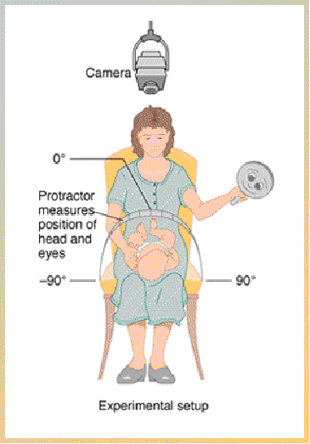
visual preferences research

Slide 29
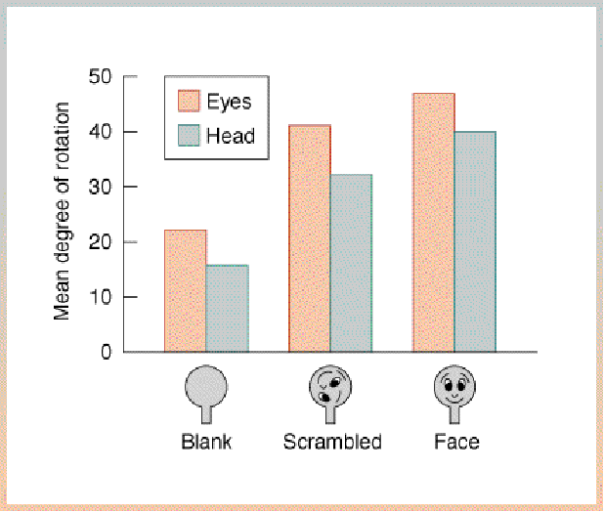

Slide 30
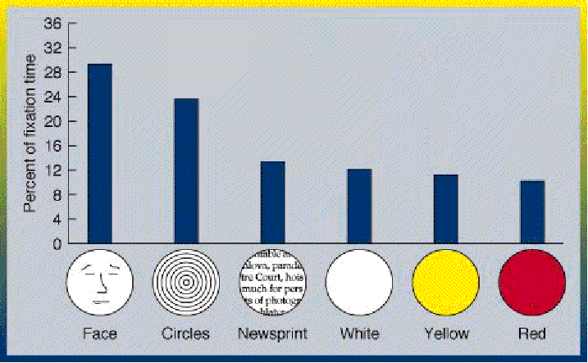

Slide 31
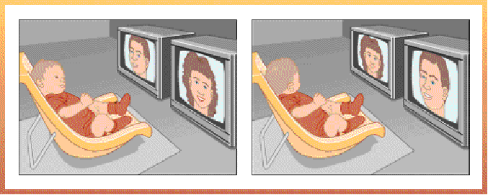
another method to determine preferences -- habituation

Slide 32
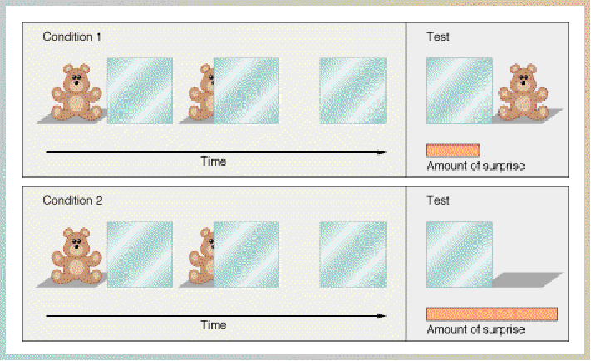
a test for object permanence

