Slide 1
Personality

Slide 2
The Big Questions / Issues
What is stable and identifiable about you?
Why is it the “big five” and not something else??
What’s the implication of different personalities?
Do you consistently behave in the same way, or does the situation strongly determine your behavior?

Slide 3
Defining Terms
Personality:
Organized
Integrated
Relatively Enduring
i.e., not just some random stuff you do..

Slide 4
Person-Situation Controversy
Does personality exist at all, or are we just a product of our situations??
Walter Mischel (1960’s): Situation is dominant
Seymour Epstein (1970’s): Need to integrate over multiple situations to see personality traits!
Trait-situation behavior model: both factors together determine behavior (the answer is always both!)
What if our behavior was so consistent that you could see personality in every action? Where is free will!?

Slide 5
The Big Five OCEAN
Openness
imaginative, curious, intellectual, creative.. Vs:
conventional and practical, enjoy routine, “down to earth”
Conscientiousness
careful, thorough, well-organized, responsible Vs:
careless, inefficient, disorganized, irresponsible
Extraversion*
Sociable, energetic, assertive, other-oriented Vs:
Passive, reserved, quiet, self-oriented
Agreeableness
Warm, kind, empathetic, compassionate, trusting Vs:
Hostile suspicious, unkind, lacking in trust..
Neuroticism*
Easily upset, anxious, emotional, self-pitying, worriers.. Vs:
Even-tempered, comfortable with selves, calm, stable.
Notes:
Do clicker quiz of class on each!!!

Slide 6
Click It..
For each personality factor:
A. Strongly agree with first line of description
B. Somewhat agree..
C. Neutral
D. Somewhat agree with second line of descr.
E. Strongly agree with second line of description

Slide 7
Eysenck Two Factors
Neuroticism and Extraversion – are these somehow more basic?

Slide 8
Approach vs. Avoid & Motivation Personality = emotion/motivation parameters
Approach orientation:
Ideas: Openness
People: Extraversion
Avoid orientation:
Generally: Neuroticism
People: Introversion, Ideas: -Openness
Anger = Agreeableness
Organization drive = Conscientiousness

Slide 9
Big Five Issues
Seem clearly distinct in general desirability: there is a “good” side and a “bad” side to each
Why has evolution preserved all these “bad” personalities? What is actually “good” about them?
Strong social orientation: mostly about how we interact with others

Slide 10
Genetics and Change
As usual, about 50% contribution of genetics to personality factors (parents know this!)
Traits get more stable over time
Biggest change is in young adulthood (you!)
Rank-order stability: how do their factors rank over time? Measures patterns within individuals. More stable
Mean-level stability: does overall population level of trait change over time? Less stable.

Slide 11
Gender Differences
Women higher in neuroticism, extraversion, agreeableness, conscientiousness

Slide 12
Measurement Techniques
MMPI: Minnesota Multiphasic Personality Inventory: objective (scored by computer)
Low in face validity, but useful for abnormal diagnosis
NEO-PI: high face validity, only useful for normal diagnosis
TAT, Rorschach: highly subjective, not used..
Low validity, low reliability

Slide 13
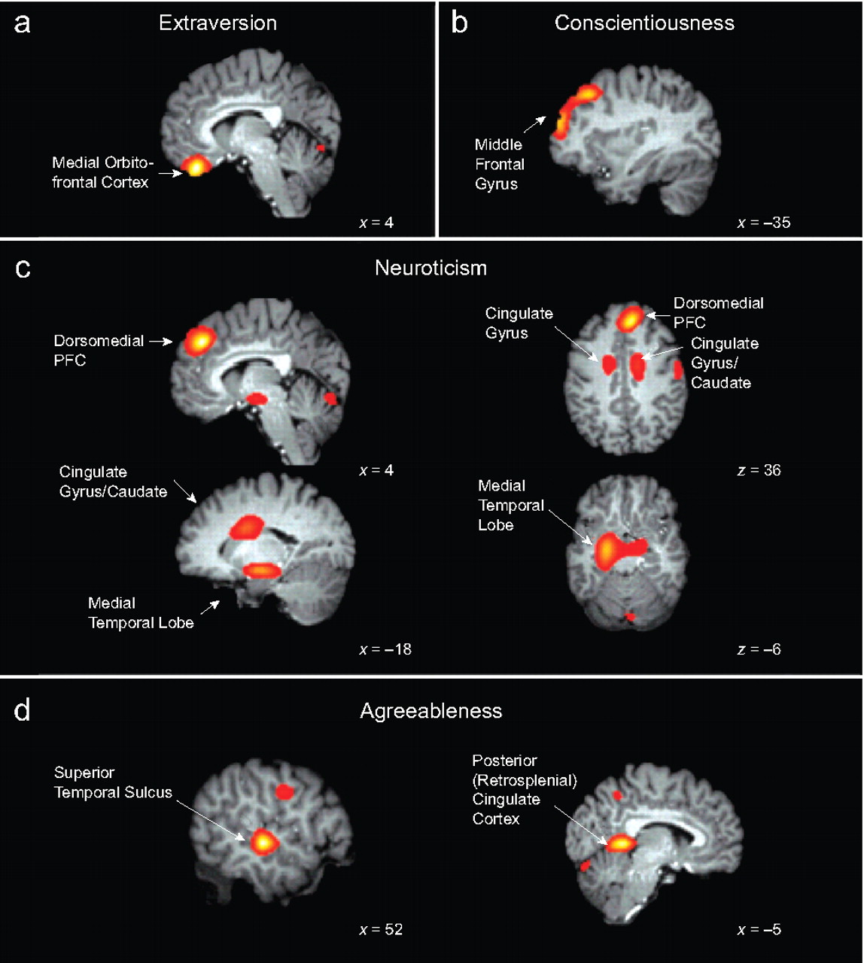

Slide 14
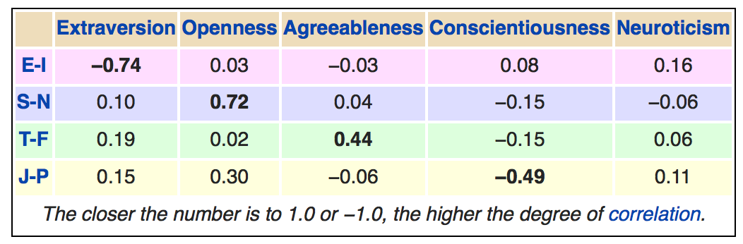
Meyers-Briggs?

Slide 15
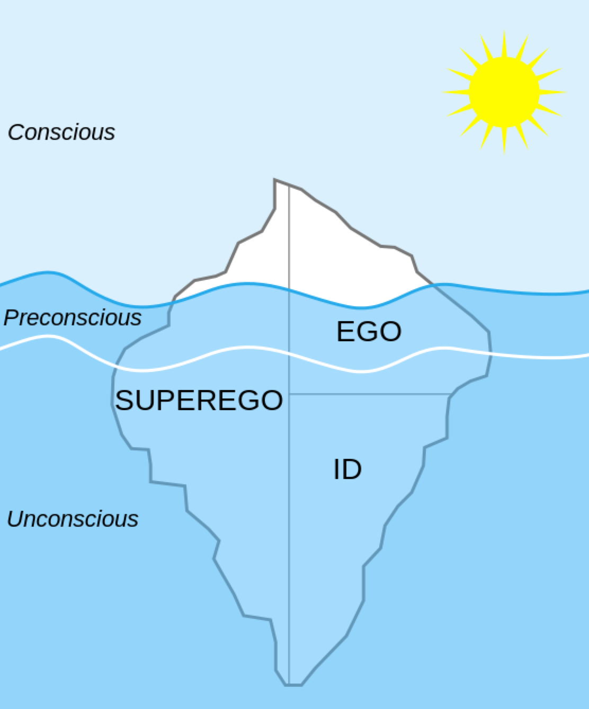
Freud

Slide 16
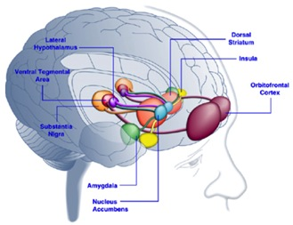
Freud: Wrestling w/ your Brainstem
How does our high-level cortex make sense of all these brainstem-level drives (Id) that are built in, and, frankly, somewhat awkward..
Libido: Oral, Anal, Phallic Stages..
(then Latency, Gential.)
Ego defense against all this stuff: repression, denial, displacement, projection, reaction formation, sublimation, undoing..

Slide 17
Self Esteem, Humanism, and Your Castle CCC = Control!
You are the sole regent of your own subjective world (the castle of your mind)
You cannot abdicate the throne!
Threats to your rule are existential threats!
We are all defensive, narcissistic, etc..

