Slide 1
General Psychology
Professor: Randall C. O’Reilly
TA: Brittany Toaksey

Slide 2
What is the Most Important thing in the Entire Universe?
Me
My Family
My Pet
The Entire Universe
.. ?

Slide 3
What is the Most Important thing about Me
My Body
My Hair
My Tan
My Brain
.. ?

Slide 4
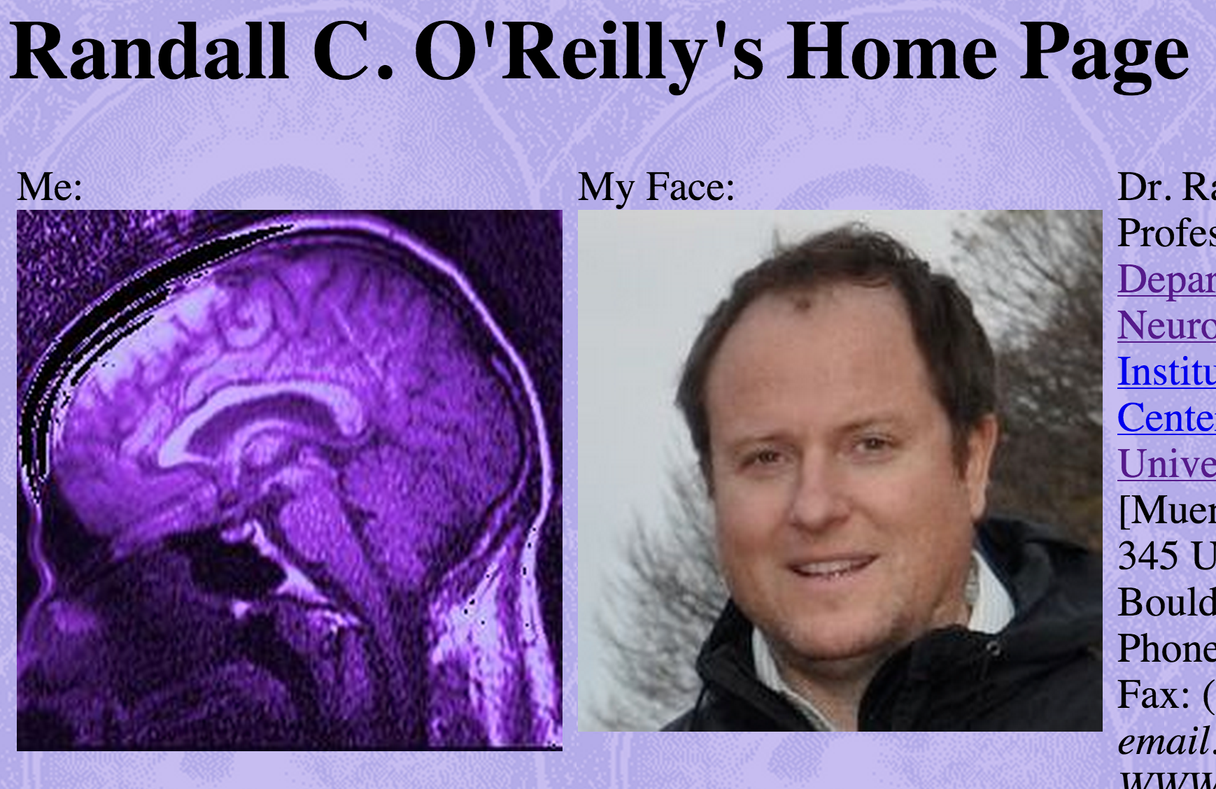
Me and My Face..

Slide 5
If you lose it, you lose it..
Different parts of your brain, when damaged, cause you to lose specific functions (language, motor control, recognizing faces, ability to use certain words, the entire left side of space..)
Brain dead = dead
Please wear a helmet!!

Slide 6
Retest: What is the Most Important thing about Me
My Body
My Hair
My Tan
My Brain
.. ?

Slide 7
This Class is All About You
Your brain
Your memories
Your fears
Your borderline mental disorders
Your joys
Your friends (and the stuff they make you do..)
Your parents
…

Slide 8
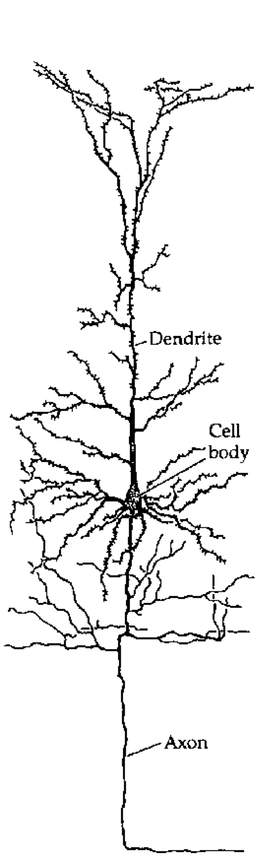
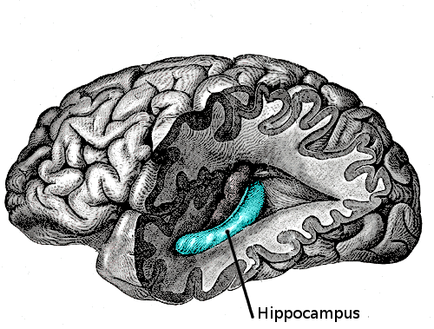
Freaky Facts about You
Every single cherished memory in your life is encoded solely through changes in the strength of synaptic connections between neurons.
Mostly just the neurons in your hippocampus, which isn’t very big.

Slide 9


Slide 10
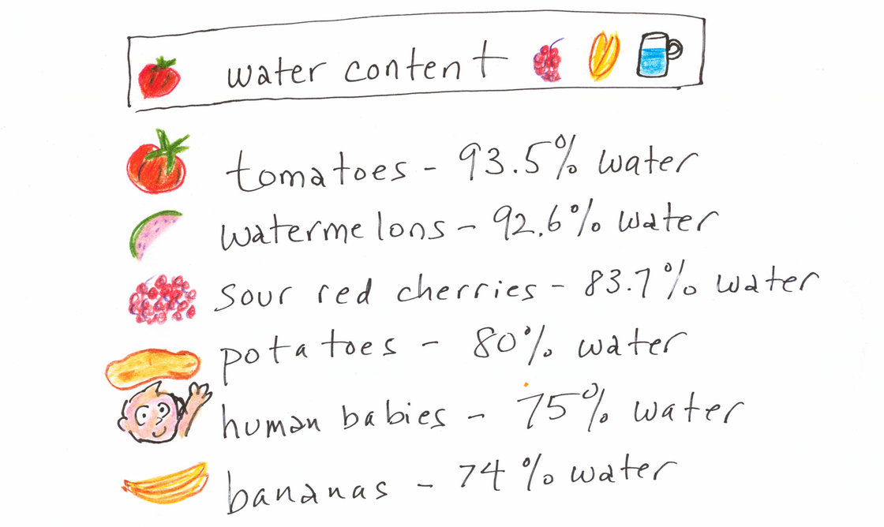
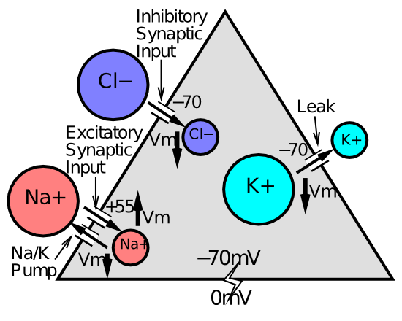
Freaky Facts about You
You are ~75% water!
Salt water, in particular
(We carry our evolutionary environment around with us)
Especially in our Brains, where NaCl (and K) are what allow you to think!

Slide 11
What Is the Point of This Class?
Learn about psychology and neuroscience
Get a good grade so you can get on with life
Catch up on sleep
Catch up on social networking
…?

Slide 12
What is the Point of College?
Why are we here (in this classroom), instead of just reading about stuff online, or taking a MOOC, etc?
How is this class going to be meaningful for the rest of your life (and worth your (parents) hard-earned tuition dollars)?

Slide 13
How Do People Learn? (your first Psychology quiz)
“I learn best by having someone tell me a list of facts”
“I learn best by reading a textbook”
“I learn best when I participate in exciting, unpredictable, meaningful interactions”
“I don’t learn best..”
“…?”

Slide 14
Facts about Learning
Learning is modulated by emotion (dopamine!)
Emotion is engaged when you’re engaged
People prefer live performances because you never know when something unexpected will happen (e.g., major fail..)
This class is a live, unpredictable thing – it is up to you to make it interactive and even more unpredictable (and fun, and personally meaningful..)

Slide 15
Half-Flipped Classroom
Flipped classroom:
Get facts at home/library/coffeeshop from textbook
Use lecture time to work through problems, etc
No problems in psychology.. ☺
Half-Flipped classroom:
Read the textbook first
Hear me synthesize it and connect the dots
Then discuss and extend and bring it to life

Slide 16
Large Scale Interactions!
Discussion requires your participation!
Attend class
Submit clicker-questions-of-the-day (learn about your peers, probe interesting issues)
Submit questions during class via cellphone
And even actually physically use your mouth to generate sonic vibrations!

Slide 17
Naming Stuff vs. How Stuff Works
“Tip of the tongue” phenomenon, “I knew it all along” phenomenon, etc..
You already know psychology: you’re it! Just learning some new names for everything (BORING)
Much more interesting (and difficult) to figure out how your brain actually works!

Slide 18
Where I’m Coming From
I spend a ridiculous amount of time building computer models of the brain, that act kinda like people (or rats, or monkeys..)
This is called “research” ☺
I also teach an advanced course where students learn to build these computer models, and end up understanding how the brain works in ways they could have never imagined..

Slide 19
CCC = The 3 C’s
CCC = Compression, Contrast, Control
Compression: filtering, simplifying, capturing the essence while removing the noise (perception, memory, learning, stereotypes, delusions..)
Contrast: everything is relative (happiness, color, size, income, social standing..)
Control: we are each little despots ruling our own fiefdoms, and don’t you ever diss me! (control is central to most mental disorders)

Slide 20
Course Goals
Develop a core understanding of how the brain works at a very basic level (CCC, etc)
Cover the major areas and discoveries of psychology, focusing on big picture issues:
How do we learn?
What is consciousness (and how can I lose it!)?
Why are some people such jerks?
What is ADHD and why have I just tuned out..?

Slide 21
Course Goals
Get you to think critically about data, statistics, theories, etc: think like a scientist.
Learn a bit about how to design a research experiment, and what to do with the data.
Have a good time, all the time!
Learn a ton!

Slide 22
Other Stuff I Have to Do
Assign grades:
2 Midterms and a Final Exam, multiple choice (Canvas)
Canvas Chapter quizzes to ensure you’re reading
Participation: click-in attendance, question-of-the-day submissions
Listen to you gripe about your grades:
My office hours are Monday 3-4 – sometimes this slot is taken for other meetings so email me if I’m not there, and in general email is best! genpsych@grey.colorado.edu

Slide 23
Research Experience
12 Credits = 6 hours
Participate in experiments and/or write papers
Required to pass class
Extra credit of 2% if completed by EC date

