Slide 1
The Neuron
Computational Cognitive Neuroscience
Randall O’Reilly

Slide 2
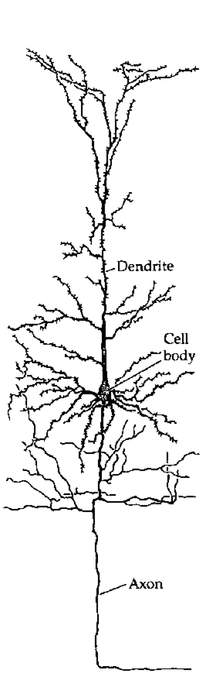
The Basic Unit of Cognition!?

Slide 3
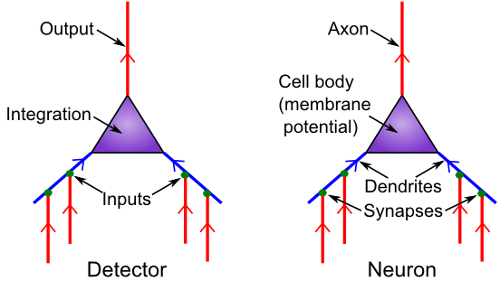
Detector Model
Is it really all just detection?

Slide 4
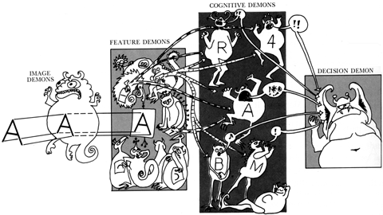
Pandemonium! (Oliver Selfridge)

Slide 5
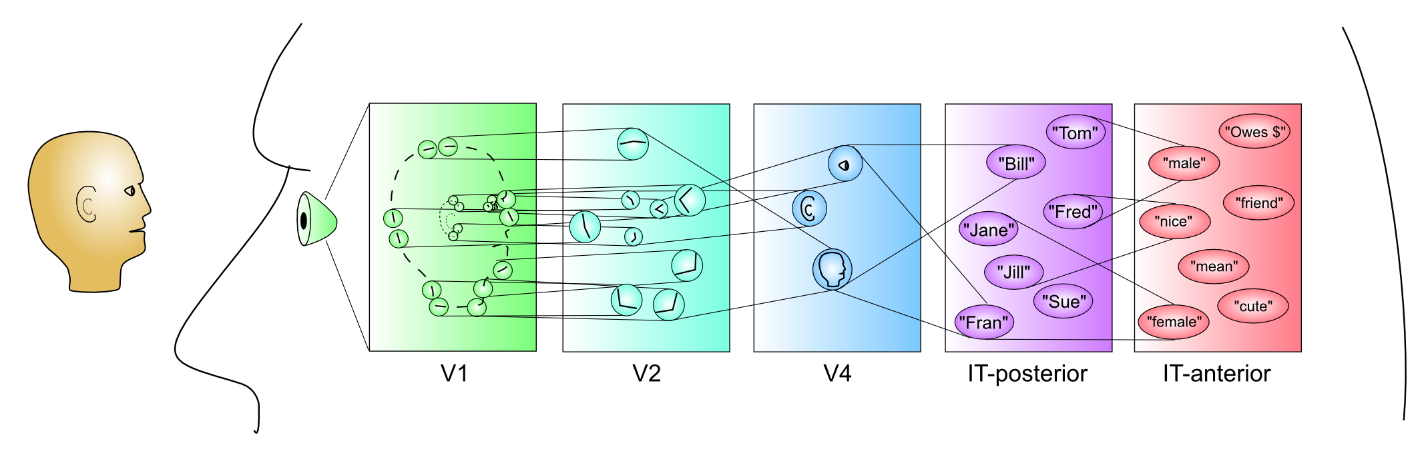
Hierarchy of Categories

Slide 6
Feature Demons
Vertical Line: |
Horizontal Line: --
Up-Right Diagonal: /
Up-Left Diagonal: \

Slide 7
Cognitive Demons
T: 1,2
V: 3,4
A: 2,3,4
K: 1,3,4

Slide 8
Testing..

Slide 9
Testing..

Slide 10
Testing..

Slide 11
Testing..

Slide 12
Testing..

Slide 13
Testing..

Slide 14
Testing..

Slide 15
Testing..

Slide 16
Testing..

Slide 17
Ooops..

Slide 18
Ooops..

Slide 19
Ooops..

Slide 20
Ooops..

Slide 21
Detector Summary
Maybe you can see how collective action of many detectors, organized hierarchically, could achieve more complex cognition?
But detection needs to be more sophisticated to avoid certain problems:
Combinatorial explosion of detectors required for each possible different feature
Exponentially worse with combinations of features!

Slide 22
Coarse Coding Efficiency
Key idea: each neuron can cover a large space by responding in a graded way
This also works for combinations across multiple dims!
See objrec simulation in Chapter 6

Slide 23
Detection = Dimension
Detection = extracting relevant dimension from input: emotion detector, gender detector
face_categ example from Chapter 3

Slide 24
Neurons in the Dark
Neurons live in the dark!
“Hear” an incredible jumble of inputs.
Have absolutely no idea what is going on in the real world outside their little area of the brain..
All of this is very counterintuitive given that we tend to think of neurons as communicating in full English sentences about the weather, etc..
Neurons only get spikes, not words!

Slide 25
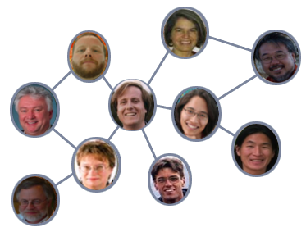
The Social Network
Neurons depend on network of “trust” built up over a long time period – only way they can overcome the jumble in the dark..

Slide 26
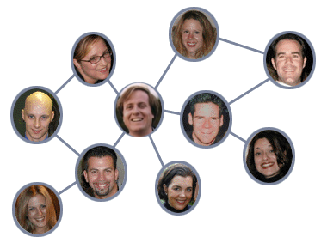
The Social Network
How do neurons ever know if senders change what they are encoding? How does the brain ever change?

Slide 27
Back to the Detector Model
How do we simulate on a computer?

Slide 28
Overall Strategy
Neurons are electrical systems, can be described using basic electrical equations.
Use these equations to simulate on a computer.
Need a fair bit of math to get a full working model (more here than most chapters), but you only really need to understand conceptually.

Slide 29
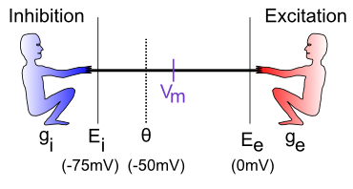
The Tug-of-War
How strongly each guy pulls: I = g (E-Vm)
g = how many input channels are open
E = driving potential (pull down for inhibition, up for excitation)
Vm = the “flag” – reflects net balance between two sides

Slide 30
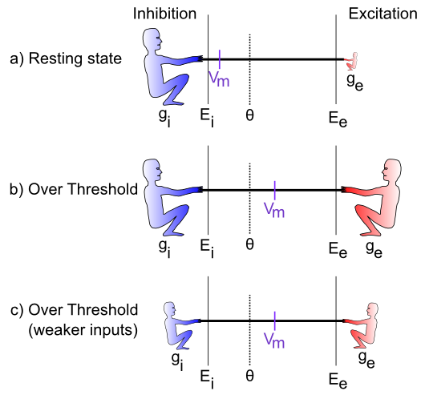
Relative Balance..

Slide 31
Equations..

Slide 32

Equilibrium
This is just the balance of forces..

Slide 33
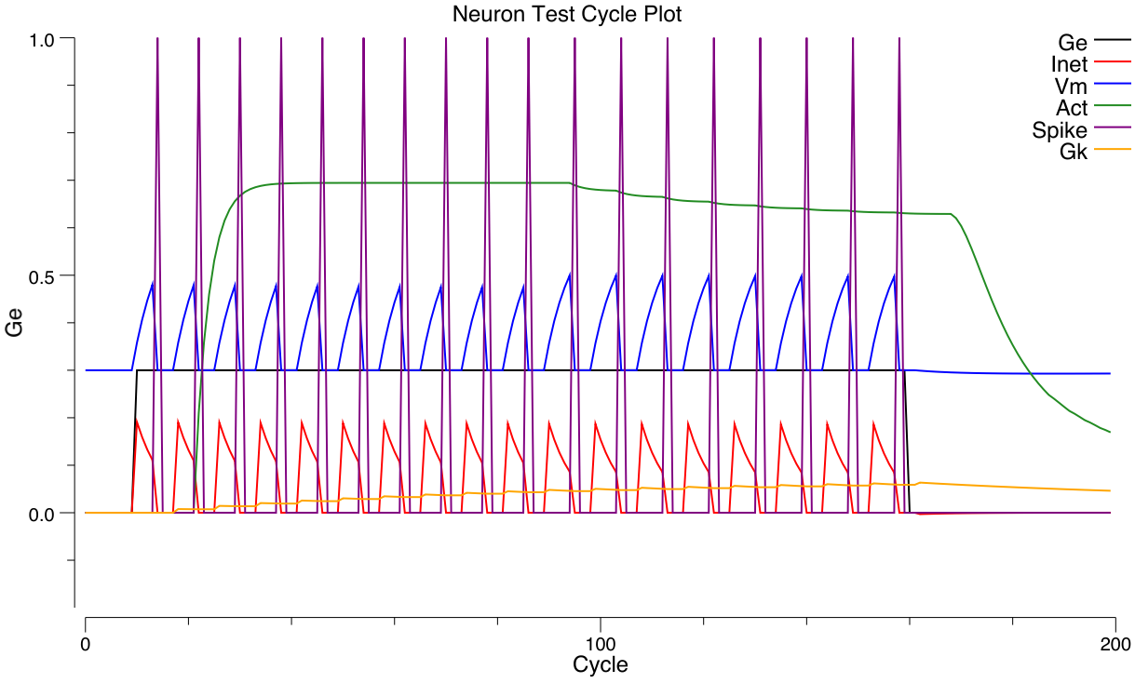
Spiking Output
If Vm gets over threshold, neuron fires a spike.
Spike resets membrane potential back to rest.
Has to climb back up to threshold to spike again

Slide 34
Rate Code Approximation
Brain likes spikes, but rates are great!
Instantaneous and steady – smaller, faster models
But definitely lose several important things
Soln: do it both ways, and see what the diffs are..
Goal: equation that makes good approx of actual spiking rate for same sets of inputs.

Slide 35
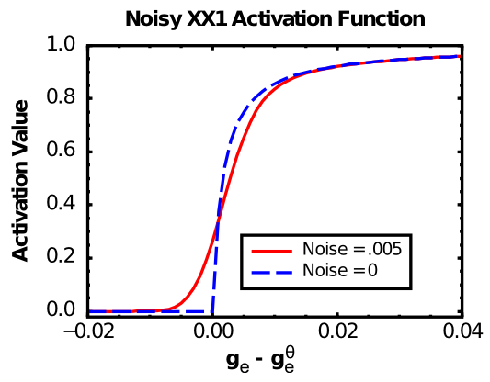
Sigmoidal Shape: Noisy X/X+1
Threshold
Saturating
Smooth

Slide 36
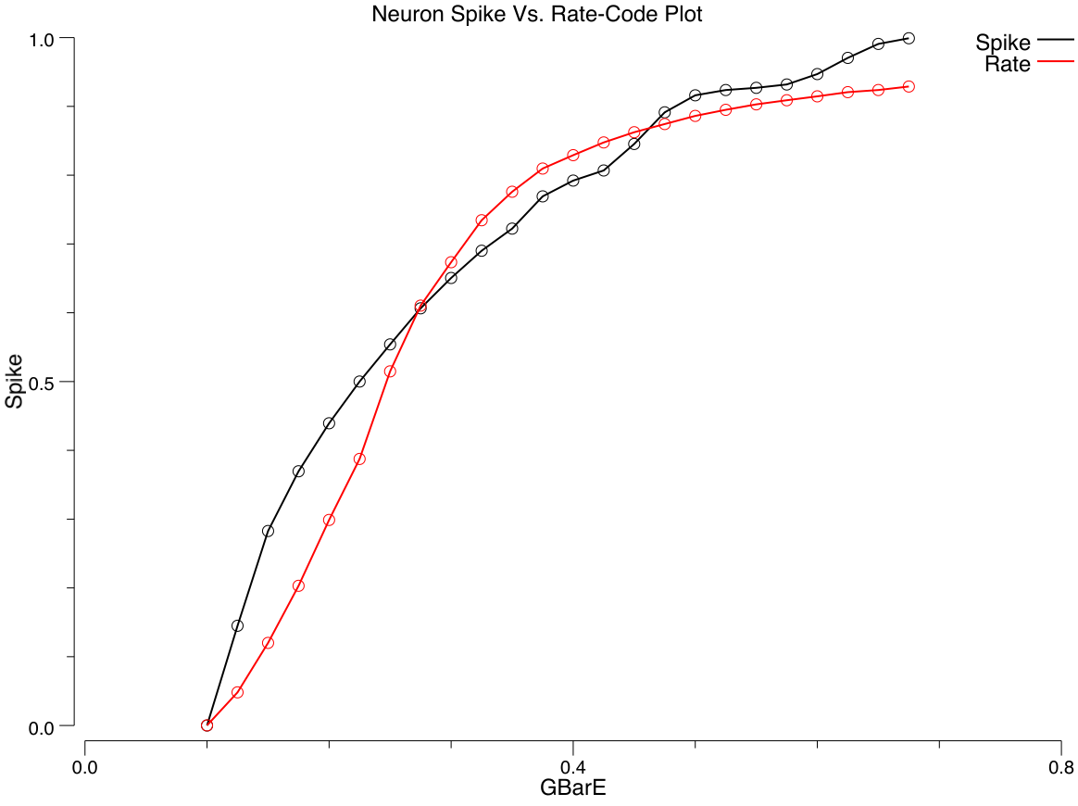
Noisy X/X+1 Approximates Spikes

Slide 37


Rate Code Equations
A little bit tricky because Vm doesn’t work.
Need to use excitatory conductance – threshold
XX1 equation:
ge-theta:
Time dyn:

Slide 38
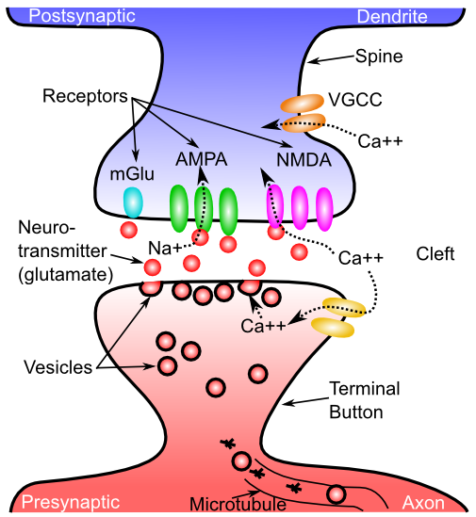
The Synapse

Slide 39
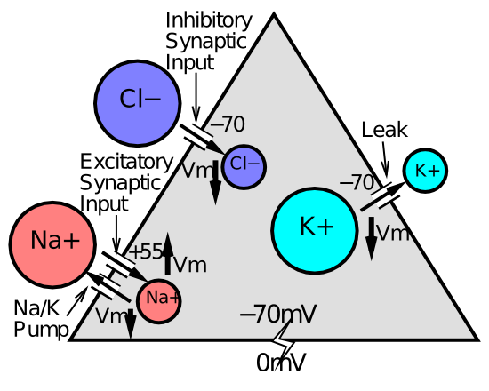
The Full Story..

Slide 40

Input Conductances and Weights
Just add ‘em up (and take the average)
Key concept is weight: how much unit listens to given input
Weights determine what the neuron detects
Everything you know is encoded in your weights..

