Slide 1
Learning and Memory
Computational Cognitive Neuroscience
Randall O’Reilly

Slide 2
Major Types of Memory
?

Slide 3
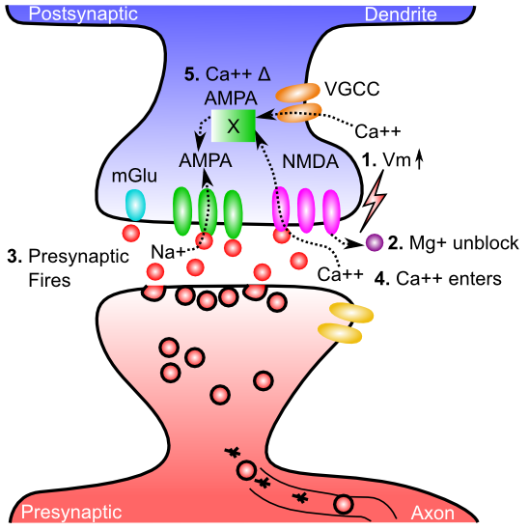
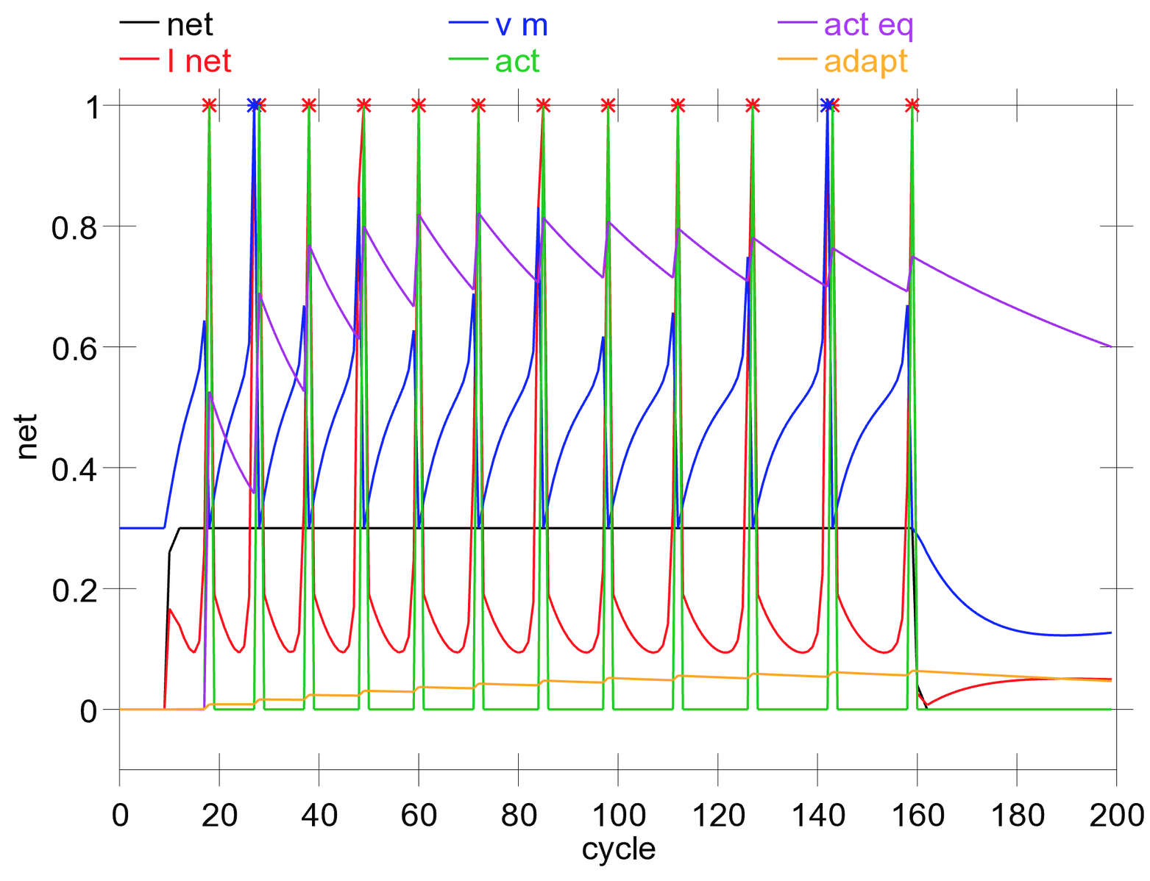
Two Neural Forms of Memory: Activation vs. Synaptic Changes
Activation = Neurons continue to fire action potentials, “remembering” what you were just seeing, thinking
But when firing stops.. You forget..
Synapses change strength (“weight”) as a result of LTP / LTD (learning): this encodes long-term memories that last even after your activation switches to something new..

Slide 4
Major Types of Memory
Weight-based (changes in synapses)
Long lasting, persist over distraction, etc
Very high capacity
Activation-based (sustained neural firing)
Transient, easily lost
Very flexible: mental arithmetic, etc.

Slide 5
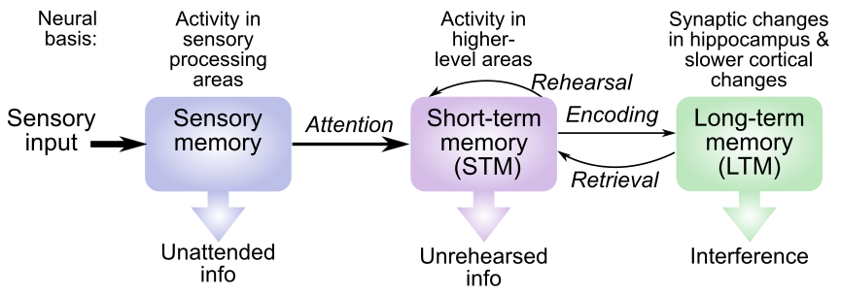
STM vs. LTM

Slide 6
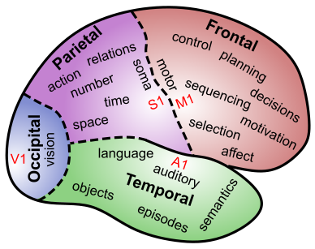
The Brain IS Memory
Memory is located in every single synapse in the brain
There are as many different kinds of memory as there are neurons and synapses and brain areas…

Slide 7
Where is Sensory Memory?
Surprise! It is just neural firing in sensory brain areas – those neurons just keep on firing away (briefly..)

Slide 8
Where is Short-Term Memory?
Surprise! It is neural firing in higher level brain areas that represent specific thing you’re remembering – those neurons just keep on firing away (briefly..)

Slide 9
Where is Short-Term Memory?
Extra surprise! And it usually requires contribution from prefrontal cortex – has extra holding power to keep those neurons firing longer!

Slide 10
Where is Long-Term Memory?
Surprise! It is in the relevant brain area(s) that encode the specific information! LTM is the sum total of all those synaptic weight changes!

Slide 11
Major Types of Memory
Episodic Memory: events, facts, etc
Hippocampus
Familiarity-based recognition
Perirhinal cortex: you look familiar, but…
Weight-based priming
Subconscious, can be very long-lasting
Activation-based priming
Also subconscious, but transient..

Slide 12
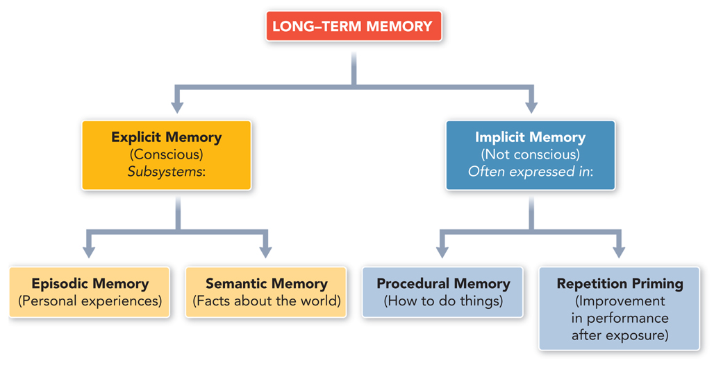
Organization of LTM
Is this the best way to organize LTM? Can you think of any other ways?

Slide 13
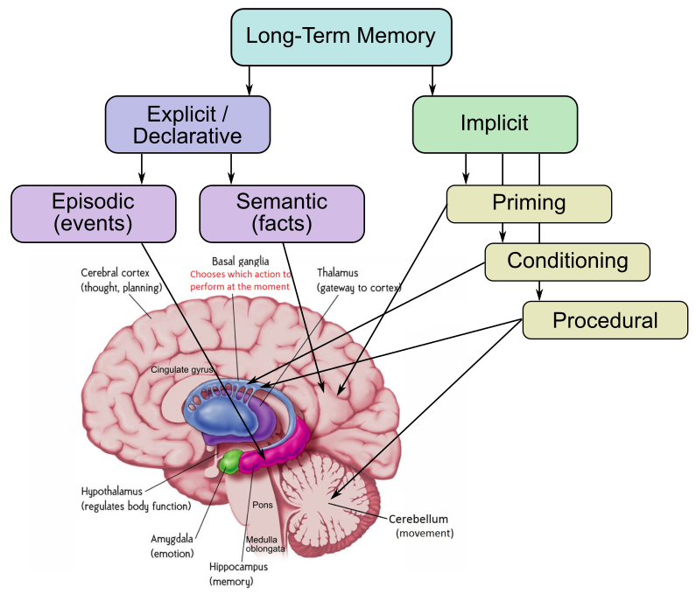
Where is Long-Term Memory?
“Explicit” vs. “Implicit” is unreliable distinction
Episodic = hippocampus
Semantic = rest of brain (mostly)
Procedural = Parietal
Priming happens everywhere..

Slide 14
Episodic Memory
Autobiographical memory (life events)
Arbitrary new memories (lab tasks)
…

Slide 15
Classic Lab Task: AB-AC
Learn AB paired associates:
window-reason
bicycle-garbage
...
Then AC paired associaties:
window-locomotive
bicycle-dishtowel
…

Slide 16
AB-AC
Test on AB list:
Window ?
Bicycle ?
And AC list:
Window ?
Bicycle ?

Slide 17
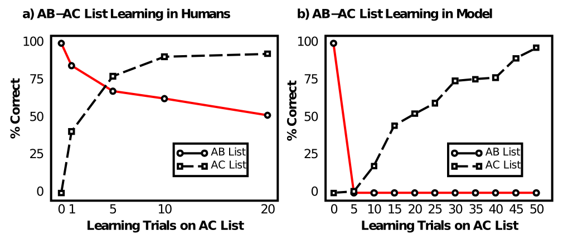
Catastrophic Interference

Slide 18
Demo AB-AC cortical model

Slide 19
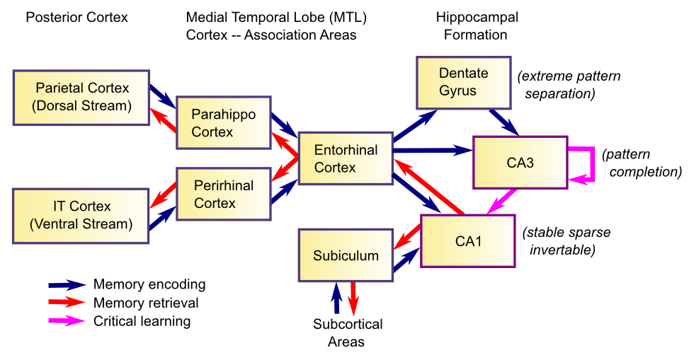
Hippocampal System

Slide 20
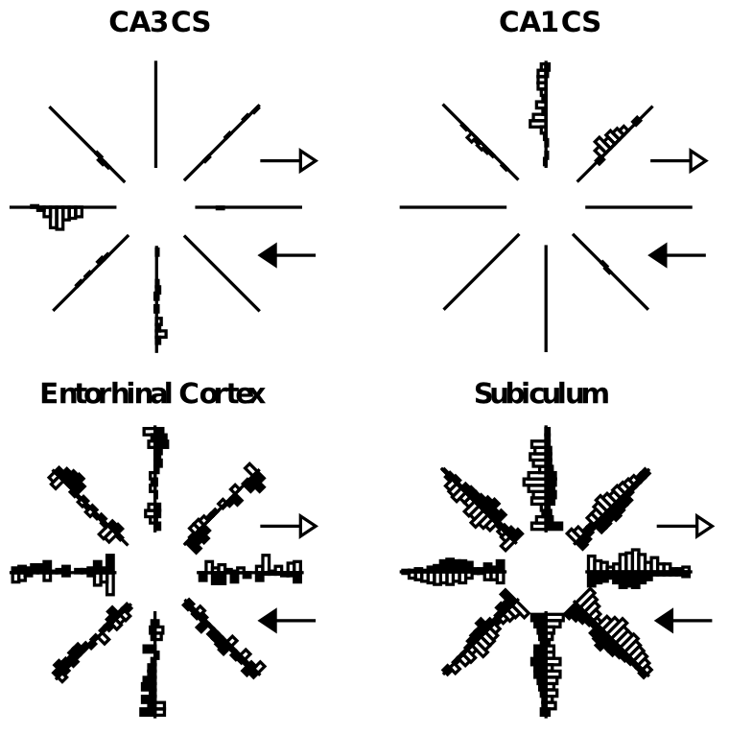
Sparse Activity

Slide 21
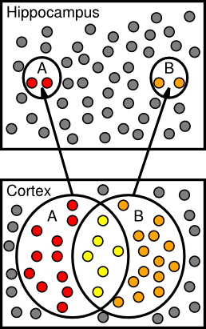
Sparse = Pattern Separation

Slide 22
Hippo Project
Run hip.proj

Slide 23
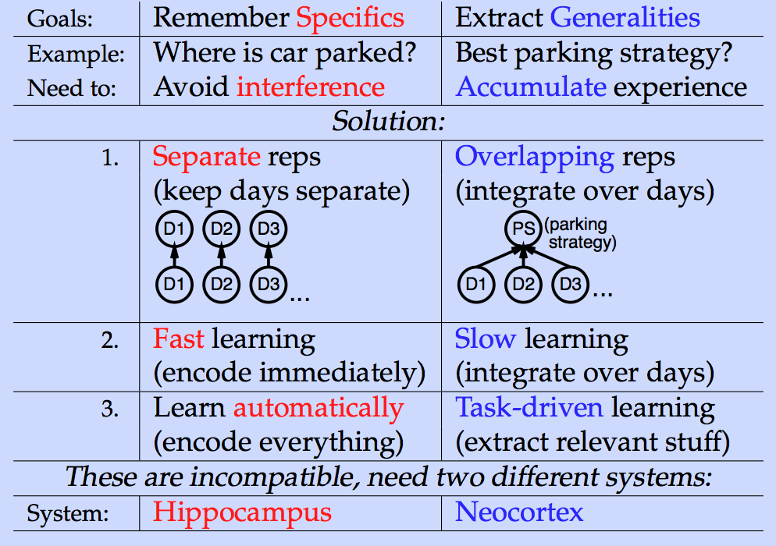
Complementary Learning Systems

Slide 24
Slow Learning Integration
Event has a .66 probability of occurring: only with a slow learning rate (.005) does it converge on an accurate estimate across discrete events

Slide 25
Priming
Can a brief subliminal message influence your behavior?

Slide 26
Two Forms of Memory
Priming provides good window onto weight vs. activation based memories.
Demos: wt, act priming

Slide 27
More Robust Activation-Based Memory
In Executive Function Chapter:
PFC robust active maintenance over secs to mins
BG provides dynamic gating signal for updt vs. maint
Used for “working memory”, cognitive control..

Slide 28
More Memory
Recognition: familiarity vs. recall
Using memory for planning: hippocampus is key hub of the “default network” – where you want to be inside your brain..

