Slide 1
The Pandemonium Model
Computational Cognitive Neuroscience
Randall O’Reilly

Slide 2
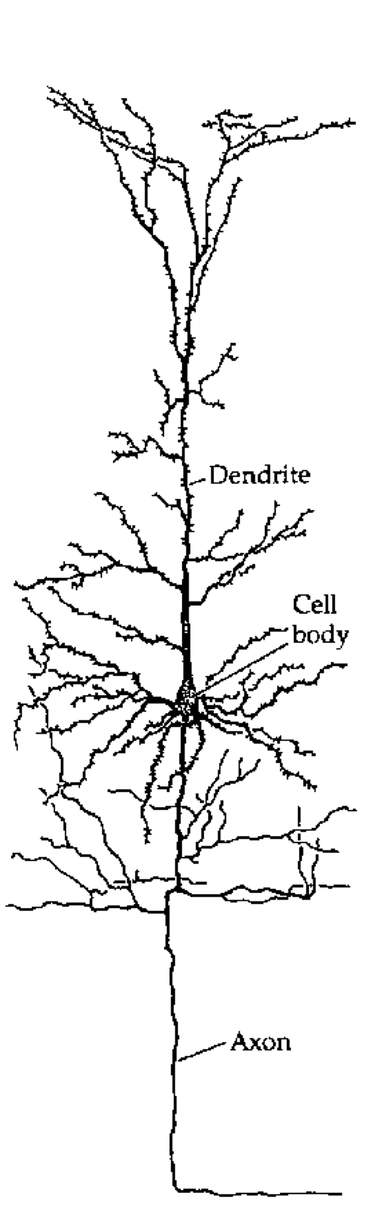
The Basic Unit of Cognition!?

Slide 3
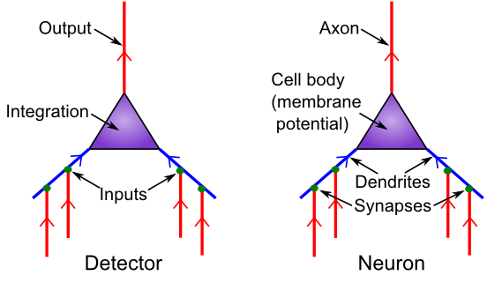
Detector Model
Is it really all just detection?

Slide 4
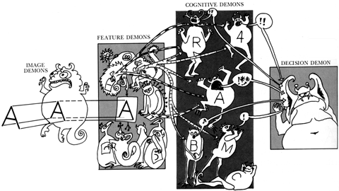
Pandemonium! (Oliver Selfridge)

Slide 5
Feature Demons
Vertical Line: |
Horizontal Line: --
Up-Right Diagonal: /
Up-Left Diagonal: \

Slide 6
Cognitive Demons
T: 1,2
V: 3,4
A: 2,3,4
K: 1,3,4

Slide 7
Testing..

Slide 8
Testing..

Slide 9
Testing..

Slide 10
Testing..

Slide 11
Testing..

Slide 12
Testing..

Slide 13
Testing..

Slide 14
Testing..

Slide 15
Testing..

Slide 16
Ooops..

Slide 17
Ooops..

Slide 18
Ooops..

Slide 19
Ooops..

Slide 20
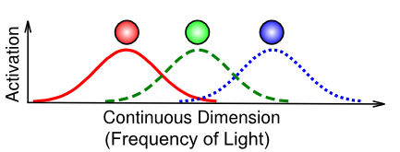
Coarse Coding Efficiency

Slide 21
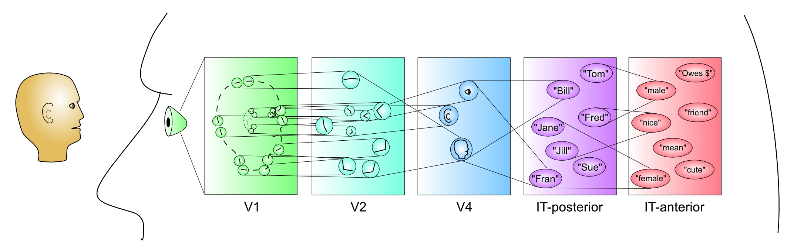
Hierarchy of Categories

Slide 22
Pandemonium Summary
Maybe you can see how collective action of many detectors, organized hierarchically, could achieve more complex cognition?
But detection needs to be a lot more sophisticated..

Slide 23
Neurons in the Dark
Neurons live in the dark!
“Hear” an incredible jumble of inputs.
Have absolutely no idea what is going on in the real world outside their little area of the brain..
All of this is very counterintuitive given that we tend to think of neurons as communicating in full English sentences about the weather, etc..
Neurons only get spikes, not words!

Slide 24
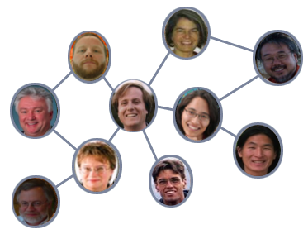
The Social Network
Neurons depend on network of “trust” built up over a long time period – only way they can overcome the jumble in the dark..

Slide 25
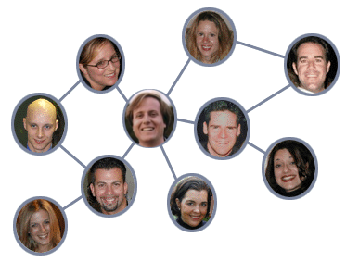
The Social Network
How do neurons ever know if senders change what they are encoding? How does the brain ever change?

