Slide 1
Disorders

Slide 2
The Big Questions / Issues
What could possibly go wrong?
The brain is billions of times more complex than a rocket ship – how does it not go wrong more often?
Why does it tend to go wrong in specific categorizable ways?
Very few clear biological bases for most disorders
Extreme personality = disorder?
Where is the cutoff??

Slide 3
Definition of a Disorder
Maladaptive: causes impairments, dysfunction
Often distressing to individual / others
Extreme version of “normal”
Edge is always fuzzy.. people go up and down in severity..
Like all categories, disorder categories are fuzzy..
Normal depression -> depression disorder transition happens when it lasts too long, is too debilitating..

Slide 4
Adaptive Disorders?
If disorders are maladaptive, why hasn’t evolution removed them?
Some are actually adaptive (creativity, “even the paranoid have actual enemies”)
Some are just “common failure modes” from wide variety of genetic mutations..

Slide 5
DSM-5 Categories: DWasSoft (Diagnostic and Statistical Manual of Mental Disorders)
Substance-Use, Addictive disorders
Schizophrenia, Psychotic disorders
Depressive and Bipolar disorders
Anxiety disorders (GAD, Phobia)
Obsessive-Compulsive disorders (OCD)
Feeding, Eating disorders (Anorexia, Bulimia)
Wake-Sleep disorders (Insomnia, Narcolepsy)
Trauma and Stressor-Related disorders (PTSD)

Slide 6
Click it
Which disorder do you know the most people with?
A) Schizophrenia
B) Anxiety Disorder (GAD, OCD, PTSD, etc.)
C) Personality Disorder
D) Depressive or Bipolar Disorder
E) None

Slide 7
Are Categories Useful?
Current trend is away from categories
Comorbidity rates are very high
Anxiety <-> Depression @ 50%
Biological differences are not very specific
Continuum of functionality – dimension is important, not the specific value..
But categories simplify, have pragmatic value
Many benefits to being definitively “sick” or not (insurance, treatment, acceptance, etc)
also drawbacks (one-size-fits-all treatment, stigma)

Slide 8
Biology of Disorders
In an “ideal” (scientific) world, each disorder would have a single very clear biological cause
Medical model: heart disease caused by plaque..
But what about cancer: very complex, multi-causal?
Reality is much more complex – e.g., schizophrenia is heritable, but 1000’s of genes involved (just like IQ!)
Many causes lead to same outcome! Why!?

Slide 9
Common Features of Disorders (Common Failure Modes)
Overactive negative affective states (fear, depression) – these are strongest to start with!
Vicious cycle pattern: spiraling downward..
Lose self-esteem, self-concept, positive goals – these are what buffer us from the negative
Plasticity reinforces existing activity: OCD repetition
Scz: “normal” adaptive response to threats:
Brain starts acting weird, so exert extra levels of control – delusions of grandeur in response to ego threat = further separation from reality..

Slide 10
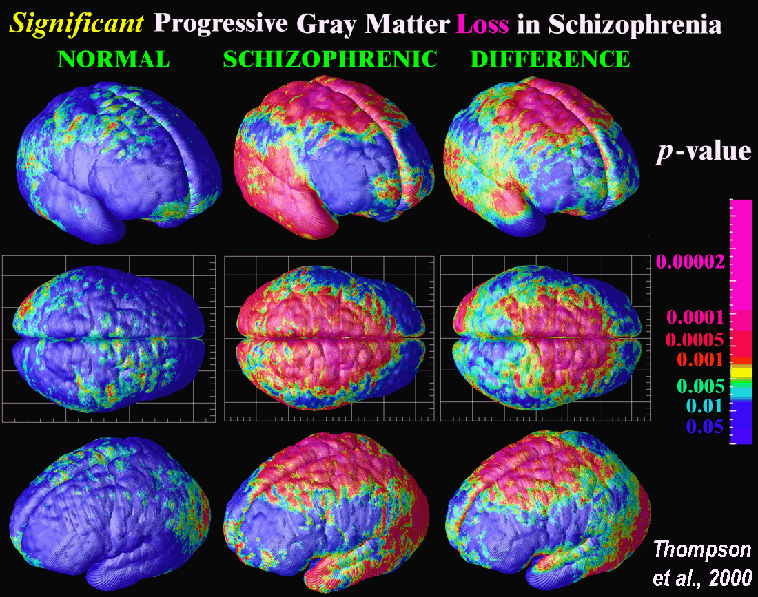
Schizophrenic Brain: Widespread Diffs

Slide 11
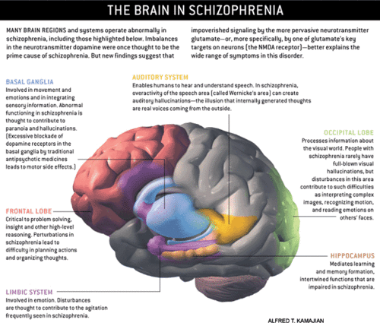
Schizophrenic Brain: Widespread Diffs
Vijay Mittal: Basal Ganglia impairments before onset of Scz

Slide 12
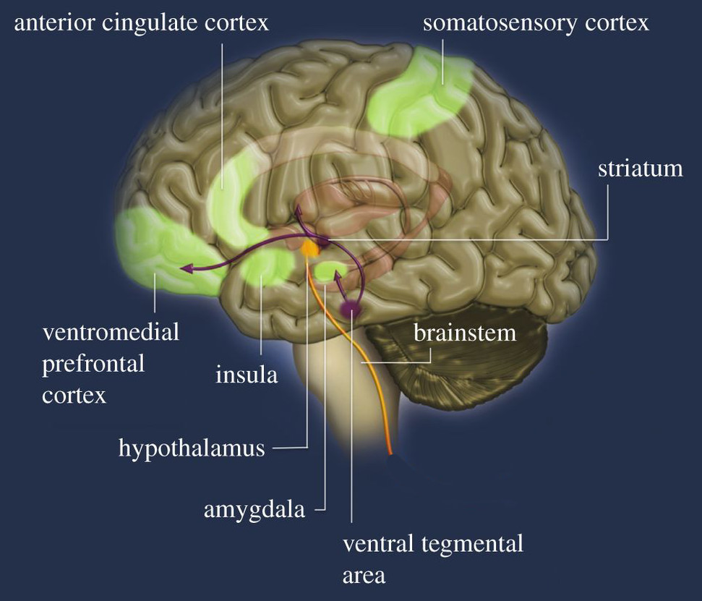
Same Major Brain Areas Involved in Most Disorders
Substance-use, addiction
Schizophrenia, Psychotic
Depression, Bipolar
Anxiety
OCD
Feeding, eating
PTSD?
This is the emotional nervous system

Slide 13
Goal-based Clinical Disorders (frontal cortex, basal ganglia function: Control)
Depression
Vicious cycle of: negative affect -> inability to select goals -> negative affect -> .. (hopelessness)
Everything has high cost, low gain
Beck negative cognitive triad: bad thoughts about self, the world, and the future..
OCD
Insatiable goals constantly re-selected, driving habitual motor plans..
Avoidance goals: when is avoiding over?

Slide 14
Depression Symptoms (DSM-5) (5 or more, must include 1st 2)
Depressed mood
Loss of interest or pleasure
Weight, appetite change
Disturbed sleep
Lethargy or agitation; fatigue or loss of energy
Feelings of worthlessness, guilt
Difficulty concentrating, decision making
Recurrent thoughts of death, suicide

Slide 15
Depression and SSRI’s
Have you:
A. Been severely depressed, but not taken SSRI
B. Been severely depressed, taken SSRI
C. Not been severely depressed, taken SSRI (?)
D. Not been severely depressed, no SSRI

Slide 16
Serotonin is VERY Complex
Many different 5HT pathways, receptors, each with different, opposing effects
“Happy” 5HT pathway: interfascicular raphe (DRI)
“Sad” 5HT pathway: caudal raphe?
Many others..!
Chemical imbalance vs. chemical intervention / jumpstart?

Slide 17
Bipolar
Manic – depressive phases
Hypomania = lower-level of mania that can produce highly creative work – many famous creative people had bipolar disorder

Slide 18
Anxiety
Generalized anxiety disorder (GAD)
Excessive, difficult to control anxiety and worry
One or more of: restlessness, on edge; difficulty concentrating, going blank; irritability; muscle tension
Panic attack: overwhelming terror (~10 min)
Panic disorder: fear of having attacks -> agorophobia (avoid public, confined places)
vs. Specific phobias (snakes etc)

Slide 19
Triple Vulnerability Theory (Barlow)
Generalized Biological Vulnerability (genetic)
Generalized Psychological Vulnerability
General beliefs about the world (dangerous, etc)
Specific Psychological Vulnerability
Specific learned beliefs / situations (embarrassment is very bad)
= Stress -> Social Anxiety Disorder

Slide 20
Diathesis-Stress Model
Diathesis = genetic vulnerability (50% heritability as usu)
Stress: experience that triggers latent genetic predisposition
Mindfulness-based therapy attempts to reduce stress response to adverse experiences, promote acceptance, understanding.

Slide 21
PTSD
Re-experiencing traumatic event
Negative changes in mood and cognition: detachment, loss of interest..
Changes in physiological arousal levels and reactivity: sleep, irritability, reckless, self-destructive..
1.3% develop in any given year. 6% of 9/11 terror attacks suffered from PTSD. Resilience!

Slide 22
Drowning in the OCEAN Personality disorders = extreme:
Openness
imaginative, curious, intellectual, creative.. Vs:
conventional and practical, enjoy routine, “down to earth”
Conscientiousness
careful, thorough, well-organized, responsible Vs:
careless, inefficient, disorganized, irresponsible
Extraversion
Sociable, energetic, assertive, other-oriented Vs:
Passive, reserved, quiet, self-oriented
Agreeableness
Warm, kind, empathetic, compassionate, trusting Vs:
Hostile suspicious, unkind, lacking in trust..
Neuroticism
Easily upset, anxious, emotional, self-pitying, worriers.. Vs:
Even-tempered, comfortable with selves, calm, stable.
Notes:
Do clicker quiz of class on each!!!

Slide 23
Personality Disorders http://www.tandfonline.com/doi/abs/10.1207/s15327965pli0402_1#.VSzQsxPF9Fs
Extreme versions of “normal” personalities?
Antisocial: ---agreeableness?
Avoidant: +++neuroticism, ---extroversion
Borderline: +++neurotic, ---agreeable, ---conscientious
Paranoid: +++neuroticism
Obsessive-compulsive PD: +++conscientious
Schizoid: ---extroversion
Narcissistic: ---agreeable, ??

Slide 24
DSM Definition of PD
Personality disorder must have at least 2 impairments:
Identity: stable self-esteem, boundaries, etc
Self-direction: ability to pursue goals
Empathy
Intimacy

Slide 25
Borderline Personality Disorder
BPD is particularly dangerous (self & other harm):
Impulsive, moody, frightened of abandonment, unstable sense of self, emptiness, worthlessness, stormy relationships

Slide 26
Click it
Which personality disorder do you know the most people with?
A) Borderline
B) Antisocial
C) Paranoid
D) Obsessive-compulsive
E) None

