Slide 1
Research Methods and Stats

Slide 2
The Big Questions
What is the full scope of Psychology, and how does it compare to Psychiatry or anything else?
Practical approaches to answering scientific questions in Psychology: how does it actually work? (Research methods)
Statistics are not lies, or damned lies, but what are they, actually?

Slide 3
Review of “core” Psychology History
Before 1879: Philosophy
1900 – 1950: Behaviorism
1960 – 1990: Cognitive-ism
1990 – current: Cognitive Neuroscience-ism
Core = basic assumptions about how the mind / brain works..

Slide 4
Other Historical Trends
Freud and psychoanalysis (1900-1920):
role of the unconscious, tripartite structure: id, ego, superego
Gestalt psychology (1910-1940)
Whole is different than sum of its parts: emergence!
Rogers, Maslow: Humanism (1950’s – now)
Motivation, individual feelings, potential for growth
Piaget: Developmental Stages, etc (1960’s)
And many others..

Slide 5
Psychology Today
What do Psychologists actually do, where, how, to whom, etc?

Slide 6
Are You a Psych / Neuro Major / Minor?
Yes
No

Slide 7
Psychology is not..
Psychiatry: M.D., prescribes drugs, deals with predominantly with mentally ill people
Neurology: M.D., cuts open brains, uses advanced imaging, inserts neurostimulators, etc.. Gets paid a LOT of money, steady hands..
Psychology: MA/MS, PhD: Clinical does counseling / therapy (but no drugs), otherwise various applied and basic research..

Slide 8
What do you think?
_____% of psychologists work in private practice or in hospital settings.
A. 90-100%
B. 70-80%
C. 60-70%
D. 50-60%

Slide 9

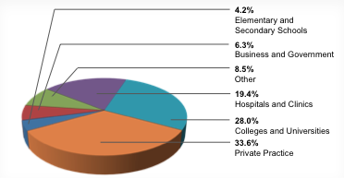
Psychology Today: Employment

Slide 10
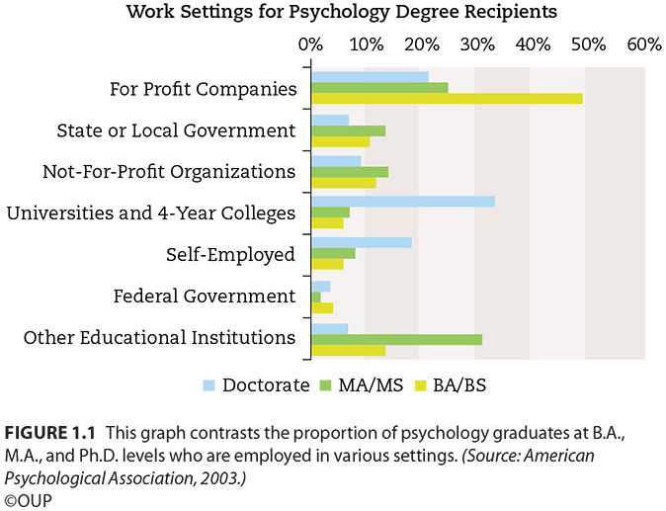
Employment by Degree

Slide 11
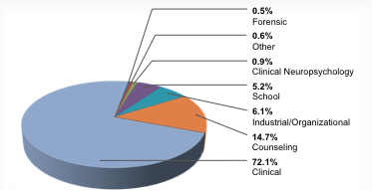
Psychology Today: Prof. specialties

Slide 12
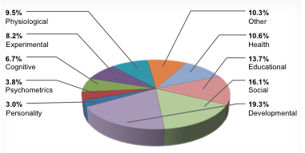
Psychology Today: Research Areas

Slide 13
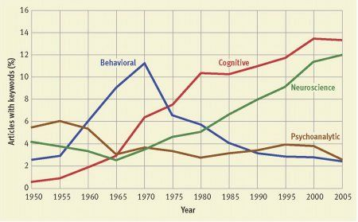
Psychology Today: Historical Trends

Slide 14
When I Grow Up..
I want to be a:
A. Clinical Psychologist
B. Research Psychologist
C. Supreme manipulator of people (e.g., business, advertising, law, etc)
D. Doctor (including Psychiatrist, Neurologist)
E. No Idea / Too Many Ideas..

Slide 15
Answering Questions
Practical techniques for answering Psychological questions..
“Ve have vays of making you talk..”
Descriptive
Correlational
Experimental

Slide 16
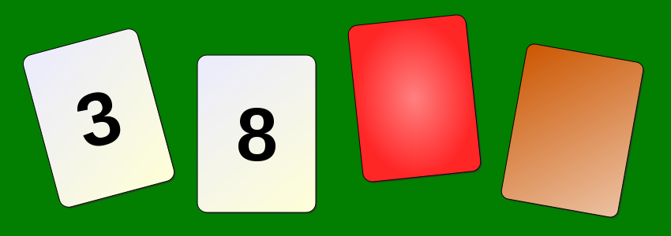
You Already Know This Stuff..
Rule: If there is an even number on one side, then the other side is red. Which two to turn over?
A. 3 and 8
B. 8 and Red
C. 8 and Brown
D. 3 and Red
E. 3 and Brown

Slide 17
You Already Know this Stuff..
Rule: If you are drinking alcohol, you must be over 21. Who do you card?
A. Not drinking, Drinking
B. Drinking, Old person
C. Drinking, Young person
D. Not drinking, Old person
E. Not drinking, Young person

Slide 18
You just can’t apply it abstractly..
People’s minds are NOT governed by logic – instead we learn about specific, concrete situations (and sometimes abstract from there..)

Slide 19
Real-world Scenario
Hypothesis: my romantic partner is cheating on me.
How do you determine if it is true or not?

Slide 20
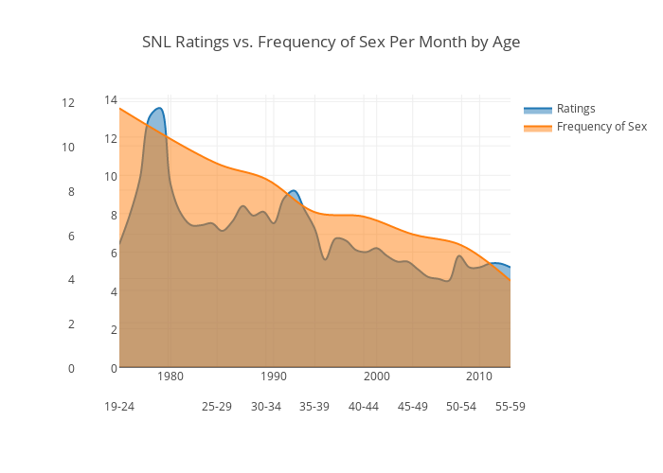
Data?

Slide 21
Methods in Action
Descriptive: observe behavior, note who they are hanging out with, paying attention to, whether they’re acting strange / distant around me..
Correlational: plot frequency of sex, fights, good times, bad times over time: has there been a change?
Experimental: probe them with challenging questions: “do you love those others as much as me?” – see how they react.. Get a “friend” to try to sleep with them..

Slide 22
Pros / Cons
Descriptive: good: doesn’t raise any suspicions (“naturalistic”) bad: not much to go on..
Correlational: good: also “naturalistic” (no suspicions), more precise understanding of data. bad: other factors at work! e.g., old marrieds, etc the third variable problem: correlation does not equal causation!!
Experimental: good: really figure out the truth! bad: create false truth! e.g., bad questions = bad answers (“does this dress make me look fat?”) external validity

Slide 23
Statistics, Expts, Data
Correlation: scatterplots
Experiments:
unlike correlation, can show causal relationship
Key design elements: independent, dependent variables, etc

Slide 24
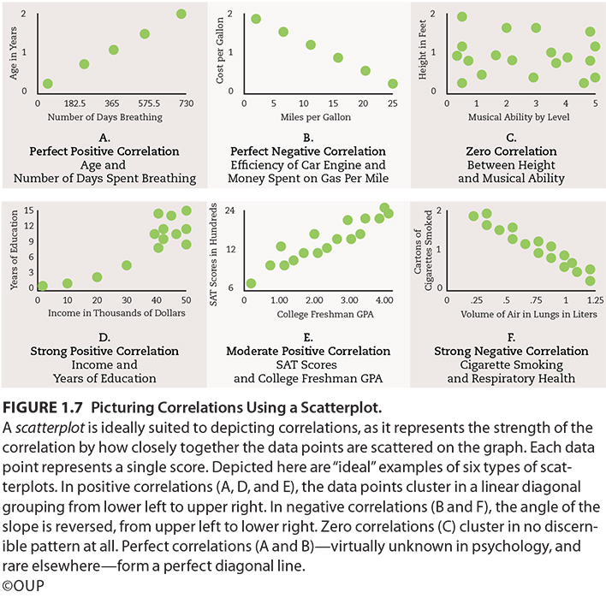

Slide 25
Correlation != Causation
EVERYBODY gets this wrong!
http://www.tylervigen.com/

Slide 26
True Experiments
Avoids 3rd variable problem, determines true causal relationships!
Random assignment to conditions
Avoids 3rd variable of pre-existing conditions..
1 or more control conditions
Must compare manipulation to something
Control over confounds
Eliminate all possible other 3rd variables

Slide 27
Possible subjects
Experimental Group
Random assignment controls for differences
Control
Group
Study and testing conditions
Identical conditions
control extraneous
variables
Study and testing conditions
Music
Independent variable
(Cause)
No
Music
Behavior
(test scores)
Behavior
(test scores)
Dependent variable
(Effect)
Is there a difference?

Slide 28
Experimental Design
Independent variable: what you manipulate
e.g., does coffee improve cognition: it’s the (amount of) coffee!
Dependent variable: what you measure
Some measure of cognition..

Slide 29
Clicker review question
As cynical hostility increases, heart disease increases. This is an example of
a positive correlation
a negative correlation
a true experiment
a quasi-experiment

Slide 30
What type of design?
Hypothesis: Watching "Sesame Street" increases the likelihood of prosocial (helping) behaviors in children.
A. a positive correlation
B. a negative correlation
C. a true experiment
D. a quasi-experiment

Slide 31
What does the treatment group get?
Hypothesis: Watching "Sesame Street" increases the likelihood of prosocial (helping) behaviors in children.
A. they get to watch Sesame Street
B. they watch a different show

Slide 32
What is the independent variable?
Hypothesis: Watching "Sesame Street" increases the likelihood of prosocial (helping) behaviors in children.
A. sesame Street
B. prosocial behavior
C. children
D. television

Slide 33
What type of design?
Hypothesis: men and women differ in intelligence.
A. a positive correlation
B. a negative correlation
C. a true experiment
D. a quasi-experiment

Slide 34
What is the independent variable?
Hypothesis: men and women differ in intelligence.
A. men
B. women
C. gender
D. intelligence

Slide 35
What does the treatment group get?
Hypothesis: men and women differ in intelligence.
A. maleness
Femaleness
There is no treatment or control group

Slide 36
What type of design?
If we tell gay and straight people that they are either gay or straight based on a brain scan or some other kind of brain wave instrument, will their behavior change to reflect what we tell them?
A. a positive correlation
B. a negative correlation
C. a true experiment
D. a quasi-experiment

Slide 37
What is the independent variable?
If we tell gay and straight people that they are either gay or straight based on a brain scan or some other kind of brain wave instrument, will their behavior change to reflect what we tell them?
A. gayness
B. straightness
C. what we tell them
D. their resulting behavior

Slide 38
What is the dependent variable?
If we tell gay and straight people that they are either gay or straight based on a brain scan or some other kind of brain wave instrument, will their behavior change to reflect what we tell them?
A. gayness
B. straightness
C. what we tell them
D. their resulting behavior

Slide 39
Are there ethical issues with this study?
If we tell gay and straight people that they are either gay or straight based on a brain scan…
A. Definitely yes
B. maybe
C. I don’t think so
D. Definitely no

Slide 40
Statistics
Descriptive: mean, median, mode, standard deviation..
Inferential statistics: is an observed difference unlikely to be due to chance?
e.g., drug A is more effective than B, p < .05 that this is due to chance in the random sample (and all the other random bs) I happened to encounter in my study.

Slide 41
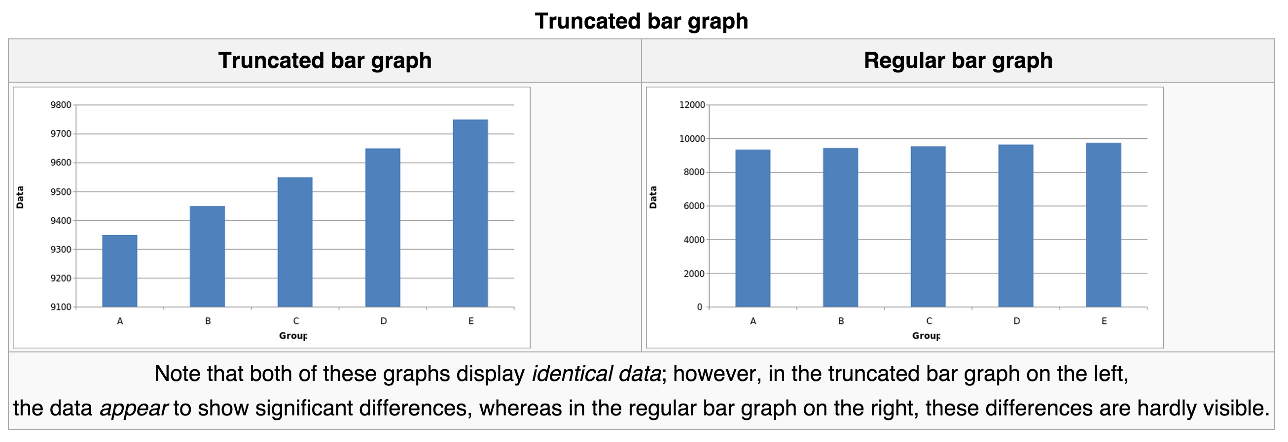
Damned Lies..
Beware of percentages! 100% of nothing is still.. Nothing!

Slide 42
Critical Thinking!
Be aware of your biases, and their biases
Look carefully at the data – the actual data, not just summary stats, graphs, etc
Correlation != causation

Slide 43
Clicker review question
A researcher tests to see if dog owners are kinder people than non-dog owners. This is an example of
a positive correlation
a negative correlation
a true experiment
a quasi experiment

Slide 44
A researcher puts participants in either a blue room or a pink room and then tests their hand strength. This is an example of
a positive correlation
a negative correlation
a true experiment
a quasi experiment

Slide 45
E. Ethics
1. Human participants (lab studies)--
must get permission from ethics committee

Slide 46
E. Ethics
1. Human participants (lab studies)--
must get permission from ethics committee
must have informed consent
right to terminate at any time
legal age (18)
procedures/risks
confidentiality

Slide 47
E. Ethics
1. Human participants (lab studies)--
must get permission from ethics committee
must have informed consent
right to terminate at any time
legal age (18)
procedures/risks
confidentiality
must debrief

Slide 48
E. Ethics
1. Human participants (lab studies)--
must get permission from ethics committee
must have informed consent
right to terminate at any time
legal age (18)
procedures/risks
confidentiality
must debrief
(IF risk, weigh risk/benefit ratio.)

Slide 49
E. Ethics
2. Use of Animals
must get permission from ethics committee

Slide 50
E. Ethics
2. Use of Animals
must get permission from ethics committee
comfort, health, humane treatment

