Slide 1
Learning

Slide 2
The Big Questions / Issues
Learning is the most important feature of the human brain: we learn almost everything!
The textbook barely scratches the surface..
In part because… it’s complicated… and unsettled
How does dopamine-based reinforcement learning work?
Role of dopamine in the basal ganglia
Key dopamine lesson: expectations vs. outcomes

Slide 3
What Learns?
Amazing fact: we know exactly what part of individual neurons learns.

Slide 4
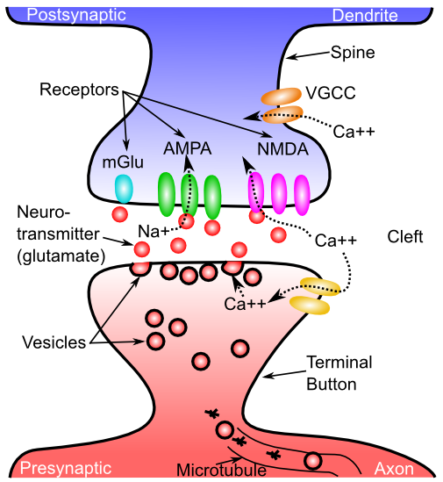
What Changes??

Slide 5
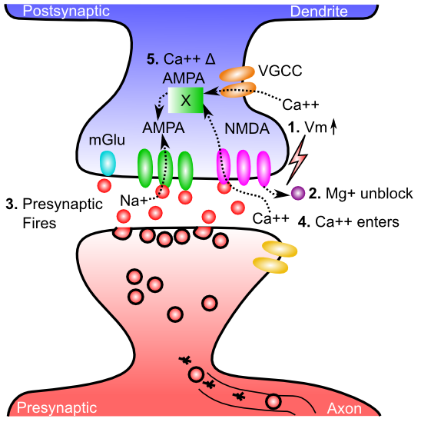
Gettin’ AMPA’d

Slide 6
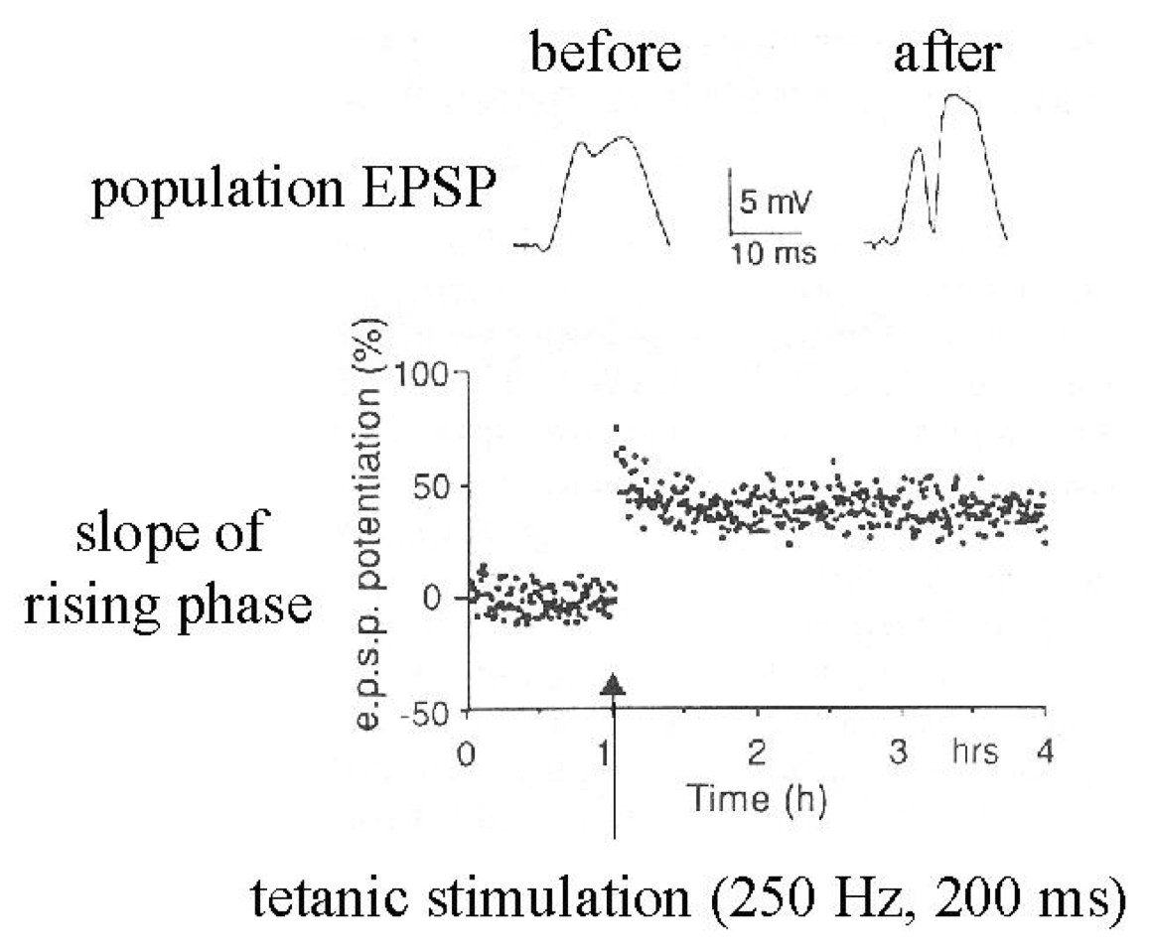
Synapses Change Strength (in response to patterns of activity)

Slide 7
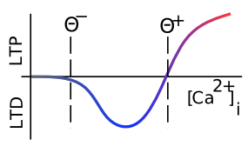
Which Way?
Low Ca = “long term depression” – synapse gets weaker
High Ca = “long term potentiation” – synapse gets stronger

Slide 8
Learning Rules Across the Brain
Area | Reward | Error | Self Org
Primitive Basal Ganglia | +++ | - - - | - - -
Cerebellum | - - - | +++ | - - -
Advanced Hippocampus | + | + | +++
Neocortex | ++ | +++ | ++
Learning Signal
+ = has to some extent … +++ = defining characteristic – definitely has
- = not likely to have … - - - = definitely does not have

Slide 9
Learning happens where it’s used (memory => processing)
Basal ganglia: learning what actions (not) to use
- based on reward / punishment (operant)
Cerebellum: learning to perfect actions
- based on error signals (e.g., feeling awkward)
Neocortex: learning how to see, hear, speak, reach, act, socialize… everything!
Hippocampus: learning snapshots of everything (explicit, declarative learning in Hippo, Cortex)

Slide 10
Textbook Taxonomy of Learning
Non-associative: Habituation / Sensitization
Less response vs. More response over time
Associative:
Classical conditioning: assoc Stimulus -> Outcome
Operant conditioning: assoc Action -> Outcome

Slide 11
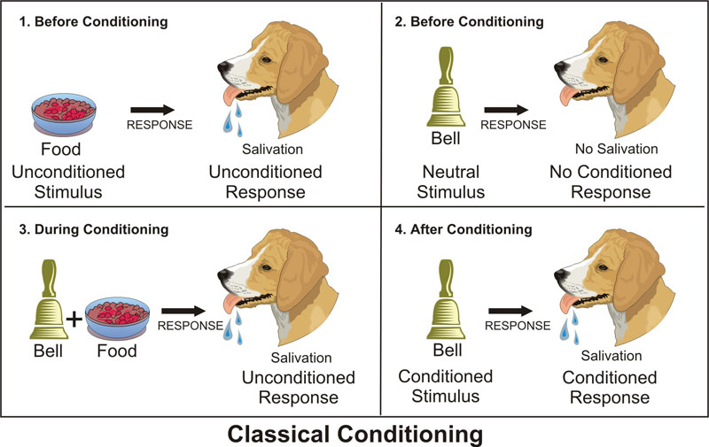
Classical Conditioning
US
UCR
CS
CR
CS associated with US, thinking of US drives CR

Slide 12
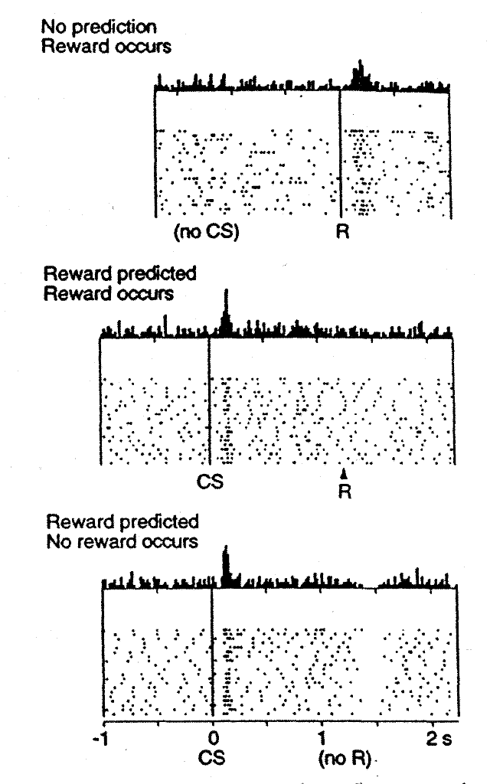
Reinforcement Learning: Dopamine
CS = Tone
R = Juice drop
Classical conditioning happens in dopamine

Slide 13
“Real World” Conditioning
The Office: https://vimeo.com/35754924
(courtesy of Hanna Green)

Slide 14


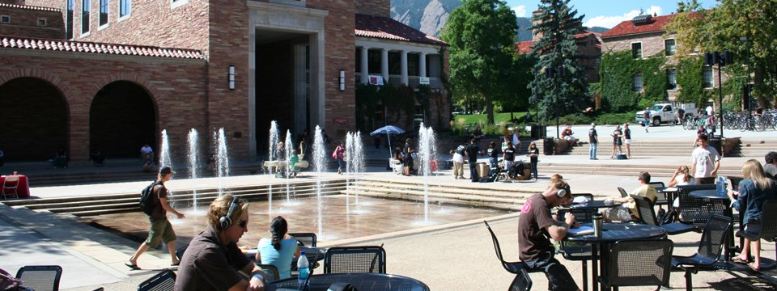
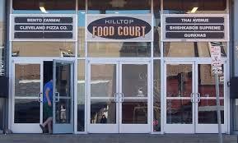
What makes you salivate?
A. McDonald’s sign?
B. Starbucks sign?
C. UMC?
D. Food court

Slide 15
Conditioning Terms
Acquisition: initial learning of CS -> US Assoc
Second order: CS1 -> CS2 -> US
Generalization: anything kinda like CS does it..
Discrimination: CS1 -> nothing, similar CS2 -> US
Extinction: learning that CS !-> US anymore
This is NEW learning, not UN-learning!
Spontaneous recovery of extinguished learning
Renewal from exposure to other contexts

Slide 16
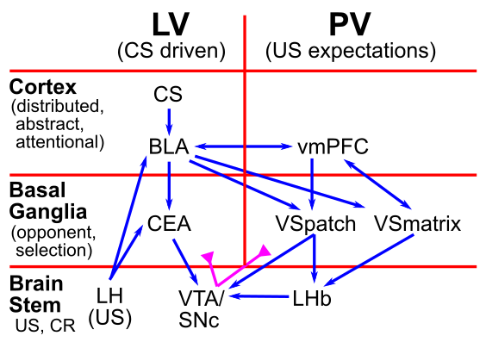
Biology of Classical Conditioning

Slide 17
Limits of Classical Conditioning
Biological Preparedness: built-in pathways for CS’s and US’s
Food can cause nausea, lights / tones shock, but not the other way around!
Conditioning is not mere association:
CS must reliably predict US! Requires more advanced (“cognitive”) statistics..

Slide 18
Operant / Instrumental Conditioning
Thorndike’s Law of Effect:
Actions -> Good stuff are “stamped in”
Actions -> Bad stuff are “stamped out”
Dopamine = Good (bursts) vs. Bad (dips/pauses) drives learning in Basal Ganglia in accord with Law of Effect!

Slide 19
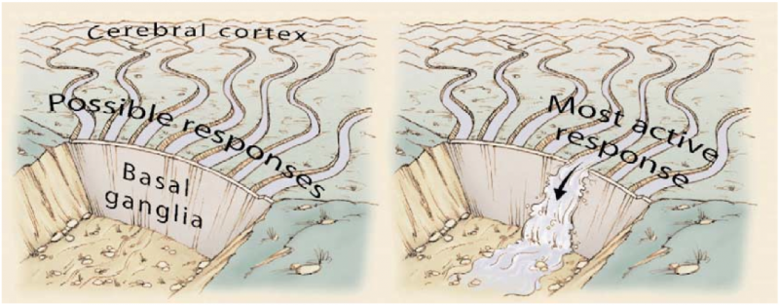
Basal Ganglia and Action Selection

Slide 20
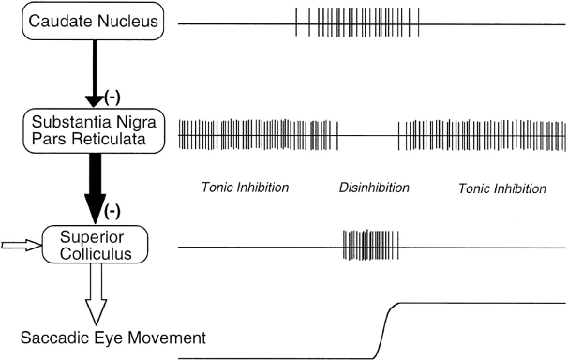
Release from Inhibition

Slide 21
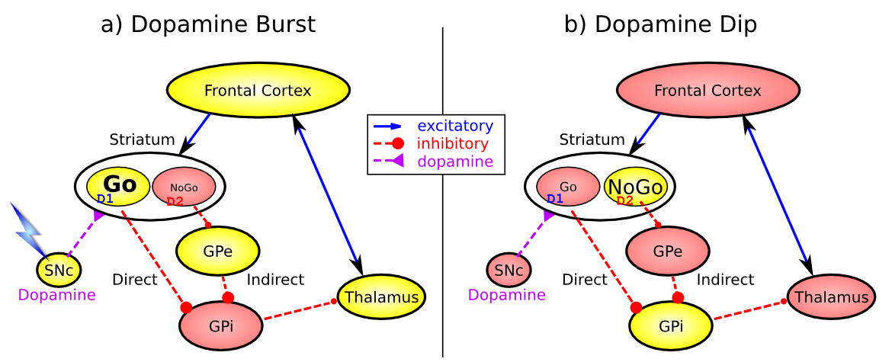
Basal Ganglia Operant Learning (Frank, 2005…; O’Reilly & Frank 2006)
Dopamine burst = do more of what you just did (Law of Effect)
Dopamine dip = do less of what you just did (bad outcome!)
-> Classical conditioning drives operant conditioning!!

Slide 22
Operant Terminology (super confusing)
Reinforcement: causes more action
“Positive” Reinforcement: presence of something that causes more action (e.g., presence of cookie!)
“Negative” Reinforcement: absence of something that causes more action (e.g., absence of pain!)
Punishment: causes less action
“Positive” Punishment: presence of something that causes less action (e.g., presence of pain!)
“Negative” Punishment: absence of something that causes less action (e.g., absence of cookie!)
But Negative Reinforcement == Punishment ‘doh

Slide 23
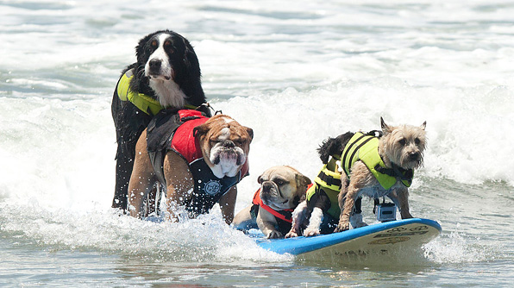
Operant Tricks
Secondary Reinforcer (e.g., $$): something associated with actual Primary Reinforcer
Shaping (by successive approximation) – it’s
how you get here:
NOT going to ask about Reinforcement Schedules (VR, VI, etc)

Slide 24
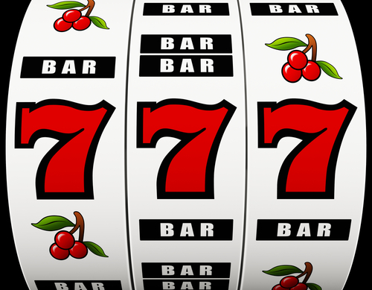
Partial Reinforcement!
Keeping your dopamine in the zone..
Dopamine learns
to expect anything
reliable and “cancels”
it out

Slide 25
Dopamine Lessons
Dopamine = Outcome – Expectation
Should you just always have low expectations, so even low outcomes seem good??
I try hard to avoid hearing anything about movies

Slide 26
What about Neocortex??
How does all the actual important learning take place??

Slide 27
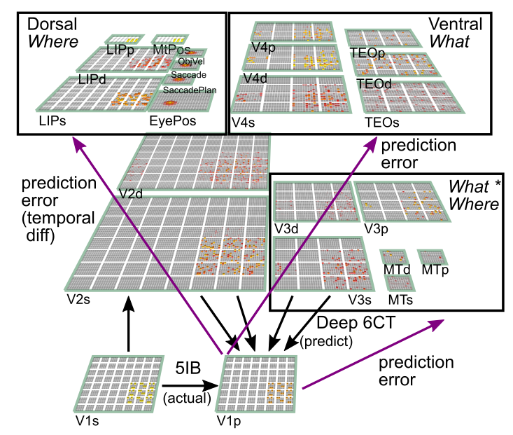
Umm, It’s Complicated…

Slide 28
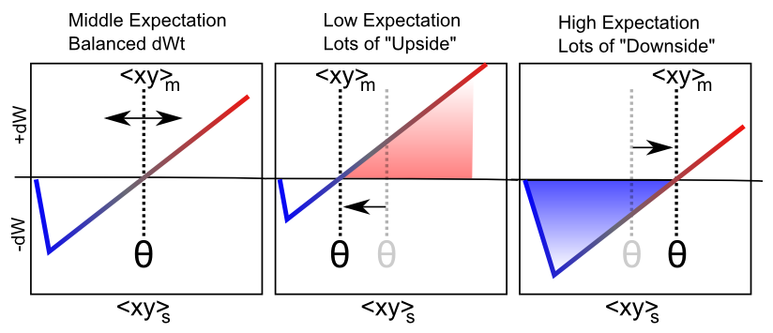
Floating Threshold = Medium Term Synaptic Activity (Error-Driven)
dW = Outcome – Expectation = <xy>_{s} - <xy>_{m}

Slide 29
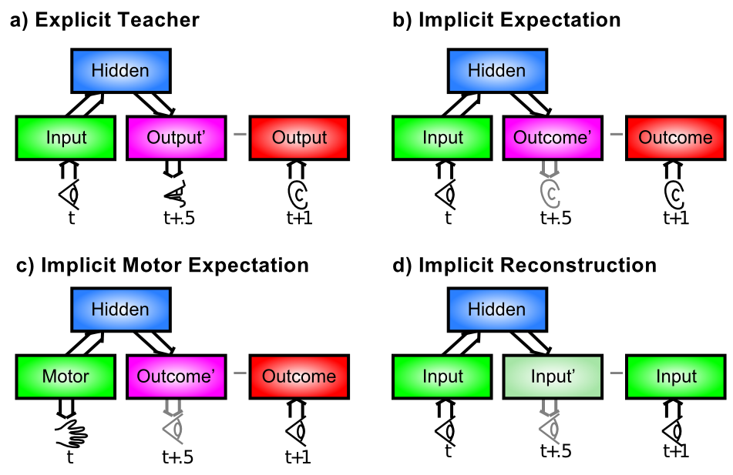
Where do the Targets Come From?

Slide 30
Observational Learning
Imitation, Modeling, Vicarious Conditioning: Socially-transmitted learning signals!
Mirror neurons: neurons that respond the same when you do an action as when someone else does it!
Does this mean when we watch violent media, we act more violent??

Slide 31
Latent Learning
Humans exhibit massive amount of “latent learning” in neocortex and hippocampus: learning that is not reinforced and not obvious in behavior
Only a tiny bit is ever expressed in behavior
Much of it is evident in rich, elaborate dreams
Or when people sit down and write novels..

