Slide 1
Motivation & Emotion

Slide 2
The Big Questions / Issues
Is motivation more extrinsic or intrinsic?
Reward / punishment vs goals
Arousal vs. motivation: related, but the same?
Emotion beyond James/Lange & relation to motivation
Challenge questions:
Why to you procrastinate?
Why do people go to graduate school?

Slide 3
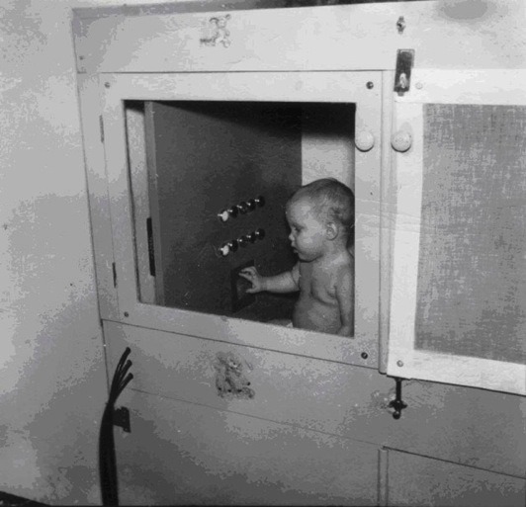
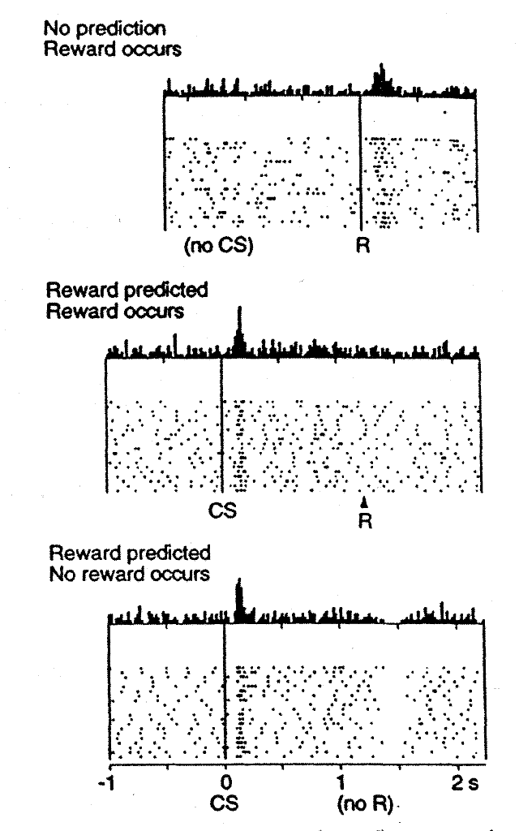
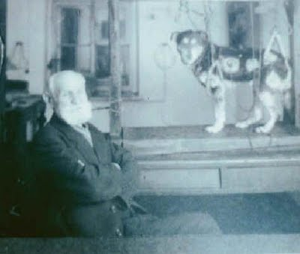
Behaviorist Motivations: Get rewards, avoid punishments..
Pavlov
Skinner
All extrinsic
Dopamine

Slide 4
Motivating Phenomenology
Why is it so hard to start something (packing for a trip, writing a paper, paying bills, cleaning desk…)
But once started, it really isn’t so bad..

Slide 5
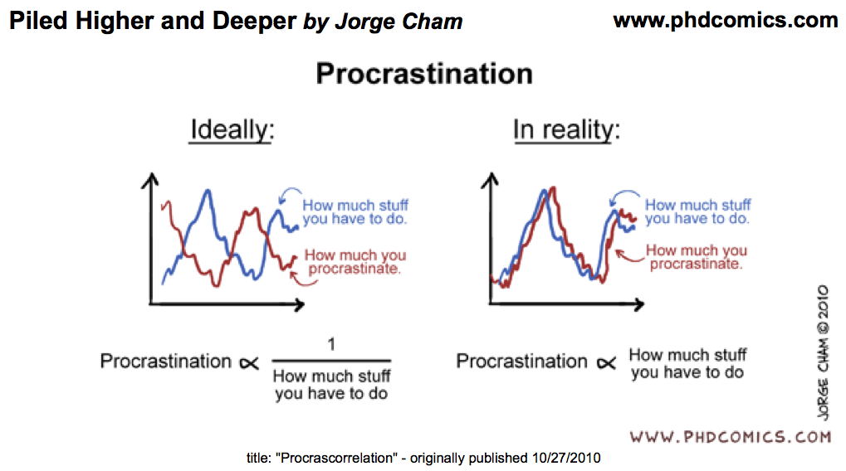

Slide 6
Motivating Phenomenology
Ever find yourself playing mindless video games for far longer than you should?
Why can’t I stop myself from organizing my kid’s Legos, or cleaning leaves from pool?

Slide 7
Two Phases of Mental Life
Goal selection
Careful weighing of costs / benefits to select goal
Multiple constraint satisfaction of needs, “drives”, opportunities, risks, costs, effort, etc..
Goal engaged
Selected goal robustly held – hard to give up..
Continuous evaluation of proximity to goal
Dopamine bursts, dips as function of changes
Costs are significantly downplayed (but learned)
Strong dissociations in value functions

Slide 8
Applied to Phenomenology
Why is it so hard to start something (packing for a trip, writing a paper, paying bills, cleaning desk…)
But once started, it really isn’t so bad..
Goal selection process carefully weighs costs / benefits, considering many different possible goals

Slide 9
I Tend to Procrastinate
A. All the time
B. Some of the time
C. Rarely

Slide 10
After I Finally Do It..
A. I often wonder why I procrastinated so much
B. I feel justified in procrastinating because it was horrible!
C. I pledge to not procrastinate again, but still find myself procrastinating..
D. I don’t procrastinate much..

Slide 11
Applied to Phenomenology
Ever find yourself playing mindless video games for far longer than you should?
Why can’t I stop myself from organizing my kid’s Legos, or cleaning leaves from pool?
Goal is engaged: incremental progress drives dopamine – video games engineered to deliver
Costs, alternatives are downplayed

Slide 12
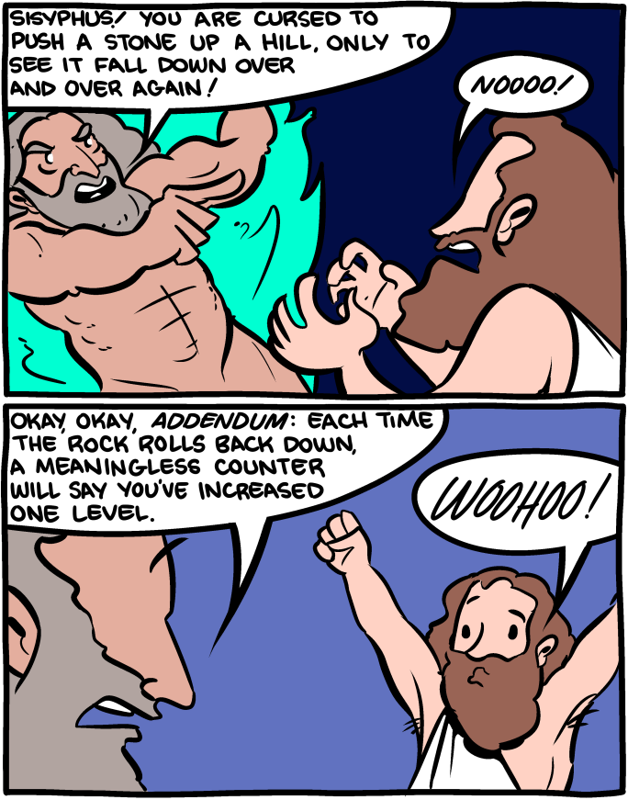

Slide 13
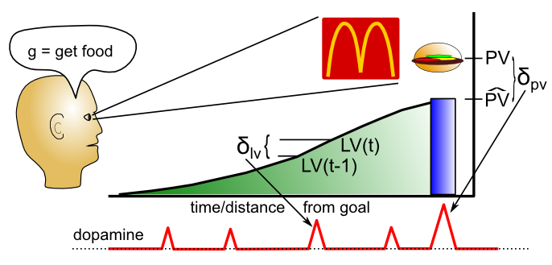
Dopamine = progress toward goal
LV = phasic dopamine driven by engaged goal
PV = was goal achieved or not; time to select new

Slide 14
Gamification of Life
My goal-engaged progress monitoring obsession is most evident in:
A. Playing video games
B. Checking news / facebook etc obsessively for signs of “progress”
C. Obsessive cleaning / organizing
D. Some other obsessive behavior..
E. Nuthin’ – I’m chill

Slide 15
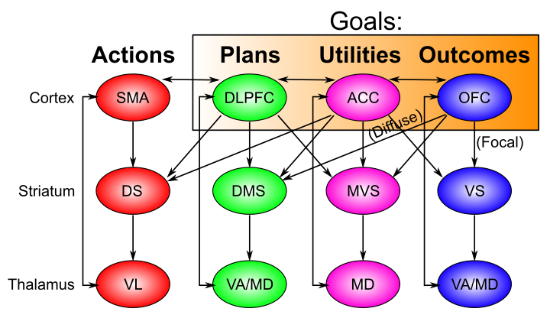
Distributed Goal Network
Striatum: helps select, maintain coordinated reps throughout network (BG gated WM)

Slide 16
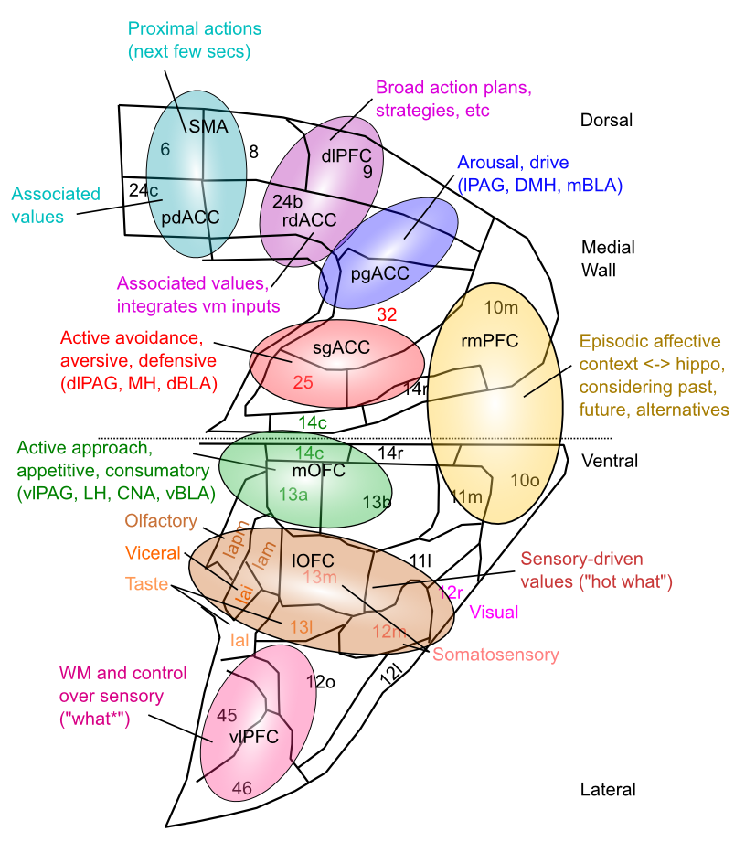
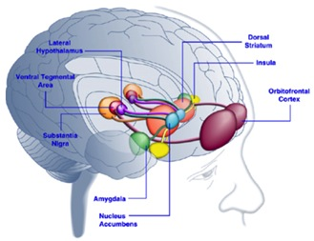
Map of Goals in vmPFC
Driven by subcortical connectivity
High-dimensional, multi-factorial representation
Consistent with fMRI, MDD in sgACC, etc

Slide 17
Approach vs. Avoid
Approach = left hemisphere = dominant
Avoid = right hemisphere = subordinate
We approach positive outcomes, and avoid negative ones.
Anger is negative: is it approach or avoid?
Need to turn negative into a positive in order to act!

Slide 18
Motivation Terms
Motivation: mental state causing purposive behavior: acting toward a desired goal.
More motivation = more intensity and persistence
Ambivalence = conflicting motivations
Instinct = innate, automatic, triggered by releasing stimuli (cues): fixed action pattern
Problem: circularity. Need richer evolutionary story for survival, propagation relevance..

Slide 19
Drives
Drive: desire to reduce unpleasant state from need (drive reduction theory: Hull, 1943)
Homeostasis: maintain target levels of blood sugar, water, etc. Drive = restore target level.
Maintain optimal arousal level? Not everything is a drive..
Need
(food, water..)
Drive
(hunger, thirst)
Drive-reducing behaviors
(eat, drink)

Slide 20
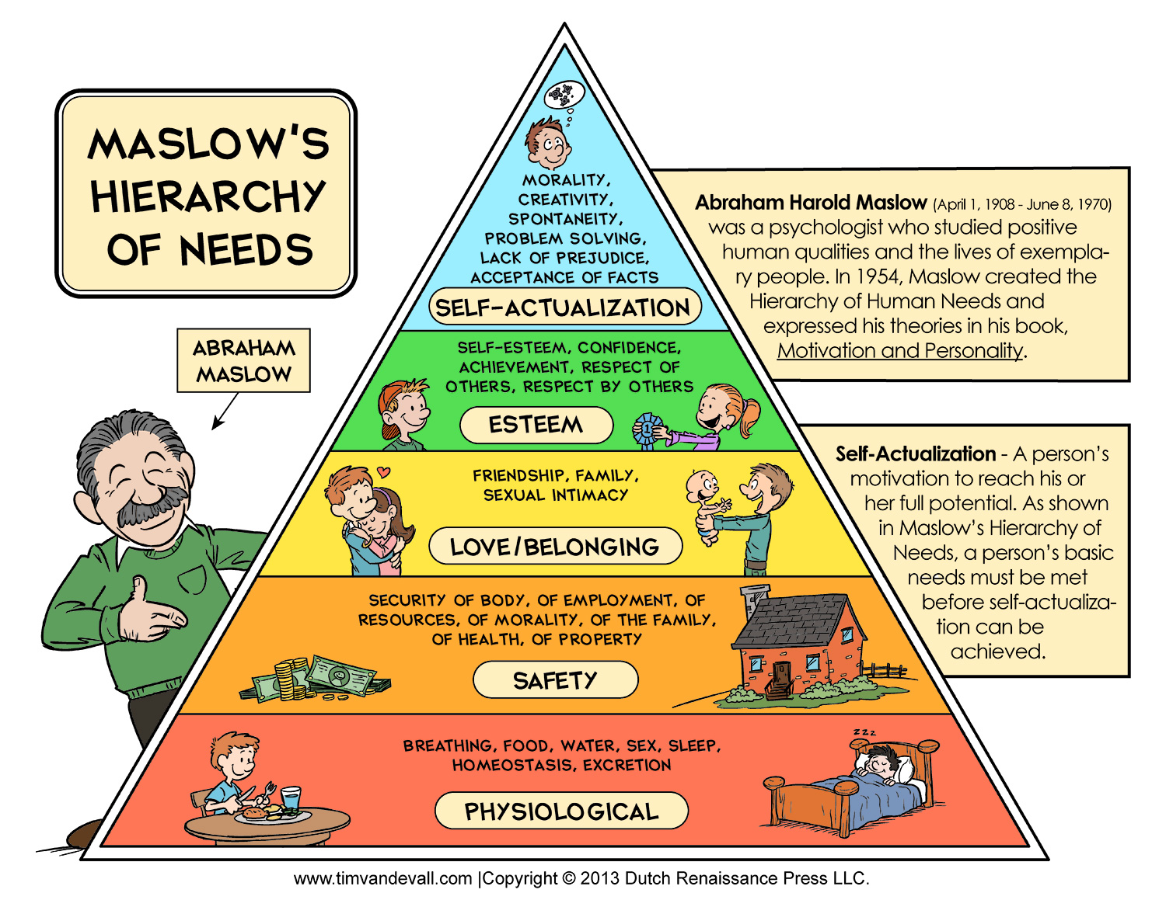
Needs

Slide 21
Needs
Any attempt to define a strict hierarchy will always fail! Death by video games, selfies, etc..
Primary vs. secondary: needed for survival vs. universally experienced but not essential..

Slide 22
Eating Disorder Experience
I have experienced the following disorders:
A. Anorexia Nervosa
B. Bulimia Nervosa
C. Binge eating disorder (lack of control > 1/week)
D. None

Slide 23
Eating Disorder Causes
I think the single biggest cause of eating disorders is:
A. Genes
B. Images of slim models in media
C. Badge of immunity against abundant food (demonstration of character)
D. Internal feelings of desire for control over eating behavior

Slide 24
Causes of Obesity
Which is the single biggest cause of obesity epidemic:
A. High fructose corn syrup
B. Supersize portions
C. Decreased physical activity
D. Cultural / social group acceptance of obesity (all my friends are obese..)

Slide 25
Work Motivation
If motivation is purely homeostatic, why are so many people motivated to work?
Extreme: workaholic (esp USA, Japan)

Slide 26
Work Motivation
Industrial and Organizational Psychology (I/O)
Traits: stable personality factors – conscientious, honest, lazy, aggressive, sociable, shy, etc..
Workaholic: neuroticism, perfectionism, conscientiousness
Perceived self efficacy: If we are good at something, we reinforce that, it becomes part of our self-image.. CCC = Control! (competence)
Goal-setting theory: specific and difficult goals are good for motivating employees..

Slide 27
Challenge Problem: Grad School
Grad students work long hours for little $ and a low-probability shot at becoming a professor.. Why?

Slide 28
Possibly Non-obvious Results
Providing extrinsic rewards undermines intrinsic motivation!
- e.g., rewarding kids for homework?
Emphasizing trait makes people nervous
- “you’re so smart” vs. “you worked hard!”

Slide 29
Social Motivation
Need to Affiliate: we like to have people around (at parties and speeches, but not at beaches..)
Women affiliate under stress, men do opposite
Need to Belong: positive mutual in-group interactions of an enduring nature: key factor in overall happiness.
Loneliness: not as much belonging as wanted
Intimacy: self-disclosure, partner responsiveness

Slide 30
What is strongest motivator?
A. Money
B. Social: fitting in, approval, impressing
C. Food, drink
D. Fear of punishment
E. Feeling of progress toward a goal

Slide 31
The Motivational Perfect Storm
Imagine something that taps directly into multiple built-in motivational pathways simultaneously.. Something so powerful that it:
Leverages strong social drives for belonging, affiliation, in-group promotion, out-group aggression
Provides frequent, unpredictable bits of “progress” in flow of news, funny, entertaining information, etc..

