Slide 1
Language

Slide 2
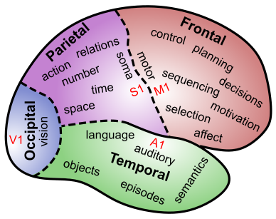
Language Involves all of Cognition
Perception: hearing & reading words
Attention: picking out words, speakers from many
Motor: speech, writing, etc
Memory: semantics, specific content – how do you encode plot of a book?
Executive Function: maintaining context, planning speech, syntax structure..

Slide 3
Language is Special
Symbols: Displacement (talk about un-present)
Syntax: Rules and Generativity (to infinity!)
Recursion: Embedded levels of structure:
“The horse raced past the barn fell”
"Isn't it true that example-sentences that people that you know produce are more likely to be accepted?”Temporally-extended sequences
Cultural transmission

Slide 4
Chomsky: Universal Grammar
Language is so amazing and special, it must be innate! Can’t possibly learn this from impoverished nature of the environment!?
Internal language faculty: language acquisition device (LAD)
All languages share certain rules (Universal Grammar)
LAD “designed” to learn these rules..

Slide 5
What do you think?
Is Language Innate, or Learned?
A. Language is largely innate
B. Language is largely learned
C. Language is learned, but constrained / informed by strong biological constraints

Slide 6
Distributed Reps of Words
I cnduo't bvleiee taht I culod aulaclty uesdtannrd waht I was rdnaieg. Unisg the icndeblire pweor of the hmuan mnid, aocdcrnig to rseecrah at Cmabrigde Uinervtisy, it dseno't mttaer in waht oderr the lterets in a wrod are, the olny irpoamtnt tihng is taht the frsit and lsat ltteer be in the rhgit pclae. The rset can be a taotl mses and you can sitll raed it whoutit a pboerlm. Tihs is bucseae the huamn mnid deos not raed ervey ltteer by istlef, but the wrod as a wlohe. Aaznmig, huh? Yaeh and I awlyas tghhuot slelinpg was ipmorantt! See if yuor fdreins can raed tihs too.

Slide 7
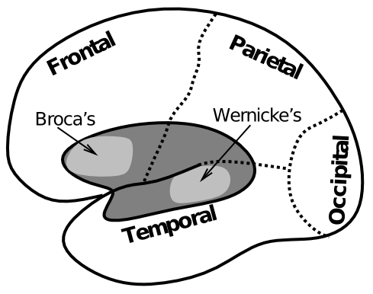
Biology of Language

Slide 8
Example of Wernicke’s Aphasia
"How are you today?”:
"Gossiping O.K. and Lords and cricket and England and Scotland battles. I don't know. Hypertension and two won cricket, bowling, batting, and catch, poor old things, cancellations maybe gossiping, cancellations, arm and argument, finishing bowling.”
https://www.youtube.com/watch?v=aVhYN7NTIKU

Slide 9
Those Pesky Time Flies..
Time flies like an arrow.
Fruit flies like a banana.
The slippers were found by the nosy dog.
The slippers were found by the sleeping dog.
Syntax depends on semantics very deeply, (and yet Chomsky says they are separate..)

Slide 10
Non-human Language
It is all about the motivation: what does a chimp really want from language??
People really want to share, chimps don’t..

