Slide 1
Thinking, Control, Intelligence

Slide 2
The Big Questions / Issues
What is thinking? What is Intelligence?
You think like a brain, not like a computer
Your PFC is particularly important for fluid thought
What is special about language, and who has it, really?

Slide 3
What Is “Smart”?
I believe that intelligence is..
A. Something that some people have more of, and others have less of, and there is little we can do to change that.
B. Something that is learned and can be changed through hard work..

Slide 4
I Am “Smart”?
I believe that my intelligence level is..
A. Well above average
B. Somewhat above average
C. Average
D. Somewhat below average
E. Well below average

Slide 5
It Takes a Village..
I believe that:
A. There are multiple different kinds of intelligence, and different people are smart in different ways
B. There is really just one major type of intelligence, and you either got it or not..

Slide 6
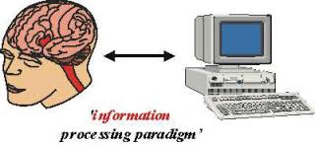
Computational Theory of Mind (‘60s)
The brain is NOT very much like a computer
And yet both are information processing systems!
Cognitive Science (ICS at CU): Psych & Neurosci, Linguistics, Philosophy, Computer Science

Slide 7
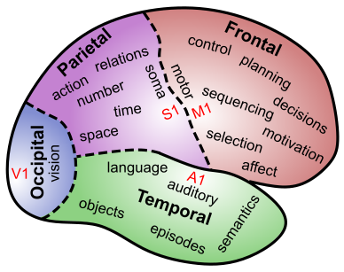
Where is Memory?
Memory is located in every single synapse in the brain
There are as many different kinds of memory as there are neurons and synapses and brain areas…

Slide 8
Where is Thinking?
Thinking is located in every single synapse in the brain
There are as many different kinds of thinking as there are neurons and synapses and brain areas…

Slide 9
But the Frontal Cortex is Special
Frontal cortex, especially Pre-Frontal Cortex (PFC) is particularly important for higher-level cognitive function!

Slide 10

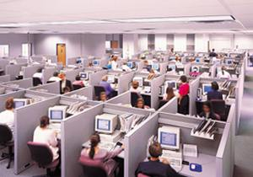
Key Idea: Top-Down Biasing
PFC active maintenance provides top-down biasing of posterior-cortical processing

Slide 11
System 1, 2
System 1: posterior cortex – domain-specific knowledge and fast processing
Previously known as automatic processing
System 2: prefrontal cortex – general purpose cognitive processing and problem solving (slow)
Previously known as controlled processing
(It takes a Nobel prize to reinvent a well-established distinction, using much worse terms!)

Slide 12
Controlled Processing = Gateway to Learning
We learn everything (driving, algebra, etc) initially via slow, deliberate, controlled processing system 2 (prefrontal cortex, PFC)
Small initial differences in PFC function can multiply over time to result in larger differences in how much is learned
How much is purely motivational? Slightly easier = more motivated to work harder etc?

Slide 13
Stroop Task: Top Down Biasing
RED

Slide 14
Stroop Task: Top Down Biasing
GREEN

Slide 15
Stroop Task: Top Down Biasing
RED

Slide 16
Stroop Task: Top Down Biasing
GREEN

Slide 17
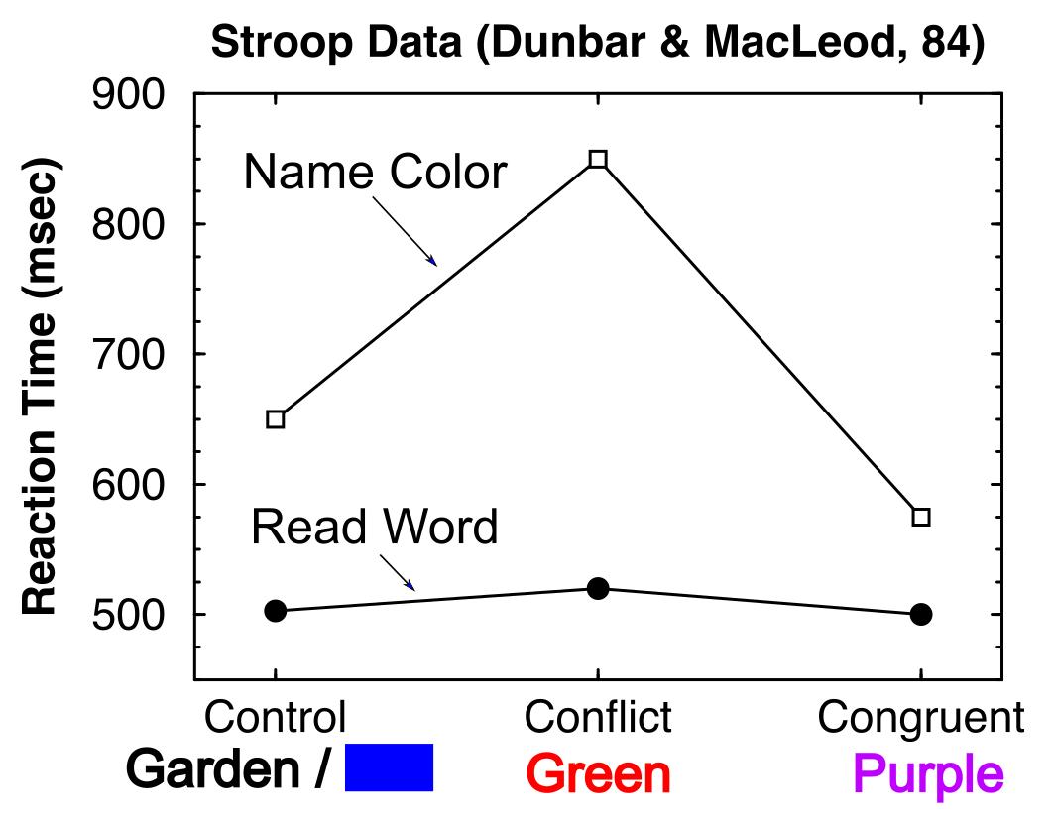
Reading is Automatic Color Naming needs Control

Slide 18
Key Idea: Top-Down Biasing
“Name colors you idiots!”
“But we prefer reading (Facebook..)”

Slide 19
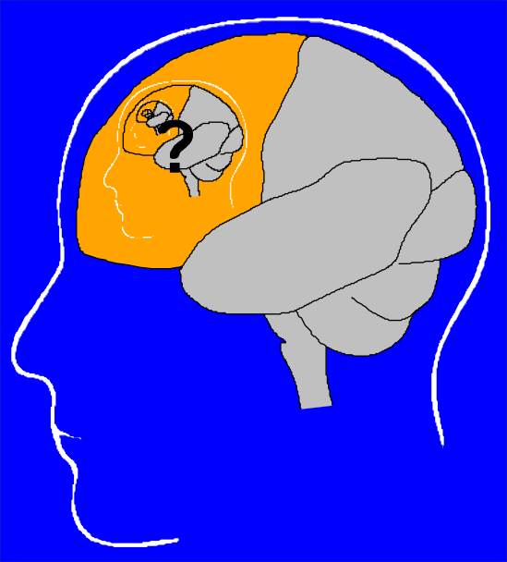
The Homunculus Problem

Slide 20
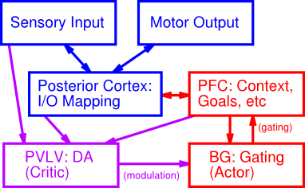
It Takes a Network..

Slide 21
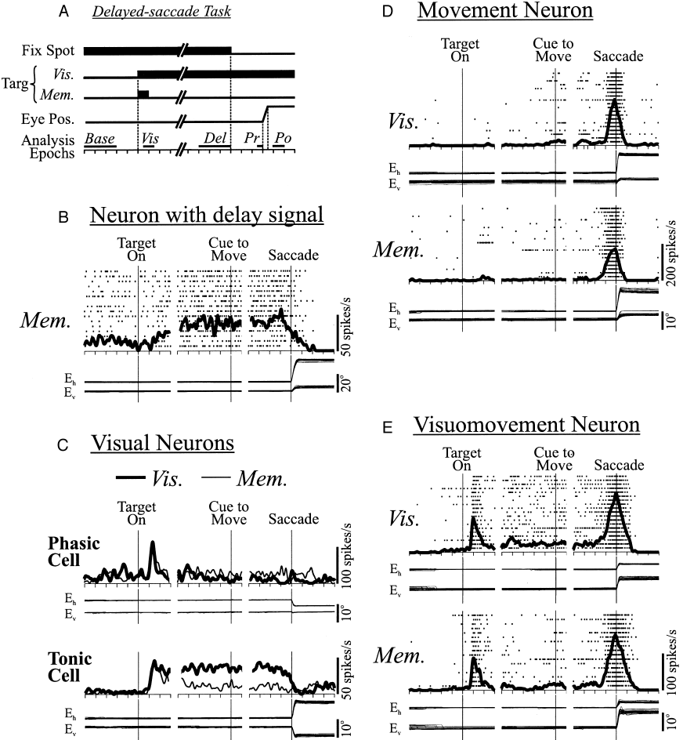
PFC Does Active Maintenance

Slide 22
Active Maintenance Can Do it All
Cognitive Control
Maintained activity drives top-down biasing
Planning
Think about things that are not there (future)
Motivation
Maintain goals
Reward processing
Maintain possible outcomes
Decision making
Maintain alternatives

Slide 23
More Dichotomies
System 1 = Automatic = Crystalized Intelligence = posterior cortex with well-tuned synapses over a lifetime of experience (wise..)
System 2 = Controlled = Fluid Intelligence = prefrontal cortex & basal ganglia with strong ability to rapidly update and maintain information in working memory

Slide 24
IQ Scales and History
Stanford-Binet: first IQ test (Alfred Binet)
WAIS-III: Wechsler Adult Intelligence Scale: first IQ test for adults
Spearman: Indifference of the Indicator: “smart” people do well on any test: g = general IQ factor
IQ is single best predictor of grades, SAT tests, educational outcomes. Correlated with health. But not best predictor of job performance.

Slide 25
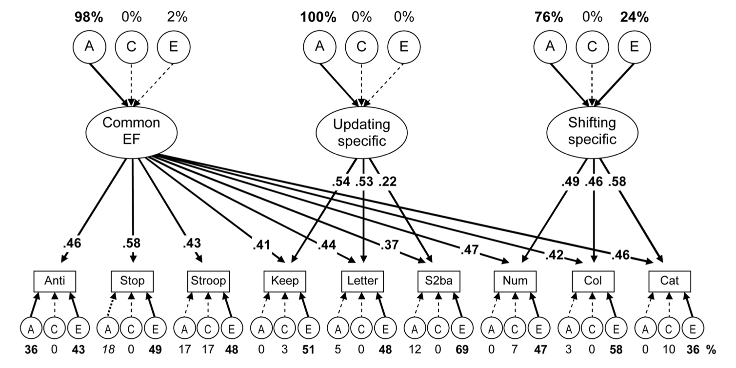
g ~ Common Executive Function (Friedman & Miyake et al, 2008)
A = Genetic, C = Shared environment, E = Separate environment
Combining across tasks eliminates “noise”, reveals surprisingly strong genetic factors
Common EF = PFC active maintenance; Updating Specific = Basal Ganglia gating

Slide 26
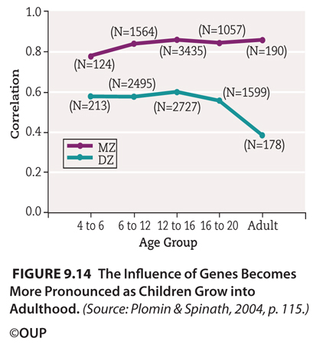
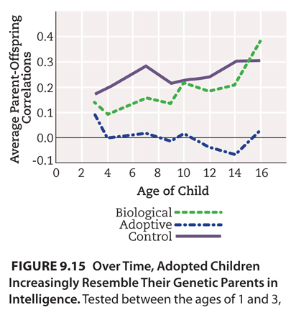
Genetic basis of IQ goes up over time (and so does IQ overall)

Slide 27
Likely Explanation of IQ Data
Small differences in PFC / BG function multiply over time: PFC / BG is gateway to learning.
Likely major contribution of genetic / environmental correlation: “smart kid” effect
What really matters is Learning! And what really drives learning is Motivation!

Slide 28
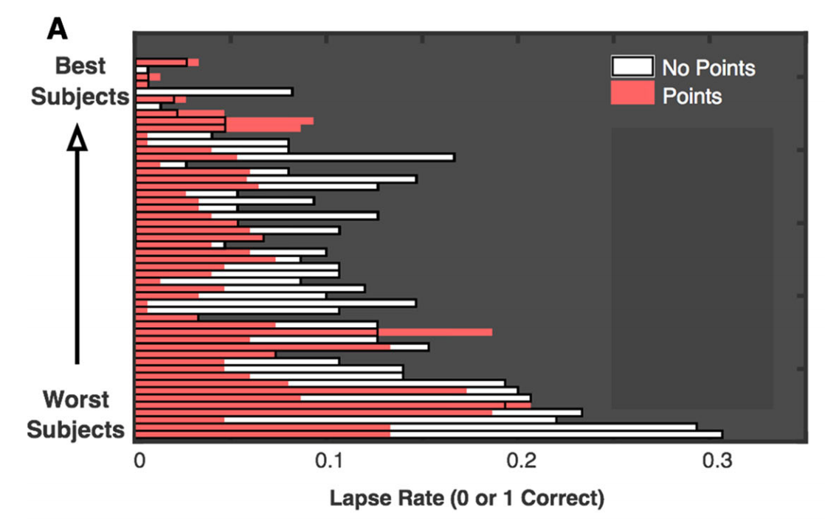
Motivation and Working Memory (Adam & Vogel, 2016)
Raw “MAX” working memory capacity does NOT differ between subjects
What DOES differ is rate of tuning out / lapsing!
Miyake (CU): Class grades predicted by mind-wandering, procrastination!

Slide 29
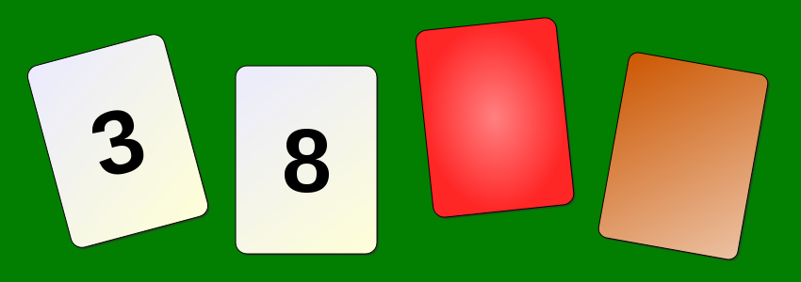
Brain Loves Concrete, not Abstract
Rule: If there is an even number on one side, then the other side is red. Which two to turn over?
A. 3 and 8
B. 8 and Red
C. 8 and Brown
D. 3 and Red
E. 3 and Brown

Slide 30
Brain Loves Concrete, not Abstract
Rule: If you are drinking alcohol, you must be over 21. Who do you card?
A. Not drinking, Drinking
B. Drinking, Old person
C. Drinking, Young person
D. Not drinking, Old person
E. Not drinking, Young person

Slide 31
Multiple Intelligences
Thinking is located in every single synapse in the brain
There are as many different kinds of thinking as there are neurons and synapses and brain areas…

Slide 32
Multiple Intelligences
Sternberg: Triarchic = analytic, creative, practical
Carroll: Three-stratum (g, 8 more specific, and then 69 even more specific)
Fluid intelligence (Gf = PFC, g) vs. Crystallized (Ge = posterior cortex, knowledge, wisdom)

Slide 33
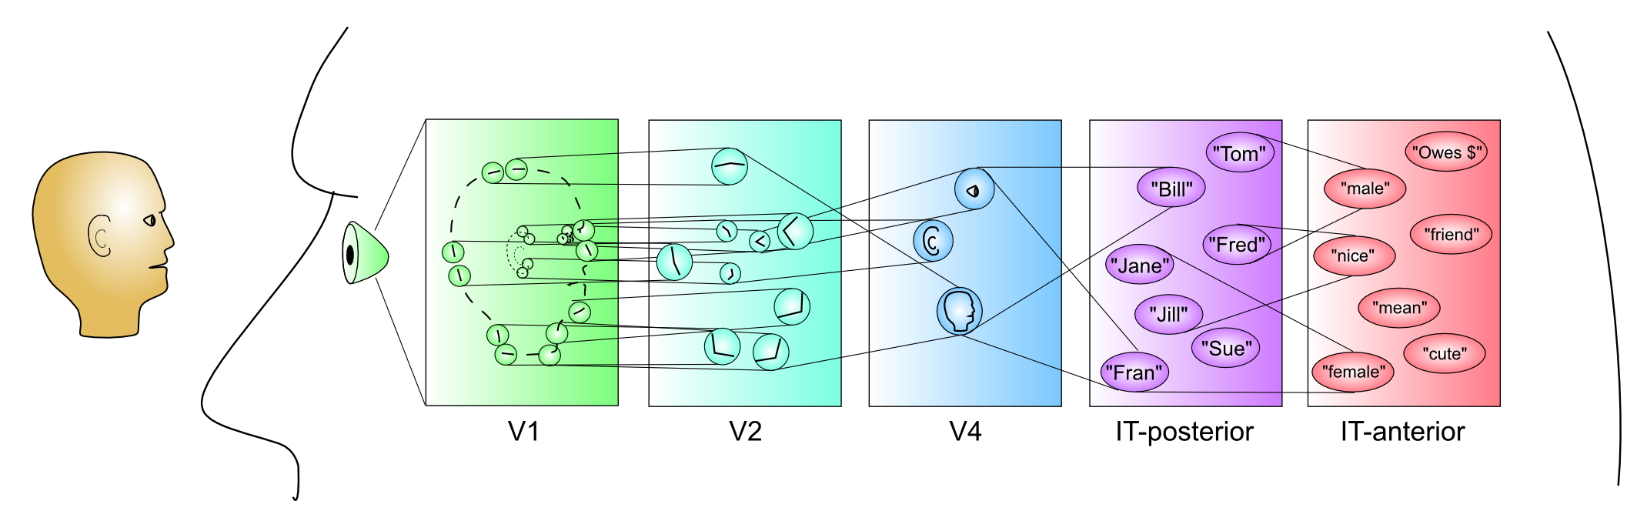
Thought & Problem Solving
Thought = deliberate manipulating information to solve problems, make decisions, etc. Consists of:
Mental Images: picture-like representations
Concepts: mental categories (CCC=compr.)
Images
Concepts

Slide 34
Problem Solving Terms
Trial and Error: try and see what works..
Algorithm: like a program – problem solving = search algorithm (chess..)
Heuristic: short cut “rule of thumb” that often works without solving the hard problem
Source of a lot of cognitive biases?

Slide 35
Availability Heuristic
Whatever comes to mind, go with that! Much easier than figuring out the actual statistics!
Problem: not very accurate..

Slide 36
What is Greatest Risk?
A. Nephritis, nephrotic syndrome, nephrosis
B. Diabetes
C. Flu and pneumonia
D. Alzheimer’s
E. Suicide

Slide 37
Actual Stats: http://www.cdc.gov/nchs/fastats/leading-causes-of-death.htm
Cause Number % Rate per 100,000
... All causes 2,596,993 100.0 821.5
1 Diseases of heart 611,105 23.5 193.3
2 Cancer 584,881 22.5 185.0
3 Chronic lower respiratory 149,205 5.7 47.2
4 Accidents 130,557 5.0 41.3
5 Cerebrovascular diseases 128,978 5.0 40.8
6 Alzheimer's disease 84,767 3.3 26.8
7 Diabetes mellitus 75,578 2.9 23.9
8 Influenza and pneumonia 56,979 2.2 18.0
9 Nephritis, etc 47,112 1.8 14.9
10 Suicide 41,149 1.6 13.0

Slide 38
Representative Heuristic
Compare how similar to a prototypical case
Problem: tend to ignore base rates.
And rely on stereotypes

Slide 39
Linda..
Linda is 31 years old, single, outspoken, and very bright. She majored in philosophy. As a student, she was deeply concerned with issues of discrimination and social justice, and also participated in anti-nuclear demonstrations.
Which is more probable?
A. Linda is a bank teller.
B. Linda is a bank teller and is active in the feminist movement.

Slide 40
Confirmation Bias CCC = Control!
Only pay attention to information consistent with our preexisting beliefs!
Astrology, politics, .. Everywhere!
Filter bubble = more and more of a problem in modern digital media!
Belief Persistence: just plain ignore / discredit inconsistent information!
Why? Our beliefs are central to our feeling of control and identity: challenge is very threatening!

Slide 41
Gambler’s Fallacy
Belief that: If you’ve just been losing, you’re more likely to win! (Or vice-versa)
But, probability of heads is always 50% no matter how many heads or tails have come before!
Interestingly: probability over time of HH vs HT is NOT the same!! This is likely basis of this fallacy.
https://grey.colorado.edu/CompCogNeuro/index.php/SunOReillyBhattacharyyaEtAl15

