Slide 1
Chapters 1-3 Study Guide

Slide 2
Summary: Four Major Approaches
Internal Factors
Biological
Cognitive
External factors
Behavioral
Sociocultural

Slide 3
Review of “core” Psychology History
Before 1879: Philosophy
1900 – 1950: Behaviorism
1960 – 1990: Cognitive-ism
1990 – current: Cognitive Neuroscience-ism
Core = basic assumptions about how the mind / brain works..

Slide 4
Hey, How about some Data!
Wilhelm Wundt (1879): First dude to actually collect scientific data about human behavior! i.e., the first true Psychologist.
But unfortunately, the data was all subjective!
Titchener: structuralism = subjective contents of experience, through introspection
James: functionalism = largely theoretical (vs. experimental) ideas about specific functions of mind, instead of contents.

Slide 5
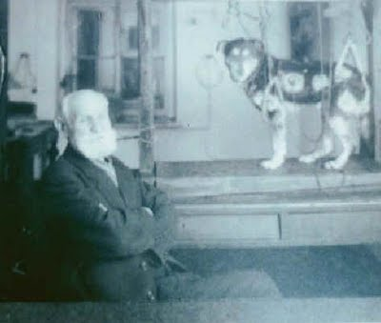
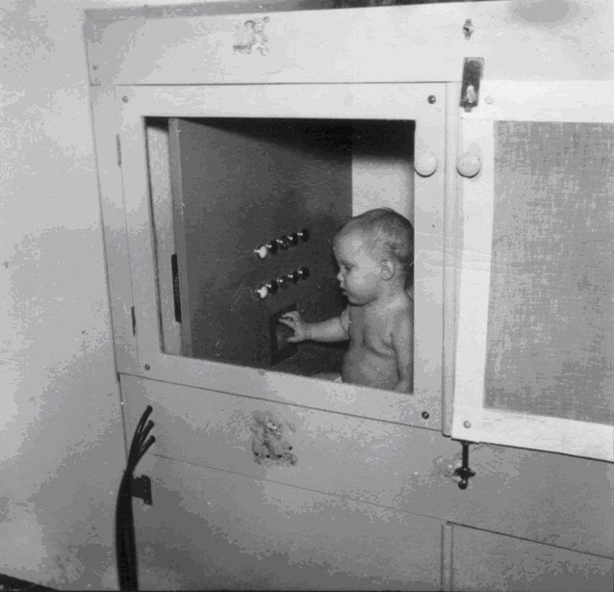
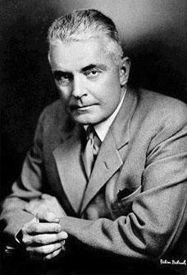
Hey, How about some Objective Data! (1913-1950’s)
Behaviorists: rejection of introspection – can only study and theorize about what is objectively observable: behavior! Stimulus -> Response
Pavlov
Skinner
Watson

Slide 6
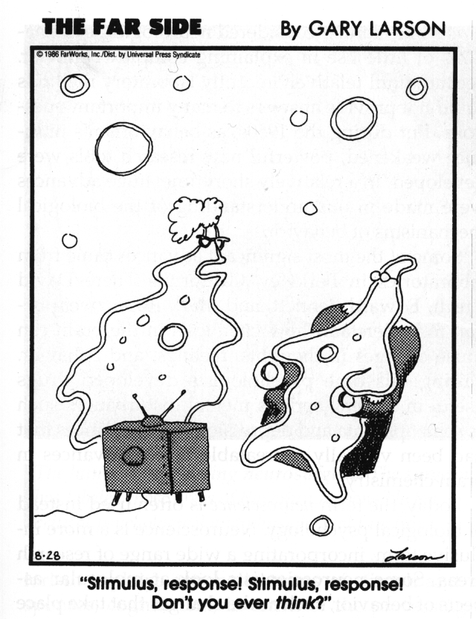
Cognitive Counter-Revolution (1960’s)
Cognitive(ism): Yeah, maybe there is actually something going on inside the mind..

Slide 7
Behaviorism:
Cognitive Psychology:
Stimulus (memorize this list)
lion, onion, Bill, firefighter, carrot, zebra, John, clerk, Tom, nurse, cow
Response (recall)
lion, zebra, cow, onion, carrot, firefighter, clerk , nurse, John, Bill, Tom
Mental Processes
Strategies, grouping, reorganization, etc
Stimuli
Responses
Stimuli
Mental Processes
Responses

Slide 8
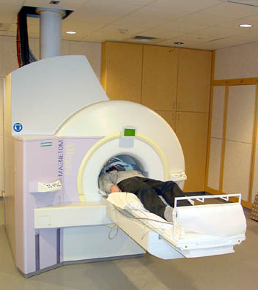
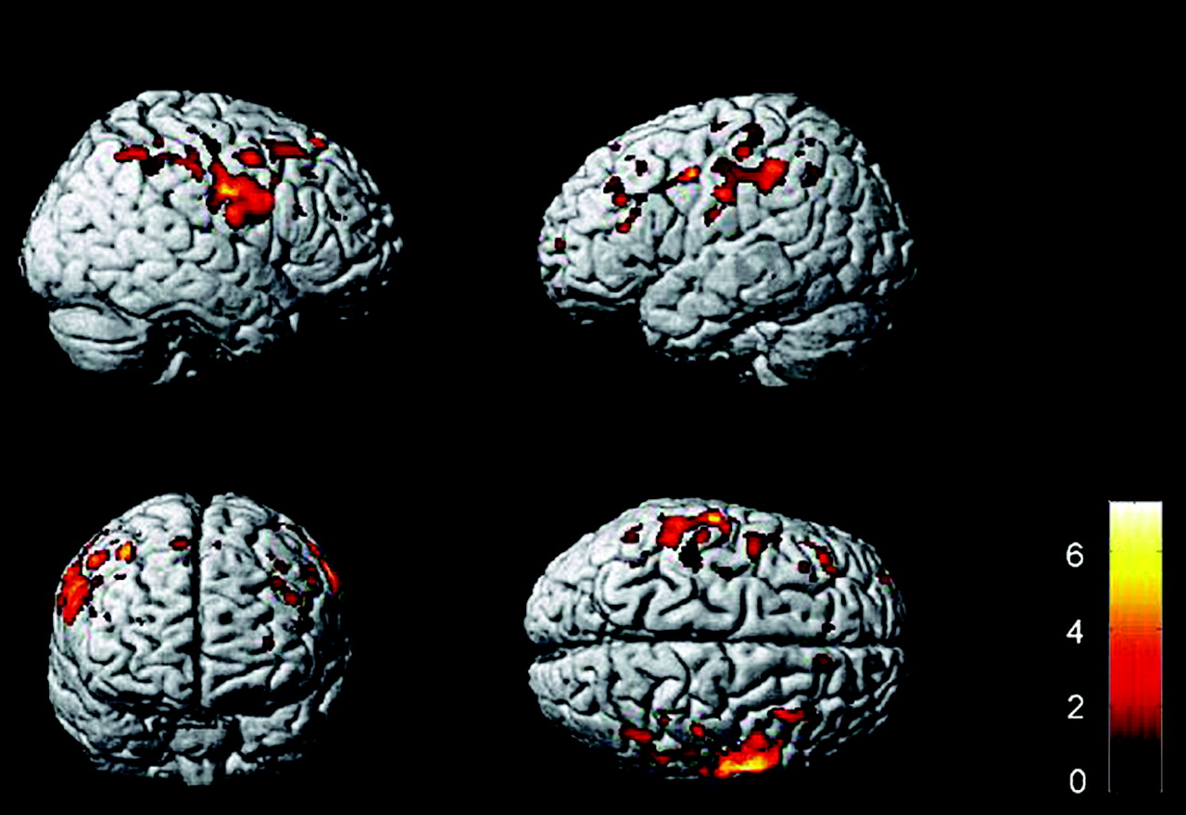
Enter the Brain..
1960’s-80’s: Cognitive “boxology” based on idea that mind is a digital computer (sure, why not..)
1990’s – now: Cognitive Neuroscience!

Slide 9
The Scientific Method
make an observation,
form a hypothesis,
collect data,
analyze data,
draw conclusions.

Slide 10
Answering Questions
Practical techniques for answering Psychological questions..
“Ve have vays of making you talk..”
Descriptive
Correlational
Experimental

Slide 11
Pros / Cons
Descriptive: good: doesn’t raise any suspicions (“naturalistic”) bad: not much to go on..
Correlational: good: also “naturalistic” (no suspicions), more precise understanding of data. bad: other factors at work! e.g., old marrieds, etc the third variable problem: correlation does not equal causation!!
Experimental: good: really figure out the truth! bad: create false truth! e.g., bad questions = bad answers (“does this dress make me look fat?”) external validity

Slide 12
True Experiments
Avoids 3rd variable problem, determines true causal relationships!
Random assignment to conditions
Avoids 3rd variable of pre-existing conditions..
1 or more control conditions
Must compare manipulation to something
Control over confounds
Eliminate all possible other 3rd variables

Slide 13
Possible subjects
Experimental Group
Random assignment controls for differences
Control
Group
Study and testing conditions
Identical conditions
control extraneous
variables
Study and testing conditions
Music
Independent variable
(Cause)
No
Music
Behavior
(test scores)
Behavior
(test scores)
Dependent variable
(Effect)
Is there a difference?

Slide 14
Experimental Design
Independent variable: what you manipulate
e.g., does coffee improve cognition: it’s the (amount of) coffee!
Dependent variable: what you measure
Some measure of cognition..

Slide 15
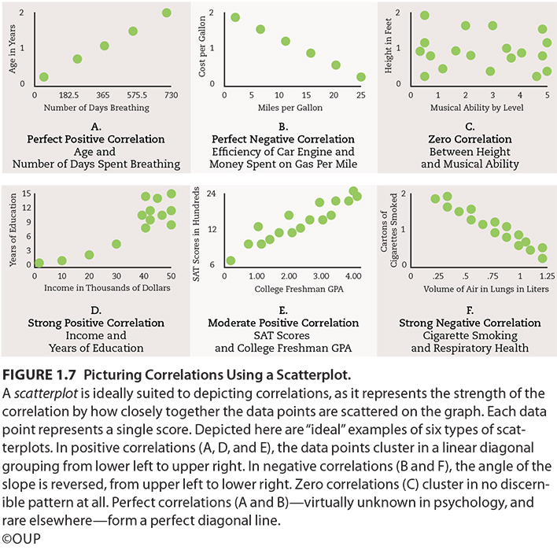

Slide 16
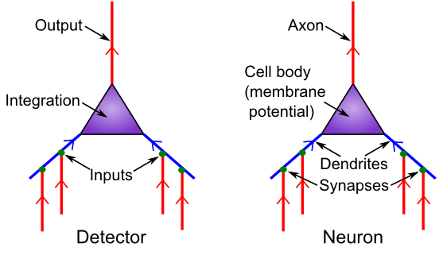
Detector Model
Is it really all just detection?

Slide 17
Neuron Summary
Neurons integrate electrical signals (depolarization) received via synapses on their dendrites, from axons of other neurons
When membrane potential exceeds threshold, action potential (spike) is sent down axon, triggering release of neurotransmitter in synapse, which opens ion channels on receiving (postsynaptic) neuron
GABA is main inhibitory neurotransmitter, Glutamate is main excitatory neurotransmitter

Slide 18
Neurotransmitter Terms
Agonist: acts like a given neurotransmitter
Antagonist: blocks receptors for given NT
Reuptake: takes NT back out of synapse
Neuromodulator: a broadly-released neurotransmitter that has widespread modulatory effects on the brain

Slide 19
Neuromodulators and Drugs (receptor agonists)
Acetylcholine (ACh): muscles, attention, learning, memory (nicotine)
Dopamine (DA): when to learn, based on reward prediction errors (cocaine)
Norephinephrine (NE): attention, engagement (speed)
Serotonin (5HT): Mood, sleep, appetite, sex, stress (SSRI, LSD = waking dream)
Oxytocin: social modulation, labor (pitocin)
Endorphins, Substance P: pain (heroin)

Slide 20
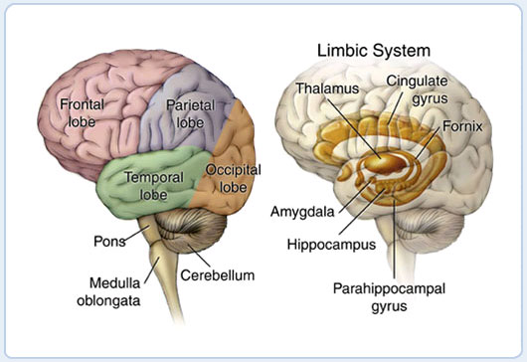
Gross Anatomy

Slide 21
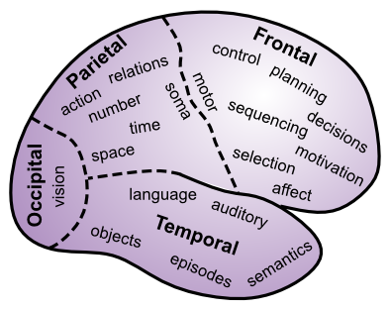
Lobular Functions: Follow the trail..

Slide 22
Rest of Brain
Hippocampus (archicortex – old cortex): episodic memories (events, facts, this lecture..)
Amygdala: emotions (reward, fear, etc): major controller of dopamine
Basal Ganglia: motor / cognitive initiation based on what has worked in the past (dopamine)
Thalamus: mini-me to cortex, interacts with BG
Cerebellum: tunes up fine motor control

Slide 23
Basic senses
Sense
Stimulus
Receptors

Slide 24
Psychophysics
Absolute threshold
Lowest level of stimulus intensity for 50% response
“How low can you go?”
Just-noticeable difference (JND)
Difference in stimulus intensity for 50% response
“Ch Ch Ch.. Changes”
Weber’s law: JND proportional to stimulus intensity
Easier to tell small weight diff between two light objs, vs. two heavy

Slide 25
Signal Detection Theory
Signal
Present
Absent
Yes
Hit
False Alarm
Response
Correct
Rejection
No
Miss

Slide 26
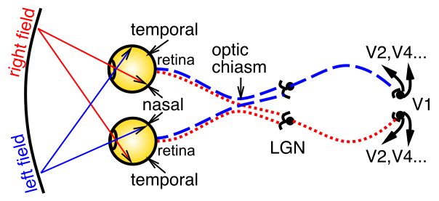
The First Sense: Vision
Light goes through pupil, size of which controlled by iris, lens focuses on retina, containing rod (fast, b/w) and cone (slow, color) photoreceptors. LGN = thalamus, V1 = primary visual cortex.

Slide 27
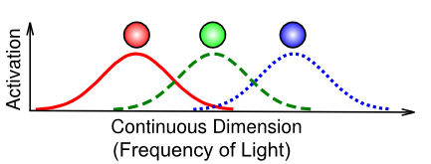
Trichromatic Color Vision
Color opponent process theory:
red vs. green,
blue vs. yellow
black vs. white (achromatic)

Slide 28
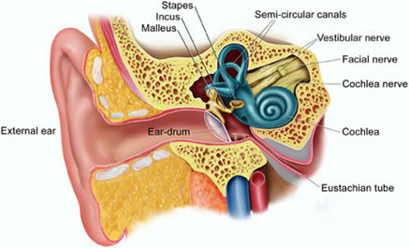
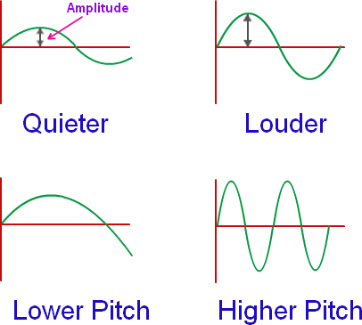
Audition
Basilar membrane: retina of the ear, located in cochlea
hair cells transduce sound, location along membrane = frequency
(place theory), except low-frequency = direct firing rate (frequency theory)
Interaural time / level differences = auditory localization

