Slide 1
Language
Randall O’Reilly

Slide 2
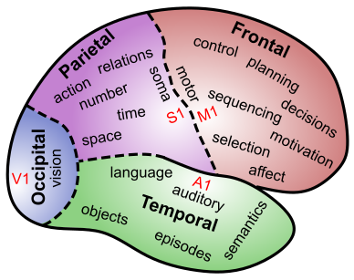
Language Involves all of Cognition
Perception: hearing & reading words
Attention: picking out words, speakers from many
Motor: speech, writing, etc
Memory: semantics, specific content – how do you encode plot of a book?
Executive Function: maintaining context, planning speech, syntax structure..

Slide 3
Language is Special
Symbols
Syntax
Temporally-extended sequences
Cultural transmission
Embedded levels of structure:
“The horse raced past the barn fell”
"Isn't it true that example-sentences that people that you know produce are more likely to be accepted?”

Slide 4
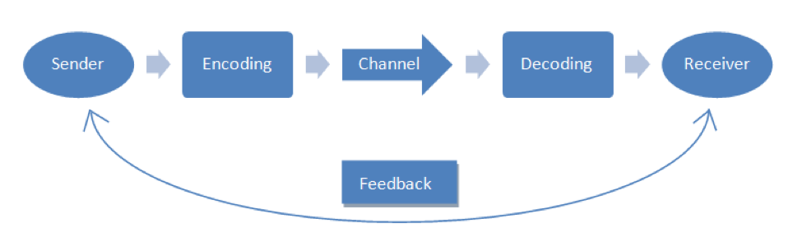
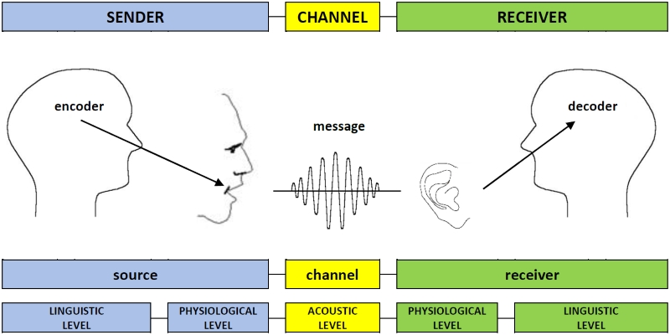
Communication

Slide 5
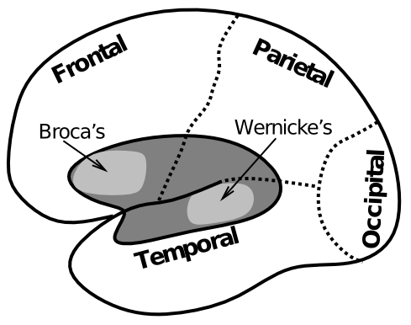
Biology of Language

Slide 6
Example of Wernicke’s Aphasia
"How are you today?”:
"Gossiping O.K. and Lords and cricket and England and Scotland battles. I don't know. Hypertension and two won cricket, bowling, batting, and catch, poor old things, cancellations maybe gossiping, cancellations, arm and argument, finishing bowling.”
https://www.youtube.com/watch?v=aVhYN7NTIKU

Slide 7
Wernicke’s Aphasia
End of the football. It influence the football right here. It crawls and it comes in, see? The end of it. Oh, we got a lot of these, see?
Well, it's playable in the government. You don't understand it, but it pauses in the long very cumbersome and it comes source in the country out through. All the under it, see, comes up, finally it comes up here and goes out... It comes in and comes out and BING That's a good free throw, see?
That's a good throw slow mosey fire, fire. See slows it cold or it gives or kicks out or bing or whatever it is, we has no for football farther down. It's just pulling, see, but they say feel good. I guess it reminds you half dead or I don't even know.
Where do you live? If you live, you appear, see. Where do you leave? Where do you live is, well friends are front and center here around here.
Yes. Right here. Rest of the hearing. How many? Holy Christmas! Oh about a hundred, let's see about a hundred and thirty. About Forty. Gosh, what time is it? One plus five...

Slide 8
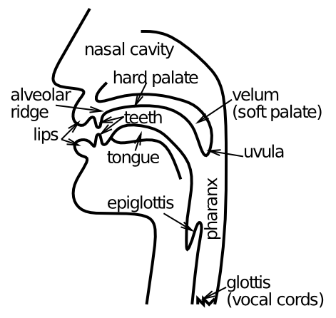
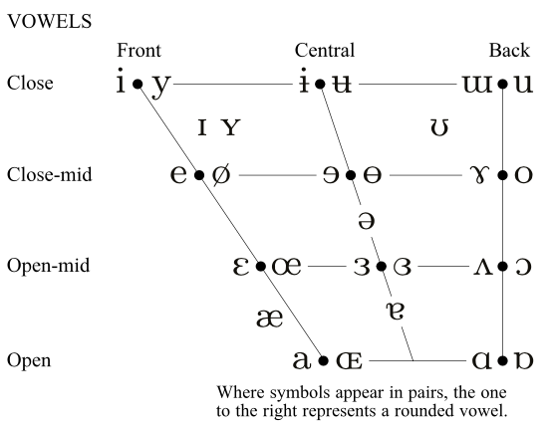
Speech Output

Slide 9
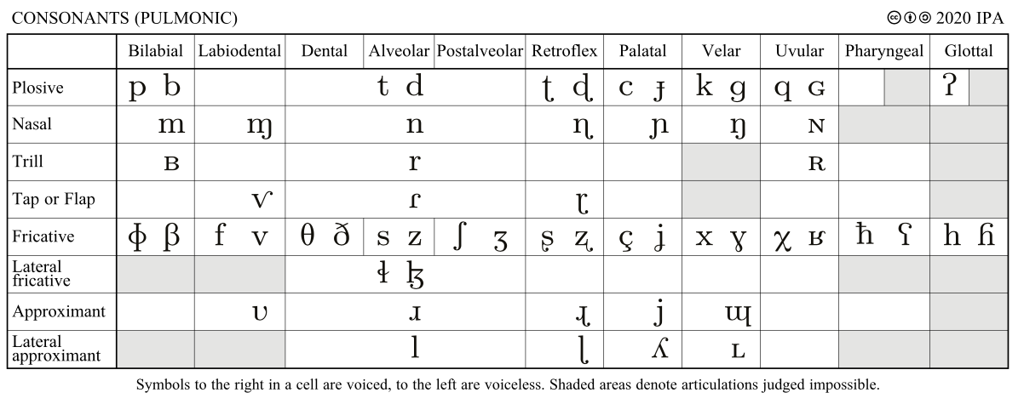
Speech Output

Slide 10
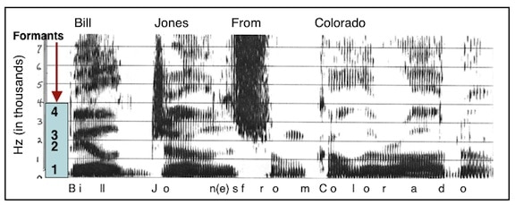
Speech Perception

Slide 11
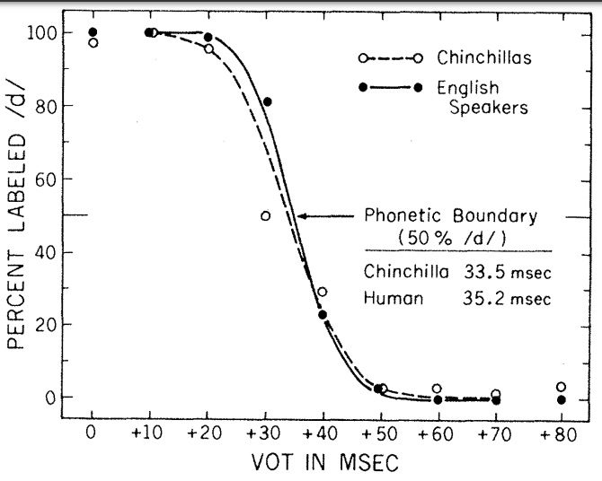
Categorical Perception (compression)

Slide 12
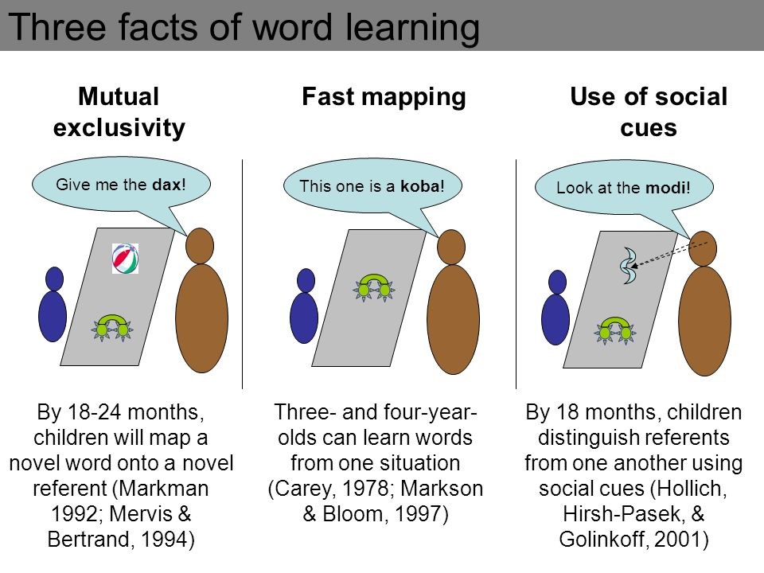
Word Learning

Slide 13
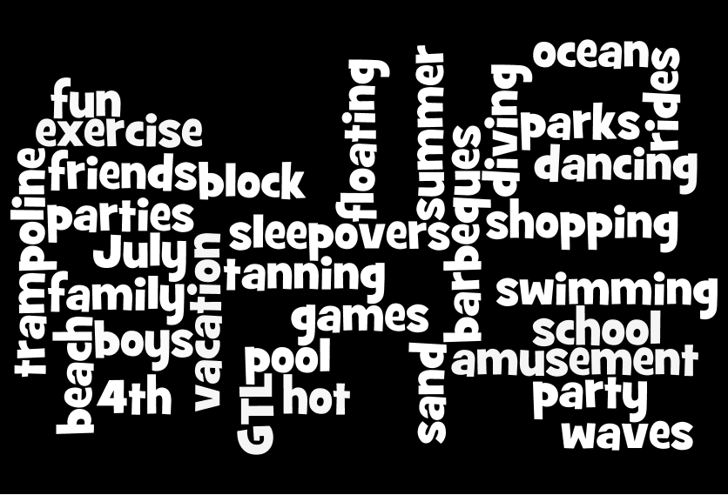
Time and Language
Distributed representation broken down and sent over a sequential channel:
The summer is a fun time for going to the beach, dancing, …

Slide 14
Distributed Reps of Words
I cnduo't bvleiee taht I culod aulaclty uesdtannrd waht I was rdnaieg. Unisg the icndeblire pweor of the hmuan mnid, aocdcrnig to rseecrah at Cmabrigde Uinervtisy, it dseno't mttaer in waht oderr the lterets in a wrod are, the olny irpoamtnt tihng is taht the frsit and lsat ltteer be in the rhgit pclae. The rset can be a taotl mses and you can sitll raed it whoutit a pboerlm. Tihs is bucseae the huamn mnid deos not raed ervey ltteer by istlef, but the wrod as a wlohe. Aaznmig, huh? Yaeh and I awlyas tghhuot slelinpg was ipmorantt! See if yuor fdreins can raed tihs too.

Slide 15
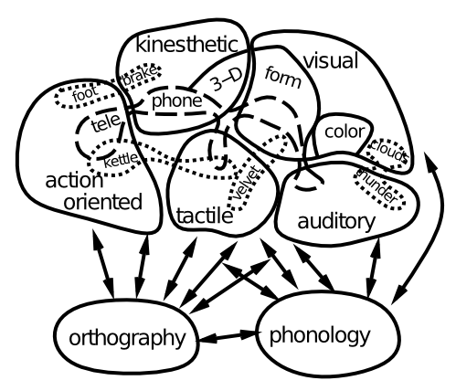
Semantics

Slide 16
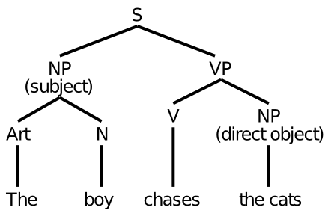
Sentences and Syntax
Is this how it really works??

Slide 17
Those Pesky Time Flies..
Time flies like an arrow.
Fruit flies like a banana.
The slippers were found by the nosy dog.
The slippers were found by the sleeping dog.
Syntax depends on semantics very deeply..

Slide 18
The “Gestalt” Alternative
Just try to get the gist of what the sentence is saying:
G. W. Bush:
“Families is where our nation finds hope, where wings take dream.”
Does this really work? How?

Slide 19
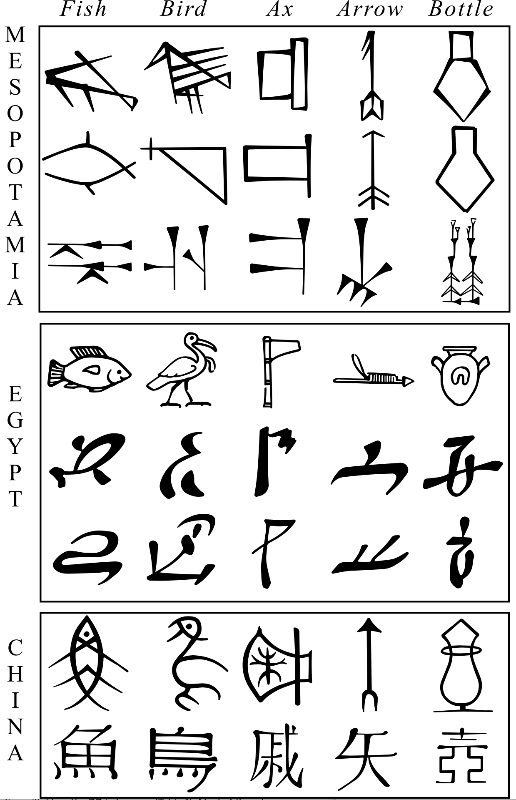
Pictograph -> Logograph

Slide 20
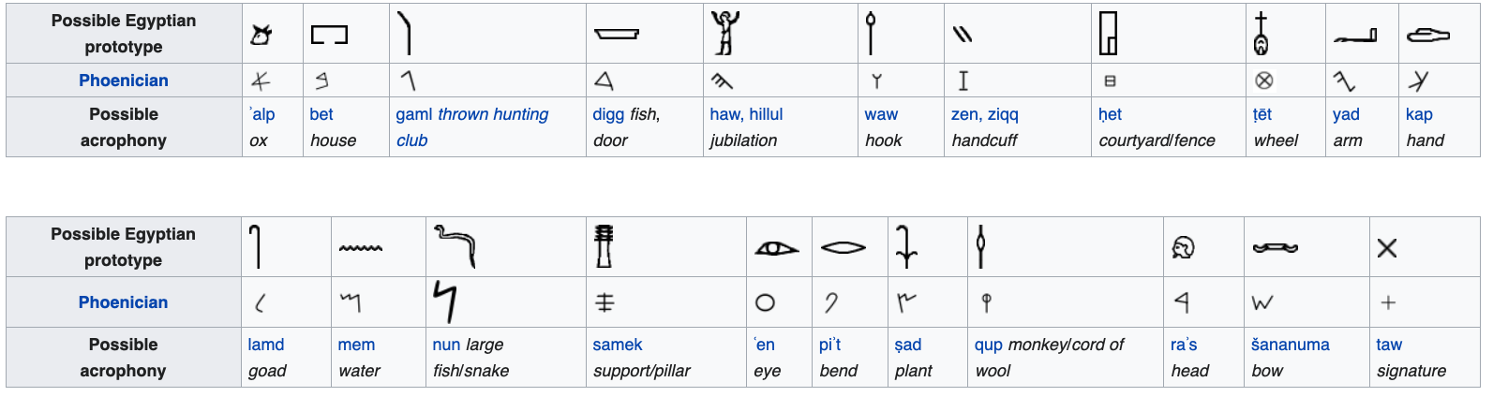
The One Alphabet!

Slide 21
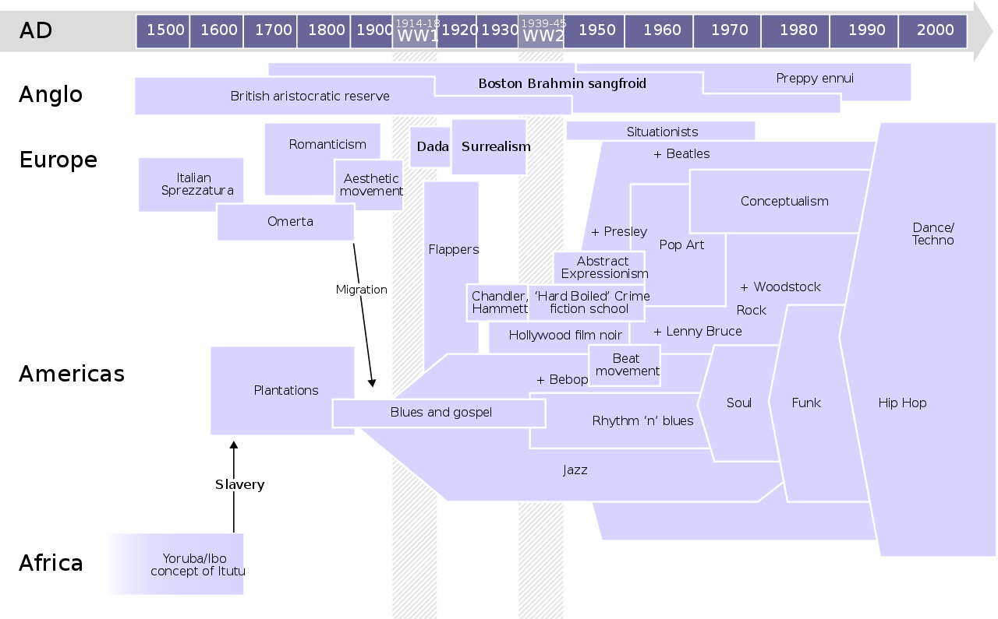
Language -> Culture

Slide 22
Innate Grammar
Similar syntax elements across languages
Poverty of the stimulus
vs.
Brain constraints
Statistics -> much richer information
Predictive learning -> "

