Slide 1
Introduction to Data Science
Lecture 8
Machine Learning Part 2
EMSE 6992 Fall 2018
Benjamin Harvey

Slide 2
Outline
Supervised Learning
Classification/Regression
Bias/Variance tradeoff
K-NN
Naïve Bayes
Training Issues
Measuring model quality
Over-fitting
Cross-validation

Slide 3
Machine Learning
Supervised: We are given input/output samples (X, y) which we relate with a function y = f(X). We would like to “learn” f, and evaluate it on new data. Types:
Classification: y is discrete (class labels).
Regression: y is continuous, e.g. linear regression.
Unsupervised: Given only samples X of the data, we compute a function f such that y = f(X) is “simpler”.
Clustering: y is discrete
Y is continuous: Matrix factorization, Kalman filtering, unsupervised neural networks.

Slide 4
Machine Learning
Supervised:
Is this image a cat, dog, car, house?
How would this user score that restaurant?
Is this email spam?
Is this blob a supernova?
Unsupervised:
Cluster some hand-written digit data into 10 classes.
What are the top 20 topics in Twitter right now?
Find and cluster distinct accents of people at GWU.

Slide 5
Techniques
Supervised Learning:
kNN (k Nearest Neighbors)
Naïve Bayes
Linear + Logistic Regression
Support Vector Machines
Random Forests
Neural Networks
Unsupervised Learning:
Clustering
Topic Models
HMMs (Hidden Markov Models)
Neural Networks

Slide 6
Outline
Supervised Learning
Classification/Regression
Bias/Variance tradeoff
K-NN
Naïve Bayes
Training Issues
Measuring model quality
Over-fitting
Cross-validation

Slide 7
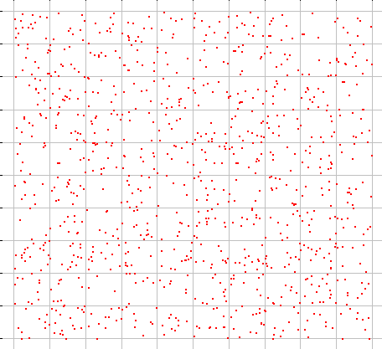
Predicting from Samples
Most datasets are samples from an infinite population.
We are most interested in models of the population, but we
have access only to a sample of it.
For datasets consisting of (X,y)
- features X + label y
a model is a prediction y = f(X)
We train on a training sample D
and we denote the model as f_{D}(X)

Slide 8
Bias and Variance
Our data-generated model 𝑓_{𝐷} 𝑋 is a statistical estimate of the true function 𝑓 𝑋 .
Because of this, its subject to bias and variance:
Bias: if we train models 𝑓_{𝐷} 𝑋 on many training sets 𝐷, bias is the expected difference between their predictions and the true 𝑦’s.
i.e. 𝐵𝑖𝑎𝑠 = E 𝑓_{𝐷} 𝑋 − 𝑦
E[] is taken over points X and datasets D
Variance: if we train models 𝑓_{𝐷}(𝑋) on many training sets 𝐷,
variance is the variance of the estimates:
𝑉𝑎𝑟𝑖𝑎𝑛𝑐𝑒 = E 𝑓 𝑋 − 𝑓 𝑋
2
𝐷
Where 𝑓 𝑋
= E 𝑓_{𝐷} 𝑋
is the average prediction on X.

Slide 9
Bias and Variance Tradeoff
There is usually a bias-variance tradeoff caused by model complexity.
Complex models (many parameters) usually have lower bias, but higher variance.
Simple models (few parameters) have higher bias, but lower variance.

Slide 10
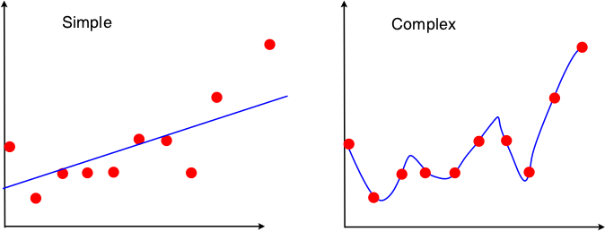
Bias and Variance Tradeoff
e.g. a linear model can only fit a straight line. A high-degree polynomial can fit a complex curve. But the polynomial can fit the individual sample, rather than the population. Its shape can vary from sample to sample, so it has high variance.

Slide 11
Bias and Variance Tradeoff
The total expected error is
𝐵𝑖𝑎𝑠² + 𝑉𝑎𝑟𝑖𝑎𝑛𝑐𝑒
Because of the bias-variance trade-off, we want to balance these
two contributions.
If 𝑉𝑎𝑟𝑖𝑎𝑛𝑐𝑒 strongly dominates, it means there is too much
variation between models. This is called over-fitting.
If 𝐵𝑖𝑎𝑠 strongly dominates, then the models are not fitting the
data well enough. This is called under-fitting.

Slide 12
Outline
Supervised Learning
Classification/Regression
Bias/Variance tradeoff
K-NN
Naïve Bayes
Training Issues
Measuring model quality
Over-fitting
Cross-validation

Slide 13
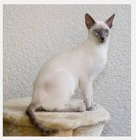
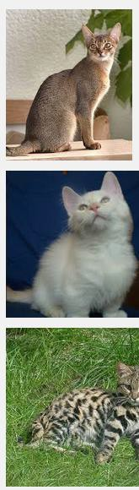
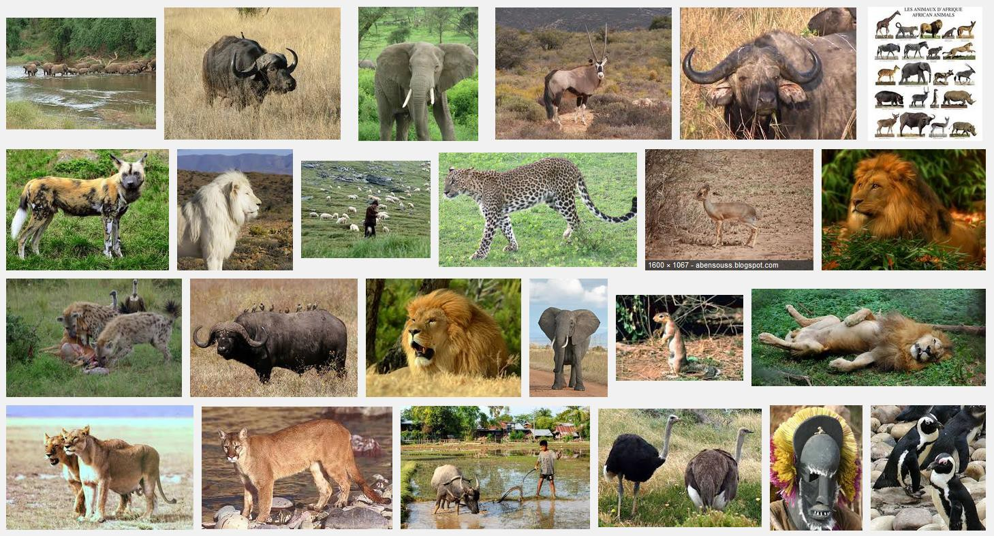
k-Nearest Neighbors
Given a query item:
Find k closest matches
in a labeled dataset ↓

Slide 14
k-Nearest Neighbors
Given a query item:
Find k closest matches
Return the most
Frequent label

Slide 15
k-Nearest Neighbors
k = 3 votes for “cat”

Slide 16
k-Nearest Neighbors
2 votes for cat,
1 each for Buffalo, Cat wins…
Deer, Lion

Slide 17
k-NN issues
The Data is the Model
No training needed.
Accuracy generally improves with more data.
Matching is simple and fairly fast if data fits in memory.
Usually need data in memory, but can be run off disk.
Minimal Configuration:
Only parameter is k (number of neighbors)
But two other choices are important:
Weighting of neighbors (e.g. inverse distance)
Similarity metric

Slide 18
k-NN Flavors
Classification:
Model is y = f(X), y is from a discrete set (labels).
Given X, compute y = majority vote of the k nearest neighbors.
Can also use a weighted vote* of the neighbors.
Regression:
Model is y = f(X), y is a real value.
Given X, compute y = average value of the k nearest neighbors.
Can also use a weighted average* of the neighbors.
* Weight function is usually the inverse distance.

Slide 19
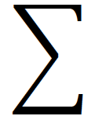
K-NN distance measures
Euclidean Distance: Simplest, fast to compute
𝑑 𝑥, 𝑦 = 𝑥 − 𝑦
Cosine Distance: Good for documents, images, etc.
𝑥 ∙ 𝑦
𝑑 𝑥, 𝑦 = 1 −
𝑥 𝑦
Jaccard Distance: For set data:
₌ ₁ ₋ 𝑋 ∩ 𝑌
𝑑 𝑋, 𝑌
𝑋 ∪ 𝑌
Hamming Distance: For string data:
𝑛
𝑑 𝑥, 𝑦 = 𝑥_{𝑖} ≠ 𝑦_{𝑖}
𝑖=1

Slide 20
K-NN metrics
Manhattan Distance: Coordinate-wise distance
𝑛
𝑑 𝑥, 𝑦 = 𝑥_{𝑖} − 𝑦_{𝑖}
𝑖=1
Edit Distance: for strings, especially genetic data.
Mahalanobis Distance: Normalized by the sample covariance matrix – unaffected by coordinate transformations.

Slide 21
Choosing k
We have a bias/variance tradeoff:
Small k → ?
Large k → ?

Slide 22
Choosing k
Small k → low bias, high variance
Large k → high bias, low variance
Assume the real data follows the blue curve, with some mean-zero additive noise. Red points are a data sample.
y
y = f(X)
X

Slide 23
Choosing k
Small k → low bias, high variance
Large k → high bias, low variance
Points from original sample
k=1
Bias = average of this offset
y
y = f(X)
X

Slide 24
Choosing k
Small k → low bias, high variance
Large k → high bias, low variance
Points from a different sample
k=1 y
Bias = average of this offset
y = f(X)
X

Slide 25
Choosing k
Small k → low bias, high variance
Large k → high bias, low variance
k=8
Bias = average
of this offset
y
y = f(X)
X

Slide 26
Choosing k
Small k → low bias, high variance
Large k → high bias, low variance
k=8
Bias = average
of this offset
y
y = f(X)
X

Slide 27
Choosing k in practice
Use cross-validation! Break data into train,validation and test
subsets, e.g. 60-20-20 % random split.
Predict: For each point in the validation set, predict using the k- Nearest neighbors from the training set. Measure the error rate (classification) or squared error (regression).
Tune: try different values of k, and use the one that gives minimum error on the validation set.
Evaluate: test on the test set to measure performance.

Slide 28
kNN and the curse of dimensionality
The curse of dimensionality refers to phenomena that occur in high dimensions (100s to millions) that do not occur in low-dimensional (e.g. 3-dimensional) space.
In particular data in high dimensions are much sparser (less dense) than data in low dimensions.
For kNN, that means there are less points that are very close in feature space (very similar), to the point we want to predict.

Slide 29
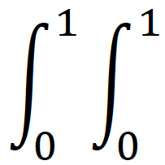
kNN and the curse of dimensionality
Example: Consider a collection of uniformly random points in the unit cube. In one dimension, the average squared Euclidean distance between any two points is:
1
2
𝑥 − 𝑦 𝑑𝑥 𝑑𝑦 = ₆
In N dimensions, we add up the squared differences for all N coordinates (because the coordinates are independent in a uniform random cube), giving:
₌ 𝑁
𝑑² = E 𝑥 − 𝑦
2
6
So the euclidean distance scales as 𝑁

Slide 30
kNN and the curse of dimensionality
From this perspective, its surprising that kNN works at all in high dimensions.
Luckily real data are not like random points in a high-dimensional cube. Instead they live in dense clusters and near much lower- dimensional surfaces.
Finally, points can be very “similar” even if their euclidean distance is large. E.g. documents with the same few dominant words (with tf- idf weighing) are likely to be on the same topic.

Slide 31
Outline
Supervised Learning
Classification/Regression
Bias/Variance tradeoff
K-NN
Naïve Bayes
Training Issues
Measuring model quality
Over-fitting
Cross-validation

Slide 32
Bayes’ Theorem
P(A|B) = probability of A given that B is true.
P(A|B) =
In practice we are most interested in dealing with events e and data D
e = “I have a cold”
D = “runny nose,” “watery eyes,” “coughing”
P(e|D)=
So Bayes’ theorem is “diagnostic”.
P(B|A)P(A)
P(B)
P(D|e)P(e)
P(D)

Slide 33
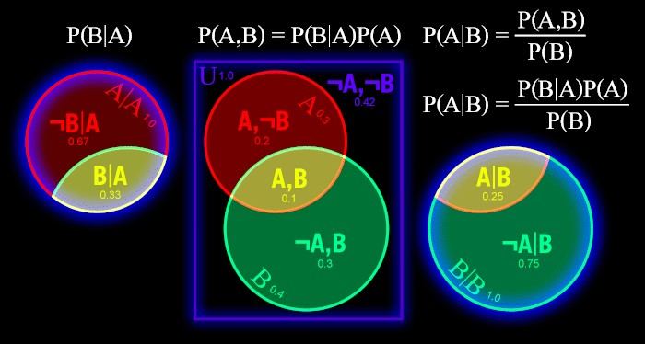
Bayes’ Theorem
Assumes probability of event is proportional to area of set. P(A) = area of A.
P(A,B) = area of A intersect B.
P(A|B) = P(A,B) / P(B)

Slide 34
Bayes’ Theorem
The theorem follows by writing:
P(A|B)P(B) = P(A,B) = P(B|A)P(A)
From which we get:
P(A|B) = P(B|A) P(A) / P(B)

Slide 35
Bayes’ Terminology
D = Data, e = some event
P(e|D) =
P(e) is called the prior probability of e. Its what we know (or think
we know) about e with no other evidence.
P(D|e) is the conditional probability of D given that e happened, or just the likelihood of D. This can often be measured or computed precisely – it follows from your model assumptions.
P(e|D) is the posterior probability of e given D. It’s the answer we want, or the way we choose a best answer.
You can see that the posterior is heavily colored by the prior, so
Bayes’ has a GIGO liability. e.g. its not used to test hypotheses
P(D|e)P(e)
P(D)

Slide 36
Naïve Bayes Classifier
Let’s assume we have an instance (e.g. a document d) with a set
of features 𝑋₁, … , 𝑋_{𝑘} and a set of classes to which the
document might belong.
𝑐_{𝑗}
We want to find the most likely class that the document belongs
to, given its features.
The joint probability of the class and features is:
Pr 𝑋₁, … , 𝑋_{𝑘}, 𝑐_{𝑗}

Slide 37
Naïve Bayes Classifier
Key Assumption: (Naïve) the features are generated
independently given 𝑐_{𝑗}. Then the joint probability factors:
𝑘
Pr 𝑋, 𝑐_{𝑗} = Pr 𝑋₁, … , 𝑋_{𝑘} | 𝑐_{𝑗} Pr 𝑐_{𝑗} = Pr 𝑐_{𝑗} Pr 𝑋_{𝑖}|𝑐_{𝑗}
𝑖=1
We would like to figure out the most likely class for (i.e. to
classify) the document, which is the 𝑐_{𝑗} which maximizes:
Pr 𝑐_{𝑗} | 𝑋₁, … , 𝑋_{𝑘}

Slide 38
Naïve Bayes Classifier
Now from Bayes we know that:
Pr 𝑐_{𝑗} | 𝑋₁, … , 𝑋_{𝑘} = Pr 𝑋₁, … , 𝑋_{𝑘} | 𝑐_{𝑗} Pr 𝑐_{𝑗} / Pr 𝑋₁, … , 𝑋_{𝑘}
But to choose the best 𝑐_{𝑗}, we can ignore Pr 𝑋₁, … , 𝑋_{𝑘} since it’s the same for every class. So we just have to maximize:
Pr 𝑋₁, … , 𝑋_{𝑘} | 𝑐_{𝑗} Pr 𝑐_{𝑗}
So finally we pick the category 𝑐_{𝑗} that maximizes:
𝑘
Pr 𝑋₁, … , 𝑋_{𝑘} | 𝑐_{𝑗} Pr 𝑐_{𝑗} = Pr 𝑐_{𝑗} Pr 𝑋_{𝑖}|𝑐_{𝑗}
𝑖=1

Slide 39
Naïve Bayes Classifier
Now from Bayes we know that:
A B B A
Pr 𝑐_{𝑗} | 𝑋₁, … , 𝑋_{𝑘} = Pr 𝑋₁, … , 𝑋_{𝑘} | 𝑐_{𝑗}
A B
Pr 𝑐_{𝑗} / Pr 𝑋₁, … , 𝑋_{𝑘}
But to choose the best 𝑐_{𝑗}, we can ignore Pr 𝑋₁, … , 𝑋_{𝑘} since it’s the same for every class. So we just have to maximize:
Pr 𝑋₁, … , 𝑋_{𝑘} | 𝑐_{𝑗} Pr 𝑐_{𝑗}
So finally we pick the category 𝑐_{𝑗} that maximizes:
𝑘
Pr 𝑋₁, … , 𝑋_{𝑘} | 𝑐_{𝑗} Pr 𝑐_{𝑗} = Pr 𝑐_{𝑗} Pr 𝑋_{𝑖}|𝑐_{𝑗}
𝑖=1

Slide 40
Data for Naïve Bayes
In order to find the best class, we need two pieces of data:
Pr 𝑐_{𝑗}
the prior probability for the class 𝑐_{𝑗}.
•
Pr 𝑋_{𝑖}|𝑐_{𝑗}
the conditional probability of the feature 𝑋_{𝑖} given
the class 𝑐_{𝑗}.

Slide 41
Data for Naïve Bayes
For these two data, we only need to record counts:
•
₌ 𝑁_{𝑑} 𝑐_{𝑗}
Pr 𝑐
𝑗
𝑁_{𝑑}
•
₌ 𝑁_{𝑤} 𝑋_{𝑖},𝑐_{𝑗}
Pr 𝑋 |𝑐
𝑖 𝑗
𝑁_{𝑤} 𝑐_{𝑗}
Where 𝑁_{𝑑} is the number of documents in class 𝑐_{𝑗}, 𝑁_{𝑑} is the
𝑐_{𝑗}
total number of documents.
𝑁_{𝑤} 𝑋_{𝑖}, 𝑐_{𝑗}
is the number of times 𝑋_{𝑖} occurs in a document in 𝑐_{𝑗},
and and 𝑁_{𝑤} is the total number of features in all docs in 𝑐_{𝑗}.
𝑐_{𝑗}

Slide 42
“Training” Naïve Bayes
So there is no need to train a Naïve Bayes classifier, only to accumulate the 𝑁_{𝑤} and 𝑁_{𝑑} counts.
But count data is only an approximation to those probabilities however, and a count of zero is problematic (why)?

Slide 43
Naïve Bayes and Smoothing
But count data is only an approximation to those probabilities however, and a count of zero is problematic: It forces the classifier not to choose classes with zero counts.
Instead of direct count ratios, we can use Laplace Smoothing:
_{𝑝 =} 𝑁₁ + 𝛼
𝑁₂ + 𝛽
With constants 𝛼 and 𝛽. These values push p toward a prior of
𝛼/𝛽.
These constants can either be set based on prior knowledge, or learned during a training phase.

Slide 44
Practical Naïve Bayes
We want the category 𝑐_{𝑗} that maximizes:
𝑘
Pr 𝑋₁, … , 𝑋_{𝑘} | 𝑐_{𝑗} Pr 𝑐_{𝑗} = Pr 𝑐_{𝑗} Pr 𝑋_{𝑖}|𝑐_{𝑗}
𝑖=1
The log of this expression has the same maximum:
𝑘
log Pr 𝑐_{𝑗} + log Pr 𝑋_{𝑖}|𝑐_{𝑗}
𝑖=1
This formula is much better numerically (avoids floating point underflow) and involves simple vector operations.
Complexity of evaluating this expression is proportional to k, the
number of features.

Slide 45
Practical Naïve Bayes
Find the class 𝑐_{𝑗} that maximizes:
𝑘
log Pr 𝑐_{𝑗} + log Pr 𝑋_{𝑖}|𝑐_{𝑗}
𝑖=1
Often we have sparse data (e.g. documents) where most 𝑋_{𝑖} are
zero.
In that case, we can evaluate the NB formula in time proportional to s, where s is the number of non-zeros in each document. (good HW problem).

Slide 46
Good, Bad and Ugly of NB Classifiers
Simple and fast. Depend only on term frequency data for the
classes. One pass over the training dataset, no iteration.
Compact model. Size is proportional to numfeats x numclasses.
Very well-behaved numerically. Term weight depends only on
frequency of that term. Decoupled from other terms.
Can work very well with sparse data, where combinations of
dependent terms are rare.
Subject to error and bias when term probabilities are not independent (e.g. URL prefixes).
Can’t model patterns in the data.
Typically not as accurate as other methods for the above reasons.

Slide 47
Summary
Supervised Learning
Classification/Regression
Bias/Variance tradeoff
K-NN
Naïve Bayes
Training Issues
Measuring model quality
Over-fitting
Cross-validation

Slide 48
Model Quality
Almost every model optimizes some quality criterion:
For linear regression it was the Residual Sum-of-Squares
For k-Means it is the “Inertia” – the mean squared distance from each sample to its cluster center.
…
The quality criterion is chosen often because of its good properties:
Convexity: so that there is a unique, best solution
Closed form for the optimum (linear regression) or at least for the gradient (for SGD).
An algorithm that provably converges.

Slide 49
Model Quality
There are typically other criteria used to measure the quality of models. e.g. for clustering models:
Silhouette score
Inter-cluster similarity (e.g. mutual information)
Intra-cluster entropy
For regression models:
Stability of the model (sensitivity to small changes)
Compactness (sparseness or many zero coefficients)

Slide 50

Evaluating Clusterings: Silhouette
The silhouette score is
where a(i) is the mean distance from sample i to its own cluster,
b(i) the mean distance from i to the second-closest cluster.
Perhaps surprisingly, silhouette scores can be, and often are, negative.

Slide 51
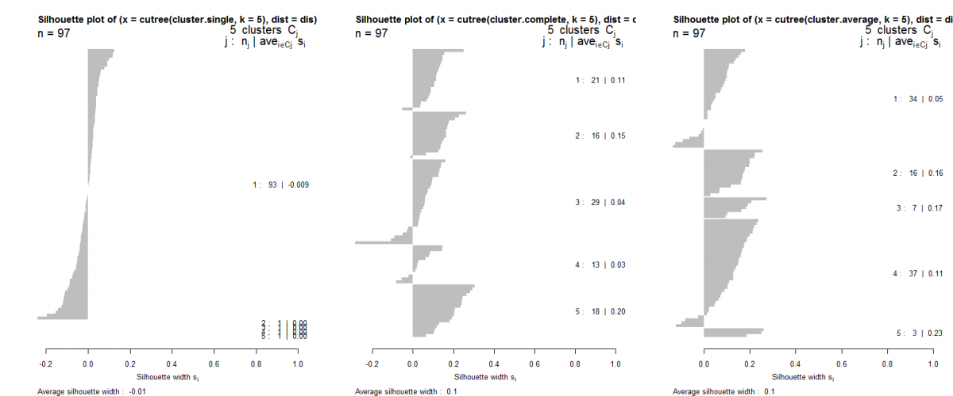
Evaluating Clusterings: Silhouette
Silhouette plot: horizontal bars with cluster score.
Sort (vertically) first by cluster, then by score.

Slide 52
Regularization with Secondary Criteria
While secondary criteria can be measured after the model is built, its too late then to affect the model.
Using secondary criteria during the optimization process is called “regularization”.
Examples:
L1 regularization adds a term to the measure being optimized which is the sum of absolute value of model coefficients.
L2 regularization adds a term to the measure being optimized which is the sum of squares of model coefficients.

Slide 53
Regularization with Secondary Criteria
L1 regularization in particular is very widely used. It has the following impacts:
Yields a convex optimization problem in many cases, so there is a unique solution.
The solution is usually stable to small input changes.
The solution is quite sparse (many zero coefficients) and requires less disk and memory to run.
L1 regularization on factorization models tends to decrease the correlation between model factors.

Slide 54
Over-fitting
Your model should ideally fit an infinite sample of the type of data you’re interested in.
In reality, you only have a finite set to train on. A good model for this subset is a good model for the infinite set, up to a point.
Beyond that point, the model quality (measured on new data) starts to decrease.
Beyond that point, the model is over-fitting the data.

Slide 55
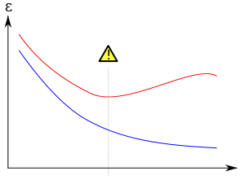
Over-fitting
Over-fitting during training
Model error
Error on new data
Training error
Number of iterations

Slide 56
Over-fitting
Another kind of over-fitting
Model error
Error on new data
Training error
Model degrees of freedom

Slide 57
Regularization and Over-fitting
Adding a regularizer:
Model error
Without regularizer
With regularizer
Number of iterations

Slide 58
Cross-Validation
Cross-validation involves partitioning your data into distinct training and test subsets.
The test set should never be used to train the model.
The test set is then used to evaluate the model after training.

Slide 59
K-fold Cross-Validation
To get more accurate estimates of performance you can do this k times.
Break the data into k equal-sized subsets A_{i}
For each i in 1,…,k do:
Train a model on all the other folds A₁,…, A_{i-1}, A_{i+1},…, A_{k}
Test the model on A_{i}
Compute the average performance of the k runs

Slide 60
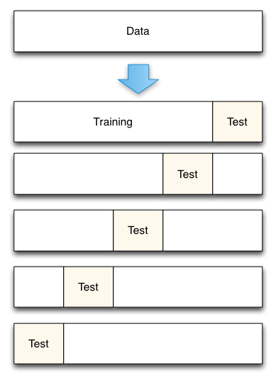
5-fold Cross-Validation

Slide 61
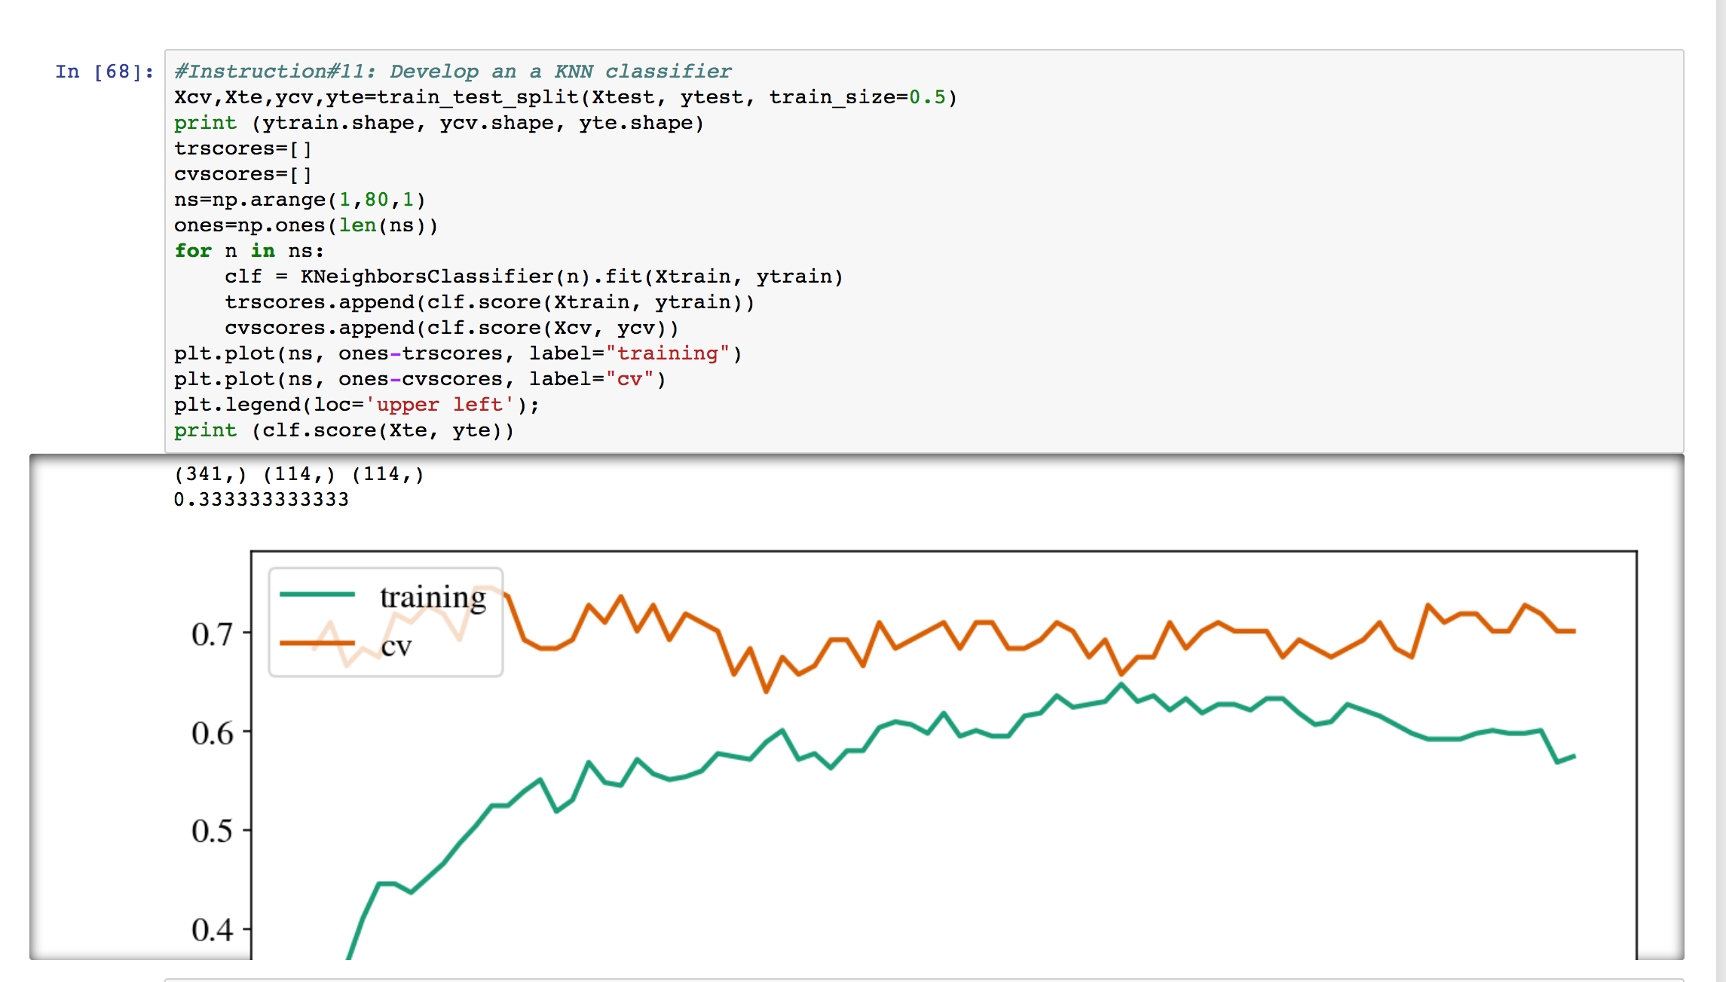
Homework Examples

Slide 62
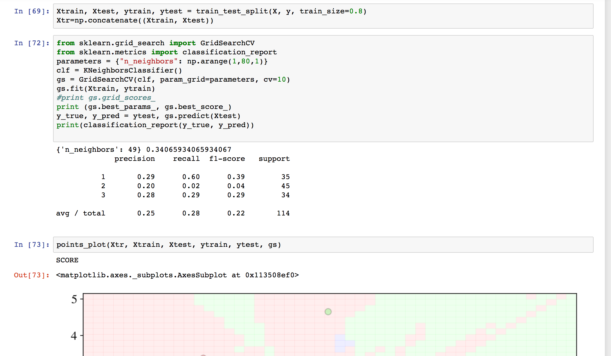
Homework Examples

